Slide 1
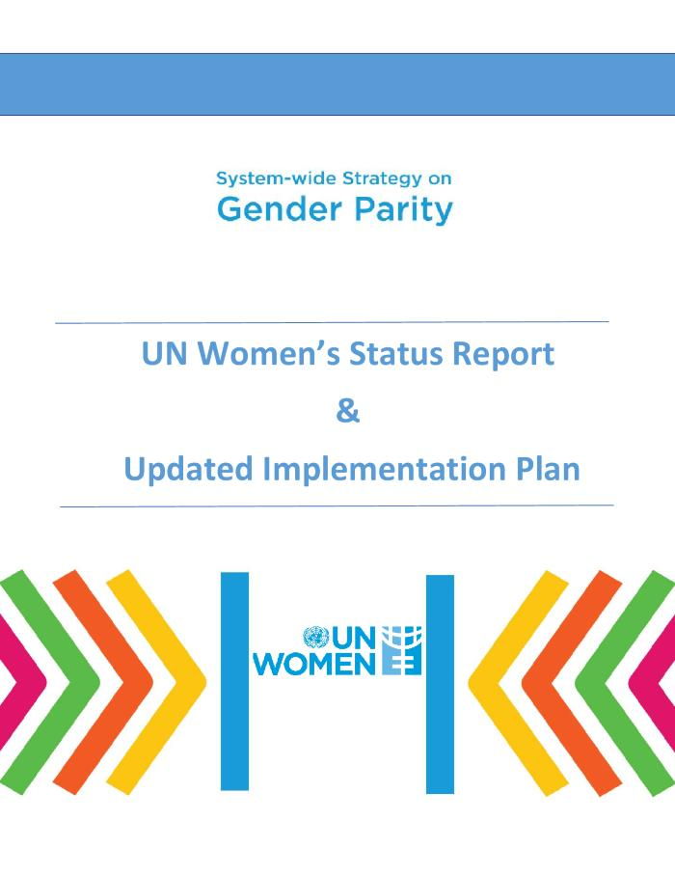
System-wide strategy on gender parity: UN Womens status report and updated implementation plan (c:amaz:14691)
Achieving gender parity continues to be an urgent priority not only as a basic human right, but also as it is essential to the United Nations efficiency, impact, and credibility. It is important to create a working environment, at all levels and wherever the United Nations operates, that embraces equality, eradicates bias, and is inclusive of all staff, so that we can truly lead by example and leave no one behind. UN Secretary-General António Guterres launched his System-wide strategy on gender parity on 13 September 2017, to operationalize system-wide efforts to advance this priority at the United Nations. The Secretary-Generals strategy includes six UN Womenspecific recommendations, which were incorporated and highlighted in UN Womens initial implementation plan (December 2017). As requested by the Secretary-General, this status report and updated implementation plan elaborates on the progress made and results achieved since 2017, based on the specific requests for UN Women. It also reports on UN Womens system-wide work as well as internal progress. Implementation, follow-up, and monitoring the progress of the key recommendations are critical to ensure that the momentum on parity is sustained and the strategy is successfully rolled out. UN Women continues to be committed to supporting the UN system to reach gender parity based on this updated plan, as well as on its mandate to lead, promote, and coordinate efforts to advance the full realization of womens rights and opportunities.
[Source: website: www.unwomen.org/en/digital-library/publications/2021/05/system-wide-strategy-on-gender-parity-un-womens-updated-implementation-plan]

Slide 2

Beleids- en actieplannen gender en gelijke kansen op regionaal, federaal, Europees en internationaal niveau: bibliografie (c:amaz:14678)
Het documentatiecentrum van Amazone heeft een screening uitgevoerd naar de beleidsplannen die momenteel actueel zijn en dit op nationaal, regionaal, Europees en internationaal niveau op vlak van gender en gelijke kansen voor vrouwen en mannen. In deze bibliografie vindt u een overzicht.;Le centre de documentation d'Amazone a effectué un screening de tous les plans politiques actuellement en vigueur au niveau national, régional, européen et international dans le domaine du genre et de l'égalité des chances entre les femmes et les hommes. Dans cette bibliographie vous trouverez un aperçu.

Slide 3

Beyond COVID-19: a feminist plan for sustainability and social justice (c:amaz:14672)
As the world learns to live with COVID-19, to emerge from the current crisis, and to build back better, UN Women's new Feminist plan provides a visionary but practical roadmap for putting gender equality, social justice, and sustainability at the centre of the recovery and transformation. COVID-19 has revealed and worsened inequalities and is a reminder of just how unsustainable and fragile the world's economies and democracies are. The crisis also provides a warning about what is rapidly coming down the track on climate change and environmental degradation. This has created both a need and an opening to rethink economic and social policies and re-evaluate what needs to be prioritized. The Feminist plan maps the ambitious and transformative policies on livelihoods, care, and the environment that are needed to build a more equal and sustainable future. To get there, it calls for context-specific policy pathways, tailored political strategies, and financing. The plan identifies key levers that can create change and the actors at global, national, and local levels that need to take action to move towards this vision.
[Source: website: www.unwomen.org/en/digital-library/publications/2021/09/feminist-plan-for-sustainability-and-social-justice]

Slide 4
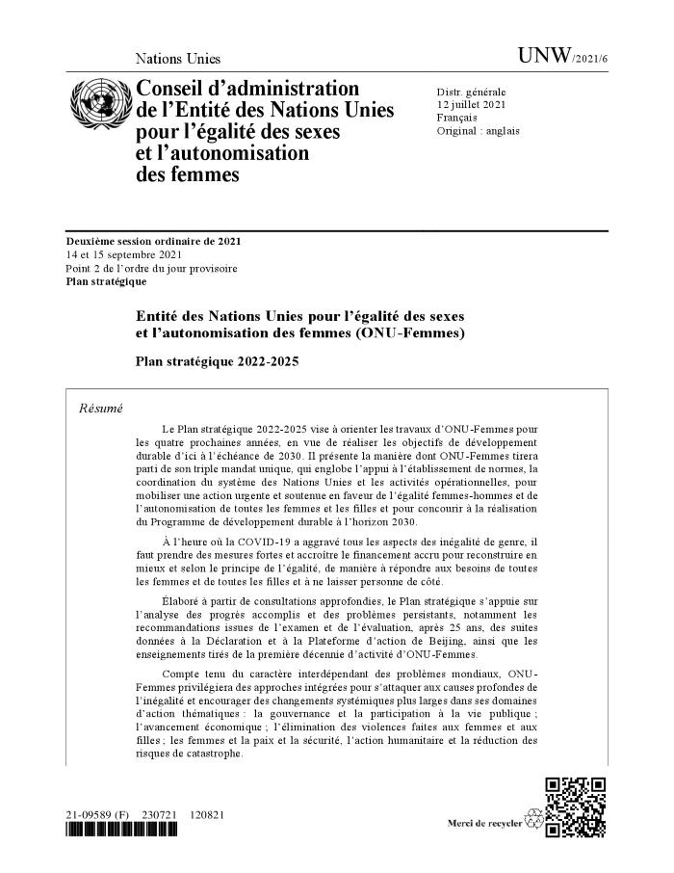
Entité des Nations Unies pour l'égalité des sexes et l'autonomisation des femmes (ONU-Femmes): plan stratégique 2022-2025 (c:amaz:14671)
Le Plan stratégique 2022-2025 vise à orienter les travaux d'ONU-Femmes pour les quatre prochaines années, en vue de réaliser les objectifs de développement durable d'ici à l'échéance de 2030. Il présente la manière dont ONU-Femmes tirera parti de son triple mandat unique, qui englobe l'appui à l'établissement de normes, la coordination du système des Nations Unies et les activités opérationnelles, pour mobiliser une action urgente et soutenue en faveur de légalité femmes-hommes et de l'autonomisation de toutes les femmes et les filles et pour concourir à la réalisation du Programme de développement durable à l'horizon 2030.
[Source: site web: www.unwomen.org/fr/digital-library/publications/2021/09/un-women-strategic-plan-2022-2025]

Slide 5
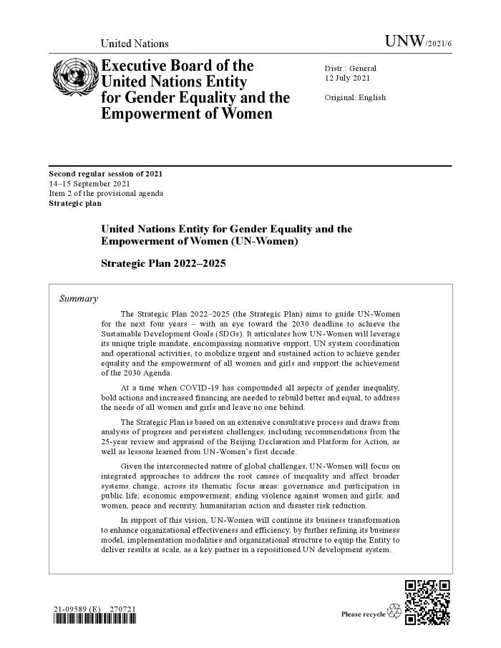
UN Women Strategic Plan 2022-2025: building a Gender-Equal World (c:amaz:14670)
The Strategic Plan 2022-2025 will guide UN Women for the next four years with an eye toward the 2030 deadline to achieve the Sustainable Development Goals (SDGs). It articulates how UN Women will leverage its unique triple mandate encompassing normative support, UN system coordination, and operational activities to mobilize urgent and sustained action to achieve gender equality and the empowerment of all women and girls and support the achievement of the 2030 Agenda for Sustainable Development.
[Source: website: www.unwomen.org/en/digital-library/publications/2021/09/un-women-strategic-plan-2022-2025#view]

Slide 6

Vingt-cinquième anniversaire de la quatrième conférence mondiale sur les femmes et de l'adoption de la Déclaration et du Programme d'action de Beijing (1995). Note d'orientation concernant les examens approfondis au niveau national : BELGIQUE (c:amaz:14725)

Slide 7
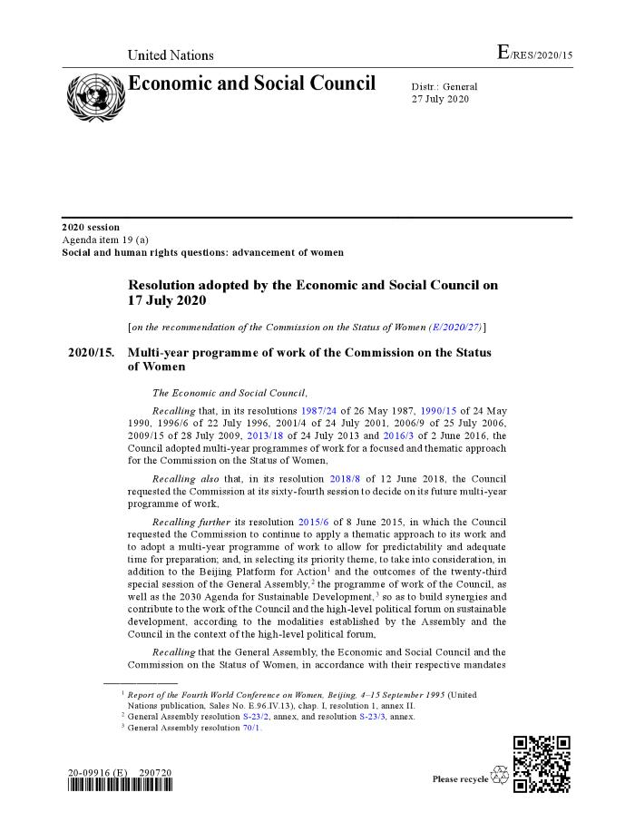
Multi-year programme of work of the Commission on the Status of Women: resolution adopted by the Economic and Social Council on 17 July 2020 [on the recommendation of the Commission on the Status of Women (E/2020/27)] [E/RES/2020/15] (c:amaz:14677)
A new multi-year programme of work for the years 2021-2024 is contained in ECOSOC resolution 2020/15. Based on the resolutions from 2018 and 2020, priority and review themes for 20202024 are: 2020: Review and appraisal of the implementation of the Beijing Declaration and Platform for Action and the outcomes of the 23rd special session of the General Assembly, and its contribution towards the full realization of the 2030 Agenda for Sustainable Development. 2021: Priority theme: Womens full and effective participation and decision-making in public life, as well as the elimination of violence, for achieving gender equality and the empowerment of all women and girls. Review theme: Womens empowerment and the link to sustainable development (agreed conclusions of the sixtieth session). 2022: Priority theme: Achieving gender equality and the empowerment of all women and girls in the context of climate change, environmental and disaster risk reduction policies and programmes. Review theme: Womens economic empowerment in the changing world of work (agreed conclusions of the sixty-first session). 2023: Priority theme: Innovation and technological change, and education in the digital age for achieving gender equality and the empowerment of all women and girls. Review theme: Challenges and opportunities in achieving gender equality and the empowerment of rural women and girls (agreed conclusions of the sixty-second session). 2024: Priority theme: Accelerating the achievement of gender equality and the empowerment of all women and girls by addressing poverty and strengthening institutions and financing with a gender perspective. Review theme: Social protection systems, access to public services and sustainable infrastructure for gender equality and the empowerment of women and girls (agreed conclusions of the sixty-third session).
[Source: website: www.unwomen.org/en/csw]

Slide 8

UN Trust Fund to End Violence against Women: strategic plan 2021-2025 (c:amaz:14676)
The UN Trust Funds Strategic Plan 2021-2025 is grounded in the right of all women and girls to live free of violence. It seeks to achieve this goal through global solidarity and partnerships that enable civil society organizations, especially women's rights organizations, to deliver survivor-centred and demand-driven initiatives to help feminist movements grow globally.
[Source: website: www.unwomen.org/en/trust-funds/un-trust-fund-to-end-violence-against-women]

Slide 9
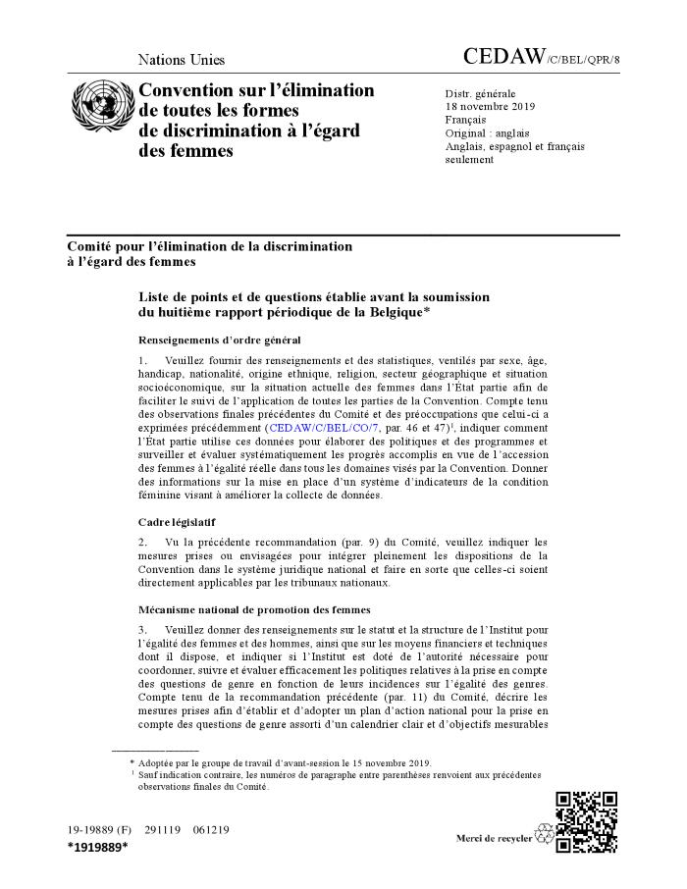
Liste de points et de questions établie avant la soumission du huitième rapport périodique de la Belgique (c:amaz:14280)

Slide 10
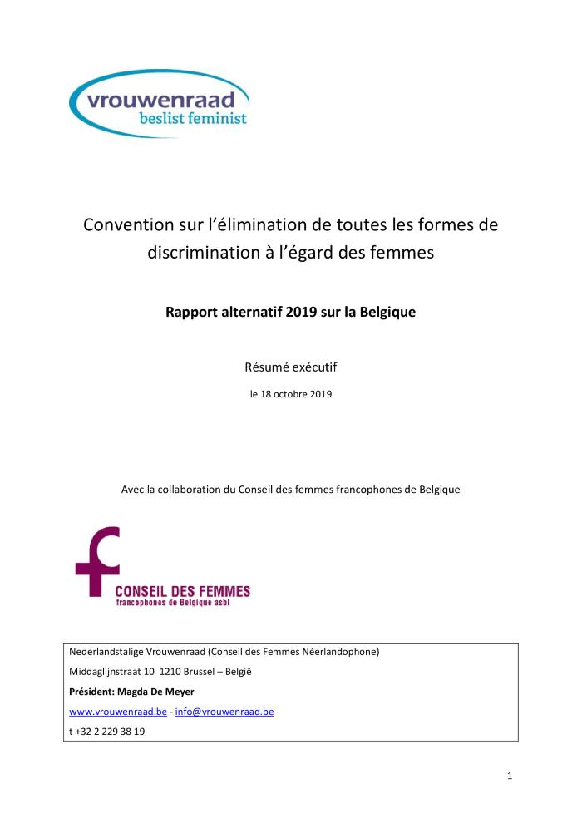
Convention sur l'élimination de toutes les formes de discrimination à l'égard des femmes : rapport alternatif 2019 sur la Belgique : résumé exécutif, le 18 octobre 2019 (c:amaz:14279)

Slide 11
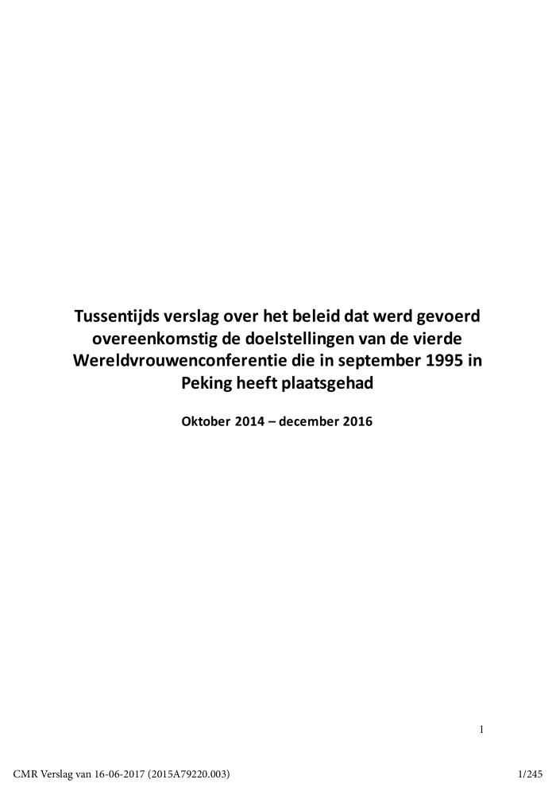
Tussentijds verslag over het beleid dat werd gevoerd overeenkomstig de doelstellingen van de vierde Wereldvrouwenconferentie die in september 1995 in Peking heeft plaatsgehad, oktober 2014 - december 2016 (c:amaz:13045)

Slide 12

Fund for gender equality : annual report 2016 (c:amaz:13793)

Slide 13
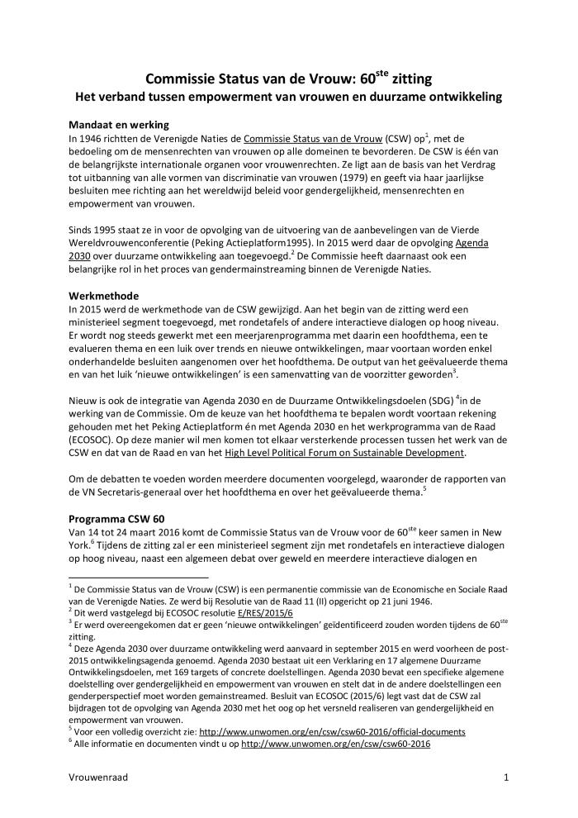
Commissie Status van de Vrouw: 60ste zitting: het verband tussen empowerment van vrouwen en duurzame ontwikkeling (c:amaz:13363)

Slide 14

Gender equality and sustainable development : world survey on the role of women in development 2014 (c:amaz:7766)

Slide 15
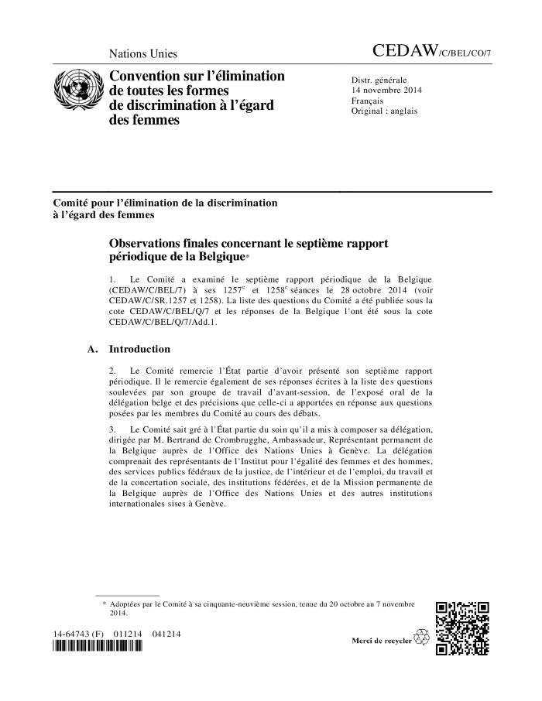
Observations finales concernant le septième rapport périodique de la Belgique (CEDAW/C/BEL/CO/7) (c:amaz:7740)

Slide 16

Verdrag inzake de Uitbanning van alle Vormen van Discriminatie van Vrouwen: schaduwrapport 2014 over België (c:amaz:7734)

Slide 17
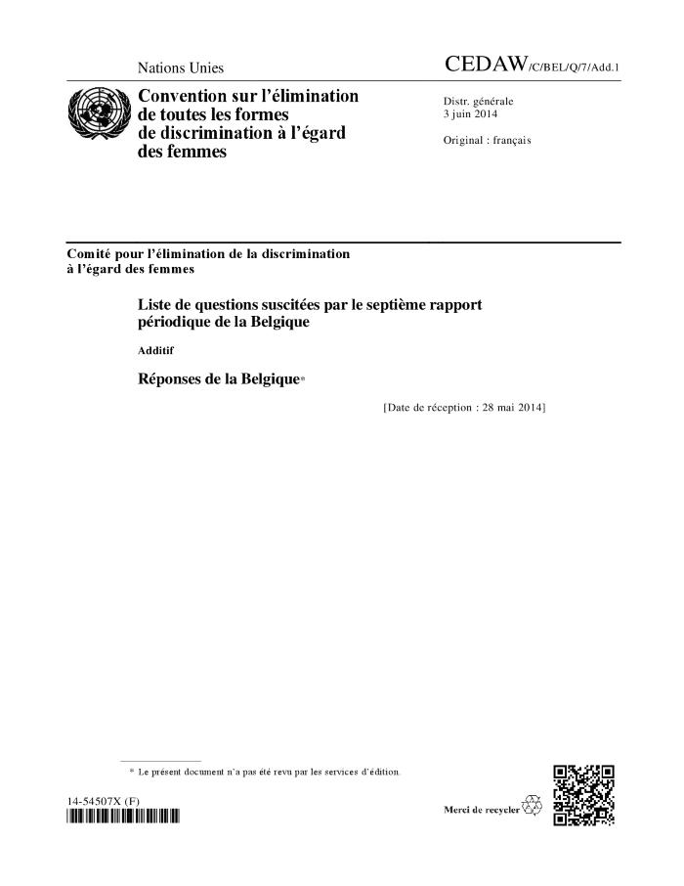
Liste de questions suscitées par le septième rapport périodique de la Belgique : Additif : Réponses de la Belgique* (CEDAW/C/BEL/Q/7/Add.1) (c:amaz:12634)

Slide 18
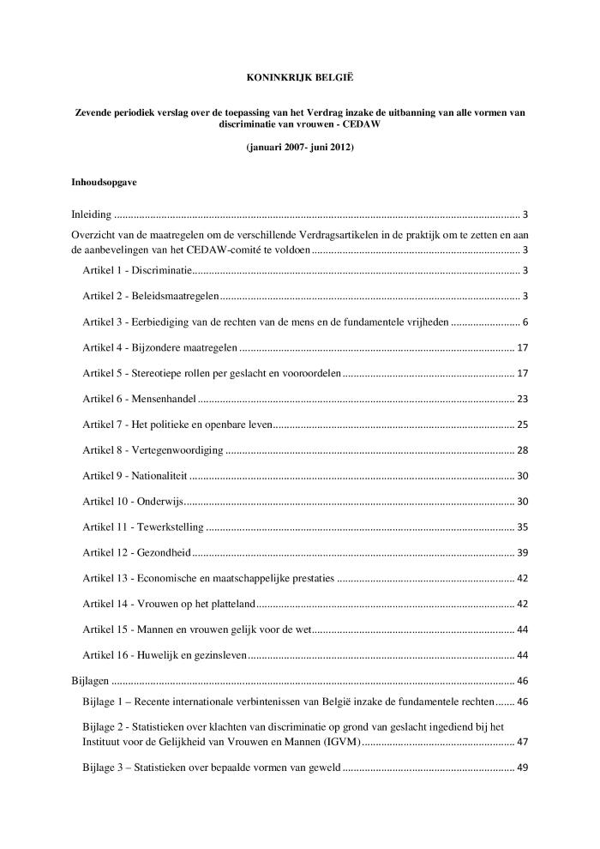
Koninkrijk België. Zevende periodiek verslag over de toepassing van het Verdrag inzake de uitbanning van alle vormen van discriminatie van vrouwen - CEDAW, (januari 2007 - juni 2012) (c:amaz:12621)

Slide 19

Het VN-verdrag voor vrouwenrechten en België 35 jaar later (c:amaz:12584)

Slide 20

Convention des droits des femmes et la Belgique, 35 ans après (c:amaz:12583)

Slide 21

Policy recommendations by the Women's Major Group on global Sustainable Development Goals (SDGs) and the Post 2015 Development Agenda (c:amaz:7184)

Slide 22
Consideration of reports submitted by States Parties under article 18 of the Convention on the Elimination of All Forms of Discrimination against Women : seventh periodic reports of States Parties due in 2012 : Belgium (CEDAW/C/BEL/7) (c:amaz:12557)

Slide 23

Vrouwenkracht is vredesmacht : aan de slag met Resolutie 1325 (c:amaz:12390)

Slide 24

La force des femmes, une chance pour la paix : actions autour de la Résolution 1325 (c:amaz:12389)

Slide 25
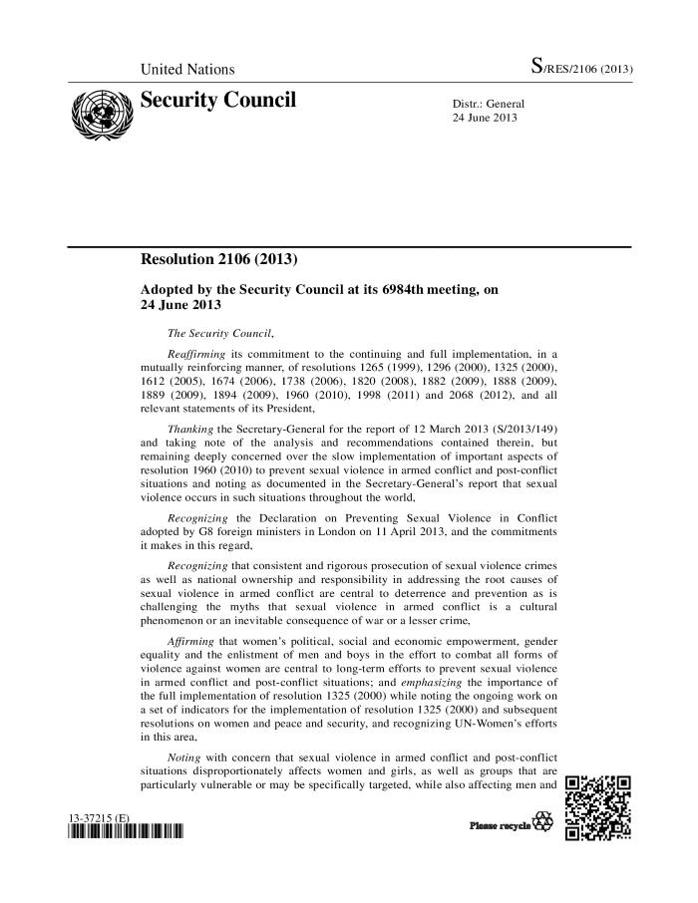
Security Council Resolution 2106 (2013) (c:amaz:12333)

Slide 26
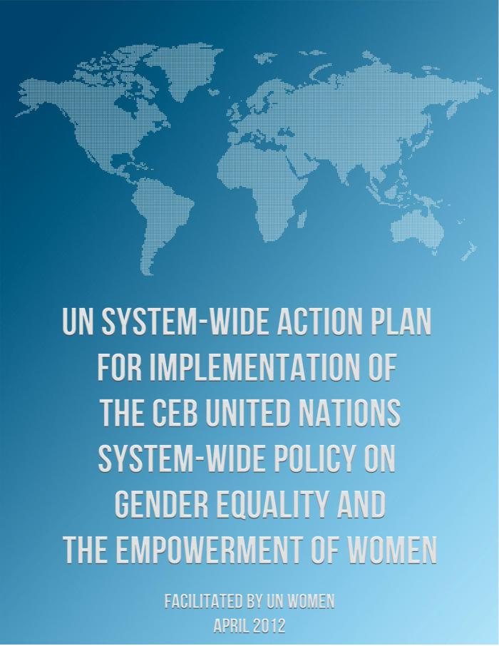
UN system-wide action plan for implementation of the CEB United Nations system-wide policy and gender equality and the empowerment of women (c:amaz:7350)

Slide 27

UN-SWAP : a plan to improve gender equality and the empowerment of women across the UN system (c:amaz:7349)

Slide 28

The future women want : a vision of sustainable development for all (c:amaz:7185)

Slide 29

A gender perspective on the 'Green Economy' : equitable, healthy and decent jobs and livelihoods : Women's Major Group position paper in preparation for the United Nations Conference on Sustainable Development 2012 (c:amaz:7186)

Slide 30
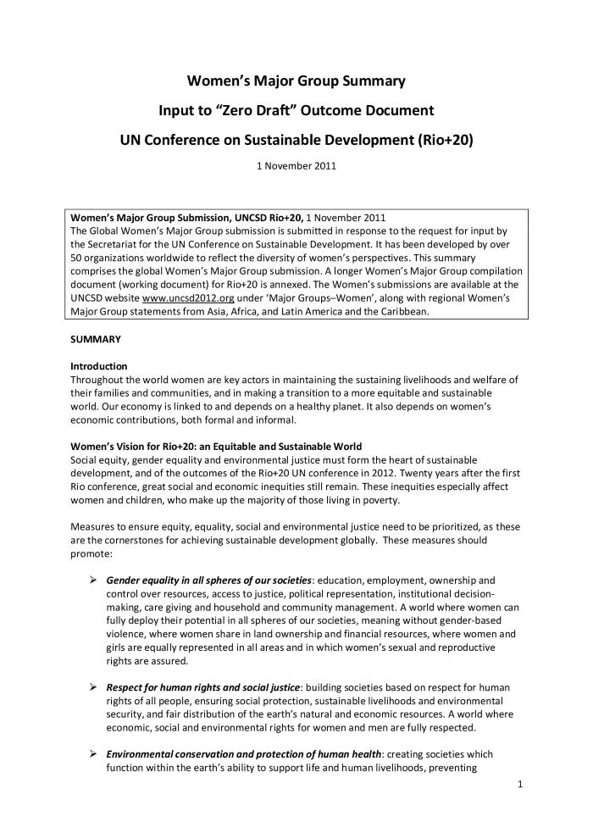
Women's Major Group Summary input to 'Zero Draft' Outcome Document (c:amaz:7183)

Slide 31
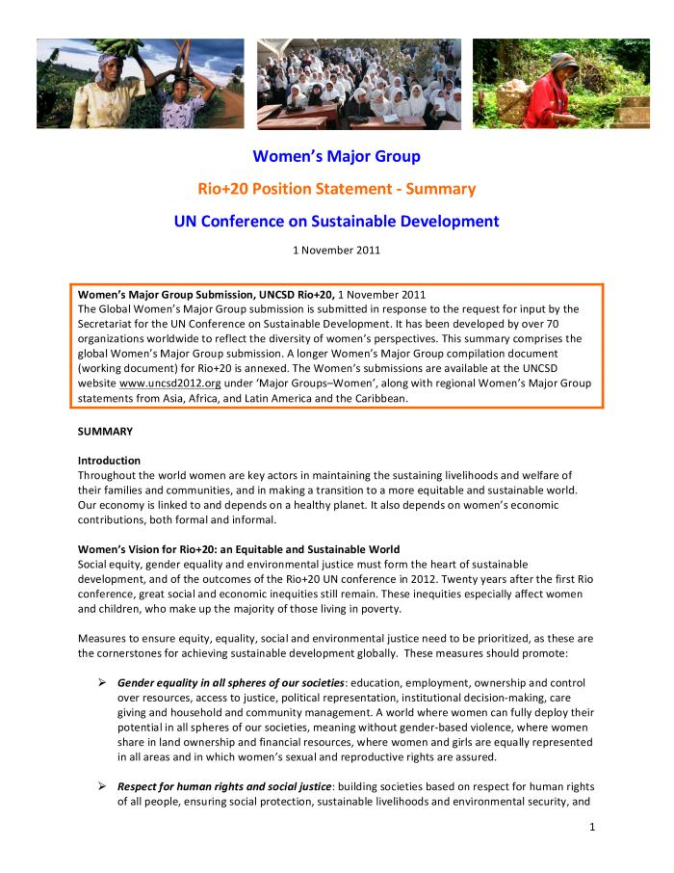
UN Conference on Sustainable Development Rio+20 : position statement. Summary / Women's Major Group (c:amaz:7182)

Slide 32
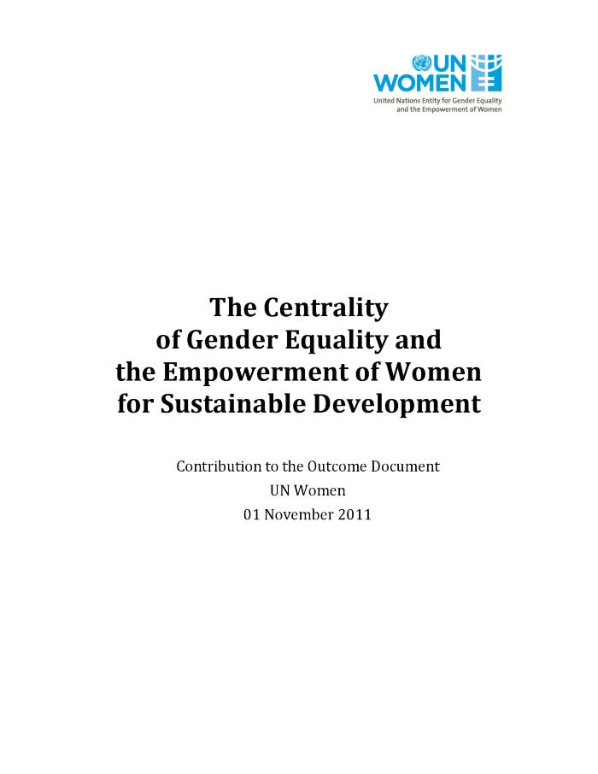
The centrality of gender equality and the empowerment of women for sustainable development : contribution to the Outcome Document (c:amaz:7180)

Slide 33
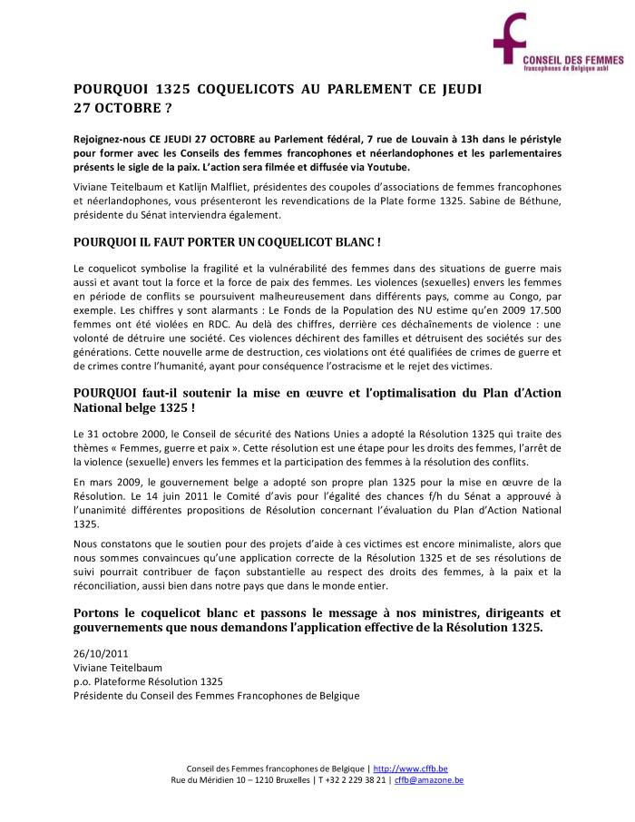
Pourquoi 1325 coquelicots au Parlement ce jeudi 27 octobre ? (c:amaz:6681)

Slide 34
Proposition de résolution concernant l'évaluation du Plan d'action national belge dans le cadre de la résolution 1325 du Conseil de Sécurité des Nations Unies : texte adopté par la Commission des Relations Extérieures et de la Défense (c:amaz:12236)

Slide 35
Principes d'autonomisation des femmes : pour l'entreprise aussi, l'égalité est une bonne affaire (c:amaz:12067)

Slide 36
Women's empowerment principles : equality means business (c:amaz:12066)

Slide 37

Gender equality for smarter cities : challenges and progress (c:amaz:7405)

Slide 38
Chaînes globales de soins : sur quels droits base un régime global de soins juste? (c:amaz:7139)

Slide 39

Ten-year impact study on the implementation of UN Security Council Resolution 1325 (2000) on Women, Peace and Security in Peacekeeping (c:amaz:6843)

Slide 40
Handbook for legislation on violence against women (c:amaz:6736)

Slide 41
Agreed conclusions of the Commission on the Status of Women on the critical areas of concern of the Beijing Platform for Action 1996-2009 (c:amaz:6735)

Slide 42
Pekin Bruxelles : un voyage inachevé : rapport Pekin +15 du Lobby Européen des Femmes sur les activités de l'Union Européenne (c:amaz:6164)

Slide 43

From Beijing to Brussels : an unfinished journey : the European Women's Lobby Beijing +15 report on the activities of the European Union (c:amaz:13161)

Slide 44
Traite des femmes et des filles : rapport du Secrétaire général (A/65/209) (c:amaz:12137)

Slide 45
Trafficking in women and girls : report of the Secretary-General (A/65/209) (c:amaz:12136)

Slide 46
Plan d'action mondial des Nations Unies pour la lutte contre la traite des personnes (A/RES/64/293) (c:amaz:12133)

Slide 47
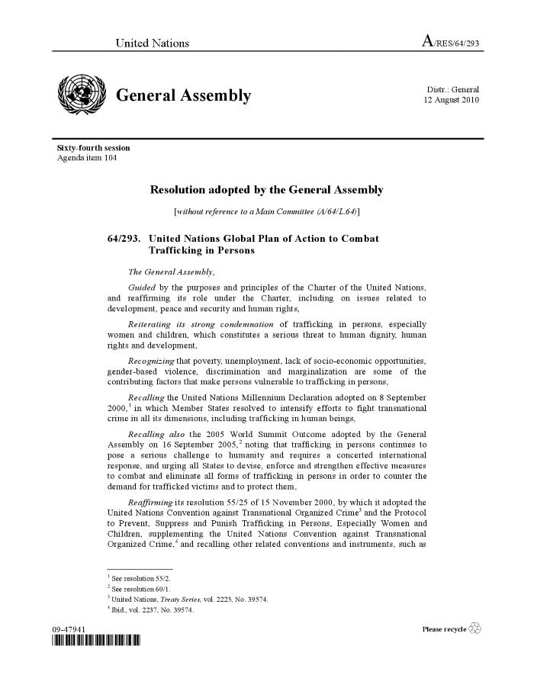
United Nations Global Plan of Action to Combat Trafficking in Persons (Resolution A/RES/64/293) (c:amaz:12132)

Slide 48
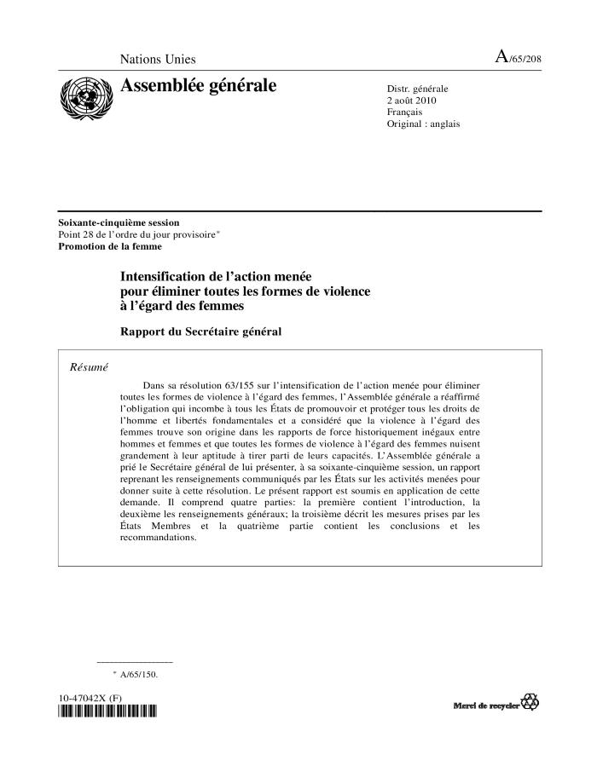
Intensification de l'action menée pour éliminer toutes les formes de violence à l'égard des femmes : rapport du Secrétaire général (A/65/208) (c:amaz:12109)

Slide 49
Intensification of efforts to eliminate all forms of violence against women : report of the Secretary-General (A/65/208) (c:amaz:12108)

Slide 50
Intensification de l'action menée pour éliminer toutes les formes de violence à l'égard des femmes (Résolution A/RES/64/137) (c:amaz:12107)

Slide 51
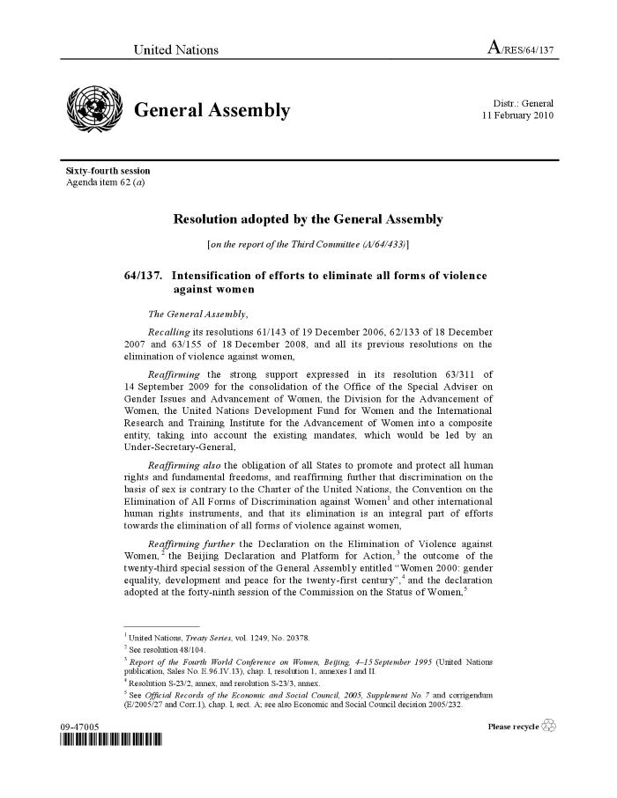
Intensification of efforts to eliminate all forms of violence against women (Resolution A/RES/64/137) (c:amaz:12106)

Slide 52
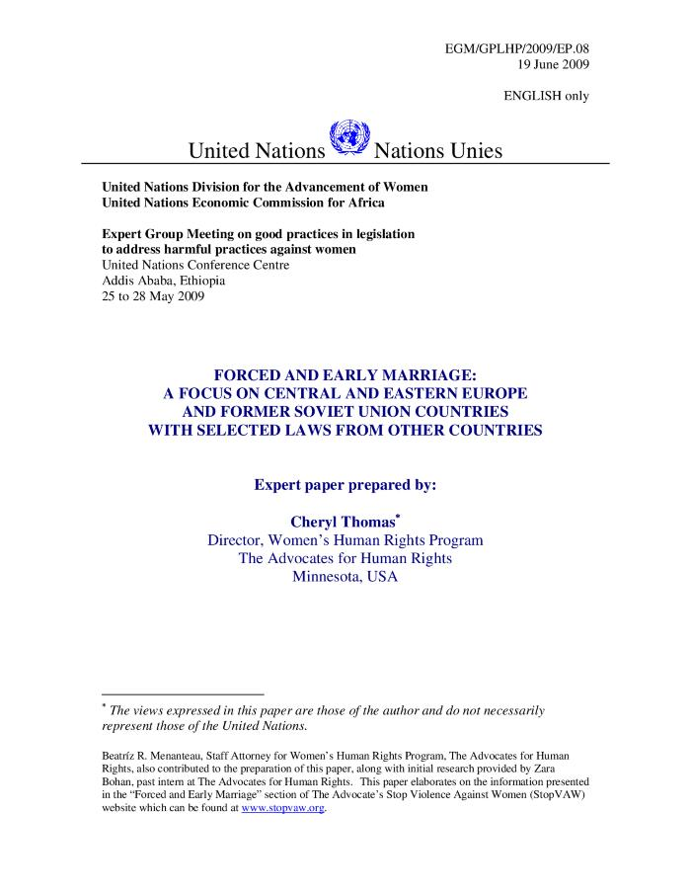
Forced and early marriage : a focus on Central and Eastern Europe and former Soviet Union countries with selected laws from other countries (c:amaz:6837)

Slide 53
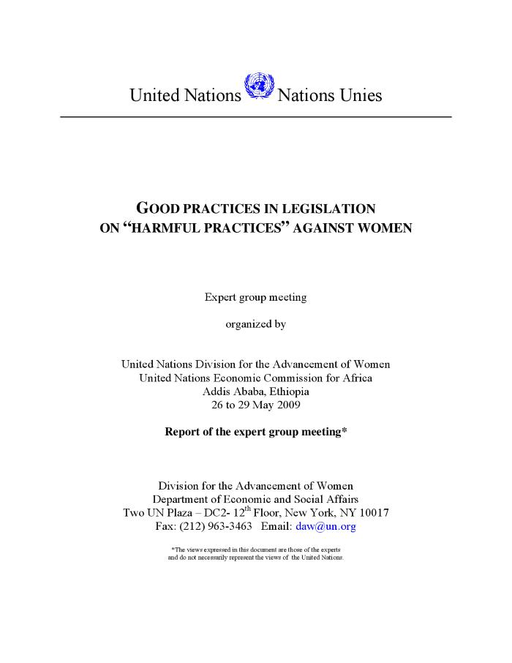
Good practices in legislation on 'harmful practices' against women : report of the Expert group meeting (c:amaz:6834)

Slide 54
Priorite égalité entre les sexes : plan d'action 2008 - 2013 (c:amaz:6800)

Slide 55
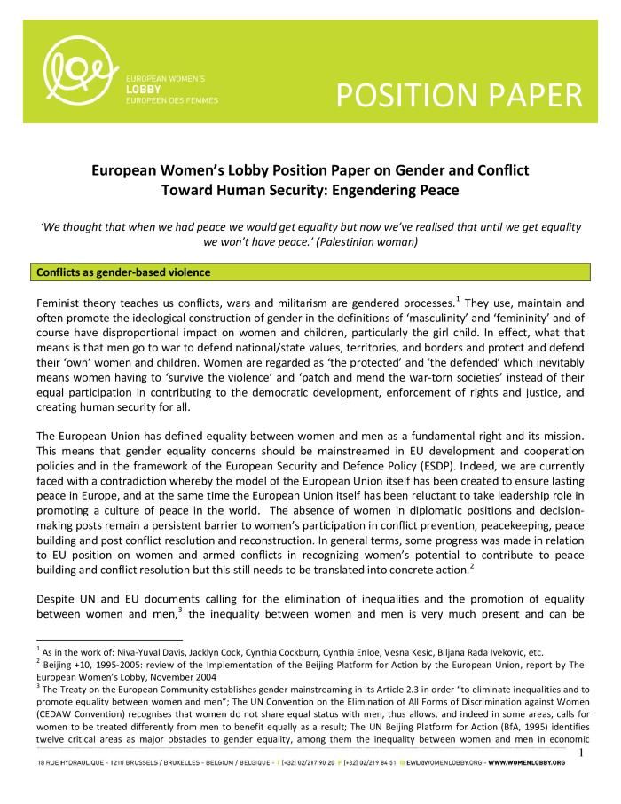
Gender and conflict : towards human security : engendering peace : position paper october 2009 (c:amaz:6680)

Slide 56
Gecombineerde vijfde en zesde periodieke verslag van België ingediend bij het Committee on the Elimination of Discrimination against Women (CEDAW) : verslag namens het Adviescomité voor Gelijke Kansen voor Vrouwen en Mannen uitgebracht door de dames de Bethune en Zrihen (c:amaz:12626)

Slide 57
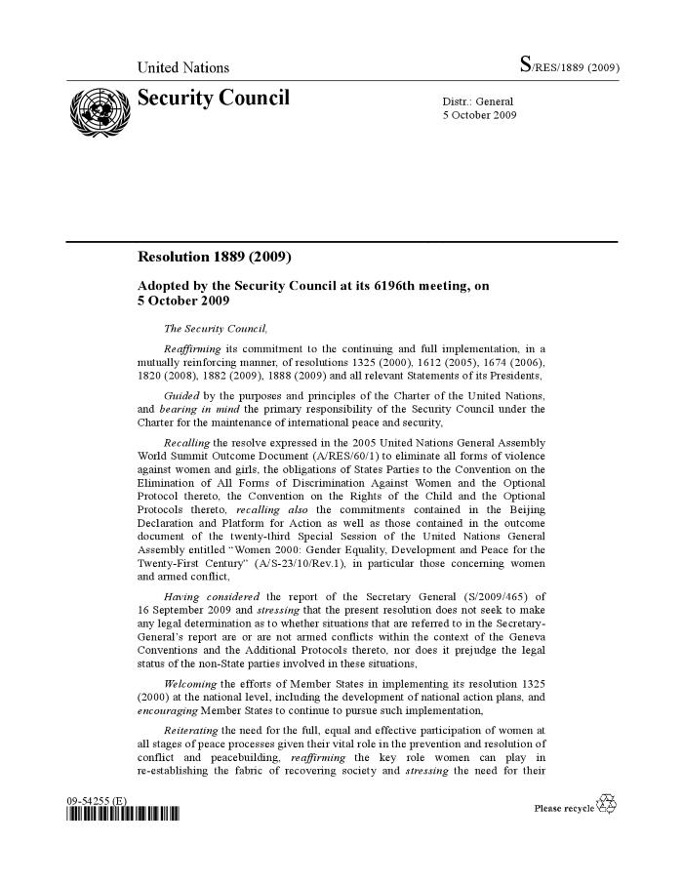
Security Council Resolution 1889 (2009) (c:amaz:12184)

Slide 58
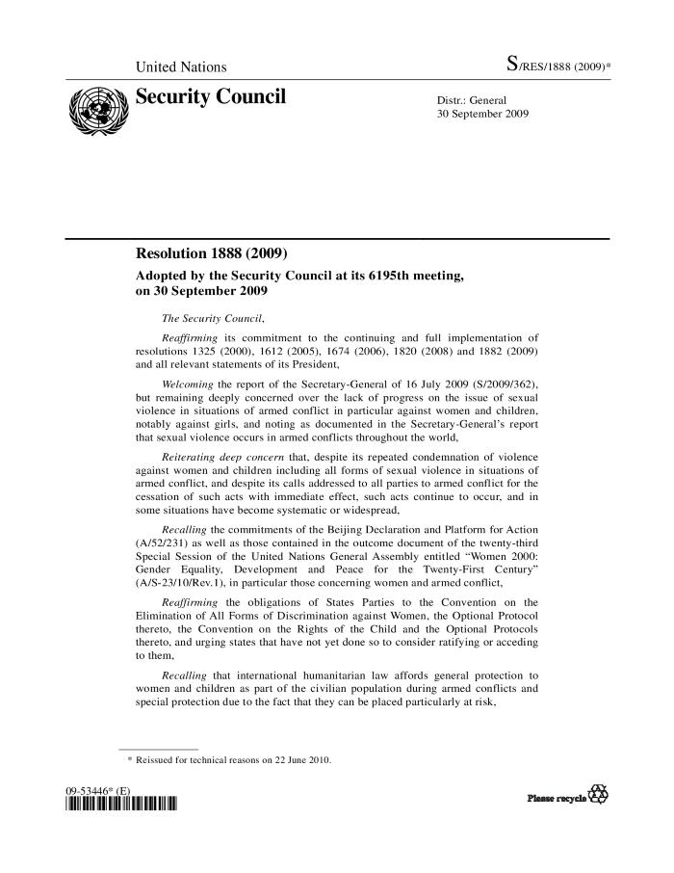
Security Council Resolution 1888 (2009) (c:amaz:12182)

Slide 59
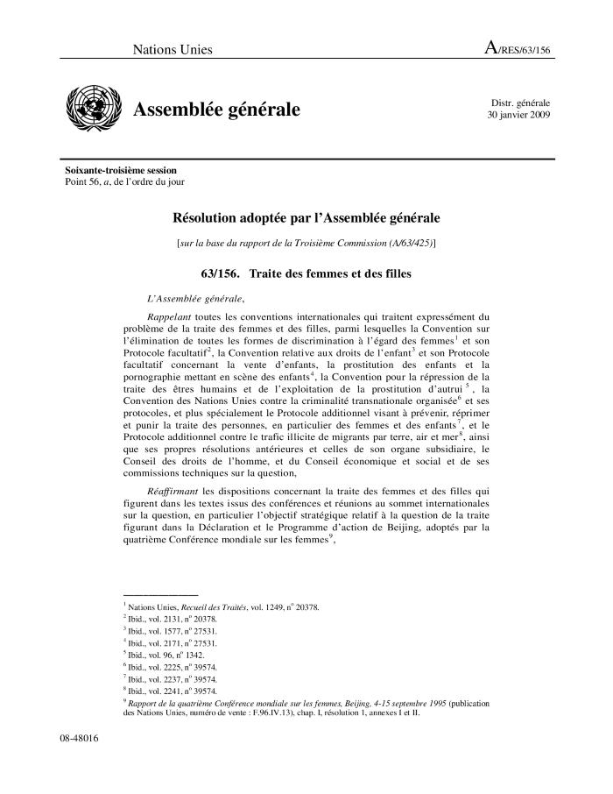
Traite des femmes et des filles (Résolution A/RES/63/156) (c:amaz:12129)

Slide 60
Trafficking in women and girls (Resolution A/RES/63/156) (c:amaz:12128)

Slide 61
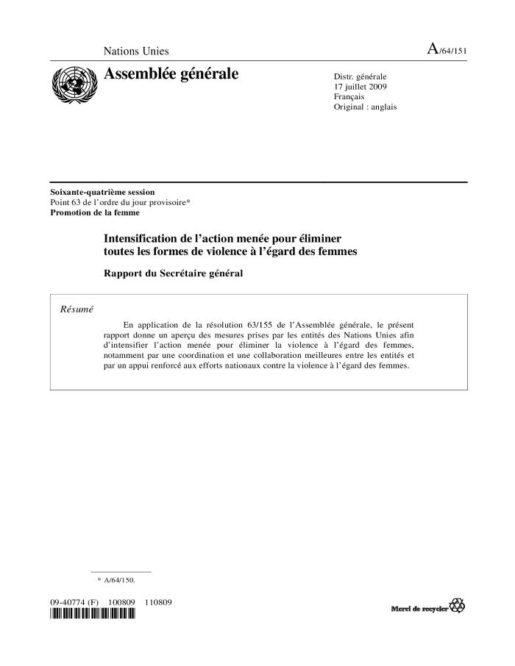
Intensification de l'action menée pour éliminer toutes les formes de violence à l'égard des femmes : rapport du Secrétaire général (A/64/151) (c:amaz:12111)

Slide 62
Intensification of efforts to eliminate all forms of violence against women : report of the Secretary-General (A/64/151) (c:amaz:12110)

Slide 63
Intensification de l'action menée pour éliminer toutes les formes de violence à l'égard des femmes (Resolution A/RES/63/155) (c:amaz:12103)

Slide 64
Intensification of efforts to eliminate all forms of violence against women (Resolution A/RES63/155) (c:amaz:12102)

Slide 65
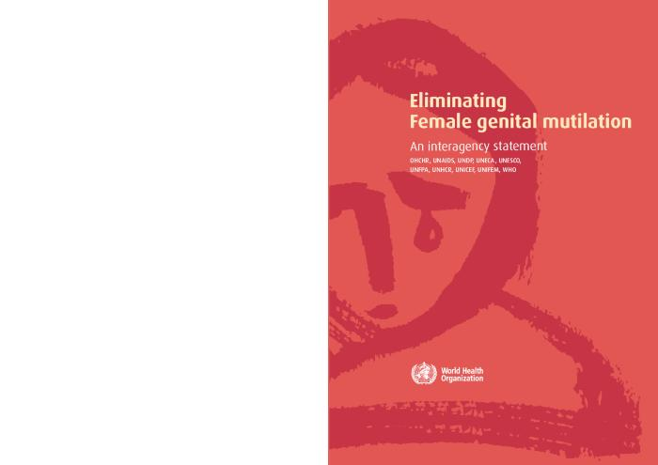
Eliminating female genital mutilation: an interagency statement (c:amaz:6839)

Slide 66
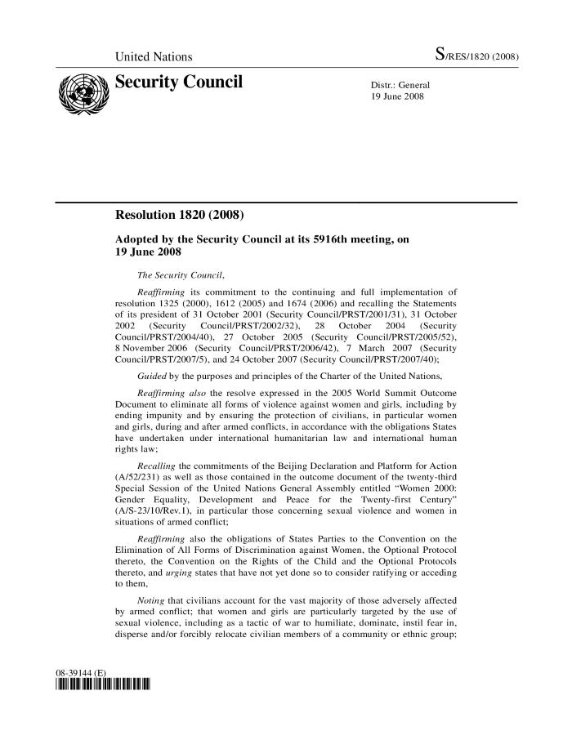
Security Council Resolution 1820 (2008) (c:amaz:12180)

Slide 67
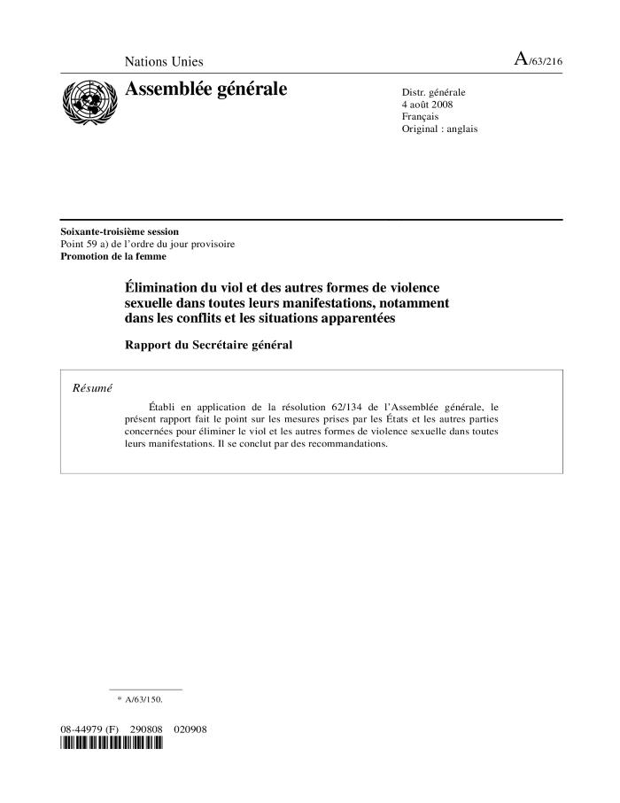
Élimination du viol et des autres formes de violence sexuelle dans toutes leurs manifestations, notamment dans les conflits et les situations apparentées : rapport du Secrétaire général (A/63/216) (c:amaz:12173)

Slide 68

Eliminating rape and other forms of sexual violence in all their manifestations, including in conflict and related situations : report of the Secretary-General (A/63/216) (c:amaz:12172)

Slide 69
Élimination du viol et d'autres formes de violence sexuelle dans toutes leurs manifestations, notamment dans les conflits et les situations apparentées (Résolution A/RES/62/134) (c:amaz:12171)

Slide 70
Eliminating rape and other forms of sexual violence in all their manifestations, including in conflict and related situations (Resolution A/RES/62/134) (c:amaz:12170)

Slide 71
Traite des femmes et des filles : rapport du Secrétaire général (A/63/215) (c:amaz:12139)

Slide 72
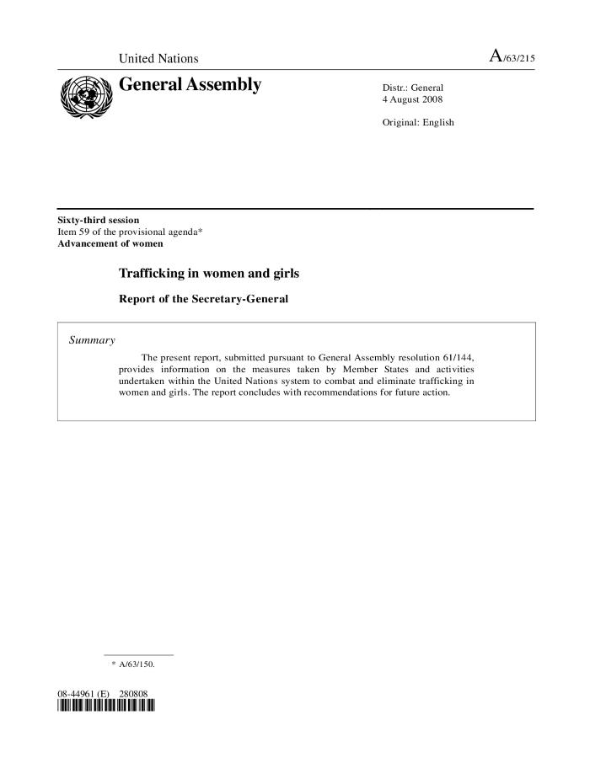
Trafficking in women and girls : report of the Secretary-General (A/63/215) (c:amaz:12138)

Slide 73
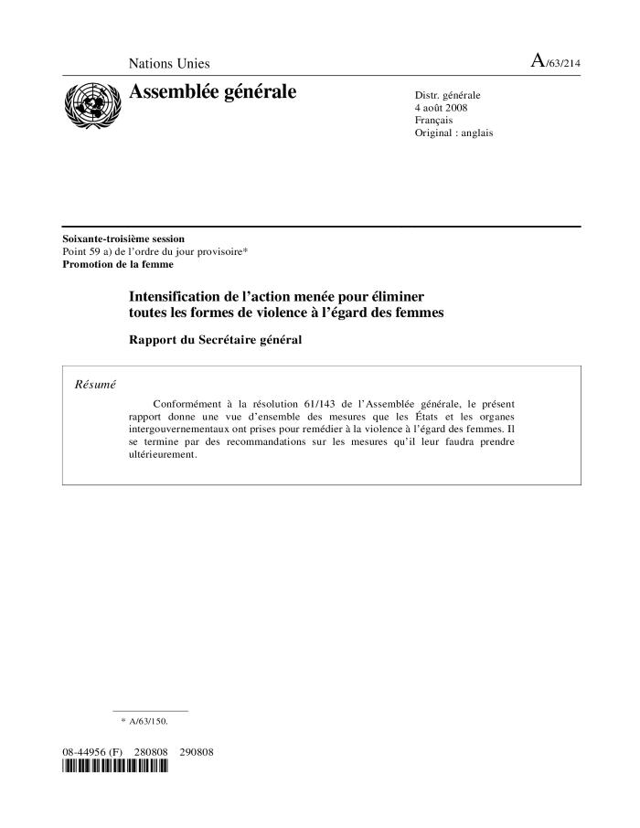
Intensification de l'action menée pour éliminer toutes les formes de violence à l'égard des femmes : rapport du Secrétaire général (A/63/214) (c:amaz:12105)

Slide 74
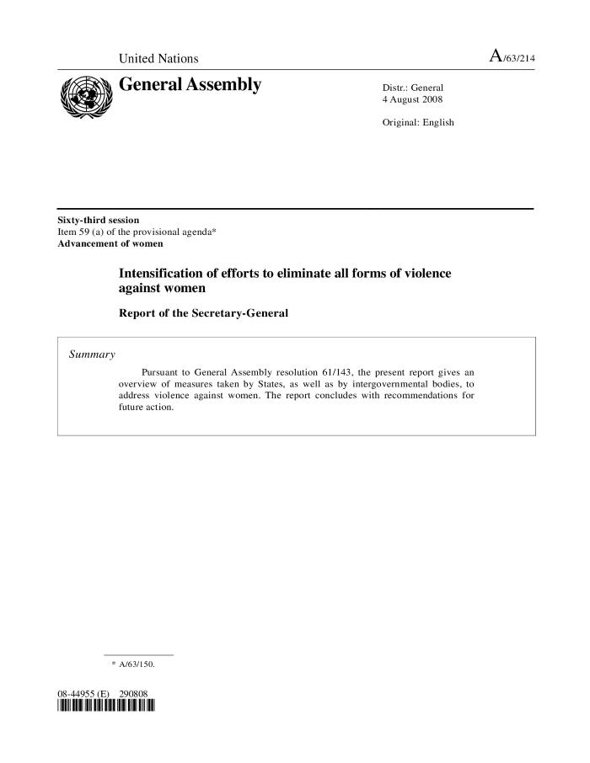
Intensification of efforts to eliminate all forms of violence against women : report of the Secretary-General (A/63/214) (c:amaz:12104)

Slide 75
Intensification de l'action menée pour éliminer toutes les formes de violence à l'égard des femmes (Résolution A/RES/62/133) (c:amaz:12101)

Slide 76
Intensification of efforts to eliminate all forms of violence against women (Resolution A/RES/62/133) (c:amaz:12100)

Slide 77
Beleidsaanbevelingen van de conferentie 'Vrouwenkracht is vredesmacht' (c:amaz:11965)

Slide 78
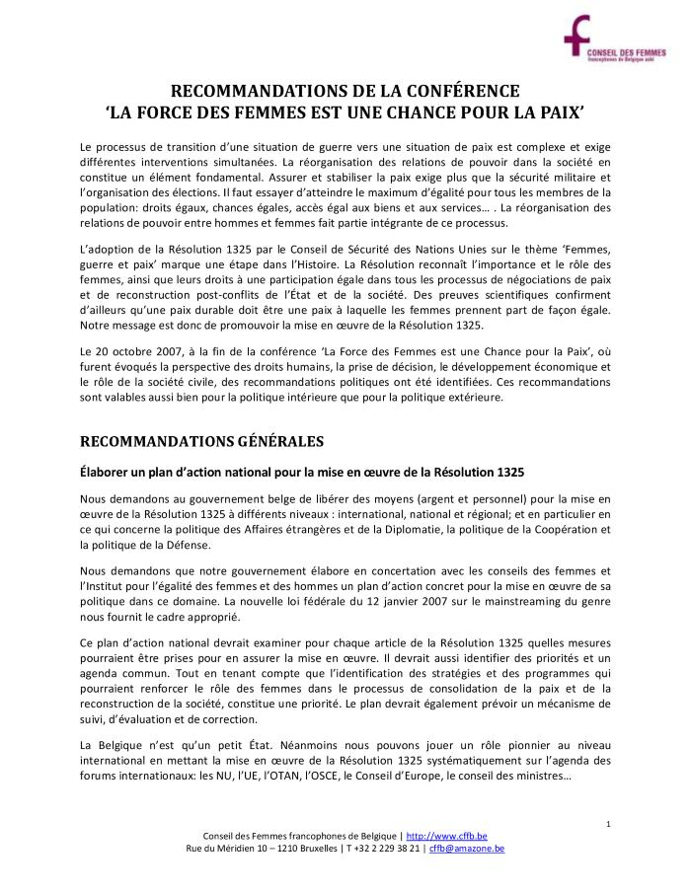
La force des femmes est une chance pour la paix : recommandations 2008 (c:amaz:11964)

Slide 79
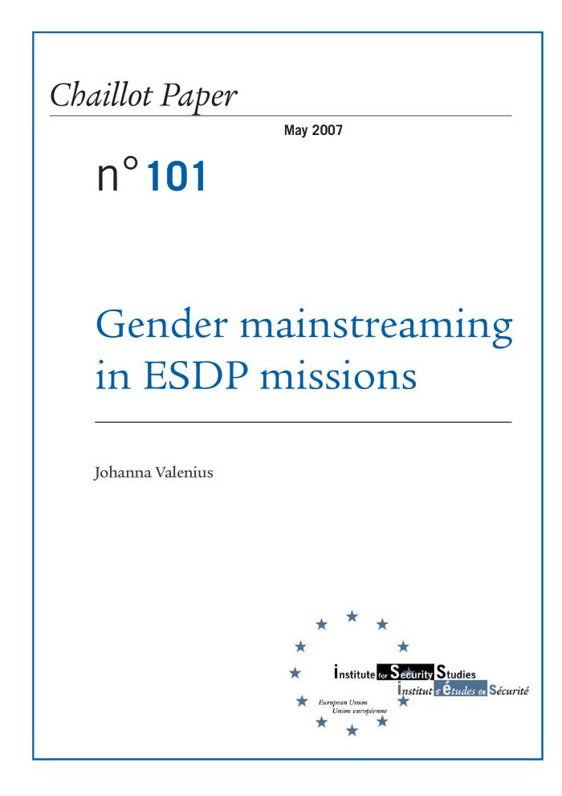
Gender mainstreaming in ESDP missions (c:amaz:6589)

Slide 80
Consideration of reports submitted by states parties under article 18 of the Convention on the Elimination of All Forms of Discrimination against Women : combined fifth and sixth periodic reports of states parties : Belgium (c:amaz:6285)

Slide 81
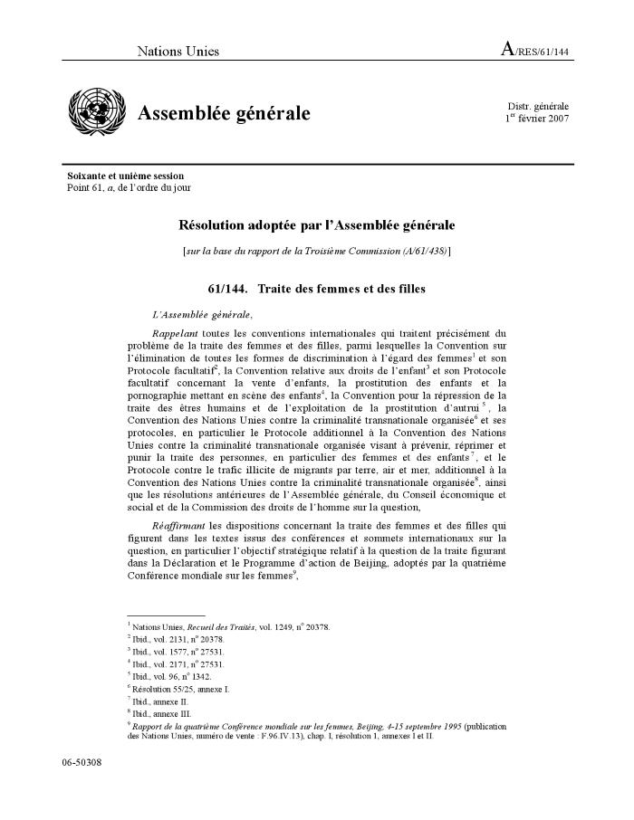
Traite des femmes et des filles (Résolution A/RES/144) (c:amaz:12125)

Slide 82
Trafficking in women and girls (Resolution A/RES/61/144) (c:amaz:12124)

Slide 83
Intensification de l'action menée pour éliminer toutes les formes de violence à l'égard des femmes : rapport du Secrétaire général (A/62/201) (c:amaz:12113)

Slide 84
Intensification of efforts to eliminate all forms of violence against women : report of the Secretary-General (A/62/201) (c:amaz:12112)

Slide 85
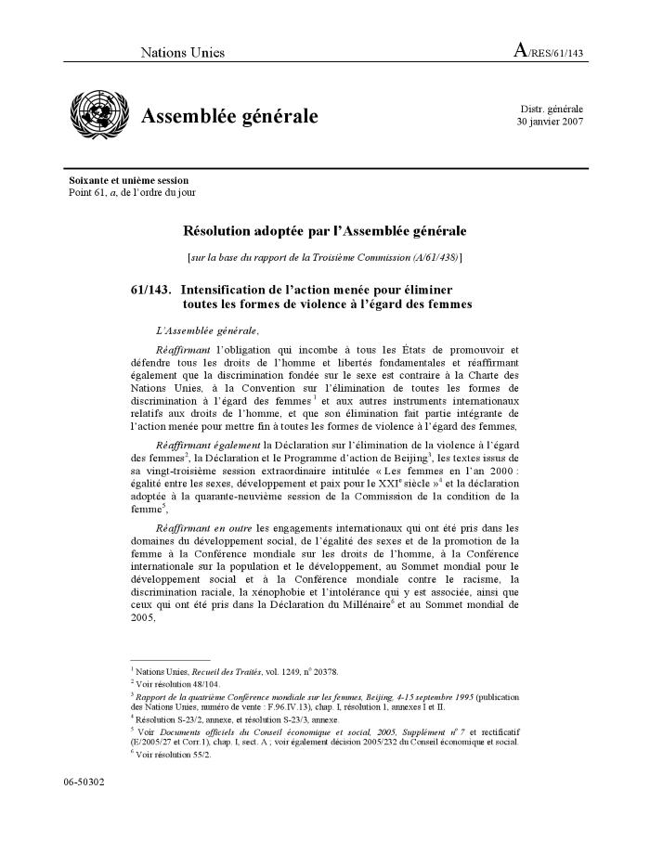
Intensification de l'action menée pour éliminer toutes les formes de violence à l'égard des femmes (Résolution A/RES/61/143) (c:amaz:12099)

Slide 86
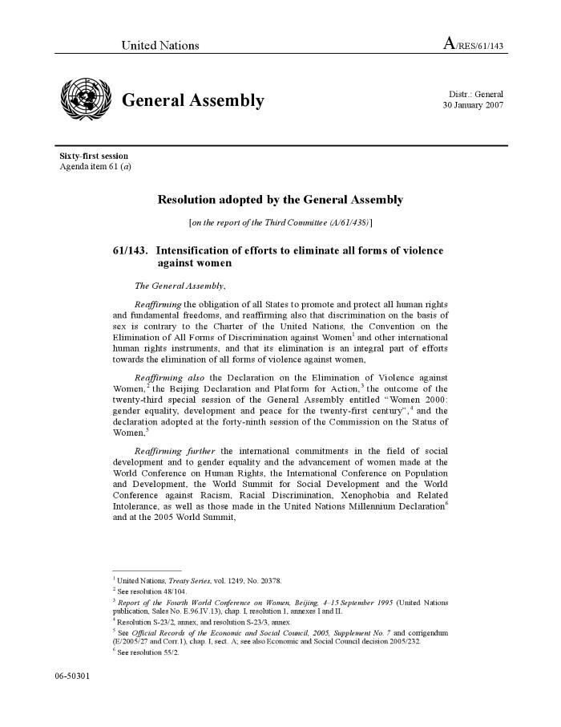
Intensification of efforts to eliminate all forms of violence against women (Resolution A/RES/61/143) (c:amaz:12098)

Slide 87
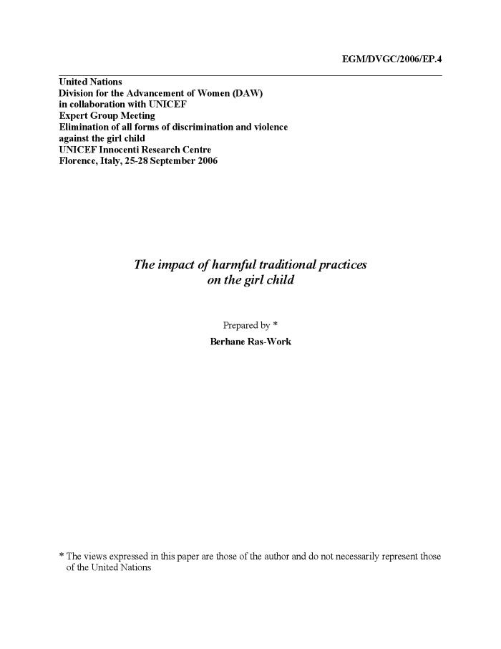
The impact of harmful traditional practices on the girl child (c:amaz:6835)

Slide 88
Ending violence against women : from words to action : study of the Secretary-General (c:amaz:6734)

Slide 89
A new chapter for human rights : a handbook on issues of transition from the Commission on Human Rights to the Human Rights Council (c:amaz:5875)
The handbook highlights the major issues of transition from the Commission to the Council. It briefly describes the old system under the Commission, what the Council needs to consider and do during its first year, and some of the key issues, and existing suggestions and choices. The handbook also identifies the main questions around each of these issues to generate discussion and reflection on what NGOs and defenders hope can be achieved through the system, what features they think would be useful, and better options.

Slide 90
Delivering as one : report of the Secretary-General's High-Level panel (c:amaz:5868)
See the press releases on the and on the .

Slide 91
Agreed conclusions of the Commission on the Status of Women on the critical areas of concern of the Beijing Platform for Action 1996-2005 (c:amaz:5694)

Slide 92
La dimension de genre et la réforme des Nations Unies (c:amaz:5682)

Slide 93

Mettre fin à la violence à l'égard des femmes : des paroles aux actes (c:amaz:13875)

Slide 94
Declaration rendue publique par la Commission de la condition de la femmes à sa quarante-neuvième session (E/CN/2005/L.1) (c:amaz:11120)

Slide 95
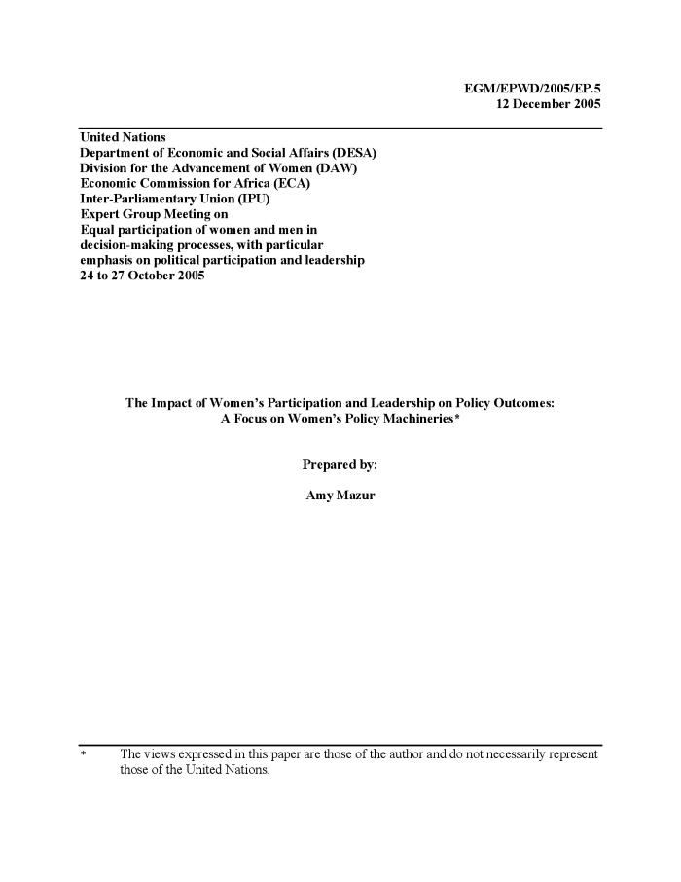
The impact of women's participation and leadership on policy outcomes : a focus on women' policy machineries (c:amaz:7779)

Slide 96
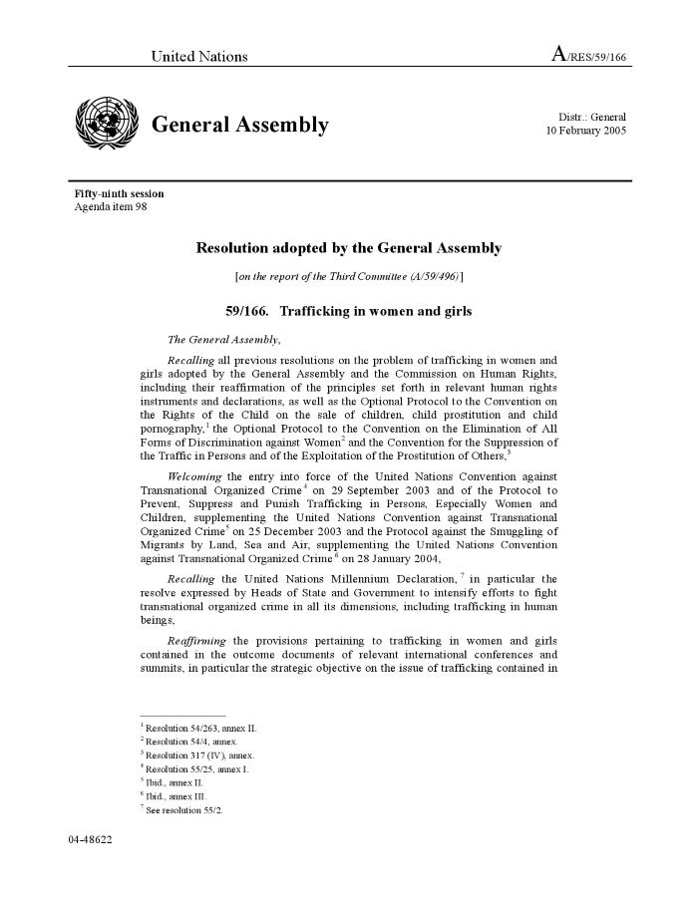
Trafficking in women and girls (A/RES/59/166) (c:amaz:6814)

Slide 97
UN Millenium Project 2005. (c:amaz:5886)
This report recommends the way forward. It outlines a way to attain this bold ambition. It describes how to achieve the Millennium Development Goals.

Slide 98
Generations and gender programme : survey instruments (c:amaz:5696)
The Generations and Gender Programme (GGP) is a system of national Generations and Gender Surveys (GGS) and contextual databases, which aims at improving the knowledge base for policy-making in countries of the United Nations Economic Commission for Europe. The GGS is a panel survey of a nationally representative sample of 18-79 year-old resident population in each participating country with at least three panel waves and an interval of three years between each wave. This publication includes four methodological documents of the GGS.

Slide 99
No turning back - full implementation of women's human rights now! : 10 year review an appraisal of the Beijing Declaration and Platform for Action (c:amaz:5453)

Slide 100
Achievements, gaps and challenges in linking the implementation of the Beijing Platform for Action and the Millennium Declaration and Millennium Development Goals : report of the Expert Group Meeting Baku, Azerbaijan, 7-10 February 2005 (EGM/BPFA-MD-MDG/2005/REPORT) (c:amaz:5402)

Slide 101
The role of the national mechanisms in promoting gender equality and the empowerment of women : report of the expert group meeting Rome, Italy, 29 November - 2 December 2004 (EGM/National Machinery/2004/REPORT) (c:amaz:5401)

Slide 102
Summary of the online discussions held in preparation for the 10 year review and appraisal of the implementation of the Platform of Action in the 49th Session of the Commision on the Status of Women (c:amaz:5400)

Slide 103
Panel discussion entitled 'Addressing the linkages between the implementation of the Beijing Platform for Action and the outcome document of the twenty-third special session of the Genaral Assembly and the internationally agreed development goals, including those contained in the Millennium Declaration : progress, gaps and challenges' : summary submitted by the Moderatr (Kyung-wha Kang) (E/CN.6/2005/CRP.8) (c:amaz:5399)

Slide 104
Regional processes in preparation for the Review of the implementation of the Beijing Platform for Action and the outcome documents of the twenty-third special session of the General Assembly during the forty-ninth session of the Commission of the Status of Women (E/CN.6/2005/CRP.7) (c:amaz:5398)

Slide 105
Measures taken by entities of the United Nations system in promoting the implementation of the twelve critical areas of concern : note by the Secretariat (E/CN.6/2005/CRP.6) (c:amaz:5397)

Slide 106
Note by the Secretariat as an input to the high-level segment of the substantive session of 2005 of the Economic and Social Council (E/CN.6/2005/CRP.4) (c:amaz:5396)

Slide 107
Proposed programme of work of the Office of the Special Adviser on Gender Issues and Advancement of Women and the Division for the Advancement of Women for the biennium 2006-2007 : note by the Secretariat (E/CN.6/2005/CRP.3) (c:amaz:5395)

Slide 108
Results of the thirty-second session of the Committee on the Elimination of Discrimination against Women : note of the Secretary-General (E/CN.6/2005/CRP.1) (c:amaz:5393)

Slide 109
Did the Beijing Platform for Action accelerate progress ? : Dutch Beijing +10 NGO report (c:amaz:5318)

Slide 110
Zijn de verwachtingen van Beijing uitgekomen ? : Nederlandse NGO-schaduwrapportage (c:amaz:5317)

Slide 111
De 49ste Zitting van de CSW [congresmap] (c:amaz:14774)

Slide 112
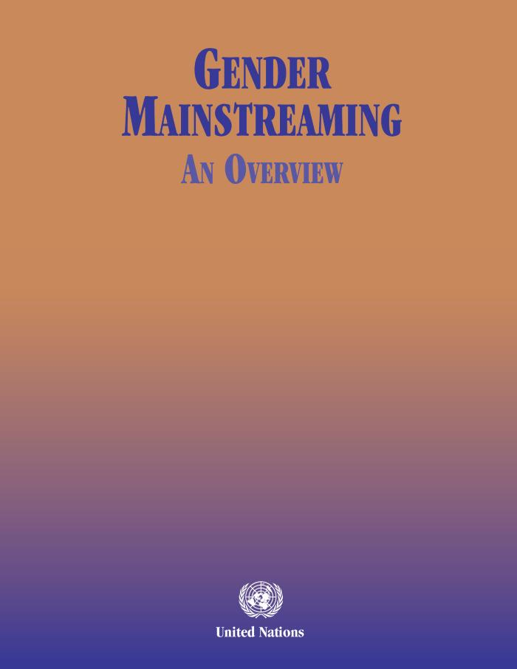
Gender mainstreaming: an overview (c:amaz:14766)

Slide 113
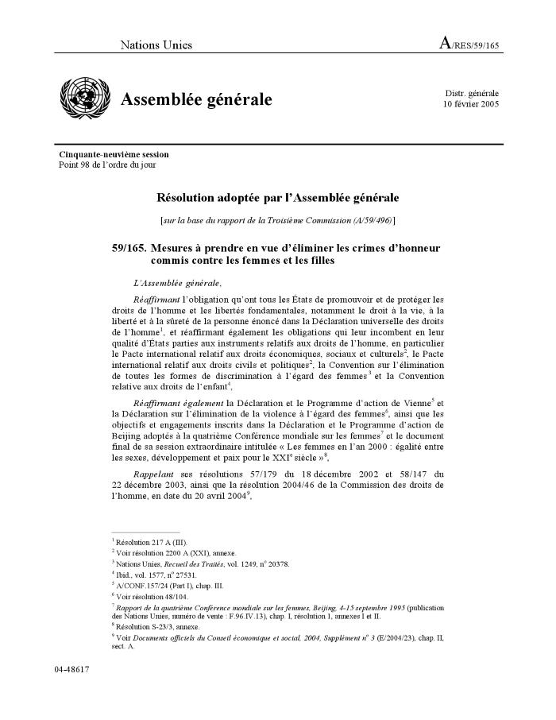
Mesures à prendre en vue d'éliminer les crimes d'honneur commis contre les femmes et les filles (A/RES/59/165) (c:amaz:12147)

Slide 114
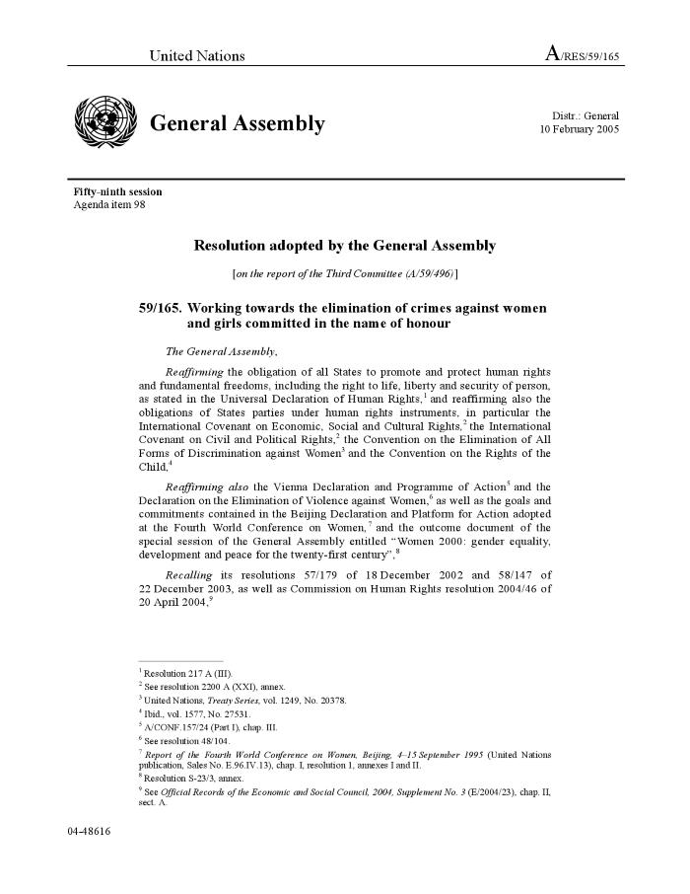
Working towards the elimination of crimes against women and girls committed in the name of honour (A/RES/59/165) (c:amaz:12146)

Slide 115
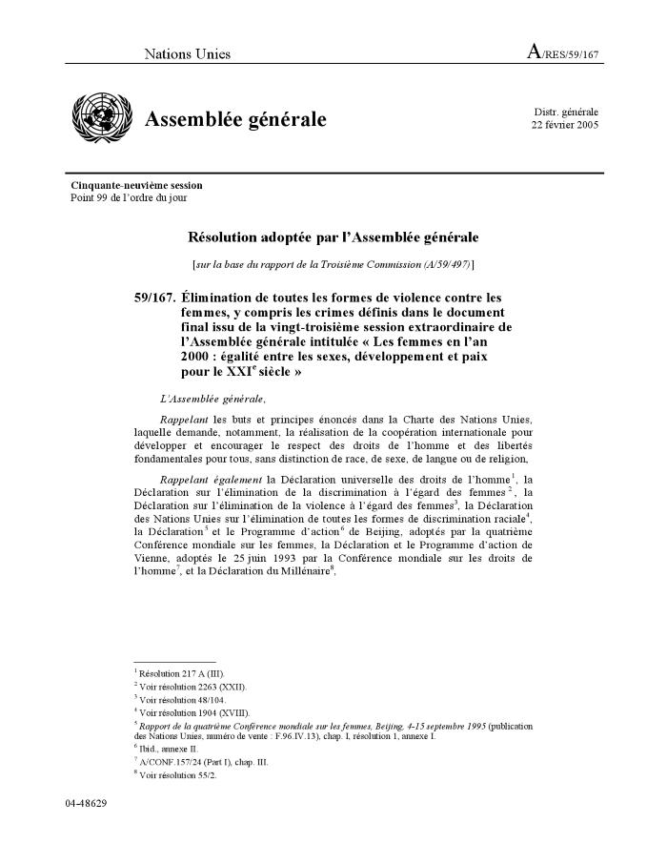
Élimination de toutes les formes de violence contre les femmes, y compris les crimes définis dans le document final issu de la vingt-troisième session extraordinaire de l'Assemblée générale intitulée « Les femmes en l'an 2000 : égalité entre les sexes, développement et paix pour le XXIe siècle » (Résolution A/RES/59/167) (c:amaz:12119)

Slide 116
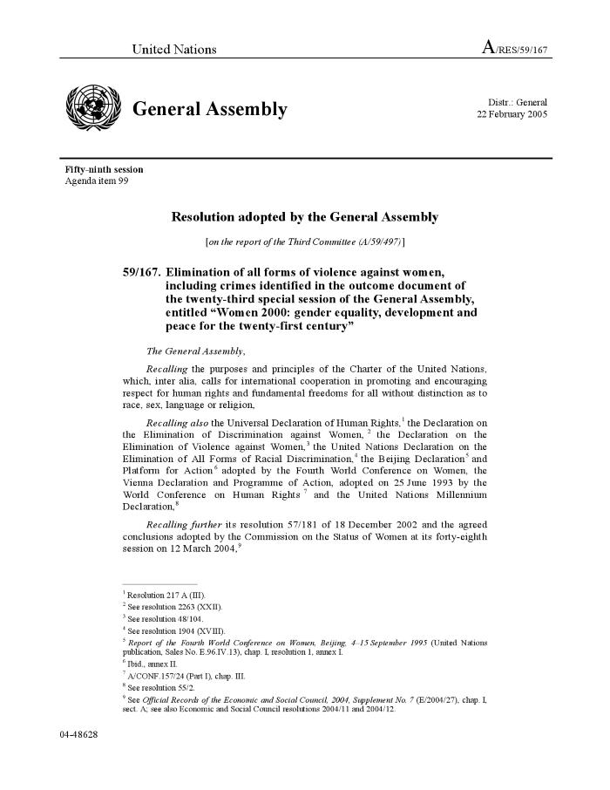
Elimination of all forms of violence against women, including crimes identified in the outcome document of the twenty-third special session of the General Assembly, entitled 'Women 2000: gender equality, development andpeace for the twenty-first century' (Resolution A/RES/59/167) (c:amaz:12118)

Slide 117
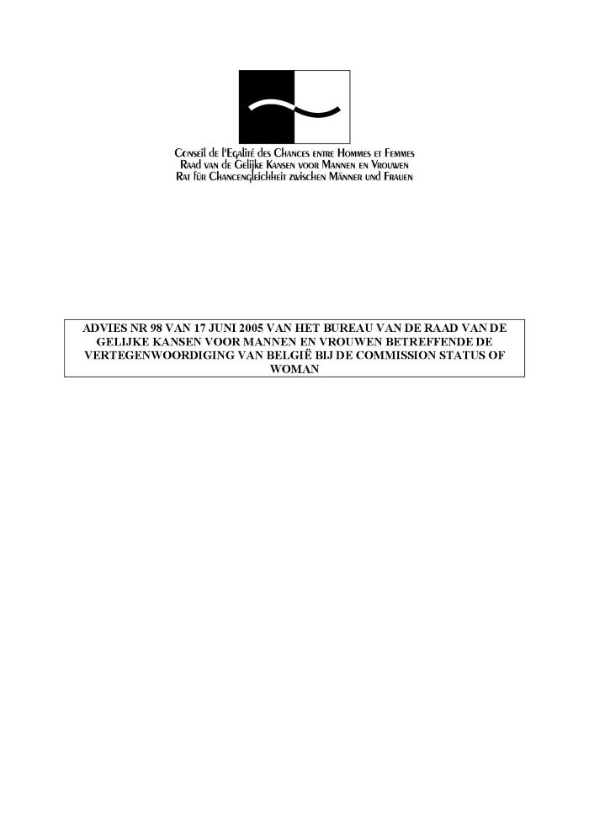
Advies nr. 98 van 17 juni 2005 van het Bureau van de Raad van de Gelijke Kansen voor Mannen en Vrouwen betreffende de vertegenwoordiging van België bij de Commission Status of Woman (c:amaz:12081)

Slide 118
Declaration issued by the Commission on the Status of Women at its forty-ninth session (E/CN.6/2005/L.1) (c:amaz:11119)

Slide 119
Les femmes au-delà des Objectifs du Millénaire (c:amaz:11098)

Slide 120
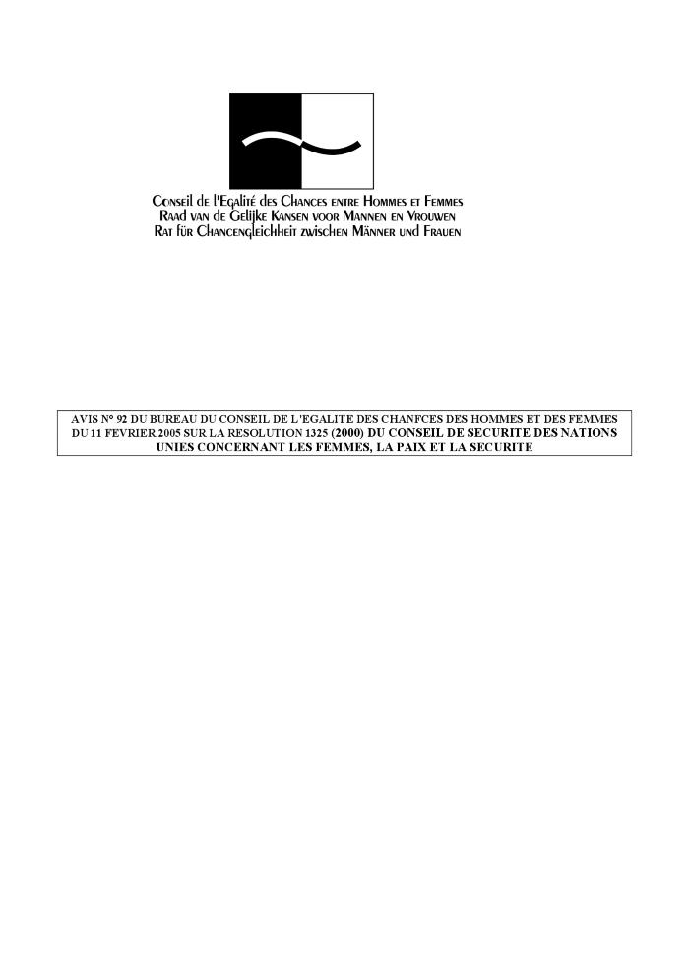
Avis n° 93 du Bureau du Conseil de l'Egalité des Chances des Hommes et Femmes du 11 février 2005 sur la résolution 1325(2000) du Conseil de sécurité des Nations Unies concernant les femmes, la paix et la sécurité (c:amaz:11079)

Slide 121
Situation des femmes palestiniennes et aide à leur apporter : rapport du Secrétaire général (E/CN.6/2005/4) (c:amaz:11110)

Slide 122
Discussion guide on the Commission on the Status of Women High-level Round Table : note by the Bureau of the Commission on the Status of Women (E/CN.6/2005/CRP.2) (c:amaz:5394)

Slide 123
Netherlands ten years after Beijing : second national implementation report (c:amaz:5241)

Slide 124
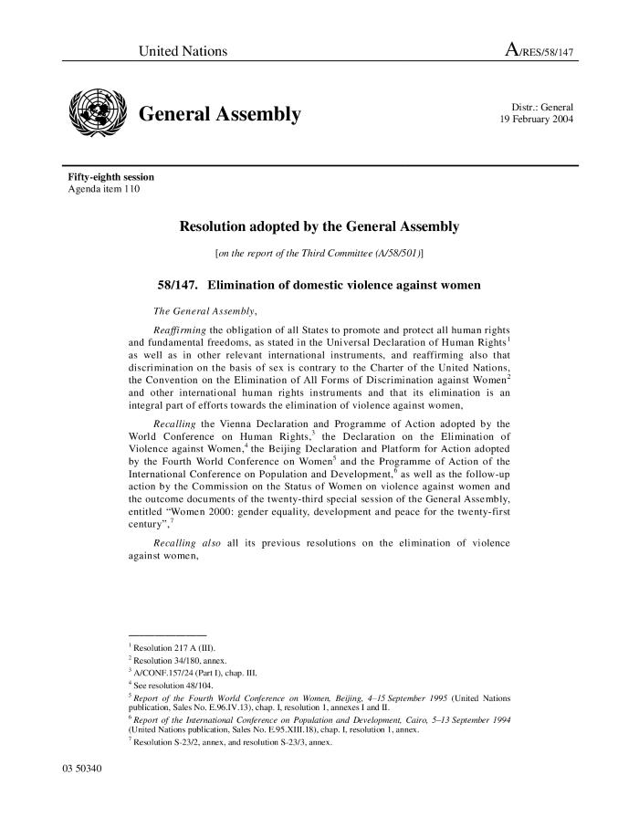
Elimination of domestic violence against women (A/RES/58/147) (c:amaz:12168)

Slide 125
Traite des femmes et des filles : rapport du Secrétaire général (A/59/185) (c:amaz:12141)

Slide 126
Trafficking in women and girls : report of the Secretary-General (A/59/185) (c:amaz:12140)

Slide 127
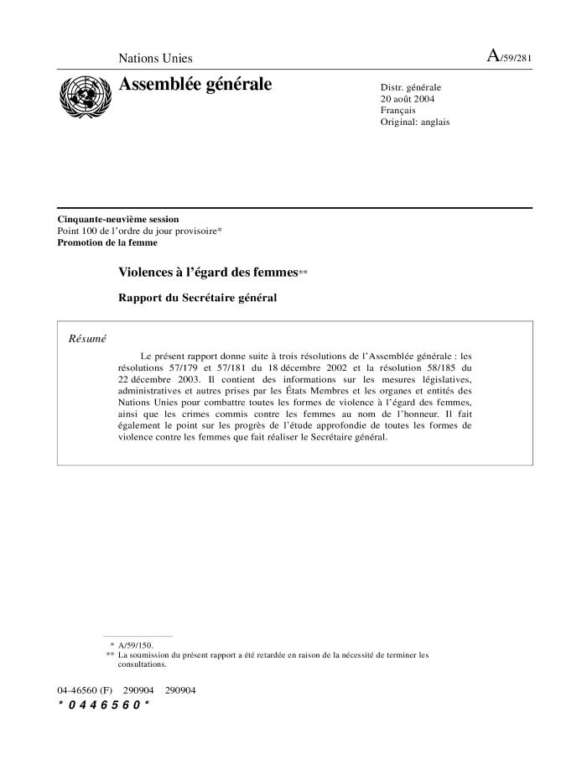
Violences à l'égard des femmes : rapport du Secrétaire général (A/59/281) (c:amaz:12123)

Slide 128

Violence against women : report of the Secretary-General (A/59/281) (c:amaz:12122)

Slide 129
Lettre datée du 16 décembre 2004, adressée à la Présidente de la Commission de la Condition de la Femme par la Présidente du Conseil Economique et Social (E/CN.6/2005/8) (c:amaz:11118)

Slide 130
Letter dated 16 December 2004 from the President of the Economic and Social Council to the Chairperson of the Commission on the Status of Women (E/CN.6/2005/8) (c:amaz:11117)

Slide 131
Rapport du Fonds de Développement des Nations Unies pour la Femme sur l'Elimination de la Violence à l'égard des Femmes : note du Secrétaire général (E/CN.6/2005/7-E/CN.4/2005/70) (c:amaz:11116)

Slide 132
Report of the United Nations Development Fund for Women on the Elimination of Violence against Women : note by the Secretary-General (E/CN.6/2005/7-E/CN.4/2005/70) (c:amaz:11115)

Slide 133
Plan de travail commun à la Division de la Promotion de la Femme et au Haut Commissariat des Nations Unies aux Droits de l'Homme : rapport du Secrétaire générale (E/CN.4/2005/69-E/CN.6/2005/6) (c:amaz:11114)

Slide 134
Joint workplan of the Division for the Advancement of Women and the Office of the United Nations High Commissioner for Human Rights : report of the Secretary-General (E/CN.4/2005/69-E/CN.6/2005/6) (c:amaz:11113)

Slide 135
La situation des femmes et des fillettes en Afghanistan : rapport du Secrétaire général (E/CN.6/2005/5) (c:amaz:11112)

Slide 136
The situation of women and girls in Afghanistan : report of the Secretary-General (E/CN.6/2005/5) (c:amaz:11111)

Slide 137
Situation of and assistance to Palestinian women : report of the Secretary-General (E/CN.6/2005/4) (c:amaz:11109)

Slide 138
Mesures prises et progrès réalisés pour ce qui est du suivi et de la mise en oeuvre de la quatrième Conférence sur les femmes et de la session extraordinaire de l'Assemblée Générale intitulée 'Les femmes en l'an 2000 : égalité des sexes, développement et paix pour le XXIe siècle' s'agissant en particulier de l'adoption par les organes et organismes des Nations Unies d'une démarche tentant compte des spécificités : rapport du Secrétaire général (E/CN.6/2005/3) (c:amaz:11108)

Slide 139
Measures taken and progress achieved in the follow-up to and implementation of the Fourth World Conference on Women and to the twenty-third special session of the General Assembly, with an assessment of progress made on mainstreaming a gender perspective within the United Nations System : report of the Secretary-General (E/CN.6/2005/3) (c:amaz:11107)

Slide 140
Examen de la mise en oeuvre du Programme d'Action de Beijing et des documents issus de la session extraordinaire de l'Assemblée générale intitulée 'Les femmes en l'an 2000 : égalité entre les sexes, développement et paix pour le XXIe siecle' : rapport du Secrétaire général (E/CN.6/2005/2) (c:amaz:11106)

Slide 141
Review of the implemention of the Beijing Platform of Action and the outcome documents of the special session of the General Assembly entitled 'Women 2000 : gender equality, development and peace for the twenty-first century' : report of the Secretary-General (E/CN.6/2005/2) (c:amaz:11105)

Slide 142
Commission de la Condition de la Femme, Quarante-neuvième session, 28 février-11 mars 2005 : ordre du jour provisoire annoté et projet d'organisation des travaux (E/CN.6/2005/1) (c:amaz:11104)

Slide 143
Commission on the Status of Women, Forty-ninth session, 28 February-11 March 2005 : annotated provisional agenda and proposed organization of work (E/CN.6/2005/1) (c:amaz:11103)

Slide 144

Het verdrag van de Verenigde Naties inzake de uitbanning van alle vormen van discriminatie van vrouwen (c:amaz:11094)

Slide 145

Convention des Nations Unies sur l'élimination de toutes les formes de discrimination à l'égard des femmes (c:amaz:11093)

Slide 146
Pékin +10 : 1995-2005 : évaluation de la mise en oeuvre de la plate-forme d'action de Pékin par l'Union Européenne : rapport du Lobby Européen des Femmes (c:amaz:11001)

Slide 147
Beijing +10 : 1995-2005 : review of the implementation of the Beijing platform for action by the European Union : report by the European Women's Lobby (c:amaz:11000)

Slide 148
Antwoord op de vragenlijst over de uitvoering van het Actieprogramma van Peking (1995) en de slotteksten van de 23e Bijzondere Zitting van de Algemene Vergadering (2000) [30 april 2004] (c:amaz:10981)

Slide 149
Réponse au questionnaire sur la mise en oeuvre du Programme d'Action de Beijing (1995) et des textes issus de la vingt-troisième session extraordinaire de l'Assemblée Générale (2000) : Belgique [30 avril 2004] (c:amaz:10980)

Slide 150
Response to the questionnaire on implementation of the Beijing Platform for Action (1995) and the outcome of the twenty-third Special Session of the Genral Assembly (2000) : Belgium (c:amaz:10979)

Slide 151
Vrouwen gaan verder dan de Milleniumdoelstellingen : verslagboek van de internationale conferentie (10 oktober 2003 ; Brussel) (c:amaz:10827)

Slide 152
Les femmes au-delà des Objectifs du Millénaire : actes de la conférence internationale (10 octobre 2003 ; Bruxelles) (c:amaz:10826)

Slide 153
Women go beyond the Millenium Goals : proceedings of the International Conference of 10 October 2003 (c:amaz:10825)

Slide 154
e.quality@work [cd-rom] : an information base on equal employment opportunities for women and men (c:amaz:4861)

Slide 155
VN-Vrouwenverdrag : een praktische gids voor belangenorganisaties (c:amaz:4773)

Slide 156

Pratiques traditionnelles ou coutumières affectant la santé des femmes et des fillettes : rapport du Secrétaire général (A/58/169) (c:amaz:12163)

Slide 157
Traditional or customary practices affecting the health of women and girls : report of the Secretary-General (A/58/169) (c:amaz:12162)

Slide 158

Mesures à prendre en vue d'éliminer les crimes d'honneur commis contre les femmes (A/RES/57/179) (c:amaz:12149)

Slide 159
Working towards the elimination of crimes against women committed in the name of honour (A/RES/57/179) (c:amaz:12148)

Slide 160

Traite des femmes et des filles (Résolution A/RES/57/176) (c:amaz:12127)

Slide 161
Trafficking in women and firls (Resolution A/RES/57/176) (c:amaz:12126)

Slide 162
Working for women's empowerment and gender equality : annual report 2001 / UNIFEM (c:amaz:6766)

Slide 163
Femmes : au nom de l'équité (c:amaz:5361)

Slide 164
VN-Vrouwenverdrag : een geannoteerde bibliografie (c:amaz:4464)

Slide 165

Pratiques traditionnelles ou coutumières préjudiciables à la santé des femmes et des filles (Résolution A/RES/56/128) (c:amaz:12155)

Slide 166

Traditional or customary practices affecting the health of women and girls (Resolution A/RES/56/128) (c:amaz:12154)

Slide 167
Mesures à prendre en vue d'éliminer les crimes d'honneur commis contre les femmes : rapport du Secrétaire général (A/57/169) (c:amaz:12153)

Slide 168
Working towards the elimination of crimes against women committed in the name of honour : report of the Secretary-General (A/57/169) (c:amaz:12152)

Slide 169
Traite des femmes et des filles : rapport du Secrétaire général (A/57/170) (c:amaz:12143)

Slide 170
Trafficking in women and girls : report of the Secretary-General (A/57/170) (c:amaz:12142)

Slide 171

Élimination de toutes les formes de violence contre les femmes, y compris les crimes tels que définis dans le document final adopté par l'Assemblée générale à sa vingt-troisième session extraordinaire, intitulée « Les femmes en l'an 2000 : égalité entre les sexes, développement et paix pour le XXIe siècle » : rapport du Secrétaire général (A/57/171) (c:amaz:12121)

Slide 172
Elimination of all forms of violence against women, including crimes identified in the outcome document of the twenty-third special session of the General Assembly entitled 'Women 2000: gender equality, development and peace for the twenty-first century' : report of the Secretary-General (A/57/171) (c:amaz:12120)

Slide 173
Met recht een vrouw : het VN-Vrouwenverdrag toegelicht (c:amaz:4465)
Dit boekje geeft informatie over de inhoud van het VN-Vrouwenverdrag en geeft aan hoe u het kunt gebruiken om uw recht te halen.

Slide 174
Commission on the Status of Women : report on the forty-fifth session (6-16 March and 9-11 May 2001) (c:amaz:4345)

Slide 175

Pratiques traditionnelles ou coutumières affectant la santé des femmes et des filles : rapport du Secrétaire général (A/56/316) (c:amaz:12165)

Slide 176

Traditional or customary practices affecting the health of women and girls : report of the Secretary-General (A/56/316) (c:amaz:12164)

Slide 177
Mesures à prendre en vue d'éliminer les crimes d'honneur commis contre les femmes (Résolution A/RES/55/66) (c:amaz:12151)

Slide 178

Working towards the elimination of crimes against women committed in the name of honour (Resolution A/RES/55/ 66) (c:amaz:12150)

Slide 179
Convention des Nations Unies contre la criminalité transnationale organisée (Résolution A/RES/25/55) (c:amaz:12131)

Slide 180

United Nations Convention against transnational organized crime (Resolution A/RES/55/25) (c:amaz:12130)

Slide 181
Élimination de toutes les formes de violence contre les femmes, y compris les crimes tels que définis dans le document final adopté par l'Assemblée générale à sa vingt-troisième session extraordinaire intitulée «Les femmes en l'an 2000: égalité entre les sexes, développement et paix pour le XXIe siècle» (Résolution A/RES/55/68) (c:amaz:12115)

Slide 182
Elimination of all forms of violence against women, including crimes identified in the outcome document of the twenty-third special session of the General Assembly, entitled 'Women 2000: gender equality, development and peace for the twenty-first century' (Resolution A/RES/55/68) (c:amaz:12114)

Slide 183

Integration of the human rights of women and the gender perspective : violence against women : report of the Special Rapporteur on violence against women, its causes and consequences, Ms. Radhika Coomaraswamy, on trafficking in women, women's migration and violence against women, submitted in accordance with Commission on Human Rights resolution 1997/44 (c:amaz:6842)

Slide 184
Working for women's empowerment and gender equality : annual report 1999 / UNIFEM (c:amaz:6765)

Slide 185
Women in power and decision-making : note by the ECE secretariat (c:amaz:5187)

Slide 186
Women in power and decision-making : draft conclusions (c:amaz:5186)

Slide 187
Women and the economy : draft conclusions (c:amaz:5185)

Slide 188
Implementation of the Platform for Action adopted at the Fourth World Conference on Women in Beijing 1995 (c:amaz:5179)

Slide 189
Women go global [cd-rom] : the United Nations and the international women's movement 1945-2000 : an interactive, multimedia cd-rom (c:amaz:4823)

Slide 190
Die grossen UN-Konferenzen der 90er Jahre : eine frauenpolitische Bilanz : Dokumentation der Veranstaltungsreihe, Sommer 2000 (c:amaz:4470)
Analyse van de impact van vrouwen op de VN-wereldcongressen.

Slide 191
La violence envers les femmes en milieu urbain : analyse du problème selon une perspective de genre (c:amaz:4452)

Slide 192
Commission on the Status of Women : report on the forty-fourth session (28 February - 2 March 2000) (c:amaz:4344)

Slide 193
The Convention on the elimination of all forms of discrimination against women : the optional protocol : text and materials (c:amaz:4200)

Slide 194
Beijing +5 : an overview of the European Union follow-up and preparations (c:amaz:4154)

Slide 195
Women's political participation and good governance : 21st century challenges (c:amaz:4015)

Slide 196
Revue quinquennale de la Plate-forme d'Action de Pékin : commentaires du Lobby Européen des Femmes sur les conclusions adoptées par la Commission Economique pour l'Europe (CEE/ONU) le 21 janvier 2000 (c:amaz:3889)

Slide 197

Security Council Resolution 1325 (2000) (c:amaz:12178)

Slide 198
Pratiques traditionnelles ou coutumières affectant la santé des femmes et des filles (Résolution A/RES/54/133) (c:amaz:12157)

Slide 199

Traditional or customary practices affecting the health of women and girls (Resolution A/RES/54/133) (c:amaz:12156)

Slide 200
Traite des femmes et des petites filles : rapport du Secrétaire général (A/55/322) (c:amaz:12145)

Slide 201
Trafficking in women and girls : report of the Secretary-General (A/55/322) (c:amaz:12144)

Slide 202
Institutional mechanism for the advancement of women : some developments since the Beijing Conference (c:amaz:10940)

Slide 203
Regional preparatory meeting on the 2000 Review of implementation of the Beijing Platform of Action, 19-21 January 2000 : report (E/ECE/RW.2/2000/7) (c:amaz:10938)

Slide 204
Activités du Conseil de l'Europe en matière d'égalité entre les femmes et les hommes relatives aux objectifs stratégiques des Programmes d'Action de Pékin et de Vienne (c:amaz:10934)

Slide 205
Council of Europe activities since 1995 in the field of equality between women and men related to the strategic objectives in the Beijing and Vienna Platforms for Action (c:amaz:10933)

Slide 206
Report of the Ad Hoc Committee of the Whole of the twenty-third session of the General Assembly (c:amaz:10929)

Slide 207
Droits des femmes : recueil de textes normatifs internationaux (c:amaz:9263)

Slide 208
Human rights of women : a collection of international and regional normative instruments (c:amaz:9262)

Slide 209
Belgisch nationaal actieplan voor de opvolging van het actieprogramma van de vierde wereldvrouwenconferentie van Peking [februari 1999] (c:amaz:9245)

Slide 210
Plan d'action national belge du suivi du programme d'action défini à l'issue de la quatrième conférence mondiale sur les femmes à Pékin [février 1999] (c:amaz:9244)

Slide 211
National machineries for gender equality and the advancement of women in Transition Countries (Central and Eastern Europe and the CIS) (c:amaz:5180)

Slide 212
Position paper women and health : contribution of the European Women's Lobby to the 43rd session of the CSW in New York (c:amaz:3896)

Slide 213
Facultatief protocol bij het verdrag voor de uitbanning van alle vormen van discriminatie van de vrouw (CEDAW-verdrag, 1979) (c:amaz:3874)

Slide 214
Linking up Cairo, Copenhagen, Beijing +5 : reviews towards the 21st century : report of a conference (c:amaz:3872)

Slide 215
Réponse au questionnaire relatif aux suites données au programme d'action de Beijing [22 avril 1999] (c:amaz:3854)

Slide 216
Women and health : mainstreaming the gender perspective into the health sector : report of the expert group meeting (28 September - 2 October 1998 ; Tunis) (c:amaz:3843)

Slide 217
Projet de protocole facultatif révisé présenté par la Présidente sur la base des consultations officieuses tenues sur le texte composite figurant à l'annexe I du rapport de la Commission de la condition de la femme sur sa quarante-deuxième session (E/1998/27) (c:amaz:3761)

Slide 218
Report of the Committee on the Elimination of Discrimination against Women : twentieth session (19 January-5 February 1999), twenty-first session (7-25 June 1999) (c:amaz:3759)

Slide 219
General Assembly adopts protocol to women's rights convention providing recourse to victims of sex discrimination (c:amaz:3757)

Slide 220
Commission on the Status of Women : report on the forty-third session (1-12 March and 1 April 1999) (c:amaz:3756)

Slide 221
Literatuurlijst IVde Wereldvrouwenconferentie (c:amaz:3649)

Slide 222
Het Actieplatform van de Vierde Wereldvrouwenconferentie (Peking 1995) in praktijk in het Vlaams beleid en de NGO's : studiedag (c:amaz:3624)

Slide 223
Vlaams Actieplan in toepassing van het Actieplatform van Peking : opvolging van de resoluties van de Wereldvrouwenconferentie, Peking, 4 tot 14 september 1995 (c:amaz:3623)

Slide 224
Female genital mutilation : information kit (c:amaz:14184)

Slide 225
Pratiques traditionnelles ou coutumières affectant la santé des femmes et des filles (Résolution A/RES/53/117) (c:amaz:12159)

Slide 226

Traditional or customary practices affecting the health of women and girls (Resolution A/RES/53/117) (c:amaz:12158)

Slide 227
Women and the economy in the ECE region (c:amaz:10945)

Slide 228
Trafficking in women and girls (c:amaz:10943)

Slide 229
Regional preparatory meeting on the 2000 Review of implementation of the Beijing Platform of Action, 19-21 January 2000 : provisional agenda (E/ECE/RW.2/2000/1) (c:amaz:10936)

Slide 230
Nederlandse NGO-rapportage Beijing +5 (c:amaz:10502)

Slide 231
The Beijing +5 NGO-report of the Netherlands (c:amaz:10501)

Slide 232
Institutions et organismes chargés de l'égalité femmes-hommes (c:amaz:10295)

Slide 233
Institutions and bodies responsible for equality between women and men (c:amaz:10294)

Slide 234
Manifest van gehandicapte vrouwen in Europa : aangenomen in Brussel op 22 februari 1997 door de Werkgroep Vrouwen en een Handicap van het Europees Gehandicaptenforum (c:amaz:9593)

Slide 235
Manifeste des femmes handicapées d'Europe : adopté à Bruxelles le 22 février 1997 par le Groupe de Travail Femmes et Handicap du Forum Européen des Personnes Handicapées (c:amaz:9592)

Slide 236
Manifesto by disabled women in Europe : adopted in Brussels on 22 February 1997 by the European Disability Forum Working Group on Women and Disability (c:amaz:9591)

Slide 237
Wereldbevolkingsrapport 1998 : nieuwe generaties (c:amaz:8824)

Slide 238
The state of the world population 1998 : the new generations (c:amaz:8823)

Slide 239
Consideration of reports submitted by states parties under article 18 of the Convention on the Elimination of All Forms of Discrimination against Women : third and fourth periodic reports of states parties : Belgium (c:amaz:6284)

Slide 240
Female genital mutilation : an overview (c:amaz:4265)

Slide 241
National machineries for gender equality : Expert Group meeting Santiago, Chile [31 August - 4 September 1998]: report (c:amaz:3654)

Slide 242
Commission on the Status of Women : report on the forty-second session (2-13 March 1998) (c:amaz:3652)

Slide 243
Gender mainstreaming in WFP : an integrated assessment (c:amaz:3647)

Slide 244
Building capacity for gender mainstreaming : UNDP's experience (c:amaz:3646)

Slide 245
Reproductive and sexual rights : policy options for follow-up on the health chapter of the Platform for Action of the 1995 Beijing Fourth World Conference on Women : summery version : final draft 30 November 1998 (c:amaz:3568)

Slide 246
Pratiques traditionnelles ou coutumières affectant la santé des femmes et des fillettes : rapport du Secrétaire général (c:amaz:12167)

Slide 247

Traditional or customary practices affecting the health of women : report of the Secretary-General (A/53/354) (c:amaz:12166)

Slide 248
Pratiques traditionnelles ou coutumières affectant la santé des femmes et des fillettes (Résolution A/RES/52/99) (c:amaz:12161)

Slide 249
Traditional or customary practices affecting the health of women and girls (Resolution A/RES/52/99) (c:amaz:12160)

Slide 250
Les mutilations sexuelles féminines : déclaration commune OMS/UNICEF/FNUAP (c:amaz:9952)

Slide 251
Female genital mutilation : a joint WHO/UNICEF/UNFPA statement (c:amaz:9951)

Slide 252
Les droits des femmes, la responsabilité de tous (c:amaz:9912)

Slide 253
Women's rights, the responsibility of all (c:amaz:9910)

Slide 254
IIIème et IVème rapports relatifs à l'application de la Convention sur l'élimination de toutes les formes de discrimination à l'égard des femmes : convention de New-York 1989-1997 (c:amaz:9198)

Slide 255
Genre : clé pour le développement et la sécurité alimentaire : plan d'action pour l'intégration des femmes dans le développement, 1996-2001 (c:amaz:8686)

Slide 256
Gender : key to sustainability and food security : plan of action for women in development, 1996-2001 (c:amaz:8685)

Slide 257
Internationaal verdrag tot uitbanning van alle vormen van discriminatie van vrouwen (c:amaz:8474)

Slide 258
Wereldbevolkingsrapport 1997 : het recht om te kiezen : reproductieve rechten en reproductieve gezondheid (c:amaz:8397)

Slide 259
The state of world population 1997 : the right to choose : reproductive rights and reproductive health (c:amaz:8396)

Slide 260
Rapport du Comité pour l'élimination de la discrimination à l'égard des femmes (seizième et dix-septième sessions) : Assemblée Générale : documents officiels - cinquante-deuxième session : supplément n° 38 (A/52/38/Rev.1) (c:amaz:7057)

Slide 261
The progress of nations 1997 : the nations of the world ranked according to their achievements in child health, nutrition, education, family planning, and progress for women (c:amaz:6313)

Slide 262
America's commitment : federal programs benefiting women and new initatives as follow-up to the UN Fourth World Conference on Women (c:amaz:5033)

Slide 263
Commission on the Status of Women : report on the forty-first session (10-12 March 1997) (c:amaz:4343)

Slide 264
UNIFEM's experiences in mainstreaming for gender equality (c:amaz:3645)

Slide 265
Coordination of the policies and activities of the specialized agencies and other bodies of the United Nations system : mainstreaming the gender perspective into all policies and programmes in the United Nations system : report of the Secretary-General (c:amaz:3644)

Slide 266
Recueil de textes adoptés au niveau international concernant la démocratie et l'égalité entre les femmes et les hommes : document d'information (c:amaz:3418)

Slide 267
Gender equality and the reconciliation of working, family and personal life : a review of documents produced by five international organisations (c:amaz:3326)

Slide 268
Basic guide of the decisions taken and recommendations and measures adopted by the international organizations on reconciling work and family responsibilities of men and women (c:amaz:3323)

Slide 269
Rechten van kinderen met een handicap : themadag 19 november 1997 (c:amaz:3274)

Slide 270
Fonds des Nations Unies pour la Population : rapport annuel 1997 (c:amaz:3263)

Slide 271
The World conferences : developing priorities for the 21st century (c:amaz:2894)

Slide 272
The platform for action 'Woman, Family, Society' based on the conclusions of the 4th World Conference on Women (c:amaz:131)

Slide 273

Violence against women : briefing (c:amaz:11944)

Slide 274

Verslag aan het Parlement van de Minister belast met het Beleid van Gelijke Kansen voor Mannen en Vrouwen naar aanleiding van de indiening van de wet strekkende tot controle op de toepassing van de resoluties van de Wereldvrouwenconferentie die van 4 tot 14 september 1995 in Peking heeft plaatsgehad (december 1997) (c:amaz:10924)

Slide 275
Rapport au Parlement de la Ministre chargée de la Politique de l'Egalité des Chances entre Hommes et Femmes suite à l'introduction de la loi visant au contrôle de l'application des résolutions de la Conférence Mondiale sur les Femmes réunie à Pékin du 4 au 14 septembre 1995 (décembre 1997) (c:amaz:10923)

Slide 276

Rapport de la Quatrième Conférence Mondiale sur les Femmes (Beijing, 4-15 septembre 1995) (c:amaz:12869)

Slide 277
Convention on the elimination of all forms of discrimination against women (c:amaz:8472)

Slide 278
De Vierde Wereldconferentie over Vrouwen, Peking, september 1995 (c:amaz:8320)

Slide 279
La Quatrième Conférence Mondiale sur les Femmes, Pékin, septembre 1995 (c:amaz:8319)

Slide 280
Quatrième Conférence mondiale sur les femmes Beijing (Chine) 4-15 septembre 1995 : programme d'action : vue synthétique (c:amaz:7235)

Slide 281
Twenty years of commitment to the world's women : annual report 1995 / UNIFEM (c:amaz:6764)

Slide 282
Beyond Beijing : a report of the Women's National Commission conference (16-18 June 1996 ; Manchester) (c:amaz:5303)

Slide 283
Vrouw en habitat (c:amaz:4403)

Slide 284
Commission on the Status of Women : report on the fortieth session (11-22 March 1996) (c:amaz:4342)

Slide 285
More & better jobs for women : an action guide : an ILO follow-up to the Fourth World Conference on Women and the World Summit for Social Development (c:amaz:3677)

Slide 286
Gender concepts in development planning : basic approach (c:amaz:3498)

Slide 287
Beijing nu en toekomst (c:amaz:3481)

Slide 288
Reproductive rights and reproductive health : a concise report (c:amaz:3461)

Slide 289
Activités du Conseil de l'Europe en matière d'égalité entre les femmes et les hommes relatives aux objectifs stratégiques des programmes d'action de Pékin et de Vienne (c:amaz:3429)

Slide 290
Convention sur l'élimination de toutes les formes de discrimination à l'égard des femmes : réponses de la Belgique aux questions écrites du comité relatives au deuxième rapport (c:amaz:3112)

Slide 291
Wereldtop voor Sociale Ontwikkeling : een evaluatie : teksten & documenten (c:amaz:2960)

Slide 292
Habitat agenda and Istanbul declaration : second United Nations conference on human settlements : Istanbul, Turkey 3-14 June 1996 (c:amaz:2941)

Slide 293
Expert Group Meeting on Violence against Women Migrant Workers (27-31 May 1996 ; Manila-Philippines) : report (c:amaz:2785)

Slide 294
Pékin-Un an plus tard : lettre circulaire - edition spéciale (c:amaz:2718)

Slide 295
The Beijing Declaration and the Platform for Action (c:amaz:2680)

Slide 296
Compendium Women and Habitat (c:amaz:2639)

Slide 297
Defying marginalisation, on the road from Beijing (c:amaz:2601)

Slide 298
Wereldbevolkingsrapport 1996 : mobiliteit : bevolking, ontwikkeling en de toekomst van de stad (c:amaz:2564)

Slide 299
La question du trafic, de l'exploitation et de la prostitution des êtres hunains (c:amaz:2357)

Slide 300
Act on equality between women and men (c:amaz:2328)

Slide 301
Rapport au Parlement de la Ministre chargée de la Politique de l'Egalité des Chances entre Hommes et Femmes suite à l'introduction de la loi visant au contrôle de l'application des résolutions de la Conférence Mondiale sur les Femmes réunie à Pékin du 4 au 14 septembre 1995 (décembre 1996) (c:amaz:14104)

Slide 302
Verslag aan het Parlement van de Minister belast met het Beleid van Gelijke Kansen voor Mannen en Vrouwen naar aanleiding van de indiening van de wet strekkende tot controle op de toepassing van de resoluties van de Wereldvrouwenconferentie die van 4 tot 14 september 1995 in Peking heeft plaatsgehad (december 1996) (c:amaz:14103)

Slide 303

Déclaration et Plateforme d'action de Beijing (c:amaz:14097)

Slide 304

Report of the Fourth World Conference on Women (Beijing, 4-15 September 1995) (c:amaz:12867)

Slide 305
Rapport sur les consultations officieuses tenues par la Présidente de la Commission de la Condition de la Femme : note du Secrétaire général (c:amaz:9928)
Resultaatverslag van de informele besprekingen omtrent het 'Platform for Action' gehouden door Patricia Licuanan, voorzitster van de Commissie voor de Status van de Vrouw, van 31 juli tot augustus 1995.

Slide 306
Report on the informal consultations convened by the Chairperson of the Commission on the Status of Women : note by the Secretary-General (c:amaz:9927)
Resultaatverslag van de informele besprekingen omtrent het 'Platform for Action' gehouden door Patricia Licuanan, voorzitster van de Commissie voor de Status van de Vrouw, van 31 juli tot augustus 1995.

Slide 307
Projet de Programme d'Action : Projet de déclaration : propositions : note du Secretaire général (c:amaz:9926)

Slide 308
Draft Platform for Action : proposals for consideration in the preparation of a draft declaration : note by the Secretary-General (c:amaz:9925)

Slide 309
Commission de la Condition de la Femme : rapport sur la trente-neuvième session (15 mars-7 avril 1995) (c:amaz:9923)

Slide 310
Commission on the Status of Women : report on the thirty-ninth session (15 March-7 April 1995) (c:amaz:9922)

Slide 311
Préparatifs de la Quatrième Conférence Mondiale sur les Femmes : lutte pour l'égalité, le développement et la paix : Projet de Plate-forme : Projet de Plate-forme d'Action : rapport du Secrétaire général (c:amaz:9921)

Slide 312
Preparations for the Fourth World Conference on Women : action for equality, development and peace : Draft Platform for Action : Draft Platform for Action : report of the Secretary-General (c:amaz:9920)

Slide 313
Handboek voor de Verenigde Naties (c:amaz:9553)

Slide 314
ABC des Nations Unies (c:amaz:9552)

Slide 315
Rapport de la Quatrième Conférence Mondiale sur les Femmes (Beijing, 4-15 septembre 1995) (c:amaz:8284)
Voorlopige versie van het resultaatrapport van de Vierde Wereldvrouwenconferentie. Het bevat o.a. de 'Beijing Declaration' en het 'Platform for Action'.

Slide 316
Report of the Fourth World Conference on Women (Beijing, 4-15 September 1995) (c:amaz:8283)
Voorlopige versie van het resultaatrapport van de Vierde Wereldvrouwenconferentie. Het bevat o.a. de 'Beijing Declaration' en het 'Platform for Action'.

Slide 317
Bericht der Vierten Weltfrauenkonferenz (Beijing, 4.-15.September 1995) (c:amaz:8282)
Voorlopige versie van het resultaatrapport van de Vierde Wereldvrouwenconferentie. Het bevat o.a. de 'Beijing Declaration' en het 'Platform for Action'.

Slide 318
Peking 1995 : studiemiddag 26 oktober 1995 : verslag (c:amaz:8277)
Persmap van de informatie- en debatnamiddag 'Peking 1995' die werd georganiseerd rondom vijf thema's : armoede, economische rechten, gezondheid, vrede, geweld en mensenrechten en migrantenvrouwen. Elk thema wordt geïntroduceerd door een deskundige terzake en toegelicht door twee personen die aanwezig waren op de Vierde Wereldvrouwenconferentie te Peking.

Slide 319
Pékin 1995 : matinée d'étude du 26 octobre 1995 : actes (c:amaz:8276)
Persmap van de informatie- en debatnamiddag 'Peking 1995' die werd georganiseerd rondom vijf thema's : armoede, economische rechten, gezondheid, vrede, geweld en mensenrechten en migrantenvrouwen. Elk thema wordt geïntroduceerd door een deskundige terzake en toegelicht door twee personen die aanwezig waren op de Vierde Wereldvrouwenconferentie te Peking.

Slide 320
Les femmes dans le monde 1995 : des chiffres et des idées (c:amaz:8274)
Deze publicatie geeft een wereldwijd statistisch overzicht van de situatie van de vrouw op verschillende terreinen : onderwijs, bevolking, gezinsleven, gezondheid, arbeidsmarkt en politieke besluitvorming en van de ontwikkelingen die zich aftekenen.

Slide 321
The world's women 1995 : trends and statistics (c:amaz:8272)
Deze publicatie geeft een wereldwijd statistisch overzicht van de situatie van de vrouw op verschillende terreinen : onderwijs, bevolking, gezinsleven, gezondheid, arbeidsmarkt en politieke besluitvorming en van de ontwikkelingen die zich aftekenen.

Slide 322
Peking '95 : een stap vooruit ? : voorbereidend verslag van de Vierde Wereldconferentie voor de Vrouw, 4/15 september 1995 (c:amaz:8244)
Informatiemap i.v.m. de Belgische voorbereidingen voor de Vierde Wereldvrouwenconferentie. Deze map bevat twee uitgaven van het Ministerie van Tewerkstelling en Arbeid en Gelijke-Kansenbeleid nl. de brochure 'IVde Wereldconferentie van de Verenigde Naties over de Vrouw : actie voor gelijkheid, ontwikkeling en vrede' en het 'Belgisch Verslag'.

Slide 323
Pékin '95 : un pas en avant ? : rapport préparatoire de la IVème Conférence mondiale de la Femme (4-15 septembre 1995) (c:amaz:8243)
Informatiemap i.v.m. de Belgische voorbereidingen voor de Vierde Wereldvrouwenconferentie. Deze map bevat twee uitgaven van het Ministerie van Tewerkstelling en Arbeid en Gelijke-Kansenbeleid nl. de brochure 'IVde Wereldconferentie van de Verenigde Naties over de Vrouw : actie voor gelijkheid, ontwikkeling en vrede' en het 'Belgisch Verslag'.

Slide 324
Vrouwenrechten zijn mensenrechten (c:amaz:8236)
Dit rapport is een van de bijdragen aan een wereldwijde campagen waarmee Amnesty International regeringen wil overtuigen dat vrouwenrechten universeel en ondeelbaar zijn. In 1993 verklaarden de Verenigde Naties unaniem dat vrouwenrechten mensenrechten zijn, en werd de 'Verklaring inzake deUitbanning van het Geweld' tegen Vrouwen door vele landen aangenomen. Het toont tevens de aard en omvang van het geweld tegen vrouwen.

Slide 325
Human rights are women's rights (c:amaz:8235)
Dit rapport is een van de bijdragen aan een wereldwijde campagen waarmee Amnesty International regeringen wil overtuigen dat vrouwenrechten universeel en ondeelbaar zijn. In 1993 verklaarden de Verenigde Naties unaniem dat vrouwenrechten mensenrechten zijn, en werd de 'Verklaring inzake deUitbanning van het Geweld' tegen Vrouwen door vele landen aangenomen. Het toont tevens de aard en omvang van het geweld tegen vrouwen.

Slide 326
Peking krant (c:amaz:8228)
Eénmalige uitgave in krantvorm met informatie over de Belgische voorbereidingen voor de Vierde Wereldvrouwenconferentie. Tevens wordt het Belgische emancipatiebeleid voorgesteld.

Slide 327
La Gazette de Pékin (c:amaz:8227)
Eénmalige uitgave in krantvorm met informatie over de Belgische voorbereidingen voor de Vierde Wereldvrouwenconferentie. Tevens wordt het Belgische emancipatiebeleid voorgesteld.

Slide 328
IVde Wereldconferentie van de Verenigde Naties over de Vrouw : Peking 5 september 1995 : [toespraak van] mevrouw Miet Smet, Mminister van Tewerkstelling en Arbeid en Gelijke Kansenbeleid in België (c:amaz:6526)

Slide 329
Mettre la femme à l'ordre du jour : guide pour la participation aux conférences mondiales de l'ONU (c:amaz:6485)

Slide 330
Focus : femmes réfugiées (c:amaz:5363)

Slide 331
Rebuilding a future together II : UNHCR and refugiee women (c:amaz:5360)

Slide 332
Report of the Fourth World Conference on Women (Beijing, 4-15 September 1995) (c:amaz:4144)

Slide 333
Fourth World Conference on Women, Beijing, China, 4-15 September 1995. Information for participants (c:amaz:4143)

Slide 334
General exchange of views : second review and appraisal of the implementation of the Nairobi Forward-looking Strategies for the advancement of women to the year 2000 : main conclusions and recommendations of regional preparatory conferences : national priorities and commitments : letter dated 14 September 1995 from the Ambassador of Turkey to the People's Republic of China addressed to the Secretary-General (c:amaz:4142)

Slide 335
General exchange of views : second review and appraisal of the implementation of the Nairobi Forward-looking Strategies for the advancement of women to the year 2000 : main conclusions and recommendations of regional preparatory conferences : national priorities and commitments : note verbale dated 14 September 1995 from the delegation of France to the Fourth World Conference on Women addressed to the Secretariat of the Conference (c:amaz:4141)

Slide 336
General exchange of views : second review and appraisal of the implementation of the Nairobi Forward-looking Strategies for the advancement of women to the year 2000 : main conclusions and recommendations of regional preparatory conferences : national priorities and commitments : note verbale dated 12 September 1995 from the Embassy of Azerbaijan to Beijijng addressed to the Secretary-General of the Fourth World Conference on Women (c:amaz:4140)

Slide 337
General exchange of views : second review and appraisal of the implementation of the Nairobi Forward-looking Strategies for the advancement of women to the year 2000 : main conclusions and recommendations of regional preparatory conferences : national priorities and commitments : note by the Secretariat (c:amaz:4139)

Slide 338
Credentials of Representatives to the Conference : report of the Credentials Committee (c:amaz:4138)

Slide 339
Platform for Action : note by the Secretary-General (c:amaz:4137)

Slide 340
General exchange of views on the second review and appraisal of the implementation of the Nairobi Forward-looking Strategies for the advancement of women to the year 2000 : main conclusions and recommendations of regional preparatory conferences : national priorities and commitments (c:amaz:4136)

Slide 341
General exchange of views on the second review and appraisal of the implementation of the Nairobi Forward-looking Strategies for the advancement of women to the year 2000 : preliminary report submitted by the Special Rapporteur on violence against women, its causes and consequences : Plan of Action for the elimination of harmful traditional practices affecting the health of women and children : note by the Secretariat (c:amaz:4135)

Slide 342
General exchange of views on the second review and appraisal of the implementation of the Nairobi Forward-looking Strategies for the advancement of women to the year 2000 : the extent to which gender concerns have been included in the activities of the United Nations human rights mechanisms : report by the Secretariat-General (c:amaz:4134)

Slide 343
General exchange of views on the main conclusions and recommendations of regional preparatory conferences : results of the regional conferences and other international conferences : note by the Secreatriat (c:amaz:4133)

Slide 344
Progress achieved in the implementation of the Convention on the Elimination of All Forms of Discrimination against Women : report by the Committee on the Elimination of Discrimination against Women (c:amaz:4132)

Slide 345
General exchange of views on the second review and appraisal of the implementation of the Nairobi Forward-looking Strategies for the advancement of women to the year 2000 : update of The World's Women : Trends and Statistics : note by the Secreatriat (c:amaz:4131)

Slide 346
General exchange of views on the second review and appraisal of the implementation of the Nairobi Forward-looking Strategies for the advancement of women to the year 2000 : 1994 World survey on the role of women in development : note by the Secretariat (c:amaz:4130)

Slide 347
Fourth World Conference on Women, Beijing, China, 4-15 September 1995. General exchange of views on the second review and appraisal of the implementation of the Nairobi Forward-looking Strategies for the advancement of women to the year 2000 : second review and appraisal of the implementation of the Nairobi Forward-looking Strategies for the advancement of women : note by the Secretariat (c:amaz:4129)

Slide 348
Fourth World Conference on Women, Beijing, China, 4-15 September 1995. Organization of work, including the establishment of the Main Committee : organizational and procedural matters : note by the Secretariat (c:amaz:4128)

Slide 349
Fourth World Conference on Women, Beijing, China, 4-15 September 1995. Adoption of the rules of procedure : provisional rules of procedure : note by the Secretariat (c:amaz:4127)

Slide 350
Fourth World Conference on Women, Beijing, China, 4-15 September 1995. Provisional agenda (c:amaz:4126)

Slide 351
Report on the informal contact group on gender (c:amaz:4125)

Slide 352
Preparations for the Fourth World Conference on Women : action for equality, development and peace : Draft of the Platform for Action : report of the Secretary-General (c:amaz:4122)

Slide 353
Draft Platform for Action (c:amaz:4121)

Slide 354
Draft of the Platform of Action following the first reading and informal consultation (c:amaz:4120)

Slide 355
Programming and coordination matters related to the United Nations and the United Nations system : proposed programme of work of the Division for the Advancement for the biennnium 1996-1997 : note by the Secretariat (c:amaz:4119)

Slide 356
Monitoring the implementation of the Nairobi Forward-Looking Strategies for the advancement of women : activities of the United Nations bodies and institutions concerned with crime prevention : report of the Secretary-General (c:amaz:4117)

Slide 357
Monitoring the implementation of the Nairobi Forward-Looking Strategies for the advancement of women : situation of and assistance to the Palestinian women : report of the Secretary-General (c:amaz:4116)

Slide 358
Programming and Coordination Matters related to the United nations and the United Nations System : improvement of the status of women in the Secretariat : report of the Secretary-General (c:amaz:4115)

Slide 359
Preparations for the Fourth World Conference on Women : action for equality, development and peace : reports from regional conferences and other international conferences : results of the regional conferences and other international conferences : note by the Secretary-General (c:amaz:4113)

Slide 360
Preparations for the Fourth World Conference on Women : report of the Secretary-General (c:amaz:4112)

Slide 361
Second review and appraisal on the implementation of the Nairobi Forward-Looking Strategies for the advancement of women : report of the Secretary-General (c:amaz:4111)

Slide 362
Adoption of the agenda and other organizational matters : provisional agenda (c:amaz:4110)

Slide 363
The United Nations and the advancement of women : 1945-1996 (c:amaz:3527)

Slide 364
Population consensus at Cairo, Mexico city and Bucharest : an analytical comparison (c:amaz:3462)

Slide 365
Rebuilding a future together : UNHCR and refugiee women (c:amaz:3110)

Slide 366
ABC des Nations Unies (c:amaz:3096)

Slide 367
Fourth World Conference on Women, Beijing, 4-15 September : Declaration and Platform for Action Break New Ground in International Efforts for Advancement of Women to Year 2000 (c:amaz:2582)

Slide 368
Beijing in your back yard : the Beijing Declaration and a condensed version of the Platform for Action from the Fourth World Conference for Women Beijing, September 1995 (c:amaz:2470)

Slide 369
Overview document prepared by the Secretariat of Directorate of Human Rights : provisional version : Strasbourg, 12-13 June 1995 (c:amaz:2440)
Overzicht van verschilpunten tussen de tekst van het 'Draft Platform for Action' en de internationaal aanvaarde teksten van de '3de Wereldvrouwenconferentie' (Nairobi, juli 1985), de 'Wereldconferentie over Mensenrechten' (Wenen, juni 1993), de 'Internationale Conferentie over Bevolking en Ontwikkeling' (Kairo, september 1994) en de 'Wereldtop voor Sociale Ontwikkeling' (Kopenhagen, maart 1995) en het Europese 'Regionale Platform voor Actie' (Wenen, oktober 1994).

Slide 370
Statement by Mrs. Gertrude Mongella, Assistant Secretary-General and Secretary-General of the Fourth World Conference on Women : Action for Equality, Development and Peace to the Opening of the 39th Session of The Commission on the Status of Women (c:amaz:2439)
Openingstoespraak van de Secretaris-Generaal van de Vierde Wereldvrouwenconferentie bij de opening van de 39ste Sessie van de Commissie voor de Status van de Vrouw.

Slide 371
Beijing - Pékin 1995 : 4ième Conférence Mondiale des Nations Unies sur les Femmes : partenaires avec les hommes solidaires avec les femmes [numéro spécial] (c:amaz:2428)

Slide 372
Hearing 'Vrouw en Ontwikkelingssamenwerking', 21 februari 1995 (c:amaz:2426)

Slide 373
Hearing 'Vrouw en Arbeid', 20 januari 1995 (c:amaz:2425)

Slide 374
Hearing 'Vrouw en Besluitvorming', 16 december 1994 (c:amaz:2423)

Slide 375
Les femmes européennes en partenariat - en route pour le 21e siècle : Quatrième Conférence Mondiale de l'ONU sur les Femmes, Pékin 1995, Forum '95 des ONG, Huairou, Chine : rapport sur les activités du Lobby Européen des Femmes en Chine (c:amaz:2422)
Weergave van de activiteiten van de Europese Vrouwenlobby ter voorbereiding van en tijdens de Vierde Wereldvrouwenconferentie en het NGO-Forum.

Slide 376
Fourth World Conference on Women : Equality, Development and Peace : Draft Platform for Action : EU Position Paper (c:amaz:2421)
Standpuntbepaling van de Raad van de Europese Unie tegenover het 'Draft Platform for Action'.

Slide 377
4de Wereldconferentie van de Verenigde Naties over de vrouw, Peking, 5 september 1995 (c:amaz:2417)
Toespraak gehouden door Miet Smet, Minister van Tewerkstelling en Arbeid en Gelijke-Kansenbeleid van België, tijdens de Vierde Wereldvrouwenconferentie.

Slide 378
Address to the Fourth World Conference on Women, Beijing, 4-15 September 1995 (c:amaz:2416)
Toespraak gehouden door Boutros Boutros-Ghali, Secretaris-Generaal van de Verenigde Naties, bij de opening van de Vierde Wereldvrouwenconferentie.

Slide 379
Platform voor Actie (samenvatting) : doelstellingen, strategieën, acties (c:amaz:2415)
Samenvatting van de in het 'Platform for Action' vastgestelde twaalf kritieke aandachtsvelden die als voornaamste struikelblok voor de bevordering van vrouwen worden beschouwd.

Slide 380
Fourth World Conference on Women : action for equality, development and peace, to convene in Beijing, 4 to 15 September : international community to seek full and equal partnership between women and men to meet challenges of twenty-first century : background release (WOM/842) (c:amaz:2413)
Toelichting bij het verloop, de tot standkoming en de topics die tijdens de Vierde Wereldvrouwenconferentie aan bod komen.

Slide 381
Commission on the Status of Women : Thirty-ninth Session. Agenda item 3 (e) (E/CN.6/1995/L.17 + Add.1-16) (c:amaz:2412)
Bespreking door de Commissie Status van de Vrouw tijdens de 39ste sessie van het 'Draft Platform for Action' ter voorbereiding op de Vierde Wereldvrouwenconferentie.

Slide 382
Commission on Status of Women : thirty-ninth Session (WOM/813-134 (onv.)) (c:amaz:2411)
Verslagen van de vergaderingen van de Commissie Status van de Vrouw tijdens de 39ste sessie ter voorbereiding van de Vierde Wereldvrouwenconferentie.

Slide 383
4de Wereldvrouwenconferentie Peking 1995 : krantenknipsels (c:amaz:2410)
Bundeling van de artikelen die verschenen in de kranten 'De Morgen' en 'De Standaard' naar aanleiding van de voorbereiding op en het gebeuren van de Vierde VN-Wereldvrouwenconferentie.

Slide 384
Beijing : Vierde VN-Wereldvrouwenconferentie 1995 : literatuurlijst (c:amaz:2408)
Literatuurlijst met een selectie van de in het IIAV aanwezige literatuur over de Vierde VN-Wereldvrouwenconferentie. Deze literatuurlijst bevat zowel informatie ter voorbereiding van de Wereldvrouwenconferentie uitgegeven door Nederland, Europe en de Verenigde Naties als informatiemateriaal dat resulteerde uit de VN-Wereldvrouwenconferentie en het NGO-Forum : teksten van speeches, landenrapporten, folders, pamfletten, oproepen, papers van workshops. Daarnaast bevat de lijst een overzicht van speciale kranten en tijdschriften die ter gelegenheid van de Wereldvrouwenconferentie/NGO-Forum werden uitgegeven.

Slide 385
Shared power responsibility : national report by the Government of Sweden for the Fourth World Conference on Women in Beijing 1995 (c:amaz:2364)

Slide 386
Rapport national du Grand-Duché de Luxembourg : Quatrième Conférence Mondiale sur les Femmes Pekin, 1995 (c:amaz:2325)

Slide 387
Jaarboek van de vrouw 1995: 50 jaar Verenigde Naties. En de vrouwen ? (c:amaz:2282)
Dit Jaarboek van de Vrouw verschijnt voor de vierde keer en is voor het eerst gewijd aan één thema. In het kader van het vijftigjarig bestaan van de Verenigde Naties (VN) is dit thema '50 jaar Verenigde Naties. En de vrouwen ?'. Met dit boek wil de NVR informatie verspreiden over en inzicht verstrekken in het VN-vrouwenbeleid. De publicatie bevat bijdragen van diverse auteurs die verschillende aspecten van het VN-vrouwenbeleid belichten. Geert van Istendael, Léa Martel, Veerle Janssens en Yves Desmet geven in een cursiefje hun visie op de man/vrouw-gelijkheid weer. De bijlagen maken van het Jaarboek bovendien een handig instrument voor iedereen die informatie zoekt omtrent de positie van de vrouw en het VN-vrouwenbeleid sinds 1945.

Slide 388
The European Community facing the challenges of the 4th World Conference on Women (c:amaz:2148)
Folder waarin de Europese Unie zijn acties en beleid uiteenzet inzake de gelijke kansen voor vrouwen n.a.v. de Vierde Wereldvrouwenconferentie te Peking.

Slide 389
Een halve eeuw verenigde Naties. En de vrouwen ? : studienamiddag (c:amaz:2143)
In het kader van het vijftigjarig bestaan van de Verenigde Naties (VN) organiseerde de NVR een studienamiddag met als thema 'Een halve eeuw Verenigde Naties. En de vrouwen ?' naar aanleiding waarvan deze persmap werd uitgegeven. Tijdens de studienamiddag wilde de NVR nagaan in hoeverre de VN-conferenties een effectieve bijdrage leveren aan het verbeteren van de situatie van de vrouw.

Slide 390
Verslag van de IVde Wereldconferentie van de Verenigde Naties over de Vrouw, Peking, 4-15 september 1995 (c:amaz:2138)
Verslag van de Vierde Wereldvrouwenconferentie. Hierin werden zowel de speeches van verschillende vooraanstaanden als interviews met regerings- en parlementsleden, leden van het Peking-coördinatiecomité en afgevaardigden van NGO's opgenomen.

Slide 391
Women in the ECE region : a call for action : highlights of the ECE High-Level Regional Preparatory Meeting for the Fourth World Conference on Women (ECE/OES/None/95/7) (c:amaz:2089)

Slide 392
Preparations for the Fourth World Conference on Women : action for equality, development and peace : Draft of the Platform for Action : report of the Secretary-General (c:amaz:2065)

Slide 393
Human development report 1995 (c:amaz:2021)
Naar aanleiding van de Vierde Wereldvrouwenconferentie in Peking staan 'gender-ongelijkheden' in het UNDP-rapport van 1995 centraal. Het rapport documenteert de vele ongelijkheden die er nog bestaan tussen mannen en vrouwen. De gedetailleerde tabellen en analyses vormen een belangrijke aanklacht van de voortdurende discriminatie van vrouwen in de meeste samenlevingen. De centrale boodschap van het rapport is duidelijk : de 'empowerment' van vrouwen moet een integraal onderdeel worden van een duurzame menselijke ontwikkeling.

Slide 394
Wereldbevolkingsrapport 1995 : wegen voor ontwikkeling : vrouwen, 'empowerment' en reproduktieve gezondheid (c:amaz:2017)
Dit Wereldbevolkingsrapport illustreert de waarde van een brede aanpak van ontwikkeling. Het toont de urgente noodzaak actie te ondernemen op het gebied van gender-gelijkheid en gelijkwaardigheid en de verbetering van de positie van de vrouw. Het rapport is ingedeeld in drie voorname hoofdstukken. In een eerste hoofdstuk bespreekt men de vooruitgang in bevolking en ontwikkeling. Hierbij wordt de Internationale Conferentie over Bevolking en Ontwikkeling uitvoerig besproken. In een tweede hoofdstuk gaat men dieper in op het zelfbeschikkingsrecht van vrouwen en het belang van deze zelfbeschikking voor een duurzame bevolkingsontwikkeling. Reproduktieve gezondheid en family planning worden in het derde hoofdstuk toegelicht.

Slide 395
Aanbevelingen aan de federale en Vlaamse Regering n.a.v. de aanvaarding van het Actieplatform van de Vierde Wereldconferentie over Vrouwen, Peking 1995 (c:amaz:2010)
De NVR heeft in de geest van het Actieplatform een aantal prioritaire aanbevelingen geformuleerd die een aanzet kunnen betekenen voor concrete acties. Voor de opstelling van deze aanbevelingen heeft men de indeling overgenomen van het Actieplatform, en deze actiepunten weerhouden die in de Belgische context nog niet of nog niet helemaal gerealiseerd zijn. Zo werden er aanbevelingen geformuleerd aan de federale en de Vlaamse regering, die op hun beurt tegen het einde van het jaar een actieplan zullen uitwerken dat rekening houdt met de verzuchtingen van het Actieplatform.

Slide 396
Perspective paper for the World Conference on Women (c:amaz:1955)
In deze folder geeft WIDE, naar aanleiding van de Vierde Wereldvrouwenconferentie, zijn standpunt i.v.m. de wereldeconomie en de mensenrechten.

Slide 397
The progress of nations 1995 : the nations of the world ranked according to their achievements in child health, nutrition, education, family planning, and progress for women (c:amaz:1888)
Deze publicatie geeft de voornaamste prioriteiten weer die gesteld zijn op de 'Wereldtop voor Kinderen', georganiseerd door de Verenigde Naties in 1990 en waarbij verschillende landen zijn overeengekomen om de situatie van vrouwen en kinderen in hun land te verbeteren. Naast deze prioriteiten stelt men ook de bekomen resultaten voor van deze overeenkomsten op het vlak van gezondheid, voeding, onderwijs, geboortenregeling, rechten van het kind en de vooruitgang van vrouwen.

Slide 398
Fourth World Conference on Women : [media information kit] (c:amaz:1881)
Informatiemap samengesteld door de Verenigde Naties ter voorbereiding van de Vierde Wereldvrouwenconferentie.

Slide 399
Women and the UN 1945-1995 (c:amaz:1745)
Folder met overzicht over de realisaties van de Verenigde Naties ten voordele van de vrouw over de laatste 50 jaar.

Slide 400
Summary of the programme of action of the International Conference on Population and Development (c:amaz:1744)
Deze publicatie vat de punten samen die aan bod komen in het Actieprogramma dat werd opgesteld ter gelegenheid van de 'Internationale Conferentie over Bevolking en Ontwikkeling' die in 1994 in Kaïro werd gehouden van 3 tot 15 september. Aan de basis van dit rapport lag de samenwerking tussen 179 landen. De bedoeling van dit rapport is een actieprogramma uit te werken i.v.m. het thema bevolking en ontwikkeling voor de volgende 20 jaar. Aandachtspunten waren bevolkingsgroei, gender-gelijkheid, de rol van de vrouw, reproductieve rechten, internationale migratie, ...

Slide 401
Wereldtop van de Verenigde Naties voor sociale ontwikkeling : bestrijding van de armoede, bevordering van de werkgelegenheid, versterking van de sociale integratie : brochure ter voorbereiding van de Sociale Wereldtop Kopenhagen, 6-12 maart 1995 (c:amaz:1743)
Van 6 tot 12 maart 1995 houden de Verenigde Naties (VN) in Kopenhagen de 'Wereldtop voor Sociale Ontwikkeling'. Deze Wereldtop zal drie belangrijke thema's behandelen die nauw met elkaar verbonden zijn : de bestrijding van de armoede, de bevordering van de tewerkstelling en de versterking van de sociale integratie. Deze brochure verschaft informatie over de doelstellingen, de historische achtergrond en de voorbereiding en de inhoud van deze top.

Slide 402
Beijing : a stop along the road : advice regarding the input to be decided upon by the Netherlands government for the Fourth World Conference on Women (c:amaz:1716)
Dit document bevat het advies van de Emancipatieraad van Nederland aan de Ministers van Sociale Zaken en Arbeid, Buitenlandse Zaken, de Eerste Minister en Ontwikkelingswerk over de bijdrage van Nederland aan de Vierde Wereldvrouwenconferentie in Peking. De Emancipatieraad formuleert hierbij een aantal aanbevelingen en vraagt aandacht voor de follow-up van deze conferentie.

Slide 403
Aanbevelingen aan de Belgische Regering n.a.v. het Belgisch verslag voor de Vierde Wereldconferentie over Vrouwen, Peking 1995 (c:amaz:1703)
Ter voorbereiding van de Vierde Wereldvrouwenconferentie die van 4 tot 15 september in Peking doorgaat, organiseerde de Nederlandstalige Nationale Vrouwenraad (NVR) vier hearings. Doel van deze hearings was vanuit NGO-hoek een kritische analyse te maken van het 'Belgisch verslag voor de 'Vierde Wereldconferentie over vrouwen, Peking 1995' en om op basis hiervan aanbevelingen te formuleren naar de regering toe. Tijdens de hearings kwamen de volgende themata aan bod : geweld, besluitvorming, arbeid en ontwikkelingssamenwerking. Daarnaast konden bij de NVR aangesloten verenigingen ook aanbevelingen overmaken buiten deze thema's om. De neerslag van deze hearings en van de aanbevelingen van de bij de NVR aangesloten leden vindt u in deze publicatie.

Slide 404
Putting gender on the agenda : a guide to participating in UN World Conferences (c:amaz:1676)
Deze publicatie van UNIFEM geeft een overzicht van de werking van de VN wereldconferenties. Op een praktische manier wordt uitgelegd hoe de deelname van de NGO's aan deze wereldconferenties kan verhoogd worden. Hierbij geeft men een aantal suggesties voor NGO-activiteiten gebaseerd op ervaringen en onderzoek.

Slide 405
The state of the world's children 1995 (c:amaz:1623)
Deze publicatie verwijst uitdrukkelijk naar de Sociale Top die in maart 1995 door de Verenigde Naties in Kopenhagen werd georganiseerd. UNICEF pleit er in zijn verslag voor dat het welzijn van kinderen op de Sociale Top een centrale plaats op de agenda zou krijgen, om ethische, maar ook om puur economische redenen. Voortst stelt UNICEF voor dat op de Sociale Top, naar analogie met de tijdens de Wereldtop voor Kinderen gehanteerde methode, een actieplan zou worden aangenomen dat in de strijd tegen armoede en werkloosheid en in het streven naar meer solidariteit, concrete doelstellingen voorop zou stellen die in tijd afgebakend zouden zijn. Het Wereldactieplan voor Kinderen bewijst dat een dergelijke methodiek vruchten aflevert.

Slide 406

Vierde Wereldvrouwenconferentie: Nederlandstalig verslag van de Vierde Wereldvrouwenconferentie te Peking, 4 - 15 september 1995 (c:amaz:14444)
Nederlandstalige versie van de Peking Verklaring en het slotdocument 'Platform for Action' van de Vierde Wereldvrouwenconferentie

Slide 407
Dossier Vierde Wereldvrouwenconferentie : informatief dossier over de Vierde Wereldvrouwenconferentie in Peking 1995 (c:amaz:1405)
Informatief dossier over de vierde wereldvrouwenconferentie van de Verenigde Naties die in 1995 in Peking zal doorgaan. Tijdens deze conferentie, waaraan België actief zal deelnemen, wordt de balans opgemaakt van de acties die ondernomen zijn sinds de derde wereldvrouwenconferentie in 1985 in Nairobi. Ook zullen er nieuwe prioriteiten worden gedefinieerd om de levensomstandigheden van een meerderheid van de vrouwen te verbeteren. De besprekingen zullen worden gewijd aan de drie grote thema's die de VN nauw aan het hart liggen : gelijkheid, vrede en ontwikkeling.

Slide 408

Beijing Declaration and Platform of Action, adopted at the 16th plenary meeting, on 15 September 1995 (c:amaz:12864)

Slide 409
Human rights commission holds fiftieth session at Geneva, 31 January - 11 March : press release (c:amaz:905)
In dit verslag wordt de vijftiende zitting van de VN-Commisssie voor de Mensenrechten weergegeven. Deze vijftiende zitting is tevens de eerste zitting na de Wereldconferentie over Mensenrechten die in 1993 plaats vond. De commissie bespreekt verschillende thema's die in deze Wereldconferentie aan bod kwamen, waaronder ook de eliminatie van de discriminatie van personen.

Slide 410
IVde Wereldconferentie van de Verenigde Naties over de Vrouw : actie voor gelijkheid, ontwikkeling en vrede (Peking, 4 tot 15 september 1995) (c:amaz:8933)
Brochure uitgegeven door de Minister van het gelijke-kansenbeleid met het oog op de bekendmaking van de 'Vierde Wereldvrouwenconferentie', die van 4 tot 15 september a.s. in Peking wordt gehouden. De brochure situeert in het kort de 'Vierde Wereldvrouwenconferentie' in een historisch kader, licht de voorbereidingen en de inhoud ervan toe, benadrukt de rol van de niet-gouvernementele organisaties en kondigt de in België genomen initiatieven i.v.m. de vierde wereldconferentie over de vrouw aan, nl. het Belgisch rapport, de Peking-krant en een slotevenement.

Slide 411
IVème Conférence Mondiale de l'ONU sur les Femmes : action pour l'égalité, le développement et la paix (c:amaz:8932)
Brochure uitgegeven door de Minister van het gelijke-kansenbeleid met het oog op de bekendmaking van de 'Vierde Wereldvrouwenconferentie', die van 4 tot 15 september a.s. in Peking wordt gehouden. De brochure situeert in het kort de 'Vierde Wereldvrouwenconferentie' in een historisch kader, licht de voorbereidingen en de inhoud ervan toe, benadrukt de rol van de niet-gouvernementele organisaties en kondigt de in België genomen initiatieven i.v.m. de vierde wereldconferentie over de vrouw aan, nl. het Belgisch rapport, de Peking-krant en een slotevenement.

Slide 412
Report of the Government of the Federal Republic of Germany for the 4th World Conference on Women 1995 (c:amaz:8302)

Slide 413
Bericht der Regierung der Bundesrepublik Deutschland für die 4. Weltfrauenkonferenz 1995 (c:amaz:8301)

Slide 414
Reports of the Working Groups formed by the German National Preparatory Committee for the 4th World Conference on Women 1995 (c:amaz:8300)

Slide 415
Berichte der 12 Arbeitsgruppen des deutschen Nationalen Vorbereitungskomitees für die 4. Weltfrauenkonferenz 1995 (c:amaz:8299)

Slide 416
Van Nairobi 1985 tot Peking 1995 : rapport over de situatie van vrouwen in België (c:amaz:8210)
Deze publicatie is de verdere uitwerking van het 'Belgisch Verslag' door het Nationale Coördinatiecomité dat werd uitgebracht ter voorbereiding van de Vierde Wereldconferentie over de vrouw, die in 1995 in Peking doorgaat. De indeling van het 'Belgisch Verslag' werd behouden, maar hier en daar werd cijfer- en datamateriaal toegevoegd. Zoals het nationale rapport zal ook deze publicatie de elementen aanreiken voor een evaluatie van de situatie van de vrouw in België sinds de vorige UNO-Wereldconferentie over de vrouw in Naïrobi 1985.

Slide 417
De Nairobi 1985 à Pékin 1995 : rapport sur la situation des femmes en Belgique (c:amaz:8209)
Deze publicatie is de verdere uitwerking van het 'Belgisch Verslag' door het Nationale Coördinatiecomité dat werd uitgebracht ter voorbereiding van de Vierde Wereldconferentie over de vrouw, die in 1995 in Peking doorgaat. De indeling van het 'Belgisch Verslag' werd behouden, maar hier en daar werd cijfer- en datamateriaal toegevoegd. Zoals het nationale rapport zal ook deze publicatie de elementen aanreiken voor een evaluatie van de situatie van de vrouw in België sinds de vorige UNO-Wereldconferentie over de vrouw in Naïrobi 1985.

Slide 418
Vierde wereldconferentie over vrouwen : actie voor gelijkheid, ontwikkeling en vrede, Peking 1995 : Belgisch verslag (c:amaz:8190)
Dit verslag werd door het Belgisch coördinatiecomité opgesteld ter voorbereiding van de Vierde Wereldvrouwenconferentie die in 1995 in Peking wordt gehouden. Het coördinatiecomité werd opgericht op initiatief van de federale ministers van Gelijke Kansen en Buitenlandse Zaken en zowel de in België bevoegde instanties op federaal niveau en de instellingen op het niveau van de gewesten en de gemeenschappen als representatieve NGO's waren hierbij betrokken. De bedoeling van dit nationale Belgisch verslag is de lezer een nauwkeurig beeld te geven van de algemene situatie in België inzake de bevordering van de vrouw en de gelijke kansen voor mannen en vrouwen en opties en strategieën uit te dokteren om de situatie van de vrouw in de toekomst te verbeteren. De ongelijke verdeling van de macht en van de beslissingsbevoegdheid op alle niveaus wordt geschetst. Men geeft een overzicht van de nationale mechanismen die belast zijn met de bevordering van de vrouw en van de in België gerealiseerde juridische garanties voor gelijke rechten. Het armoedeprobleem wordt besproken vanuit het standpunt van de vrouw. De toegang tot het onderwijs, de gezondheidszorg en de arbeidsmarkt, en de maatregelen genomen omtrent het geweld tegenover vrouwen worden doorgelicht. Verder wordt de aanwezigheid van vrouwen in het leger besproken en de aandacht die vrouwen krijgen in de Belgische ontwikkelingshulp.

Slide 419
Quatrième conférence mondiale sur les femmes : lutte pour l'égalité, le développement et la paix, Pékin, 1995 : rapport de la Belgique (c:amaz:8189)
Dit verslag werd door het Belgisch coördinatiecomité opgesteld ter voorbereiding van de Vierde Wereldvrouwenconferentie die in 1995 in Peking wordt gehouden. Het coördinatiecomité werd opgericht op initiatief van de federale ministers van Gelijke Kansen en Buitenlandse Zaken en zowel de in België bevoegde instanties op federaal niveau en de instellingen op het niveau van de gewesten en de gemeenschappen als representatieve NGO's waren hierbij betrokken. De bedoeling van dit nationale Belgisch verslag is de lezer een nauwkeurig beeld te geven van de algemene situatie in België inzake de bevordering van de vrouw en de gelijke kansen voor mannen en vrouwen en opties en strategieën uit te dokteren om de situatie van de vrouw in de toekomst te verbeteren. De ongelijke verdeling van de macht en van de beslissingsbevoegdheid op alle niveaus wordt geschetst. Men geeft een overzicht van de nationale mechanismen die belast zijn met de bevordering van de vrouw en van de in België gerealiseerde juridische garanties voor gelijke rechten. Het armoedeprobleem wordt besproken vanuit het standpunt van de vrouw. De toegang tot het onderwijs, de gezondheidszorg en de arbeidsmarkt, en de maatregelen genomen omtrent het geweld tegenover vrouwen worden doorgelicht. Verder wordt de aanwezigheid van vrouwen in het leger besproken en de aandacht die vrouwen krijgen in de Belgische ontwikkelingshulp.

Slide 420
Fourth world conference on women : action for equality, development and peace, Peking 1995 Belgian report (c:amaz:8188)
Dit verslag werd door het Belgisch coördinatiecomité opgesteld ter voorbereiding van de Vierde Wereldvrouwenconferentie die in 1995 in Peking wordt gehouden. Het coördinatiecomité werd opgericht op initiatief van de federale ministers van Gelijke Kansen en Buitenlandse Zaken en zowel de in België bevoegde instanties op federaal niveau en de instellingen op het niveau van de gewesten en de gemeenschappen als representatieve NGO's waren hierbij betrokken. De bedoeling van dit nationale Belgisch verslag is de lezer een nauwkeurig beeld te geven van de algemene situatie in België inzake de bevordering van de vrouw en de gelijke kansen voor mannen en vrouwen en opties en strategieën uit te dokteren om de situatie van de vrouw in de toekomst te verbeteren. De ongelijke verdeling van de macht en van de beslissingsbevoegdheid op alle niveaus wordt geschetst. Men geeft een overzicht van de nationale mechanismen die belast zijn met de bevordering van de vrouw en van de in België gerealiseerde juridische garanties voor gelijke rechten. Het armoedeprobleem wordt besproken vanuit het standpunt van de vrouw. De toegang tot het onderwijs, de gezondheidszorg en de arbeidsmarkt, en de maatregelen genomen omtrent het geweld tegenover vrouwen worden doorgelicht. Verder wordt de aanwezigheid van vrouwen in het leger besproken en de aandacht die vrouwen krijgen in de Belgische ontwikkelingshulp.

Slide 421
Wereldbevolkingsrapport 1994 : keuzes en verantwoordelijkheden (c:amaz:8175)
Het United Nations Population Fund (UNFPA) is verantwoordelijk voor deze uitgave waarin de bevolkingsproblematiek centraal staat. Verschillende thema's komen aan bod : medezeggenschap van vrouwen, vrouwen en het milieu, gezinsplanning, reproduktieve gezondheid.

Slide 422
Etat de la population mondiale 1994 : choix et responsabilités (c:amaz:8174)
Het United Nations Population Fund (UNFPA) is verantwoordelijk voor deze uitgave waarin de bevolkingsproblematiek centraal staat. Verschillende thema's komen aan bod : medezeggenschap van vrouwen, vrouwen en het milieu, gezinsplanning, reproduktieve gezondheid.

Slide 423
Le débat européen des ONGD sur la population et le développement : rapport du séminaire sur la population et le développement (c:amaz:8163)
Dit document bevat de neerslag van het debat van de niet-gouvernementele organisaties (NGO's) van Europa over bevolking en ontwikkeling, dat georganiseerd werd ter voorbereiding van de internationale VN Wereldbevolkingsconferentie te Kaïro, september 1994. Het debat van de Europese NGO's ging door in Brussel op 21 en 22 februari 1994. In dit document zijn de aanbevelingen die tijdens dit debat gedaan werden, opgenomen.

Slide 424
The European NGDO debate on population and development : report on WIDE-LC seminar on population and development (c:amaz:8162)
Dit document bevat de neerslag van het debat van de niet-gouvernementele organisaties (NGO's) van Europa over bevolking en ontwikkeling, dat georganiseerd werd ter voorbereiding van de internationale VN Wereldbevolkingsconferentie te Kaïro, september 1994. Het debat van de Europese NGO's ging door in Brussel op 21 en 22 februari 1994. In dit document zijn de aanbevelingen die tijdens dit debat gedaan werden, opgenomen.

Slide 425

Fact Sheet No.23, Harmful traditional practices affecting the health of women and children (c:amaz:6833)

Slide 426
Draft Platform for Action : annex to resolution 38/10 of the Commission on the Status of Women (c:amaz:4124)

Slide 427
Preparations for the Fourth World Conference on Women : action for equality, development and peace : Draft Platform for Action : report of the Secretary-General (c:amaz:4123)

Slide 428
Priority themes : equality : equality in economic decision-making : report of the Secretary-General (c:amaz:4118)

Slide 429
Preparations for the Fourth World Conference on Women : Action for Equality, Development and Peace : technical assistance and women : from mainstreaming into institutional accountability : note by the Secretary General (c:amaz:4114)

Slide 430
Gender equality in Norway : the national report to the Fourth UN Conference on Women on Beijing 1995 (c:amaz:3613)

Slide 431
Progress in further developing the draft Platform for Action to be adopted at the Fourth World Conference on women : note by the Secretary-General of the Fourth World Conference on Women : informal consultations for the further development of the Platform for Action, New York, 7-9 December 1994 (c:amaz:2441)
Verslagen van de besprekingen gehouden tijdens de informele vergaderingen voorafgaand aan de 39ste sessie van de Commissie voor de Status van de Vrouw.

Slide 432
Persconferentie n.a.v. de IVde Wereldconferentie van de Verenigde Naties over de Vrouw (c:amaz:2438)
Neerslag van de toespraken gehouden op de persconferentie van de voorstelling van het Belgisch rapport voor de Vierde Wereldvrouwenconferentie op 12 oktober 1994. De persmap bevat de bijdragen van toenmalig Minister van Buitenlandse Zaken Willy Claes, van de co-voorzitters van het Nationaal Coördinatiecomité Peking '95 en van Mieke Van Nuland van Vrouwenstudies Antwerpen. De sprekers belichtten achtereenvolgens de Belgische deelname, de werkzaamheden ter voorbeiding van de Vierde Wereldvrouwenconferentie en de totstandkoming en de aard van het Belgisch rapport. Ook de samenstelling van het Coördinatiecomité Peking '95 werd opgenomen.

Slide 433
Hearing 'Vrouw en Geweld', 23 november 1994 (c:amaz:2427)

Slide 434
Vienna NGO forum 94 call to Action : Adoption of the report : draft report annex II (E/ECE/RW/HLM/L.4/Add.4) (c:amaz:2419)
Bundeling door de 'drafting group' van de eindconclusies van de workshops, gehouden door de niet gouvernementele organisaties tijdens de Regionale Conferentie te Wenen.

Slide 435
Vierde Wereldconferentie over vrouwen, Beijing (China), 4-15 september 1995 (c:amaz:2418)
Brochure met praktische informatie omtrent de Vierde Wereldvrouwenconferentie.

Slide 436
Third Committee to begin considering advancement of Women tomorrow (GA/SHC/3274) (c:amaz:2414)
Overzicht van de activiteiten van de Verenigde Naties ter voorbereiding van de Vierde Wereldvrouwenconferentie.

Slide 437
4th World Conference on Women United Nations (Beijing, 4 - 15th September 1995) : national report Portugal (c:amaz:2373)

Slide 438
Spanish women on the threshold of the 21st century : report submitted by Spain to the Fourth World Conference on Women Beijing, 1995 (c:amaz:2362)

Slide 439
United Nations Fourth World Conference on Women - Beijing 1995 : report of the United Kingdom of Great Britain and Northern Ireland (c:amaz:2326)

Slide 440
From Nairobi to Beijing : report of the measures taken in the Netherlands to implement the Nairobi Forward Looking Strategies (1985-1995) (c:amaz:2324)

Slide 441
United Nations Fourth World Conference on Women : national report of Ireland (c:amaz:2323)

Slide 442
Equality in Denmark : the Danish national report to the Fourth World Conference on Women 1995 (c:amaz:2322)

Slide 443
Asielrecht in de Europese Unie : ontwikkeling van een harmonisatieproces (c:amaz:2073)

Slide 444
Action for the 21st century reproductive health & rights for all : summary report of recommended actions on reproductive health and rights of the Cairo ICPD programme of action, September 1994 (c:amaz:1958)
Samenvattend rapport over de aanbevelingen op het vlak van reproduktieve gezondheidszorgen, opgenomen in het Actieprogramma dat werd voorgesteld op de 'Internationale Conferentie over Bevolking en Ontwikkeling' van september 1994 te Kaïro.

Slide 445
Bevolking en duurzaamheid : een uitdaging voor de 21ste eeuw : resultaten van de Internationale Conferentie over Bevolking en Ontwikkeling (Caïro ; 5-13 september 1994) (c:amaz:1675)
Deze monografie handelt over de 'Internationale Conferentie over Bevolking en Ontwikkeling' (Kaïro, 1994) en de activiteiten ter voorbereiding ervan. De monografie bestaat uit drie delen. In een eerste deel poogt men, vanuit de wetenschappelijke literatuur, de essentie van het bevolkings-, ontwikkelings- en milieuvraagstuk weer te geven. In een tweede deel wordt eerst een overzicht gegeven van de voorgeschiedenis en de voorbereidende activiteiten van de Kaïro-Conferentie. Vervolgens wordt het verloop van de Kaïro-Conferentie geschetst en haar resultaten voorgesteld. In het laatste deel wordt gepoogd de Kaïro-Conferentie te evalueren, vooral door haar resultaten te vergelijken met de bevindingen van de wetenschappelijke literatuur en worden de implicaties van de Kaïro-Conferentie voor ons land en zijn gemeenschappen nagegaan. Er wordt zowel ingegaan op haar betekenis voor het ontwikkelingsbeleid als voor het eigen beleid.

Slide 446
Position paper of the European Women's Lobby : International Conference on Population and development, Caïro, September 1994 (c:amaz:1587)
In deze standpuntbepaling geeft de Europese Vrouwenlobby commentaar op het bestaande 'Draft action plan'. Daarnaast geeft zij aanbevelingen i.v.m. specifiek vrouwelijke en demografische problemen.

Slide 447
Quelques réflexions a propos d'une politique de migration (c:amaz:1585)
Michel Poulain geeft enkele bedenkingen bij een migratiebeleid, gebaseerd op wetenschappelijke zekerheden en ideologische overtuigingen voortgevloeid uit ontmoetingen, uitwisselingen en lezingen, bedoeld om de hoofdbestanddelen van een probleem waarvan het belang immens is, duidelijk te maken.

Slide 448
Population et développement durable (c:amaz:1584)
André Lambert legt uit wat een 'houdbare' samenleving is, waarom de planeet Aarde geen houdbare ontwikkeling kent en welke de gevolgen van de bevolkingsgroei zijn. Hij heeft het over scenario's voor de toekomst en over de Belgische samenwerking voor een houdbare ontwikkeling. Tenslotte bespreekt hij dit onderwerp in eigen land.

Slide 449
Bevolkingsgroei en structuur (c:amaz:1583)
Deze bijdrage beoogt een bondig overzicht te geven van de recente en toekomstige demografische ontwikkeling op wereldschaal, meer in het bijzonder inzake bevolkingsaantal en leeftijdsstructuur. Zij spitst zich vooral toe op de demografie van de ontwikkelingslanden.

Slide 450
Bevolkingsbeleid en programma's (c:amaz:1582)
Deze bijdrage beoogt in de eerste plaats een overzicht te geven van de bevindingen en aanbevelingen van de werkgroep van deskundigen over het 'bevolkingsbeleid en bevolkingsprogramma's' in het kader van de voorbereiding van de VN Wereldconferentie 'Bevolking en Ontwikkeling'. In de tweede plaats geeft men de meest markante bevindingen en aanbevelingen weer die werden bediscussieerd. In de derde en laatste plaats worden een aantal krachtlijnen geformuleerd i.v.m. de mogelijke bijstand van België inzake bevolkingsbeleid.

Slide 451
High-level Regional Prepatory Meeting for the Fourth World Conference on Women, Vienna, 17-21 October 1994. [Press release] (WOM/771-776) (c:amaz:1581)
Persverslagen van de besprekingen gehouden tijdens de Europese Regionale Conferentie te Wenen, 17-21 oktober 1994 ter voorbereiding van de Vierde Wereldvrouwenconferentie te Peking, 1995. De volgende themata kwamen aan bod : de demografische en economische positie van de vrouw, de positie van de vrouw in de landbouw en in het wetenschappelijk onderzoek, de afwezigheid van de vrouw in de besluitvorming.

Slide 452
The NGO caucus at the High-level Regional Preparatory Meeting for the Fourth World Conference on Women : amendments to the 'Draft Regional Platform for Action - Women in a Changing World - Call for Action from an ECE Perspective' (17-21 october 1994 ; Vienna) : final (c:amaz:1580)
Amendementen op het ontwerp-regionaal Actieplatform aangebracht door de niet gouvernementele organisaties tijdens de 'High-level Regional Preparatory Meeting for the Fourth World Conference on Women' in Wenen van 17 tot 21 oktober 1994.

Slide 453
Report of the High-level Regional Preparatory Meeting for the Fourth World Conference on Women, Vienna, 17-21 October 1994 (E/ECE/RW/HLM/7) (c:amaz:1579)
Voorstelling van de organisatie en van de agenda van de e Europese Regionale Conferentie ter voorbereiding van de Vierde Wereldvrouwenconferentie.

Slide 454
Regional Platform for Action - Women in a Changing World - Call for Action from an ECE Perspective : preambular declaration (E/ECE/RW/HLM/8) (c:amaz:1577)
Ontwerp-regionaal Actieplatform dat opgesteld werd t.b.v. de Europese Regionale Conferentie te Wenen (17-21 oktober 1994). Deze tekst concentreert zich voornamelijk op de meest relevante problemen voor de ECE-regio.

Slide 455
Reproductive health care (c:amaz:1574)
Marleen Temmerman bekijkt in haar uiteenzetting de gezondheidsontwikkeling van naderbij. Zij gaat ondermeer dieper in op de situatie van de Derde Wereld waarbij het aspect van de demografische veranderingen en de daarmee gepaard gaande voortdurende evolutie van de gezondheidsontwikkeling vooral van belang is. Om een efficiënt bevolkingsbeleid op het vlak van gezondheid te kunnen voeren moet men volgens haar dit vanuit verschillende invalshoeken benaderen zoals de situatie van de vrouw, de mensenrechten, de geboortenregeling, de aanwezigheid en de bereikbaarheid van de gezondheidscentra, het onderwijs, het preventiebeleid, het genderbeleid,...

Slide 456
De knelpunten voorbij : NGO beïnvloeding nationale regeringsrapportage 22 april 1994, ter voorbereiding op de VN-Wereldvrouwenconferentie en het NGO-Forum 1995 : verslag (c:amaz:1416)
Dit verslag bevat de uiteenzetting tegenover ambtenaren van de Nederlandse overheid van maar liefst 74 niet-gouvernementele vrouwenorganisaties en organisaties voor ontwikkelingssamenwerking en mondiale vorming, over hoe het emancipatiebeleid tot aan het jaar 2000 er volgens hen uit zou moeten zien. 'De Knelpunten Voorbij' is een eerste samenhangende inventarisatie van standpunten over het Nederlandse emancipatiebeleid, die bijeengebracht zijn in het kader van de voorbereidingen van de VN-Wereldconferentie en het NGO-Forum van 1995 in Peking. Dit verslag had de bedoeling invloed uit te oefenen op de 'nationale regeringsrapportage' die op dat moment nog in voorbereiding was voor de regionale voorbereidingsconferentie, die van 17 tot 21 oktober 1994 in Wenen werd gehouden. 'De knelpunten voorbij' informeert tevens over de wisselwerking tussen NGO's en overheden, en over de samenwerkingsverbanden van niet-gouvernementele organisaties voor ontwikkelingssamenwerking en mondiale vorming.

Slide 457
Verslag Konferentie over bevolking en ontwikkeling : Kaïro, 5 tot 13 september 1994 (c:amaz:1299)
De auteurs van dit verslag waren aanwezig op de 'Bevolkingsconferentie' die van 5 tot 13 september 1994 in Kaïro plaatsvond. Zij volgden de vergaderingen waarin de discussiepunten uit het 'Programme of Action of the United Nations International Conference on Population and Development'(zie elders in deze rubriek) één voor één aan bod kwamen. In dit document geven zij verslag van deze discussies, die zij af en toe ook voorzien van een kort commentaar. Het document sluit af met een beschouwing over de opvolging van deze Conferentie door het NCOS en de NCOS-Vrouwendienst met het oog op de Vierde Wereldvrouwenconferentie die in 1995 in Peking wordt gehouden.

Slide 458
Conférences de l'ONU 1994-1995 : un guide destiné aux femmes (c:amaz:1224)
Deze gids geeft in de eerste plaats een overzicht van al de conferenties georganiseerd door de VN in 1994-1995. In een eerste gedeelte geeft men algemene informatie : hoe kunnen niet-gouvernementele organisaties (NGO's) deelnemen en zich laten accrediteren, hoe kan men als NGO reageren naar de conferenties toe, wat betekent een nationaal rapport en welke fondsen kan men aanspreken ? Vervolgens wordt er in het kort praktische informatie gegeven over de volgende conferenties te Kaïro, Wenen, Kopenhagen en Peking.

Slide 459
Heading for change : UNDP 1993 annual report (c:amaz:1196)
Jaarverslag van het 'United Nations Development Programme' (UNDP) voor het jaar 1993. Het UNDP ontwikkelt projecten ten voordele van de armen en vrouwen in harmonie met de natuur en ter bevordering van de werkgelegenheid van achtergestelde groepen. Dit jaarverslag geeft een overzicht van de werking van het UNDP en van de in 1993 verrichtte activiteiten in Afrika, Azië en de Pacific, Latijns-Amerika en de Caraïben, de Arabische staten en Europa.

Slide 460
Human rights and elections : a handbook on the legal, technical and human rights aspects of elections (c:amaz:1176)
Dit handboek voor mensenrechten en verkiezingen is een nuttig en praktisch instrument voor regeringen, niet-gouvernementele organisaties, onderwijzers en individuen betrokken bij verkiezingen. Het onderzoekt de fundamentele internationale mensenrechtenprincipes met betrekking tot vrije en eerlijke verkiezingen en recht om aan de regering deel te nemen en beschrijft hoe de VN, inclusief het Centrum voor Mensenrechten, landen helpt om deze principes toe te passen bij de verkiezingen.

Slide 461
The United Nations and the situation in the former Yugoslavia (c:amaz:1104)
Deze bijdrage geeft een stand van zaken van de acties ondernomen door de VN in het voormalig Joegoslavië. Er wordt ook verslag gegeven over de massale volksverkrachtingen.

Slide 462
Werkconferenties ter voorbereiding op de VN-Wereldvrouwenconferentie en het Forum 1995 : 23 en 25 november 1993 : verslag (c:amaz:846)
In dit document vindt u het verslag van de twee werkconferenties die op 23 en 25 november in Amsterdam werden gehouden ter voorbereiding op de VN-Wereldvrouwenconferentie 1995 in Peking. Op 23 november was de invalshoek 'educatie en informatie', op 25 november ging het om 'belangenbehartiging en beleidsbeïnvloeding'. Dit verslag is bedoeld als werkdocument. Zo staan er (plannen voor) activiteiten en samenwerkingsverbanden in met betrekking tot de VN-Wereldvrouwenconferentie. Achterin het verslag staan adressen en telefoonnummers van de organisaties en instellingen die de werkconferenties bezochten.

Slide 463
Non à la discrimination envers les femmes (c:amaz:7237)

Slide 464
Convention sur l'élimination de toutes les formes de discrimination à l'égard des femmes : analyse de l'article 16 et autres articles de la Convention se rapportant à la famille (c:amaz:6541)

Slide 465
De stilte na Nairobi : vrouwen en de Verenigde Naties (c:amaz:538)
Er wordt een overzicht en een analyse weergegeven tot op heden van de VN-acties ten voordele van vrouwen. (o.a. over 'the forward looking strategies FLS'). Bovendien wordt er aan de hand van verschillende theorieën met name deze van Maria Mies ( de 'Biehfelder Schule') en van Quarles van Uffard, een verklaring gegeven voor de discrepantie tussen de FLS en de ontwikkelingen in de realiteit.

Slide 466
Human development at work : UNDP annual report 1992 (c:amaz:1337)
Jaarverslag van het 'United Nations Development Programme' (UNDP) voor het jaar 1992. Het UNDP ontwikkelt projecten ten voordele van de armen en vrouwen in harmonie met de natuur en ter bevordering van de werkgelegenheid van achtergestelde groepen. Dit jaarverslag geeft een overzicht van de werking van UNDP en van de in 1992 verrichtte activiteiten ter bevordering van de werkgelegenheid in Afrika, Azië en de Pacific, Latijns Amerika en de Caraïben, de Arabische staten en Europa.

Slide 467
Convention sur l'élimination de toutes les formes de discrimination à l'égard des femmes : examen des rapports presentes par les états parties conformemant à l'article 18 de la convention troisièmes rapports périodiques des états partis : Canada (c:amaz:6733)

Slide 468
The Penn State Report : international meeting of experts on sexual exploitation, violence, and prostitution (c:amaz:4023)

Slide 469
Strategies for confronting domestic violence : a resource manual (c:amaz:3426)

Slide 470
An agenda for peace : preventive diplomacy, peacemaking and peace-keeping. Report of the secretary-general pursuant to the statement adopted by the summit meeting of the security council on 31 January 1992 : Nederlandse vertaling (c:amaz:1444)
Dit document is de Nederlandse vertaling van het rapport van Boutros Boutros-Ghali, 'An agenda for peace'. Dit rapport kwam tot stand op vraag van staats- en regeringshoofden van de lidstaten van de Verenigde Naties. Zij willen de mogelijkheden van de Verenigde Naties binnen de bepalingen van het kader van het handvest versterken en meer efficiënt maken op het vlak van preventieve diplomatie en van handhaving en herstel van de vrede.

Slide 471
Femmes : défis pour l'an 2000 (c:amaz:3593)

Slide 472
Guidelines on the protection of refugee women (c:amaz:1787)
Dit rapport belicht in een eerste gedeelte de specifieke behoeften van de bescherming en de opvang van vrouwelijke vluchtelingen. Vervolgens gaat men de beleidspolitiek van de Verenigde Naties na inzake de bescherming en de opvang van vluchtelingen en bekijkt men in hoeverre deze tegemoet komt aan de noden van vrouwen. Hierbij stelt men nieuwe richtlijnen voor en werkt men een programma terzake uit.

Slide 473
Report of the Committee on the Elimination of Discrimination against Women : eight session, supplement n° 38 (A/44/38) (c:amaz:7140)

Slide 474
Rapport du Comité pour l'Elémination de la Discrimination à l'Egard des Femmes : neuvième session : Assemblée Générale documents officiels : quarante-cinquième session : supplément n° 38 (A/45/38) (c:amaz:7019)

Slide 475
Etude mondiale sur le rôle des femmes dans le développement (c:amaz:3614)

Slide 476
Répertoire des travaux du Conseil de l'Europe en matière d'égalité entre les femmes et les hommes (1950-1988) (c:amaz:3433)

Slide 477
Convention sur l'élimination de toutes les formes de discrimination à l'égard des femmes (c:amaz:8473)

Slide 478
Rapport du Comité pour l'élimination de la discrimination à l'égard des femmes : Sixième session : Assemblée Générale documents officiels : quarante-deuxième session : supplément n° 38 (A/42/38) (c:amaz:7012)

Slide 479
Convention sur l'élimination de toutes les formes de discrimination à l'égard des femmes : examen des rapports présentés par les états parties en vertu de l'article 18 de la convention : rapports initiaux des Etats parties : Belgique [CEDAW/C/5/Add.53] (c:amaz:6404)

Slide 480
Les stratégies prospectives d'action de Nairobi pour la promotion de la femme : adoptées par la Conférence mondiale chargée d'examiner et d'évaluer les résultats de la Décennie des Nations Unies pour la femme : égalité, développement et paix, Nairobi, 15-26 juillet 1985 (c:amaz:9234)

Slide 481
Rapport du Comité pour l'élimination de la discrimination à l'égard des femmes : Cinquième session : Assemblée Générale documents officiels : quarante et unième session : supplément n° 45 (A/41/45) (c:amaz:7013)

Slide 482
Rapport du Comité pour l'élimination de la discrimination à l'égard des femmes : quatrième session: Assemblée Générale documents officiels : quarantième session : supplèment n° 45 (A/40/45) (c:amaz:7011)

Slide 483
National report of Hellas (Greece) : World conference to review and appraise the achievements of the United Nations decade for women equality, development and peace : Nairobi, Kenya, July 15-26 1985 : summarised version (c:amaz:6826)

Slide 484
UNO-Decennium voor de Vrouw : Mexico 1975 - Kopenhagen 1980 - Naïrobi 1985 (c:amaz:1739)
Een van de belangrijkste verwezenlijkingen van de UNO-decennium voor de vrouw, is de goedkeuring door de Algemene Vergadering van de UNO in 1979 van het 'Internationaal verdrag tot uitbanning van alle vormen van discriminatie van vrouwen'. De preambule van het Verdrag formuleert algemene principes over gelijke rechten voor mannen en vrouwen en legt de nadruk op het feit dat die gelijkheid niet kan gerealiseerd worden zonder een grondige wijziging van de traditionele rolpatronen. De eerste 16 artikelen sommen uiteenlopende terreinen op waar specifieke maatregelen nodig zijn om discriminatie uit te bannen (o.a. positieve discriminatie, rolpatronen, politiek en openbaar leven, prostitutie, nationaliteit, onderwijs, tewerkstelling, gezondheid, economische en sociale rechten, enz.). De overige 14 artikelen handelen over de toepassing van het verdrag.

Slide 485

The Geneva Conventions of 12 August 1949 (c:amaz:12176)

Slide 486
Een habitat voor vrouwen ? (c:amaz:2517)
Enerzijds werd aangetoond dat ongelijkheden en beperkingen op grond van sekse bij het beheer van hulpbronnen kunnen leiden tot een slecht beheer van bestaansmiddelen en een uitputting van het milieu. Anderzijds gaat er voor elke frank die besteed wordt aan de bouw van een huis een frank terug naar het nationaal inkomen en is de relevantie van het verband tussen huisvesting, basisdiensten en de reproductieve rol van vrouwen erkend. Nochtans zijn kredietinstellingen en leenprogramma's meestal ontoegankelijk voor (de toch al armere) vrouwen en hebben vrouwen in vele landen geen gelijke rechten op land- en eigendombezit. Beleidsmakers moeten daarom de vele wettelijke obstakels aanpakken die vrouwen verhinderen om volledig deel te nemen aan de ontwikkeling van de menselijke nederzettingen. Maar ook voor de vrouwenbeweging is hier een taak weggelegd. Zij moet vrouwen bewust maken van hun rechten en hun mogelijkheden en via de vorming van netwerken een effectieve lobby-vaardigheid ontwikkelen.

Slide 487
In gesprek met Han Verschure (c:amaz:2516)
Prof. Han Verscheure, deskundige op het vlak van 'human settlements' en Belgische betrokkene bij de voorbereiding van de 'Habitat II'-Conferentie, merkt op dat op deze Conferentie vroegere verwordenheden worden afgebouwd, dat vrouwen nog steeds als bepaalde groep worden gemarginaliseerd en dat de discussies inhoudelijke niet genoeg worden uitgediept. Illustratief voor dit laatste vindt hij het blijvend beschouwen van het 'kerngezin' als basiseenheid van de maatschappij, het tekort aan aandacht m.b.t. het grondbeleid (vrouwen zouden evengoed moeten kunnen beschikken over financiële middelen, zelf leningen moeten kunnen afsluiten en het recht moeten hebben om te erven) en de negatie van het feit dat vrouwen in heel wat culturen actief bezig zijn met bouwen en wonen. Verder gaat Han Verschure in op de voorbereiding van de VN-Conferentie in België. Hoewel er heel wat cijfers in de Belgische rapportage werden opgenomen, ontbreken vrouw-eigen indicatoren omdat deze statistisch nog niet bestaan. In het op zichzelf positieve stedebouwkundig debat op Vlaams beleidsniveau wordt weinig aandacht besteed aan specifiek vrouwelijke aspecten.

Slide 488
Cinquième et sixième rapports périodiques de la Belgique présentés au Comité pour l'élimination de la discrimination à l'égard des femmes (Comité CEDAW) : rapport fait au nom du Comité d'Avis pour l'Egalité des Chances entre les Femmes et les Hommes par Mmes de Bethune et Zrihen (c:amaz:12627)

Slide 489

Examen des rapports soumis par les États parties en application de l'article 18 de la Convention : septièmes rapports périodiques des États parties devant être soumis en 2012 : Belgique (CEDAW/C/BEL/7) (c:amaz:12558)

Slide 490
Advies van het Economisch en Sociaal Comité over het thema 'De follow-up van de vierde VN-Wereldvrouwenconferentie' (c:amaz:9809)

Slide 491
Avis du Comité Economique et Social sur le 'Suivi de la Quatrième Conférence mondiale sur les femmes' (c:amaz:9808)

Slide 492
Verslag over de follow-up van het Actieplatform van Beijing (2000/2020(INI)) (c:amaz:9795)

Slide 493
Rapport sur le suivi du Programme d'action de Pékin (2000/2020(INI)) (c:amaz:9794)

Slide 494

Verslag van de Regering over het beleid gevoerd overeenkomstig de doelstellingen van de Vierde Wereldvrouwenconferentie die in september 1995 te Peking heeft plaatsgehad (jaar 1999) (c:amaz:9783)

Slide 495

Rapport du Gouvernement sur la politique menée conformément aux objectifs de la Quatrième Conférence Mondiale sur les Femmes tenue à Pékin en septembre 1995 (année 1999) (c:amaz:9782)

Slide 496
Gender, social justice, and population policies (c:amaz:965)
Om duurzame ontwikkeling te realiseren moet het wereldbevolkingsaantal gestabiliseerd worden. Dit kan niet alleen door het beschikbaar stellen van anticonceptiva. Even belangrijk is de erkenning en opwaardering van de economische en sociale status van de vrouw, de tegemoetkoming aan 'vrouwen'-rechten en een algemene gezondheidszorg voor vrouwen. Vrouwen hebben niet enkel binnen het gezin, maar ook in de samenleving en meer bepaald in de duurzame ontwikkeling hiervan, een sleutelfunctie. Duurzame ontwikkeling heeft daarnaast evenzeer te maken met produktie- en consumptiemethoden : consumptie moet beperkt worden, produktie moet uitgaan van hernieuwbare energiebronnen. Vraagstukken m.b.t. armoede, gelijkheid, ecologische duurzaamheid en demografische verandering moeten in elk economisch beleid geïntegreerd worden.

Slide 497
Voorstel van resolutie inzake de ratificatieprocedure van het facultatief protocol bij het VN-Verdrag voor de uitbanning van alle vormen van discriminatie van de vrouw (c:amaz:9514)

Slide 498
Proposition de résolution relative à la procédure de ratification du protocole facultatif additionnel à la Convention des Nations unies sur l'élimination de toutes les formes de discrimination à l'égard des femmes (c:amaz:9513)

Slide 499
Voorstel van resolutie inzake de ratificatie van het facultatief klachtrechtprotocol bij het VN-Verdrag voor de uitbanning van alle vormen van discriminatie van de vrouw (c:amaz:9360)

Slide 500
Proposition de résolution relative à la ratification du protocole facultatif instaurant une procédure de plainte, additionnel à la Convention des Nations unies sur l'élimination de toutes les formes de discrimination à l'égard des femmes (c:amaz:9359)

Slide 501
Voorstel van resolutie betreffende de ondertekening van het facultatief protocol bij het Verdrag inzake de uitbanning van alle vormen van discriminatie van vrouwen (c:amaz:9306)

Slide 502
Proposition de résolution relative à la signature du protocole facultatif à la Convention sur l'élimination de toutes les formes de discrimination à l'égard des femmes (c:amaz:9305)

Slide 503
Jaar van het gezin : de valse idylle (c:amaz:926)
In dit dossier geeft men een stand van zaken van de gezinswaarden en de gezinsvormen naar aanleiding van het 'Internationaal Jaar van het Gezin'. Men stelt dat er nog een hele discussie moet gevoerd worden om een aantal mythen rond het gezin te doorbreken : het gezin is het traditionele, harmonieuze gezin; de traditionele gezinswaarden gaan verloren; de achteruitgang van de familiale waarden is de oorzaak van wat er maatschappelijk misloopt.

Slide 504
III° en IV° Verslag betreffende de toepassing van het Verdrag inzake de uitbanning van alle vormen van discriminatie ten aanzien van vrouwen : verdrag van New-York 1989-1997 (c:amaz:9199)

Slide 505
13 mei 1997 : Decreet houdende de opvolging van de resoluties van de Wereldvrouwenconferentie die van 4 tot 14 september 1995 in Peking heeft plaatsgehad / Vlaamse Gemeenschap (c:amaz:9177)

Slide 506
13 mai 1997 : Décret portant le suivi des résolutions de la Conférence mondiale sur les Femmes qui a eu lieu à Pékin du 4 au 14 septembre 1995 [traduction] / Communauté Flamande (c:amaz:9176)

Slide 507
L'action du CEDAW : rapports du Comité pour l'élimination de la discrimination à l'égard des femmes [CEDAW] (c:amaz:8943)

Slide 508
The Work of CEDAW : reports of the Committee on the Elimination of Discrimination against Women [CEDAW] (c:amaz:8942)

Slide 509
Werkconferenties ter voorbereiding op de VN-Wereldvrouwenconferentie en het Forum 1995 : 23 en 25 november 1993 : reader (c:amaz:845)
De bedoeling van deze werkmap is organisaties die zich in Nederland op de VN-Wereldvrouwenconferentie en het NGO-Forum voorbereiden en daartoe de werkconferenties op 23 en 25 november 1993 bezoeken, algemeen te informeren over : de voorbereidingen in Nederland, de regionale voorbereidingen (in het bijzonder de Europese voorbereidingen) en de internationale voorbereidingen in Peking. In deze map vindt u de nationale plannen van de Werkgroep VN-Wereldvrouwenconferentie '95, de afspraken die eerder in VN-verband gemaakt zijn over relevante thema's (zoals politieke besluitvorming en participatie, de sociaal-economische positie van vrouwen, mensenrechten van vrouwen...) en de uitgangspunten van het Peking-Actieplatform. In bijlage zijn de 24 aanbevelingen die de Commissie Status van de Vrouw heeft gedaan naar aanleiding van de eerste rapportage en evaluatie van de Nairobi Forward Looking Strategies, opgenomen.

Slide 510
6 maart 1996 : Wet strekkende tot controle op de toepassing van de resoluties van de Wereldvrouwenconferentie die van 4 tot 14 september 1995 in Peking heeft plaatsgehad (c:amaz:8360)

Slide 511
6 mars 1996 : Loi visant au contrôle de l'application des résolutions de la Conférence mondiale sur les femmes réunie à Pékin du 4 au 14 septembre 1995 (c:amaz:8359)

Slide 512
Hilary and sisters : de vrouwen in de Amerikaanse verkiezingen (c:amaz:785)
Vragen die in dit korte artikeltje worden gesteld zijn : 'is de derde feministische golf dan toch in zicht?' en 'zal Hillary Clinton er in slagen de functie van 'first lady' te veranderen in die van presidentieel partner'?

Slide 513

Examen des rapports soumis par les États parties en application de l'article 18 de la Convention : septièmes rapports périodiques des États parties devant être soumis en 2012 : Belgique. Annexes (c:amaz:7739)

Slide 514

Intervention d'ouverture du Président de la délégation belge à l'occasion de la présentation par la Belgique de son 7ième rapport sur la Convention sur l'Élimination de toutes les Formes de Discrimination à l'Égard des Femmes (c:amaz:7738)

Slide 515
Internationale Conferentie over Bevolking en Demografie (c:amaz:752)
Dit artikel is een Nederlandstalige samenvatting van het verslag uitgegeven door de UNO inzake de voorbereiding tot de Internationale Conferentie over de Demografie 1994 te Kaïro.

Slide 516
Women entrepreneurs in Africa : experience from selected countries (c:amaz:6887)

Slide 517

Further promotion and encouragement of human rights and fundamental freedoms, including the question of the programme and methods of work of the Commission : alternative approaches and ways and means within the United Nations System for improving the effective enjoyment of human rights and fundamental freedoms : report of the Special Rapporteur on violence against women, its causes and consequences, Ms. Radhika Coomaraswamy, submitted in accordance with Commission on Human Rights resolution 1995/85 : a framework for model legislation on domestic violence (c:amaz:6841)

Slide 518

Domestic violence against women and girls (c:amaz:6840)

Slide 519

No more excuses! : ending all harmful traditional practices against girls and young women (c:amaz:6836)

Slide 520

Global report on trafficking in persons (c:amaz:6832)

Slide 521

Legal approaches to trafficking as a form of violence against women : implications for a more comprehensive strategy in legislation on the elimination of violence against women (c:amaz:6831)

Slide 522
Conférence Internationale sur la Population et le Développement (Le Caïre ; 1994) : rapport de la Belgique (c:amaz:591)
Dit rapport is opgesteld met het oog op de wereldconferentie i.v.m. bevolking en ontwikkeling die in 1994 in Kaïro zal gehouden worden. Het geeft een overzicht van de demografische evolutie in België en van de politieke maatregelen die op demografisch vlak werden genomen.

Slide 523
Rapport au Parlement Wallon présenté par le Ministre-Président en charge de l'égalité des chances : politique menée par le Gouvernement wallon conformément à la Quatrième Conférence Mondiale sur les Femmes, à Pékin (c:amaz:5268)

Slide 524
Nederland vijf jaar na Beijing : nationale implementatie rapportage : rapportage over het Beijing Platform for Action (c:amaz:5240)

Slide 525
A new role for men : partners for women's empowerment (c:amaz:4054)

Slide 526
Bespreking van het Verslag aan het Vlaams Parlement over de toepassing van het decreet van 13 mei 1997 houdende de opvolging van de resoluties van de Wereldvrouwenconferentie die van 4 tot 14 september 1995 in Peking heeft plaatsgehad (c:amaz:3999)

Slide 527
18 december 1979 : Verdrag inzake de uitbanning van alle vormen van discriminatie van vrouwen (c:amaz:3938)

Slide 528
18 december 1979 : Overeenkomst tot uitschakeling van elke vorm van discriminatie ten opzichte van de vrouw, gedaan te New-York op 18 december 1979 (c:amaz:3937)

Slide 529
Voorstel van resolutie betreffende de opmaak van een voortgangsnota overeenkomstig het decreet van 13 mei 1997 houdende de opvolging van de resoluties van de Wereldvrouwenconferentie die van 4 tot 14 september 1995 in Peking heeft plaatsgehad (c:amaz:3921)

Slide 530
Discriminatie van de vrouw : het Verdrag en het Comité (c:amaz:3878)

Slide 531
UNDP gender mainstreaming information pack (c:amaz:3780)

Slide 532
Privacy : seminarie Egmontpaleis - 26&27 nov. 1998 (c:amaz:3778)

Slide 533
Mid-term Report of the Online Working Group on National Machineries for Gender Equality : 'Examples' and 'Lessons Learned' : voices from Activists, Researchers and Government Officials prepared for the 43rd Session of the Commission on the Status of Women 1-19 March 1999 (c:amaz:3651)

Slide 534
United Nations : Fourth World Conference on Women (September 5-6, 1995 China) (c:amaz:3603)

Slide 535
Une éducation pour une culture de l'égalité des sexes : manifeste (c:amaz:3594)

Slide 536
Wachten op de executie : steeds hardere straffen voor vrouwen in de VS (c:amaz:343)
In de VS is er de laatste jaren een tendens merkbaar in de rechtspraak t.o.v. vrouwen. Steeds meer vrouwen worden ter dood veroordeeld zonder dat het aantal misdaden vermeerderd is. De rechtspraak voor vrouwen is veel harder geworden, niettegenstaande de vrouwen meestal gedood hadden uit zelfbescherming.

Slide 537
Het positieve beleid van België voor vrouwen valt niet genoeg op (c:amaz:3231)

Slide 538
Report of Women, Health and Development : activities in WHO's programmes 1982-1983 (c:amaz:2820)

Slide 539
Voorstel van decreet houdende de opvolging van de resoluties van de Wereldvrouwenconferentie die van 4 tot 14 september 1995 in Peking heeft plaatsgehad (c:amaz:2712)

Slide 540
Habitat II (c:amaz:2515)
Thema van het tweede nummer van 'Vrouwenraad' is 'Habitat II' of de 'Conferentie over Menselijke Nederzettingen', de laatste VN-wereldconferentie van de 20ste eeuw die van 3 tot 14 juni 1996 werd gehouden rond het thema van het stadsbeheer en het verbeteren van de levensomstandigheden. Dit artikel legt uit waarom juist dit thema door de Algemene Vergadering van de Verenigde Naties werd gekozen voor de laatste VN-conferentie van de 20ste eeuw. Verder wordt er nagegaan welke objectieven 'Habitat II' beoogt en hoe deze moeten gerealiseerd worden, welke de deelnemers zijn aan deze Conferentie en wat de impact is van het NGO-forum. Een van de belangrijke doelstellingen van de Conferentie is het aannemen van de 'Habitat Agenda'. Deze 'Habitat Agenda' behandelt de voornaamste uitdagingen voor de kleine en de grote steden tijdens het komende decennium. Er wordt een selectie opgenomen uit de aanbevolen actiemaatregelen die voor vrouwen belangrijk zijn.

Slide 541
Women : background information (c:amaz:2437)

Slide 542
Focus on women (c:amaz:2436)

Slide 543
Women on the move (c:amaz:2435)

Slide 544
Preview '95 : an occasional bulletin of the International Women's Tribune Centre covering plans and preparations for the NGO Forum and UN Fourth World Conference on Women (Aug/Sept 1995, Beijing) (c:amaz:2434)

Slide 545
NGO Forum '95 : newsletter of China NGO Forum Committee (c:amaz:2433)

Slide 546
NGO Forum on Women '95 bulletin (c:amaz:2432)

Slide 547
Fourth World Conference on Women. Summary (c:amaz:2431)

Slide 548
Kalender : periodiek overzicht van provinciale en landelijke activiteiten in het kader van de VN-Wereldvrouwenconferentie '95 (c:amaz:2430)

Slide 549
Literatuurlijst Vierde Wereldvrouwenconferentie in Peking 1995 (c:amaz:2409)

Slide 550
50 jaar Verenigde Naties. En de vrouwen ? (c:amaz:2405)
Bespreking van het vierde jaarboek van de Nederlandstalige Nationale Vrouwenraad dat verscheen onder de titel '50 jaar Verenigde Naties. En de vrouwen ?' en dat in 1995 voor het eerst aan één thema werd gewijd nl. het door de VN gevoerde beleid ten aanzien van vrouwen.

Slide 551
Vierde Wereldvrouwenconferentie in Peking 1995 : een terugblik (c:amaz:2389)
In deze bijdrage biedt men achtergrondinformatie aan over de vorige drie Wereldvrouwenconferenties en over de voorbereidingen voor Peking op regionaal, nationaal en wereldniveau. Vervolgens worden enkele bedenkingen weergegeven over de rol van de niet-gouvernementele organisaties (NGO's), over de controverse rond de keuze van China als gastland en over het nut van de Wereldvrouwenconferenties. Ten slotte staat men even stil bij de vraag wat de conferentie te Peking nu eigenlijk heeft opgeleverd.

Slide 552
Resolutie over de deelname van de Europese Unie aan de Vierde Wereldvrouwenconferentie van de Verenigde Naties te Peking : 'Acties voor gelijke rechten, ontwikkeling en vrede' (A4-0142/95) (c:amaz:2358)
Tekst van de resolutie.

Slide 553
The State of the World's Refugees (c:amaz:2341)

Slide 554
Fourth United Nations World Conference on Women 4-15 September 1995, Peking : report of the UK delegation (c:amaz:2327)

Slide 555
Internationale solidariteit (c:amaz:2297)
In dit artikel wordt de Vierde Wereldvrouwenconferentie benaderd vanuit NGO-gezichtspunt. De auteur zet vraagtekens bij het begrip 'vrouwensolidariteit' en vraagt zich af of de vanuit de VN gestimuleerde samenwerking tussen overheden en NGO's vruchtbaar en wenselijk is. Voorts stelt zij de vraag of de FLS niet tot een deficit zullen leiden indien de vrouwenproblematiek niet vanuit de werkelijk belangrijke - door de NGO's aangebrachte - invalshoeken zoals de globalisering van de wereldeconomie of de overaccentuatie van de eigen culturele en religieuze waarden wordt aangepakt.

Slide 556
Het Actieplatform : werkinstrument van de Vierde Wereldconferentie voor de vrouw (c:amaz:2296)
In dit artikel licht Chris Verhaegen, co-voorzitter van het Belgisch coördinatiecomité Peking '95, de structuur, de aandachts- en de kritiekpunten toe van het 'Platform for Action' dat in de Europese regionale conferentie ter voorbereiding van de Vierde Wereldvrouwenconferentie te Wenen als discussietekst werd gebruikt. Daarnaast geeft zij een opsomming van de Belgische aanvaarde en verworpen amendementen op deze platformtekst.

Slide 557
De Economic Council for Europe : de Vierde Wereldvrouwenconferentie in het klein (c:amaz:2295)
Bea Rabe beschrijft de werking van de Europese regionale conferentie, de ECE-conferentie, die van 17 tot 21 oktober werd gehouden ter voorbereiding van de Vierde Wereldvrouwenconferentie. De conferentie werd zowel aan de zijde van de NGO's als van de gouvernmentele organisaties gekenmerkt door een uitwisseling tussen workshops of 'drafting groups' en plenaire vergaderingen. De gouvernmentele vergaderingen leverden een definitieve tekst op van het 'Platform for Action : Women in a Changing World : Call for Action from an ECE perspective'. De vergaderingen van de NGO's leidden tot 'Amendments to the Draft Regional Platform for Action' en de NG0-'drafting group' stelde ook een eigen rapport op nl. 'Vienna NGO Forum 94 Call to Action'.

Slide 558
Het Belgisch landenrapport over de situatie van de vrouw (c:amaz:2294)
Dit artikel geeft een korte samenvatting van het Belgisch verslag dat door het Belgisch coördinatiecomité werd opgesteld ter voorbereiding van de Vierde Wereldvrouwenconferentie. Dit verslag had de bedoeling na te gaan welke vooruitgang er geboekt is in de positie van de Belgische vrouw sinds de Derde Wereldvrouwenconferentie die in 1985 te Naïrobi werd gehouden.

Slide 559
Achtergrondinformatie bij de Vierde Wereldvrouwenconferentie (c:amaz:2293)
Korte en overzichtelijke uiteenzetting van het opzet, de historische achtergrond en de voorbereidingen van de Vierde Wereldvrouwenconferentie op wereld-, regionaal en nationaal vlak. Ook de functie van het NGO-forum wordt belicht.

Slide 560
Onderwijs overwint armoede (c:amaz:2252)
Artikel met een overzicht van de stand van zaken over het recht op onderwijs voor kinderen in de wereld. In 1990 spraken staatshoofden en regeringsleiders op de 'Wereldtop voor Kinderen' af om alle kinderen in de wereld tegen het jaar 2000 de mogelijkheid te geven basisonderwijs te volgen. Deze afspraak werd gemaakt op basis van onderzoeken die aantoonden dat basisonderwijs een absolute noodzaak is voor de economische ontwikkeling van een land.

Slide 561
De Vierde VN-wereldconferentie voor de vrouw : gelijkheid, ontwikkeling en vrede Peking 4-15 september 1995 (c:amaz:2251)
Verslag van Ann Veys, vertegenwoordiger van de Vlaamse minister van gezondheidsbeleid, over haar indrukken die zij op de Vierde Wereldvrouwenconferentie te Peking heeft opgedaan. Zij bespreekt het verloop van de Wereldvrouwenconferentie en haalt de voornaamste discussiepunten van het forum aan en geeft tevens de besluiten weer van deze discussies.

Slide 562
Hoe verder na de vierde VN-wereldconferentie : het actieprogramma van Beijing en de toekomst (c:amaz:2250)
Bevindingen van een aantal conferentiegangers, die deel uit maakte van de Nederlandse delegatie in Beijing, over de Vierde Wereldvrouwenconferentie, het actieprogramma en de compromissen die er gesloten werden. Zij geven ook hun visie over hoe het beleid kan aangepakt worden om de follow-up van de conferentie te verzekeren.

Slide 563
Van Mexico tot Peking [themanummer] (c:amaz:2247)
Themanummer gewijd aan de Vierde Wereldvrouwenconferentie te Peking. Eerst wordt er een overzicht gegeven van de voorbije Wereldvrouwenconferenties vanaf 1975 tot 1995. Vervolgens geeft men een aantal interviews weer met o.a. Reginald Moreels, Staatssecretaris voor ontwikkelingssamenwerking. Verder wordt ook nog aandacht besteed aan : de impact van Peking, doelstellingen, controversen en verworvenheden van een internationale conferentie en vrede, duurzame ontwikkeling en sensibilisering.

Slide 564
Women (c:amaz:2242)
Dossier over de Vierde Wereldvrouwenconferentie te Peking met bijdragen over het effect van deze conferentie op de vooruitgang van de vrouwen in de wereld en de overeenkomsten en tegenstrijdigheden in het actieplatform. Specifieke problemen voor vrouwen uit ontwikkelingslanden worden besproken in functie van het recht op gelijkheid, gelijke behandeling en gelijke kansen wat voor deze vrouwen nog niet zo vanzelfsprekend lijkt te zijn.

Slide 565
Conferentie van Peking [themanummer] (c:amaz:2227)
In dit hemanummer heeft men getracht een sfeerbeeld te geven van de Vierde Wereldvrouwenconferentie te Peking. Een aantal bijdragen zijn opgenomen van verschillende getuigenissen van gepriviligieerden die aan de conferentie hebben deelgenomen, van de leden van de officiële EU-delegatie, van de vertegenwoordigers van de NGO's, van de journalisten en van vrouwen die zich op eigen houtje naar Peking hebben begeven.

Slide 566
Anne Van Lancker over de Vrouwenconferentie in Peking : 'een geslaagde conferentie en nu de actie' (c:amaz:2219)
Persoonlijk verslag van Anne Van Lancker, Europees Parlementslid, over haar bevindingen als deelnemer aan de Vierde Wereldvrouwenconferentie in Peking. Het EP dacht eerst aan een boycot, omwille van de mensenrechtenschendingen in China, waarvan vooral vrouwen het slachtoffer zijn, maar kreeg weinig weerklank en koos hierbij voor een strategie van actieve en kritische deelname in Peking. Het EP liet geen gras groeien over de conferentie en eiste een week na Peking tijdens het parlementaire debat voor een actiestrategie voor Europa.

Slide 567
Peking : wereldvrouwenconferentie 1995 (c:amaz:2218)
Artikel waarin o.a. een historisch kader geschetst wordt van de Wereldconferenties over de vrouw. Tevens geeft men ook een aantal indrukken weer over de laatste Wereldvrouwenconferentie die doorging in Peking van 4 tot 15 september 1995.

Slide 568
Les femmes et l'environnement : une liaison très étroite (c:amaz:2167)
Alhoewel weinig vrouwen ook bezitter zijn van het land dat zij bewerken, zijn zij het die hun familie dagelijks van voedsel moeten voorzien. Vanuit deze noodzaak hebben vrouwen door de decennia heen een sterke voeling ontwikkeld met de natuur. Daarom is voor hen, aldus het ecofeminisme, ook een speciale taak weggelegd : bescherming van het milieu om te overleven.

Slide 569
Femmes, migration et développement (c:amaz:2166)
In Peking werd nogmaals duidelijk : de positie van vrouwen moet op alle domeinen worden verbeterd. Zal men dit bekomen door de op winst gerichte economie te ondersteunen ? Veeleer moet er, aldus de auteur, worden gezocht naar alternatieve ontwikkelingswijzen die het menselijk kapitaal en de individuën in hun verscheidenheid centraal stellen.

Slide 570
Pékin : féminisme et patriarcat (c:amaz:2165)
In dit artikel stelt de auteur de vraag of men de resultaten van de Vierde Wereldvrouwenconferentie kan beschouwen als een overwinning van het feministische gedachtengoed op het patriarchaat. Hiervoor gaat zij na hoe de in Peking geformuleerde eisen op verschillende aandachtsdomeinen zoals onderwijs, media, politieke besluitvorming, seksuele relaties ... in relatie staan tot de feministische strijdpunten. Vooral echter staat zij stil bij de globalisering van de patriarchale economische orde en de kracht van de vrouwen die deze contesteren.

Slide 571
Huairou, l'autre conférence (c:amaz:2164)
De auteur beschrijft haar indrukken van het niet officiële forum dat van 30 augustus tot 8 september 1995 ter gelegenheid van de Vierde Wereldvrouwenconferentie in Huairou werd gehouden door de niet gouvernmentele organisaties. Zelf was zij ten persoonlijke titel aanwezig op het NGO-forum om op te komen voor 'Vrouwen in het Zwart'. Wat haar vooral frappeerde was het levendige feminisme van de vrouwen uit de derde wereld. In vergelijking daarmee lijkt de Westerse vrouwenbeweging wel uitgebloed.

Slide 572
WIDE in Beijing (c:amaz:2092)
Bijdrage van het 'Network Women in Development Europe' over hun bevindingen van de Vierde Wereldvrouwenconferentie die in Beijing is doorgegaan in september 1995. Het thema ontwikkeling wordt extra toegelicht.

Slide 573
Vrouwenconferentie Peking (c:amaz:2081)
Deze bijdrage geeft een globaal overzicht van wat er zich precies in Peking allemaal heeft voorgedaan. Aan de hand van twee interviews, één met NVR-voorzitster Mieke Van Haegendoren en één met de Franse schrijfster Elisabeth Badinter, toetste men het twaalf-puntenprogramma van het actieplatform en de organisatie van de Vierde Wereldvrouwenconferentie door het het gastland China. Vervolgens worden de belangrijkste punten van het actieplatform toegelicht.

Slide 574
Women and health (c:amaz:2079)
Samenvatting van een aantal bijdragen voorgedragen op de Vierde Wereldvrouwenconferentie te Peking. Aan bod komen verschillende thema's met betrekking tot de gezondheid van vrouwen nl. : eerstelijnsgezondheidszorg, culturele aspecten met betrekking tot de gezondheid van vrouwen, leefmilieu, post- en prenatale gezondheidszorgen, reproductieve gezondheid, geboortenregeling...

Slide 575
Women and the United Nations (c:amaz:2076)
Uitgebreid hoofdstuk over vrouwen en de Verenigde Naties. Aan bod komen een aantal thema's waaronder : uiteenzetting over de Vierde Wereldvrouwenconferentie te Peking met toespraken van vooraanstaanden, vrouwendelegaties en de conferentiedeelnemers; samenvatting van het UNDP rapport; de invloed van de Rooms Katholieke kerk op de VN; de VN en de vooruitgang van vrouwen 1948-1995; bespreking van UNIFEM; bijdrage over gender, ontwikkeling en werkgelegenheid en een bespreking van het wereldbevolkingsrapport 1995.

Slide 576
Vrouwenrechten zijn mensenrechten : wereldvrouwenconferentie in Peking groot succes (c:amaz:2034)
Bijdrage over de bevindingen van het Europees Parlement over de Vierde Wereldvrouwenconferentie die in september 1995 gehouden werd in Peking. Verschillende EP-leden betreurden het dat de conferentie in China gehouden werd omdat dit land de mensenrechten nog al eens met de voeten durft treden. Inhoudelijk vindt men dat Peking een grote vooruitgang heeft geboekt op het gebied van de vrouwenrechten. Enige kritiek had men dat in de slotverklaring de discriminatie op grond van seksuele geaardheid niet veroordeeld werd en ook dat er geen tijdslimieten werden afgesproken voor de uitvoering van de maatregelen die in het actieprogramma zijn opgenomen.

Slide 577
Vrouwenkonferentie te Peking : 'konferentie is vooral de show die de zaken afrondt' (c:amaz:2026)
Interview met Linda Turelinckx, verantwoordelijke voor de vrouwenwerking van het ACV, over haar bevindingen van de Vierde Wereldvrouwenconferentie te Peking. Zij nam deel aan het NGO-forum als afgevaardigde voor de vrouwenkommissie van het Wereldverbond van de Arbeid.

Slide 578
VN-wereldvrouwenconferentie : verklaring van de Commissie over de VN-wereldvrouwenconferentie te Peking (c:amaz:2000)
Verslag van een debat waarin Commissaris Padraig Flynn en een aantal parlementsleden van de EU hun bevindingen weergeven over de VN-wereldvrouwenconferentie die in september 1995 te Peking doorging.

Slide 579
De grote winst van Peking : Westers cynisme is onterecht (c:amaz:1993)
Bijdrage over het verloop van het Forum van de wereldvrouwenconferentie in Beijing. Een korte balans vlak na het forum geeft weer dat het westers cynisme over de vrouwenbeweging onterecht is.

Slide 580
Dossier Verenigde Naties : de VN en de vluchtelingenhulp (c:amaz:1976)
In dit artikel beschrijft de auteur in 't kort de hulpverlening d.m.v. voedselbevoorrading aan vluchtelingen. Deze voedselhulp werd opgestart onder een programma van de VN nl. het WFP (world food programme) dat in noodsituaties voedsel aanbrengt ter plaatse. Aan het woord een medewerkster van de organisatie AICF (action internationale contre la faim), een Franse NGO, over haar ervaring met voedselbedeling, die zij krijgen van het WFP, in Burundi en Tanzania.

Slide 581
Dossier Verenigde Naties : de VN en de vrouwenemancipatie (c:amaz:1975)
In dit dossier beschrijft men de belangrijke bijdrage van de VN gedurende 50 jaar aan de emancipatie van de vrouw door de invloed van de wereldvrouwenconferenties. Deze werleldvrouwenconferenties stonden voor gelijkheid, ontwikkeling en vrede.

Slide 582
Dossier Verenigde Naties : UNICEF op de bres voor kinderen (c:amaz:1974)
In dit dossier staat men even stil bij de talrijke sociale verwezenlijkingen van UNICEF, het kinderfonds van de Verenigde Naties. UNICEF zorgt over de hele wereld samen met regeringen voor betere overlevings- en ontwikkelingskansen voor kinderen.

Slide 583
Het gezin op nieuwe wegen (c:amaz:196)
Het gezin maakt een crisis door die o.a. te wijten is aan de veranderde rolpatronen. Inspelend op deze realiteit heeft de UNO 1994 uitgeroepen tot het 'Internationaal jaar van de familie'.

Slide 584
Hoofd vrouwenprogramma Theresa Fogelberg : 'de magie van Beijing' (c:amaz:1945)
Interview met Theresa Fogelberg, hoofd vrouwenprogramma van Ontwikkelingssamenwerking voor Nederland. Volgens haar kan de vrouwenconferentie in Beijing eigenlijk al niet meer mislukken. Tijdens de voorbereidingen zijn ontwikkelingen in gang gezet, bijvoorbeeld op het gebied van democratisering en participatie van vrouwen in Afrika, waardoor de overheid er niet meer omheen kan om deze problematieken te negeren.

Slide 585
Nog vele heikele punten op Vrouwenconferentie (c:amaz:1944)
Bijdrage over de volgende wereldvrouwenconferentie die zal doorgaan te China in Peking. Deze wereldse bijeenkomst heeft als doel de positieverbetering van alle vrouwen bespreekbaar te maken. Een antwoord wordt gegeven op een aantal vragen zoals waarom wordt deze conferentie gehouden in Peking en wat staat er zoal in het twaalf punten tellende 'Platform voor Aktie' ?

Slide 586
Des milliers de personnes se dirigent vers Beijing pour la Quatrième conférence mondiale sur les femmes (c:amaz:1933)
In dit artikel geeft men een kritische bespreking van het actieplatform van de Vierde Wereldvrouwenconferentie te Peking, september 1995. Men haalt hierbij vooral de onduidelijkheden en de vage formuleringen aan die in dit actieplatform gebruikt werden.

Slide 587
Europa's boodschappenlijstje voor Beijing (c:amaz:1928)
In dit artikel worden de belangrijkste punten van de prioriteitenlijst van de EU aan de vierde wereldvrouwenconferentie te Beijing kort toegelicht.

Slide 588
Women moving forward (c:amaz:1926)
Korte toelichting over de Vierde Wereldvrouwenconferentie die zal doorgaan van 4 tot 15 september 1995 in Peking. Een aantal punten belangrijk voor de EU worden nader toegelicht.

Slide 589
Vierde wereldconferentie van de Verenigde Naties over de vrouwen : de prioriteiten van de Europese Unie (c:amaz:1921)
Dit artikel geeft een korte beschrijving van de mededeling die de Europese Commissie op 1 juni 1995 heeft aangenomen over de prioriteiten van de EU betreffende de Vierde Wereldconferentie van de VN over de vrouw die zal plaatsvinden in Peking van 4 tot 15 september 1995. De mededeling is gebaseerd op de strategische principes en doelstellingen die als basis kunnen dienen voor de gemeenschappelijke positie van de vijftien EU Lid-Staten en legt de nadruk op één belangrijk punt nl. het creëren van een 'nieuw partnerschap' tussen mannen en vrouwen 'met een gelijke deelname van de vrouw aan het burgerlijke, politiekeconomische, sociale en culturele leven.

Slide 590
Wat gaat Beijing opleveren ? (c:amaz:1918)
Kort artikel met stand van zaken aan de vooravond van de vierde wereldvrouwenconferentie in Beijing en korte beschrijving van de belangrijke vooronderhandelingen in New York tussen de VN-lidstaten.

Slide 591
Beijing 1995 : de verwachtingen van vier Beijing-reizig(st)ers (c:amaz:1913)
Els Leys (BRTN-journaliste), Frans Swartelé (Centrum voor mundiale vorming), Mieke Van der Veken (WIDE) en Chris Verhaegen (co-voorzitter van het Belgisch coördinatie-komitee voor de Vierde VN-Wereldconferentie) geven hun visie over wat zij van de toekomstige Vierde Wereldvrouwenconferentie te Peking verwachten.

Slide 592
Beijing 1995 : een stap vooruit ? (c:amaz:1911)
In dit artikel gaat men na wat de vorige wereldvrouwenconferenties hebben opgeleverd voor de verbetering van de positie van de vrouw in de wereld. De Forward Looking Strategies van Naïrobi zijn weinig omgezet in de praktijk gedurende de voorbije tien jaar. Men vreest voor hetzelfde scenario na Beijing.

Slide 593
Initiatiefadvies van het Economisch en sociaal comité over de 'Vierde Wereldconferentie' : verzoek tot het opstellen van een initiatiefadvies (c:amaz:1905)
Dit verslag benadrukt de voornaamste aandachtspunten met betrekking tot de belangstelling van het Economisch en Sociaal Comité voor de sociale en economische problemen van vrouwen. Naar aanleiding van de Vierde Wereldvrouwenconferentie wil het Comité een bijdrage leveren en stelt een initiatiefadvies terzake op. Dit advies zet het standpunt van het Comité ten aanzien van de economische en sociale rechten van vrouwen in de EU uiteen en schetst de arbeidssituatie van vrouwen; ook wordt nagegaan in welke mate het samenwerkingsbeleid van de Gemeenschap tot de ontwikkeling van vrouwen uit het Zuiden heeft bijgedragen.

Slide 594
From Rio to Beijing : the long march of civil society (c:amaz:1904)
In dit artikel geeft men een overzicht van de voornaamste wereldconferenties die aan de Wereldvrouwenconferentie te Peking zijn voorafgegaan. In elke wereldconferentie zijn er belangrijke thema's omtrent de vrouwenproblematiek besproken. De Wereldvrouwenconferentie zal hierbij in zijn context al de reeds besproken thema's aanhalen en bevestigen. Niettegenstaande zal deze Wereldvrouwenconferentie na een lange weg te hebben afgelegd van grote betekenis zijn voor de vooruitgang van de situatie van de vrouw.

Slide 595
Het onderhandelingscircus rond Beijing : Nederland maakt zich klaar voor de Wereldvrouwenconferentie (c:amaz:1862)
In september 1995 vond in Peking de Vierde Wereldvrouwenconferentie plaats. De redactie van 'Lover' interviewde zes vrouwen die betrokken waren bij de voorbereidingen op de conferentie en vroeg naar de samenwerking tussen de verschillende vrouwenorganisaties en het resultaat hiervan. De voorbereidingen lieten bij de geïnterviewden een indruk van chaos achter. De Nederlandse overheid werkte via koepelorganisaties, een pad dat blijkbaar enkel goed te bewandelen is indien koepelorganisaties ook werkelijk als intermediair optreden tussen de overheid en de aangesloten verenigingen.

Slide 596
Twijfels rond Peking : dossier (c:amaz:1842)
Bedenkingen omtrent de efficiëntie van de Vierde Wereldvrouwenconferentie te Peking voor de vooruitgang van de vrouwen in de wereld. Marianne Vergeyle (vrouwendienst NCOS), die deel uitmaakt van de officiële Belgische delegatie geeft enkele negatieve kanttekeningen over de Wereldvrouwenconferentie en het vrouwenbeleid.

Slide 597
VN-Conferentie over vrouwen : werkdocument van de Commissie over de Vierde internationale conferentie van de VN over vrouwen (Peking, september 1995) (c:amaz:1805)
Verslag van het debat waarin het werkdocument van de Commissie over de Vierde Wereldvrouwenconferentie van de VN wordt besproken. Het werkdocument stelt elf belangrijke doelstellingen voorop die aangewezen zijn voor het vrouwenbeleid in de komende tien jaar. Enkele EP-leden geven hun bevindingen hierop weer.

Slide 598
Bevolking en ontwikkeling na de Conferentie van Caïro : verslagboek (c:amaz:1790)
Verslagboek met teksten en referaten van de studiedag 'Bevolking en ontwikkeling na de conferentie van Caïro' georganiseerd door de Vereniging voor Demografie. Op deze studiedag werd het verloop en de resultaten van de conferentie van Kaïro geanalyseerd door sprekers die ter plekke aanwezig waren en specialisten terzake.

Slide 599
Women at the ILO : participation remains insufficient (c:amaz:1754)
Overzicht van het aantal vrouwen dat deel uitmaakt van de delegaties van de International Labour Organisation (ILO). Verder bekijkt men de positieve evolutie van het aantal vrouwelijke werkneemsters op de verschillende functieniveaus.

Slide 600
From the 'strategies' of Nairobi to the 'platform' of Beijing (c:amaz:1697)
Terugblik op de vorige wereldvrouwenconferentie van 1985 te Naïrobi met zijn 'Forward-Looking Strategies for the Advancement of Women' en een vooruitzicht naar de nakende vierde wereldvrouwenconferentie in september 1995 te Beijing met zijn 'Platform for Action'.

Slide 601
A high-priced slot in the world of work (c:amaz:1688)
Dit artikel belicht de positie van de vrouw op de arbeidsmarkt in de onderontwikkelde landen. Vrouwen verrichten er meestal ondergewaardeerde en onderbetaalde arbeid en blijven instaan voor de gezinslasten. Een aantal punten waarop vrouwen nog steeds geen vooruitgang hebben geboekt zoals gelijke beloning, sociale zekerheid en opleiding worden uitvoerig opgenomen door de ILO in het Platform voor Aktie ter voorbereiding op de Vierde Wereldvrouwenconferentie.

Slide 602
Wat heeft de bijstandsvrouw aan Peking ? (c:amaz:1666)
In dit artikel gaat men dieper in op de mogelijke effecten van de Vierde Wereldvrouwenconferentie te Peking en de Sociale Top in Kopenhagen voor de positie van de vrouw in Nederland. De aandacht wordt gevestigd op het feit dat er vooral zal gestreden worden voor de emancipatie van vrouwen in ontwikkelingslanden. Op die manier dreigen de conferenties in Beijing en Kopenhagen een bliksemafleider te worden voor het Haagse emancipatiebeleid.

Slide 603
Vrouwen centraal bij het wereldbevolkingsvraagstuk (c:amaz:1602)
Bijdrage over het verloop van de 'VN-wereldconferentie over bevolking en ontwikkeling' te Kaïro. Bij deze conferentie werd er veel aandacht besteed aan de vrouw.

Slide 604
Vrouwen naar Peking (c:amaz:1590)
In dit artikel gaat men verder in op het doel van de wereldvrouwenconferentie. Men geeft een overzicht van de wereldvrouwenconferenties vanaf 1945 tot 1985 en bespreekt de voornaamste thema's die in 1995 aan bod zullen komen o.a. arbeidsmarktsituatie, onderwijs, rolpatronen... .

Slide 605
Internationale Conferentie over Bevolking en Ontwikkeling : het Belgisch rapport (c:amaz:1548)
Dit artikel geeft een weerslag van het Belgisch demografisch rapport dat opgesteld werd ter voorbereiding van de 'Derde Internationale Conferentie over Bevolking en Ontwikkeling' op vraag van de Verenigde Naties.

Slide 606
De Internationale Conferentie over Bevolking en Ontwikkeling : de aanbevelingen van de expertengroep (c:amaz:1547)
Dit artikel is een samenvatting van de bevindingen van de expertgroep die samengeroepen werd ter voorbereiding van de 'Internationale Conferentie over Bevolking en Ontwikkeling'. Deze expertgroep evalueerde actuele trends in bevolking en ontwikkeling, waarbij vooral aandacht geschonken werd aan de implicaties voor duurzame ontwikkeling. De belangrijkste taak was het onderzoeken van essentiële verbanden en prioriteitskwesties m.b.t. snelle demografische groei, stijgende milieudegradatie en blijvende armoede. Op deze basis werden aanbevelingen geformuleerd voor regeringen, intergouvernementele en niet-gouvernementele organisaties.

Slide 607
Het Internationaal Congres over Bevolking en Ontwikkeling, Caïro 1994 vanuit het perspectief van een demograaf (c:amaz:1546)
In dit artikel worden eerst een aantal demografische feiten geanalyseerd. Daarna bespreekt de auteur een aantal punten waarover bepaalde landen opvallende meningsverschillen hebben : de rol van de vrouw in het demografisch proces, milieuontwikkeling in de derde wereld, gezondheidsontwikkeling en geboortenregeling en abortus.

Slide 608
Ontwikkeling ? vorming voor vrouwen ! : een interview met Lily Boeykens over de Conferentie van Kaïro (c:amaz:1428)
Interview met Lily Boeykens, vertegenwoordiger van de Internationale Vrouwenraad en toekomstig 'Belgian Commissioner to the UN-Commission on the Status of Women', over de Wereldconferentie 'Bevolking en Ontwikkeling' van de Verenigde Naties en de positie en het statuut van de vrouw.

Slide 609
Vrouwen voor vrouwen : op weg naar Peking '95 (c:amaz:1404)
Kort artikel over de vierde VN-Wereldvrouwenconferentie die in 1995 in Peking zal gehouden worden.

Slide 610
De wereldbevolkingsconferenties (c:amaz:1401)
Artikel waarin Léon Tabah, voormalig directeur van de bevolkingsafdeling van de Verenigde Naties en adjunct-secretaris-generaal bij de vorige wereldbevolkingsconferenties in Bukarest (1974) en Mexico (1984), de vorige conferenties historisch weergeeft. Vervolgens zet hij de centrale thema's op de Kaïro-conferentie uiteen.

Slide 611
De status en de positie van vrouwen, demografische verandering, gelijke verantwoordelijkheden van mannen en vrouwen inzake gezinsplanning (c:amaz:1340)
Neerslag van een lezing die handelt over de vraag of de verandering in de status en de positie van vrouwen kan leiden tot demografische veranderingen en over de betrokkenheid van mannen en vrouwen bij gezinsplanning. De auteur stelt een empirisch onderzoek i.v.m. vrouwen in de ontwikkelingslanden voor, waarbij zij tot de frappante vaststelling komt dat meer dan één op vijf vrouwen een zwangerschap willen voorkomen, terwijl zij toch geen anticonceptiva gebruiken. Zij analyseert vervolgens de situatie van vrouwen in ontwikkelingslanden zoals die werd besproken in de bijeenkomsten van experten van de Verenigde Naties over vrouwen en bevolking en in de voorbereidende vergaderingen van de Wereldconferentie van Kaïro. De auteur tracht in een derde gedeelte de algemene opvatting op de wereldconferentie naar voor gebracht, nl. dat een verandering in de situatie en de positie van de vrouw een directe weerslag zou hebben op het vruchtbaarheidsniveau in de ontwikkelingslanden, te nuanceren aan de hand van vijf hypothesen. In een vierde deel gaat zij in op de participatie van mannen in de gezinsplanning. Zij formuleert tenslotte een aantal conclusies en aanbevelingen en komt tot het algemene besluit dat het belangrijk is dat mannen betrokken worden bij het onderzoek inzake gezinsplanning en anticonceptie.

Slide 612
Press summary of key action recommendations from the international conference on population and development, Caïro, Egypt, 5-13 September, 1994 (c:amaz:1339)
Dit persoverzicht is een korte samenvatting van het 'Programme of Action of the United Nations International Conference on Population and Development' (zie elders in deze rubriek).

Slide 613
Synthesis of national reports on population and development : based on submissions by 150 countries for the International conference on population and development [Caïro] (c:amaz:1331)
Dit syntheserapport belicht de hoofdpunten uit de 150 nationale rapporten die op vraag van de UNO werden opgesteld ter voorbereiding van de Wereldbevolkingsconferentie in Kaïro. Deze nationale rapporten moesten de UNO de zekerheid verschaffen dat de reële problemen werden aangepakt. Tegelijkertijd moesten zij ook de discussie op nationaal niveau op gang brengen en konden zij bijdragen aan de uitwisseling van nuttige ervaringen tussen de verschillende landen. De rapporten werden opgesteld door ministeries verantwoordelijk voor bevolkingsbeleid, maar ook door universiteiten en onderzoeksinstituten. Van de 150 ingezonden bijdragen kwamen er 117 uit onwikkelingslanden, 33 uit geïndustrialiseerde landen. Behandelde themat's zijn : bevolkingsgroei, vruchtbaarheid, rol en status van de vrouw, familiestructuren, migratiepatronenen.

Slide 614
Bevolking en ontwikkeling na de Conferentie van Caïro (c:amaz:1329)
Bevat : Toespraak van Minister Derycke, Staatssecretaris voor ontwikkelingssamenwerking, ter gelegenheid van de Bevolkingsconferentie in Kairo en : Address by the Minister for development cooperation of the Kingdom of the Netherlands : Jan Pronk to the International conference on population and development Kaïro, 8 september 1994 en : De rol van het UNFPA / Jan M.J. Fransen en : UNFPA in 1993 : highlights en : Bevolkingsgroei en ecologie in perspectief : anders-gaan-denken over leven en dood / H.J. Dumon en : Wereldbevolkingsrapport 1994

Slide 615
Programme of action of the United Nations International conference on population and development [Caïro] : for information (c:amaz:1317)
De 'Internationale Conferentie over Bevolking en Ontwikkeling' die plaatshad in Kairo van 5 tot 13 september 1994 bracht 20.000 mensen op de been om te debatteren over verschillende thema's. Abortus slorpte de meeste media-aandacht op, maar nog andere kontroversiële onderwerpen lagen in de vuurlijn van de politieke discussie zoals het concept van de familie, de vruchtbaarheidsregeling, de bestrijding van HIV/AIDS, seksualiteit van adolescenten, familiehereniging, seksuele rechten, ... . Dit document is de onuitgegeven versie van het latere officiële document van het 'Progamme of Action'. Het document opent met de weergave van de voorgeschiedenis van de tot standkoming van de Conferentie en met een overzicht van de principes die voor de deelnemers aan de Conferentie als richtlijn moeten dienen bij de discussies. Vervolgens worden in een tiental hoofdstukken de verschillende themat's besproken. Telkens wordt er een motivering gegeven voor het actieterrein, formuleert men de objectieven en geeft men een overzicht van de acties die moeten ondernomen worden. Verder komen nog de kostenberekening van het UNFPA, de internationale samenwerking en de samenwerking met de NGO's aan bod. Ook wordt er een hoofdstuk gewijd aan de follow-up van de Conferentie.

Slide 616
Peking '95 (c:amaz:1298)
Interview met Chris Verhaegen, co-voorzitster van het Peking-comité, over de voorbereidingen van de volgende wereldvrouwenconferentie die in oktober '95 in Peking zal gehouden worden.

Slide 617
Internationale vrouwenrechten (c:amaz:1294)
In deze bijdrage gaat Lily Boeykens, gewezen voorzitster van de Internationale Vrouwenraad, uitgebreid in op het belang van de internationale vrouwenrechten. Ook zet ze de verschillende VN-actieprogramma's, die geformuleerd worden in het kader van de vijftigste verjaardag van de VN en die eventueel tot mogelijke verdragen kunnen leiden, op een rijtje en maakt ze de band met de rechten van de vrouw duidelijk.

Slide 618

List of issues in relation to the Seventh periodic report of Belgium : Addendum : Replies of Belgium* (CEDAW/C/BEL/Q/7/Add.1) (c:amaz:12633)

Slide 619

List of issues and questions in relation to the Seventh periodic report of Belgium (CEDAW/C/BEL/Q/7) (c:amaz:12631)

Slide 620
Lily Boeykens : het verhaal van een vranke en vrije vrouw (c:amaz:1251)
In dit verhaal vertelt Lily Boeykens over haar actieve leven in de vrouwenbeweging en haar strijd voor de emancipatie. Bijna twintig jaar was ze voorzitster van de Nationale Vrouwenraad, waarvan de laatste zes jaar tegelijkertijd voorzitster van de Internationale Vrouwenraad. Nu wacht haar de vertegenwoordiging van de Belgische regering bij de VN-Commissie Status van de Vrouw.

Slide 621

'Beijing +10' : rapport de la 49e session de la 'Commission de la condition de la femme', New York - (28/02/05-11/03/05) : rapport de la DGD, service d'appui à la politique (c:amaz:12337)

Slide 622

Conseil de sécurité Résolution 2106 (2013) (c:amaz:12334)

Slide 623
Vragen aan Staatssecretaris Erik Derycke over het bevolkingsvraagstuk (c:amaz:1225)
In dit interview licht staatssecretaris Erik Derycke het Belgisch standpunt toe dat op de 'Wereldbevolkingsconferentie' in Kaïro zal ingenomen worden.

Slide 624
Conferentie van Kaïro : verklaring van de Raad en Commissie over de resultaten van de Internationale Conferentie van Kaïro over Bevolking en Ontwikkeling (c:amaz:1220)
Bespreking van de resultaten in het Europees Parlement over de resultaten geboekt tijdens de VN Wereldconferentie van Kaïro. Tot besluit van dit deabt werden drie ontwerp-resoluties goedgekeurd.

Slide 625

Conseil de sécurité Résolution 1889 (2009) (c:amaz:12185)

Slide 626
Conseil de sécurité Résolution 1888 (2009) (c:amaz:12183)

Slide 627
Conseil de sécurité Résolution 1820 (2008) (c:amaz:12181)

Slide 628
Conseil de Sécurité Résolution 1325 (2000) (c:amaz:12179)

Slide 629

Combating trafficking in persons : a handbook for parliamentarians (c:amaz:12174)

Slide 630
Élimination de la violence familiale à l'égard des femmes (A/RES/58/147) (c:amaz:12169)

Slide 631

Traite des femmes et des filles (RésolutionA/RES/55/ 67) (c:amaz:12135)

Slide 632

Traffic in women and girls (Resolution A/RES/55/67) (c:amaz:12134)

Slide 633
Élimination de toutes les formes de violence contre les femmes, y compris les crimes définis dans le document final issu de la vingt-troisième session extraordinaire de l'Assemblée générale intitulée « Les femmes en l'an 2000 : égalité entre les sexes, développement et paix pour le XXIe siècle » (Résolution A/RES/57/181) (c:amaz:12117)

Slide 634
Elimination of all forms of violence against women, including crimes identified in the outcome document of the twenty-third special session of the General Assembly, entitled 'Women 2000: gender equality, development and peace for the twenty-first century' (Resolution A/RES/57/181) (c:amaz:12116)

Slide 635
Kaïro 1994 voorbeschouwd : zijn bevolking en vrouwen ongelijke grootheden ? (c:amaz:1210)
In september 1994 vindt in Kaïro de derde intergouvernementele wereldbevolkingsconferentie plaats, waar de relatie tussen bevolking en duurzame ontwikkeling aan de orde zal komen. Men verwacht dat ook hier de positie van de vrouw, met name in het kader van haar reproduktieve rechten, zal besproken worden. In dit artikel geeft men een overzicht van de besproken evoluties in voorgaande conferenties over de vrouw en haar relatie tot de duurzame ontwikkeling, alsook een beknopte weergave van de algemene verwachtingen hieromtrent voor de conferentie in Kaïro.

Slide 636

Follow-up van de vierde Wereldvrouwenconferentie (Beijing - 1995) : verslag namens het Adviescomité voor de Maatschappelijke Emancipatie (c:amaz:11795)

Slide 637

Suivi de la quatrième Conférence mondiale sur les femmes (Pékin - 1995) : rapport fait au nom du Comité d'avis pour l'Emancipation sociale (c:amaz:11794)

Slide 638
Rapport annuel 2006 - 2007 / UNIFEM (c:amaz:11524)

Slide 639
Annual report 2006 - 2007 / UNIFEM (c:amaz:11523)

Slide 640
24 juni 2004 : Wet houdende instemming met de volgende internationale akten : 1° het Verdrag van de Verenigde Naties tegen transnationale georganiseerde misdaad, 2° het Aanvullend Protocol tegen de smokkel van migranten over land, over de zee en in de lucht, bij het Verdrag van de Verenigde Naties tegen transnationale georganiseerde misdaad, 3° het Aanvullend Protocol inzake de preventie, bestrijding en bestraffing van mensenhandel, in het bijzonder vrouwenhandel en kinderhandel, bij het Verdrag van de Verenigde Naties tegen transnationale georganiseerde misdaad, gedaan te New York op 15 november 2000, 4° het Aanvullend Protocol tegen de ongeoorloofde vervaardiging van en handel in vuurwapens, de onderdelen, componenten en munitie ervan, bij het Verdrag van de Verenigde Naties tegen de transnationale georganiseerde misdaad, gedaan te New York op 31 mei 2001 (c:amaz:11274)

Slide 641
24 juin 2004 : Loi portant assentiment aux actes internationaux suivants : 1° la Convention des Nations unies contre la criminalité transnationale organisée, 2° le Protocole contre le trafic illicite de migrants par terre, air et mer, additionnel à la Convention des Nations unies contre la ciminalité transnationale organisée, 3° le Protocole additionnel à la Convention des Nations unies contre la criminalité transnationale organisée visant à prévenir, réprimer et punir la traite des personnes, en particulier des femmes et des enfants, faits à New York le 15 novembre 2000, 4° le Protocole contre la fabrication et le trafic illicites d'armes à feu, de leurs pièces, éléments et munitions, additionnel à la Convention des Nations unies contre la criminalité transnationale organisée, fait à New York le 31 mai 2001 (c:amaz:11273)

Slide 642

Verslagen van de Regering, van de Minister belast met het Gelijkekansenbeleid en van de Staatssecretaris voor Ontwikkelingssamenwerking [sic] over het beleid gevoerd overeenkomstig de doelstellingen van de Vierde Wereldvrouwenconferentie die in september 1995 te Beijing heeft plaatsgehad (jaar 2002-2003) (c:amaz:11131)

Slide 643

Rapports du Gouvernement, de la Ministre chargée de la Politique d'Egalité des Chances et du Ministre à la Coopération au Développement sur la politique menée conformément aux objectifs de la Quatrième Conférence Mondiale sur les Femmes tenue à Pékin en septembre 1995 (années 2002-2003) (c:amaz:11130)

Slide 644
Vrouwen gaan verder dan de Millenniumdoelstellingen (c:amaz:11099)

Slide 645
Women go beyond the Millenium Goals (c:amaz:11097)

Slide 646
Les femmes et l'économie dans la région de la CEE (c:amaz:10946)

Slide 647
La traite des femmes et des petites filles (c:amaz:10944)

Slide 648
Mécanismes institutionnels pour la promotion de la femme : quelques faits nouveaux intervenus depuis la Conférence de Beijing (c:amaz:10941)

Slide 649
Réunion régionale préparatoire de l'examen en l'an 2000 de la mise en oeuvre du Programme d'action de Beijing 19-21 janvier 2000 : rapport (E/ECE/RW.2/2000/7) (c:amaz:10939)

Slide 650
Réunion régionale préparatoire de l'examen en l'an 2000 de la mise en oeuvre du programme d'Action de Beijing, 19-21 janvier 2000 (E/ECE/RW.2/2000/1) (c:amaz:10937)

Slide 651
Rapport van het 'Ad Hoc Committee of the Whole' van de drieëntwintigste bijzondere zitting van de Algemene Vergadering (c:amaz:10931)

Slide 652
Verslagen van de Regering, van de Minister belast met het Gelijkekansenbeleid en van de Staatssecretaris voor Ontwikkelingssamenwerking over het beleid gevoerd overeenkomstig de doelstellingen van de Vierde Wereldvrouwenconferentie die in september 1995 te Peking heeft plaatsgehad (jaar 2001) (c:amaz:10301)

Slide 653
Rapports du Gouvernement, de la Ministre chargée de la Politique d'Egalité des Chances et du Secrétaire d'Etat à la Coopération au Développement sur la politique menée conformément aux objectifs de la Quatrième Conférence Mondiale sur les Femmes tenue à Pékin en septembre 1995 (année 2001) (c:amaz:10300)

Slide 654
Verslagen van de Regering, van de minister belast met het Gelijke Kansenbeleid en van de staatssecretaris voor Ontwikkelingssamenwerking over het beleid gevoerd overeenkomstig de doelstellingen van de Vierde Wereldvrouwenconferentie die in september 1995 te Peking heeft plaatsgehad (jaar 2000) (c:amaz:10063)

Slide 655
Rapports du Gouvernement, de la Ministre Chargée de la Politique d'Egalité des Chances et du Secrétaire d'Etat à la Coopération au Développement sur la politique menée conformément aux objectifs de la Quatrième Conférence Mondiale sur les Femmes tenue à Pékin en septembre 1995 (année 2000) (c:amaz:10062)

