Slide 1

Seksuele intimidatie op de werkvloer: een onderzoek onder werknemers en werkgevers naar meldingen en schriftelijke klachten (c:amaz:14746)
Seksuele intimidatie op de werkvloer vormt een wijdverspreid probleem in de afgelopen 10 jaar heeft 16% van de Nederlandse werknemers hiermee te maken gehad. Vrouwen worden twee keer zo vaak getroffen als mannen. Voor slachtoffers is dit vaak een ingrijpende gebeurtenis met veel gevolgen voor hun werk en welzijn. Hoewel al langer bekend is dat deze problematiek speelt, was nog weinig bekend over hoeveel slachtoffers hun ervaring daadwerkelijk melden en of zo'n melding tot een oplossing leidt. Het College voor de Rechten van de Mens liet onderzoek doen. Hieruit blijkt dat melden helpt, maar dat zowel werknemers als werkgevers nog te veel knelpunten ervaren.

Slide 2

Global gender gap report 2021: insight report 2021 (c:amaz:14618)
Another generation of women will have to wait for gender parity, according to the World Economic Forums Global Gender Gap Report 2021. As the impact of the COVID-19 pandemic continues to be felt, closing the global gender gap has increased by a generation from 99.5 years to 135.6 years.

Slide 3

Second General report on GREVIO's activities : covering the period from June 2019 to December 2020 (c:amaz:14521)
Following on from the first general report on our activities, this report covers the period from June 2019 to December 2020. GREVIO also engaged in a number of other activities, notwithstanding the challenges encountered because of the Covid-19 pandemic.

Slide 4
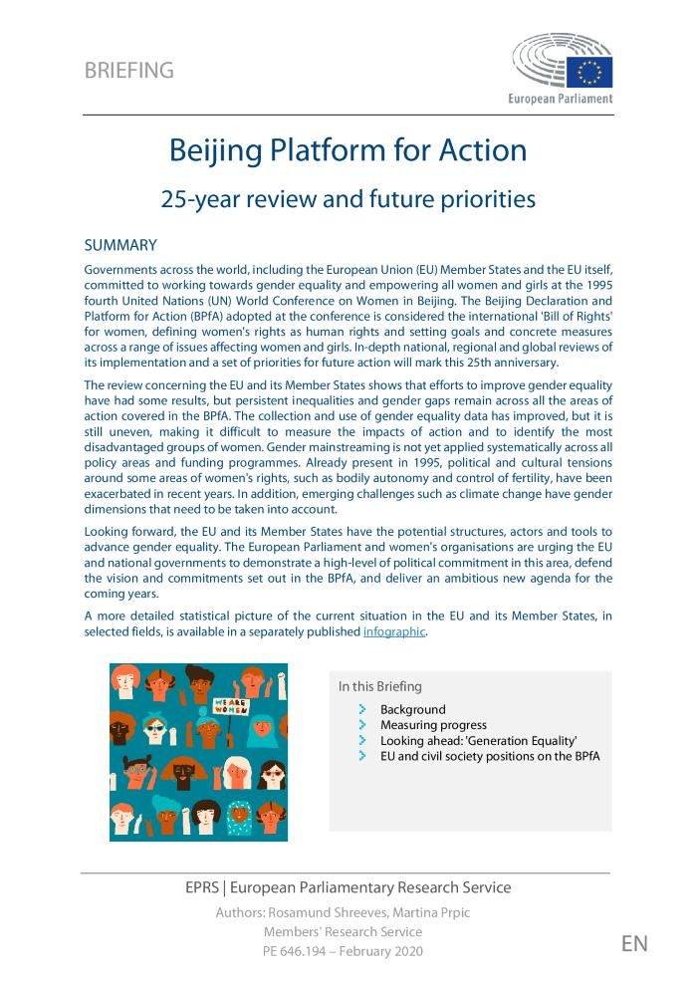
Beijing Platform for Action: 25-year review and future priorities (c:amaz:14751)

Slide 5

Vingt-cinquième anniversaire de la quatrième conférence mondiale sur les femmes et de l'adoption de la Déclaration et du Programme d'action de Beijing (1995). Note d'orientation concernant les examens approfondis au niveau national : BELGIQUE (c:amaz:14725)

Slide 6
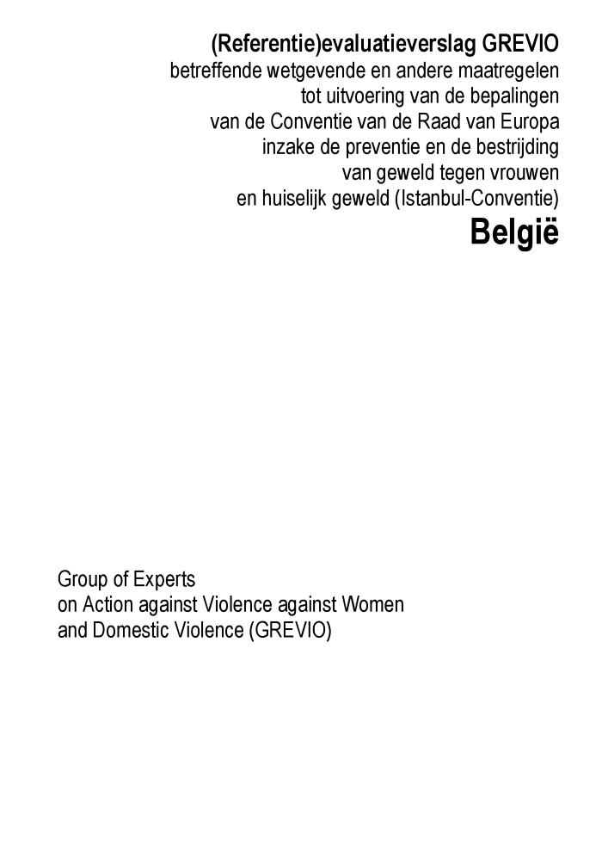
(Referentie)evaluatieverslag GREVIO betreffende wetgevende en andere maatregelen tot uitvoering van de bepalingen van de Conventie van de Raad van Europa inzake de preventie en de bestrijding van geweld tegen vrouwen en huiselijk geweld (Istanbul-Conventie). België [GREVIO/Inf(2020)10. Goedgekeurd op 26 juni 2020. Gepubliceerd op 21 september 2020] (c:amaz:14594)

Slide 7
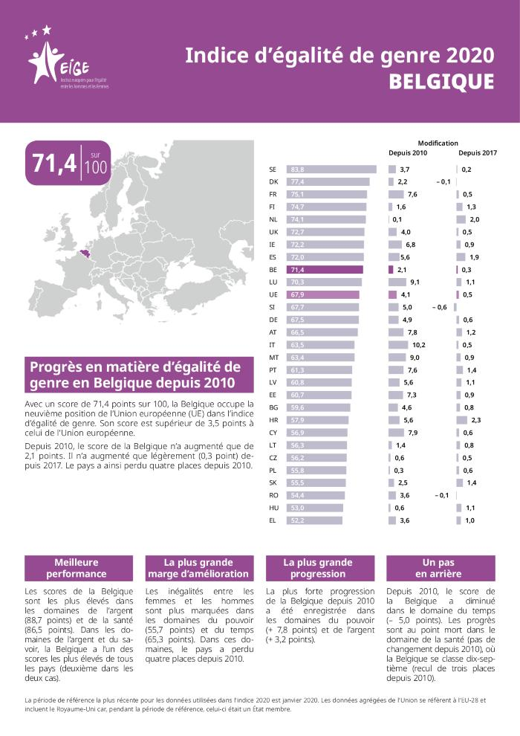
Indice d'égalité de genre 2020 : Belgique (c:amaz:14536)

Slide 8
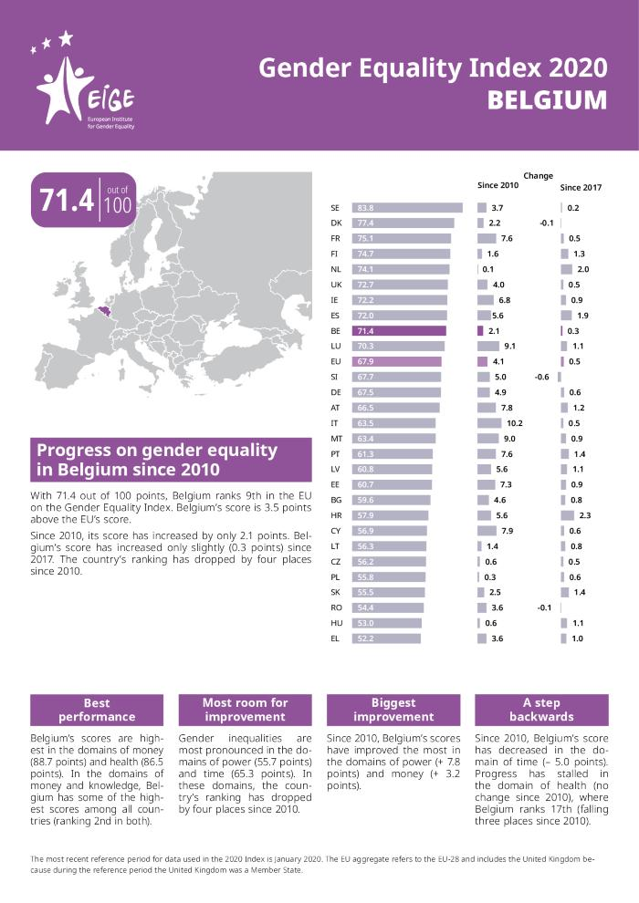
Gender Equality Index 2020: Belgium (c:amaz:14535)

Slide 9
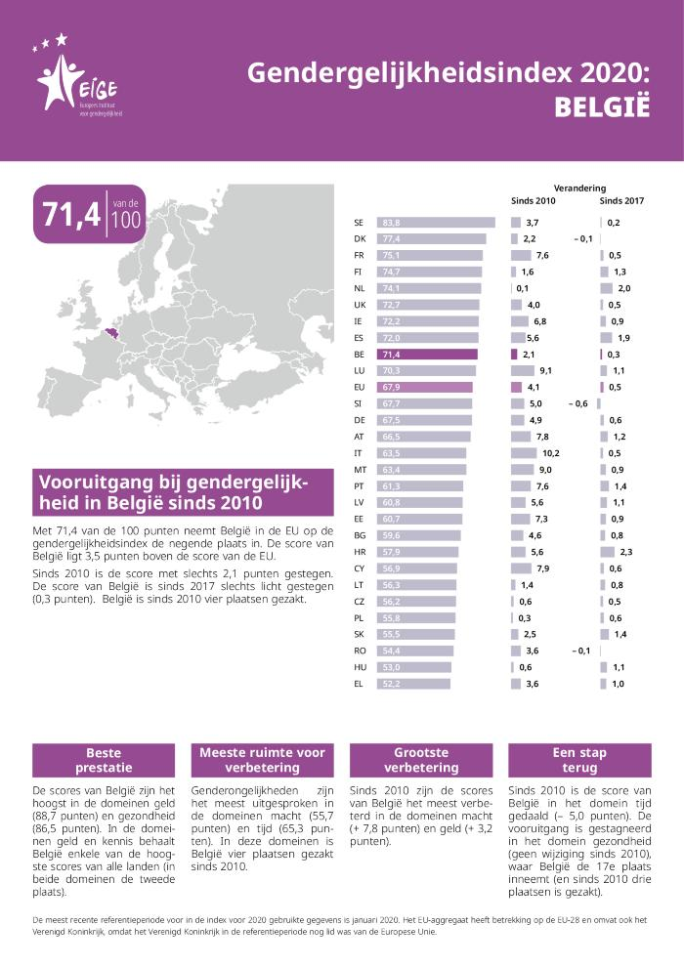
Gendergelijkheidsindex 2020: België (c:amaz:14534)

Slide 10

Commentaires soumis par la Belgique sur le rapport final du GREVIO sur la mise en oeuvre de la Convention du Conseil de l'Europe sur la prévention et la lutte contre la violence à l'égard des femmes et la violence domestique (Rapport de référence) [Réceptionnés par le GREVIO le 11 septembre 2020 GREVIO/Inf(2020)16] (c:amaz:14435)

Slide 11
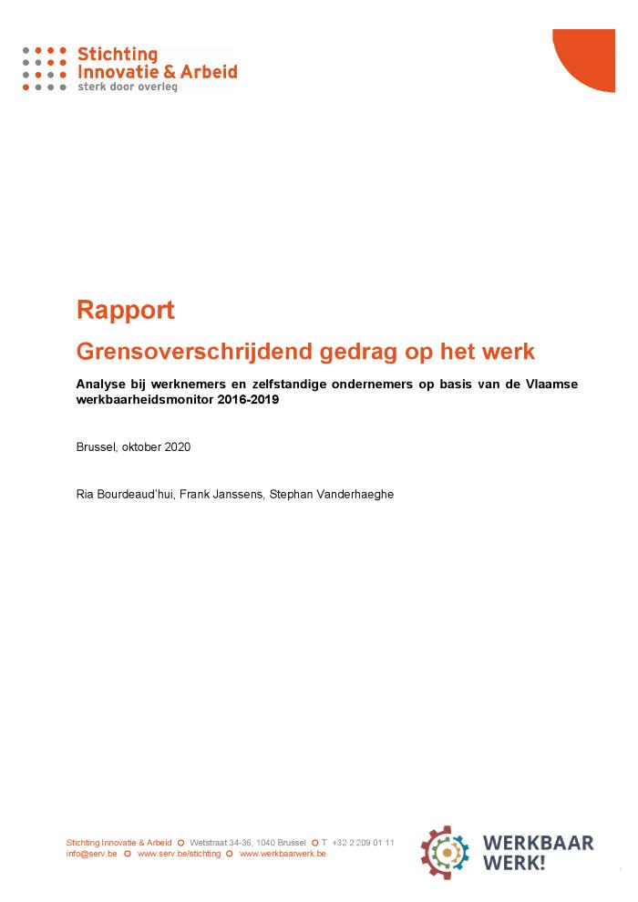
Grensoverschrijdend gedrag op het werk: analyse bij werknemers en zelfstandige ondernemers op basis van de Vlaamse werkbaarheidsmonitor 2016-2019: rapport (c:amaz:14423)

Slide 12
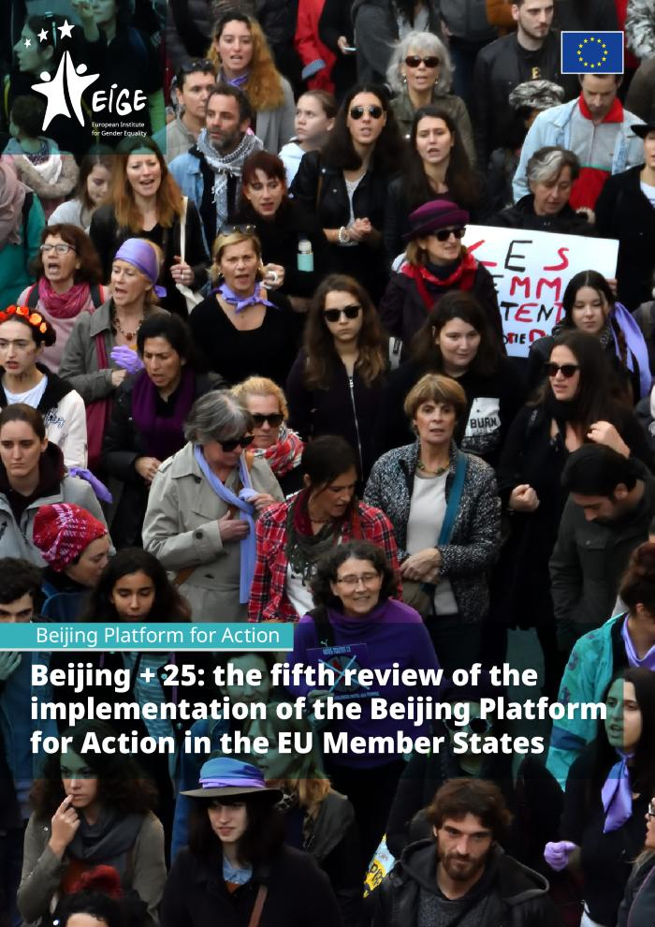
Beijing + 25: the fifth review of the implementation of the Beijing Platform for Action in the EU Member States (c:amaz:14411)
Although the Beijing Platform for Action (BPfA) was established 25 years ago, many of the challenges identified in 1995 remain relevant today (such as the gender pay gap, unequal distribution of unpaid work or experiences of gender-based violence, to name just a few). This report both tracks progress against these long-standing challenges and goes beyond them to assess new challenges that have emerged in recent years, including those brought by digitalisation, recent migration flows and a mounting backlash against gender equality. The report is the fifth review of the overall developments at EU level related to the 12 BPfA areas of concern. The report focuses particularly on trends and developments observed since 2013, picking up where the last such review (Beijing + 20, review period 2007-2012) left off. The report covers research and policy developments only up to March 2019, with a few exceptions in cases where important EU-level developments have happened more recently (such as the coming into force of the WorkLife Balance Directive or the recent elections to the European Parliament).

Slide 13

Justice for women amidst COVID-19 (c:amaz:14339)
The COVID-19 pandemic has created a global emergency of multiple dimensions.
Most national governments have adopted extraordinary measures to protect their citizens
and overcome the pandemic. Prior to the COVID-19 global crisis, 2020 was expected to be a year for reviewing achievements and accelerating progress on gender equality after 25 years of the adoption of the Beijing Declaration and Platform for Action and 20 years since UN Security Council resolution 1325 on women, peace and security. There is now major concern that COVID-19 and its impact will push back fragile progress on gender equality, including in relation to reversing discriminatory laws, the enactment of new laws, the implementation of existing legislation, and broader progress needed to achieve justice for all. This rapid assessment examines how the impacts of COVID-19 are threatening women's ability to access justice. The assessment reflects challenges faced by women and girls of diverse backgrounds and socio-economic groups, including those experiencing overlapping disadvantages for example, women on the front lines and those facing amplified challenges in humanitarian settings. Cross-regional and local experiences are highlighted, and quantitative data is utilized where available. Past epidemics are informative and sobering in terms of risks for women and offer lessons about how to prevent and mitigate these risks. [Source: website: www.unwomen.org/en/digital-library/publications/2020/05/justice-for-women-amidst
-covid-19#:>~:text=Past%20epidemics%20are%20informative%E2%80%94
and,prevent%20and%20mitigate%20these%20risks]

Slide 14

1st General report on GREVIO's activities : covering the period from June 2015 to May 2019 (c:amaz:14300)
This First General Report on the activities of the Group of Experts on Action against Violence against Women and Domestic Violence (GREVIO) covers the period from September 2015 to May 2019 and provides a comprehensive summary of the results of GREVIOs first eight reports as well as the findings emerging from final draft reports adopted as of May 2019

Slide 15

GREVIO's (Baseline) Evaluation Report on legislative and other measures giving effect to the provisions of the Council of Europe Convention on Preventing and Combating Violence against Women and Domestic Violence (Istanbul Convention). Belgium [GREVIO Baseline Evaluation Report. Belgium. Adopted by GREVIO on 26 June 2020. Published on 21 September 2020] (c:amaz:14299)

Slide 16
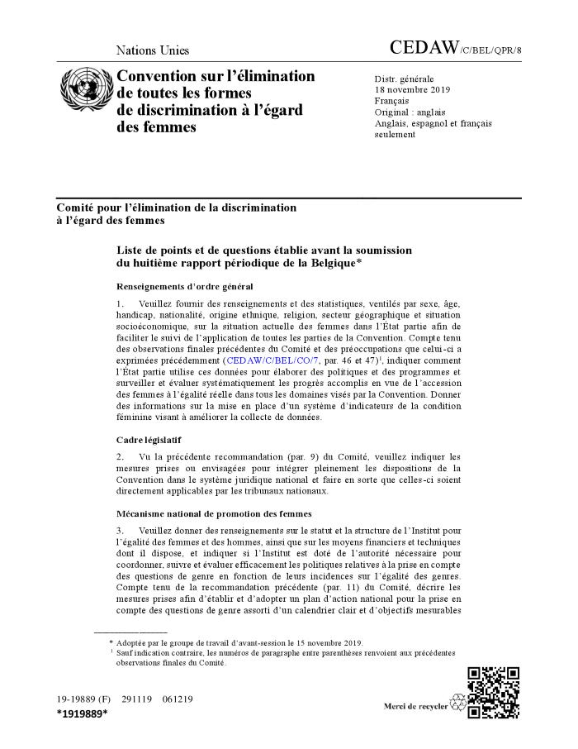
Liste de points et de questions établie avant la soumission du huitième rapport périodique de la Belgique (c:amaz:14280)

Slide 17
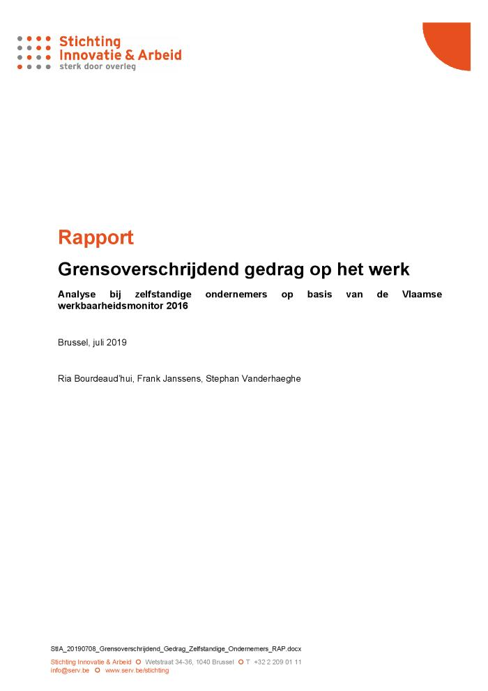
Grensoverschrijdend gedrag op het werk : analyse bij zelfstandige ondernemers op basis van de Vlaamse werkbaarheidsmonitor 2016 : rapport (c:amaz:14248)
In het eerste deel van dit rapport wordt nagegaan hoeveel zelfstandige ondernemers in Vlaanderen het slachtoffer werden van grensoverschrijdend gedrag tijdens het werk. Het kan hierbij gaan om lichamelijk geweld, ongewenst seksueel gedrag, pestgedrag of intimidatie/bedreiging tijdens het werk. De situatie wordt bekeken van de zelfstandige ondernemers ook met deze van de werknemers. In het tweede deel van het rapport wordt bekeken welke verschillen er zijn in de blootstelling aan grensoverschrijdend gedrag tijdens het werk naar een aantal persoonskenmerken (geslacht, leeftijd, opleidingsniveau, gezinssituatie), kenmerken van het werk en de sector.

Slide 18
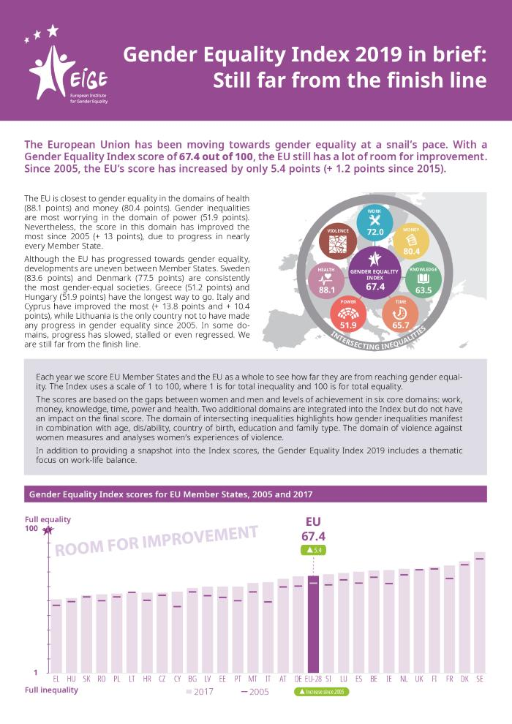
Gender Equality Index 2019 in brief: still far from the finish line (c:amaz:14206)

Slide 19
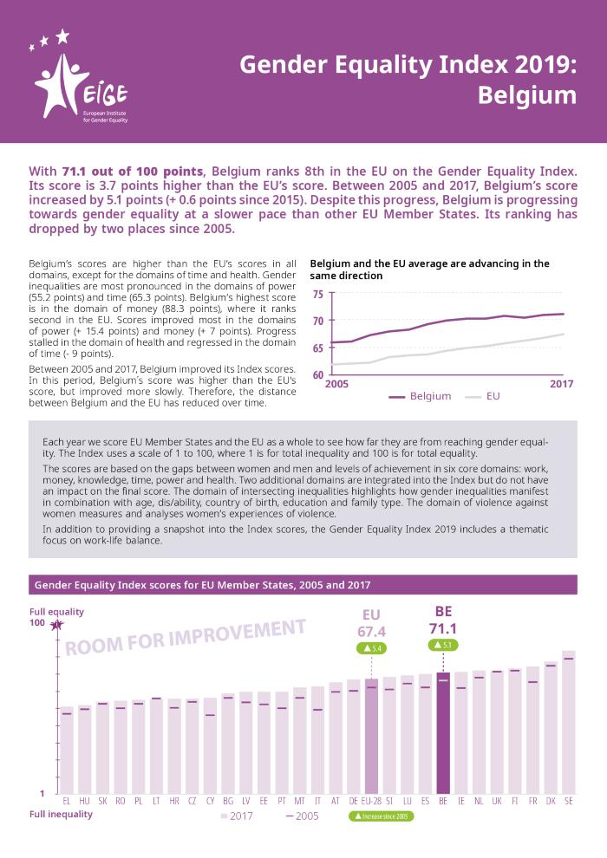
Gender equality index 2019. Belgium (c:amaz:14205)

Slide 20
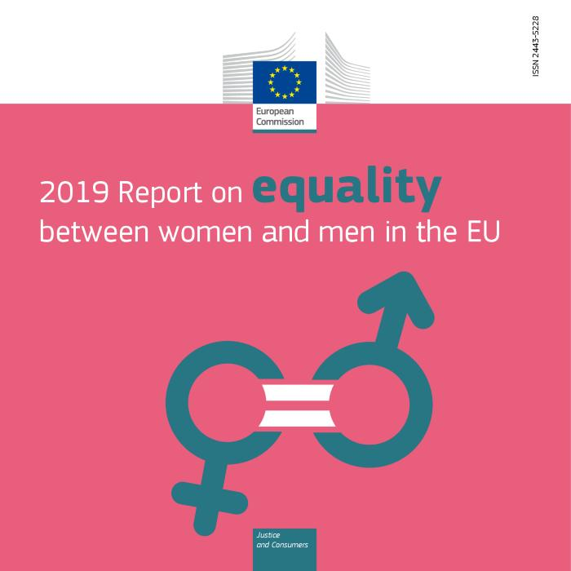
2019 Report on equality between women and men (c:amaz:14040)

Slide 21

Rapport soumis par la Belgique donnant effet aux dispositions de la Convention du Conseil de l'Europe sur la prévention et la lutte contre la violence à l'égard des femmes et la violence domestique conformément à l'article 1, paragraphe 68 (Rapport de référence) [Réceptionné par le GREVIO le 18 février 2019 GREVIO/Inf(2019)4] (c:amaz:14019)

Slide 22
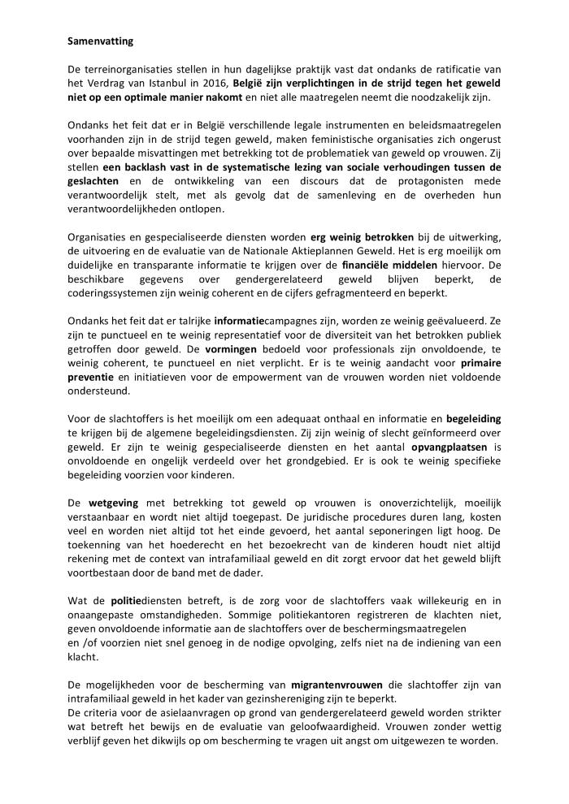
Évaluation de la mise en oeuvre de la Convention du Conseil de l'Europe sur la prévention et la lutte contre la violence à l'égard des femmes et la violence domestique par la Belgique: samenvatting [Rapport alternatif de la coalition « Ensemble contre les violences »] (c:amaz:14013)

Slide 23
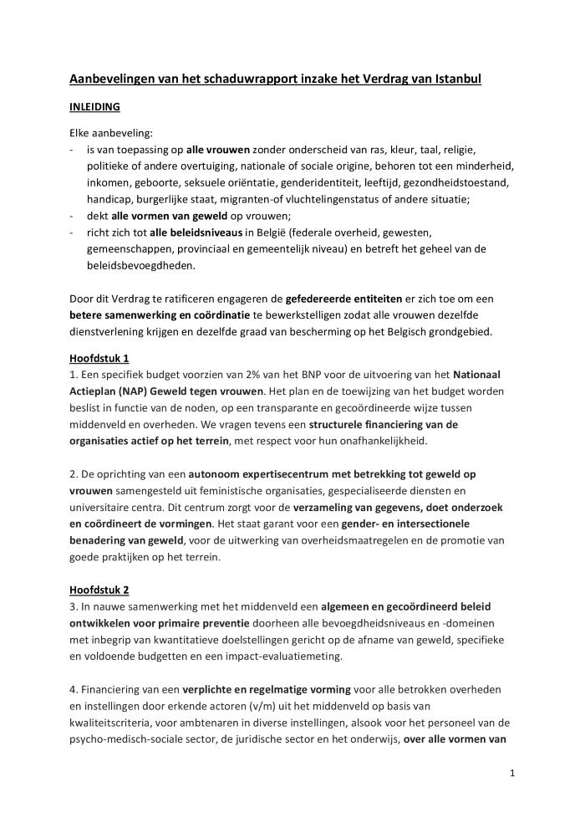
Aanbevelingen van het schaduwrapport inzake het Verdrag van Istanbul: [10 punten] [Alternatief rapport van het feministisch collectief « Ensemble contre les violences »] (c:amaz:14012)

Slide 24
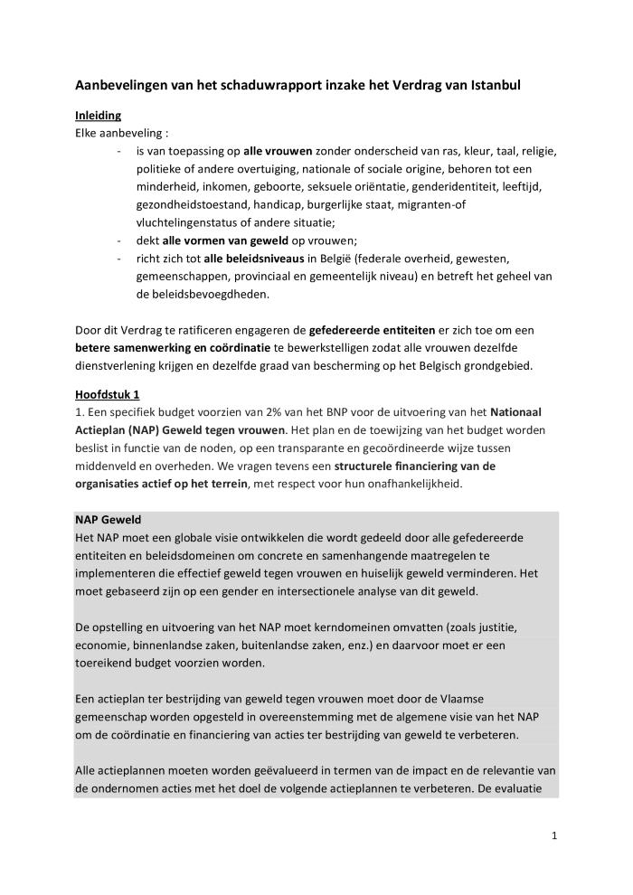
Aanbevelingen van het schaduwrapport inzake het Verdrag van Istanbul [Alternatief rapport van het feministisch collectief « Ensemble contre les violences »] (c:amaz:14011)

Slide 25

Évaluation de la mise en oeuvre de la Convention du Conseil de l'Europe sur la prévention et la lutte contre la violence à l'égard des femmes et la violence domestique par la Belgique [Rapport alternatif de la coalition « Ensemble contre les violences »] (c:amaz:13995)

Slide 26

Femmes et espaces publics [Pour l'égalité entre les femmes et les hommes dans la rue, les transports et les espaces de loisirs] (c:amaz:14128)

Slide 27

Zo man, zo vrouw ? : gender en de creatieve sector in Vlaanderen (c:amaz:13952)

Slide 28

Violence at work (c:amaz:13946)

Slide 29

Global Wage Report 2018 / 19 : what lies behind gender pay gaps (c:amaz:13878)

Slide 30

Emploi et questions sociales dans le monde : tendances pour les femmes 2018 (Résumé analytique) (c:amaz:13873)

Slide 31

Emploi et questions sociales dans le monde : tendances pour les femmes 2018 (Aperçu global) (c:amaz:13872)

Slide 32
Les enfants migrants et refugiés en Belgique prennent la parole : What Do You Think ? (c:amaz:13570)
"What Do You Think?" veut donner une voix aux enfants vulnérables. En 1999, UNICEF Belgique a lancé cette initiative daans le but de faire entendre au plus haut niveau la voix des enfants et des jeunes les plus vulnérables.

Slide 33
Migranten- en vluchtelingenkinderen in België aan het woord : What Do You Think ? (c:amaz:13543)
"What Do You Think?" wil kwetsbare kinderen een stem geven. In 1999 ging UNICEF België met dit initiatief van start om de meest kwetsbare kinderen en jongeren aan het woord te laten. UNICEF België zorgt ervoor dat de kinderen tot op het hoogste niveau en door het Kinderrechtencomité worden gehoord.

Slide 34

Methodiekenboek: alleenstaande moeders begeleiden in het OCMW (c:amaz:13373)

Slide 35
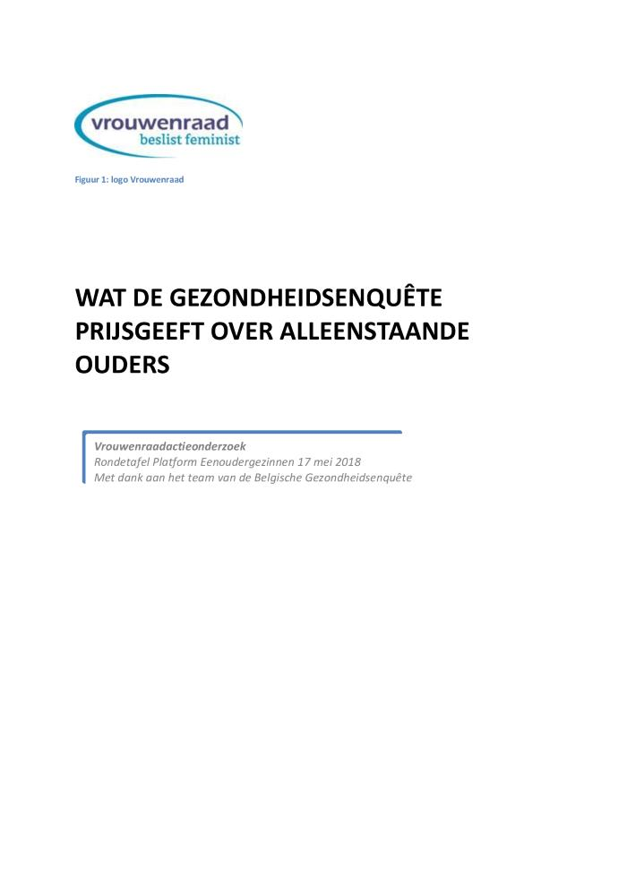
Wat de gezondheidsenquête prijsgeeft over alleenstaande ouders: Vrouwenraadactieonderzoek Rondetafel Platform Eenoudergezinnen 17 mei 2018 (c:amaz:13342)

Slide 36
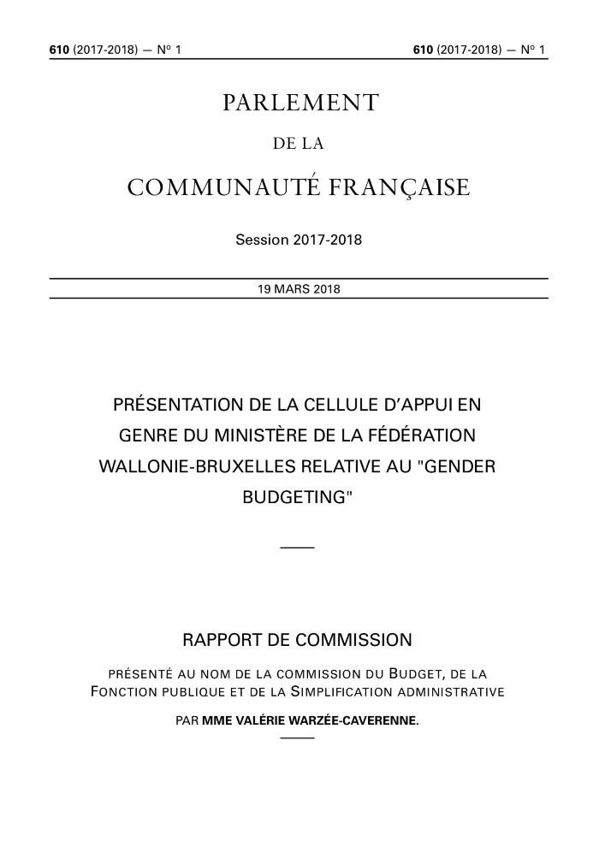
Présentation de la Cellule d'appui en genre du Ministère de la Fédération Wallonie-Bruxelles relative au "gender budgeting" [Rapport de Commission présenté au nom de la Commission du budget, de la Fonction publique et de la Simplification administrative] (c:amaz:13257)

Slide 37

Regards croisés : rapport bruxellois sur l'état de la pauvreté 2016. (c:amaz:14118)

Slide 38

Aperçus du non-recours aux droits sociaux et de la sous-protection sociale en Région bruxelloise: rapport bruxellois sur l'état de la pauvreté 2016. (c:amaz:14116)

Slide 39

Inzichten in non take-up van de sociale rechten en in sociale onderbescherming in het Brussels Gewest : Brussels armoederapport 2016. (c:amaz:14095)

Slide 40

Gekruiste blikken : Brussels armoederapport 2016. (c:amaz:14094)

Slide 41

The state of the world's children 2017 : children in a digital world (c:amaz:13985)

Slide 42

The state of the world's children 2017 : children in a digital world (Summary) (c:amaz:13984)

Slide 43

La situation des enfants dans le monde 2017 : Les enfants dans un monde numérique (Résumé) (c:amaz:13983)

Slide 44

Vers un meilleur avenir pour les femmes au travail : Ce qu'en pensent les femmes et les hommes (c:amaz:13881)

Slide 45

Emploi et questions sociales dans le monde : tendances pour les femmes 2017 (c:amaz:13871)

Slide 46

Rapport mondial sur les salaires 2016/2017 : les inégalités salariales au travail (c:amaz:13870)

Slide 47

Gender equality global report & ranking : 2017 Edition (c:amaz:13864)

Slide 48

Trans legal mapping report : recognition before the law 2017 (c:amaz:13852)

Slide 49
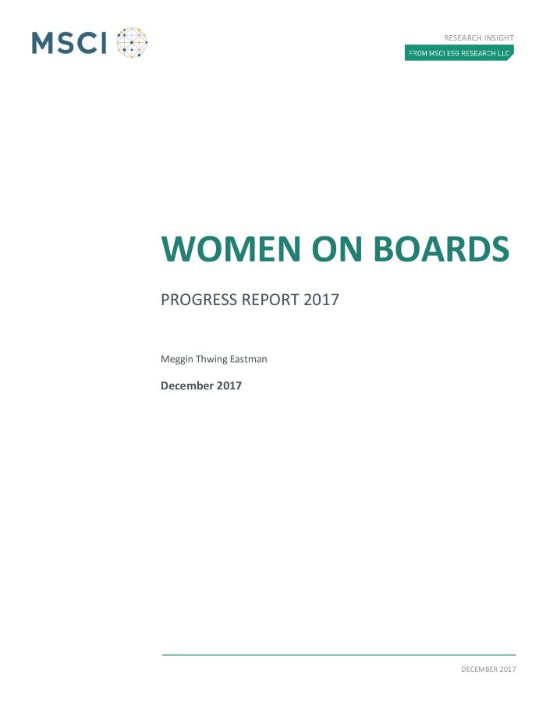
Women on boards : progress report 2017 (c:amaz:13844)

Slide 50

Discrimination and access to employment for female workers with disabilities : study for the EMPL Committee (c:amaz:13839)

Slide 51
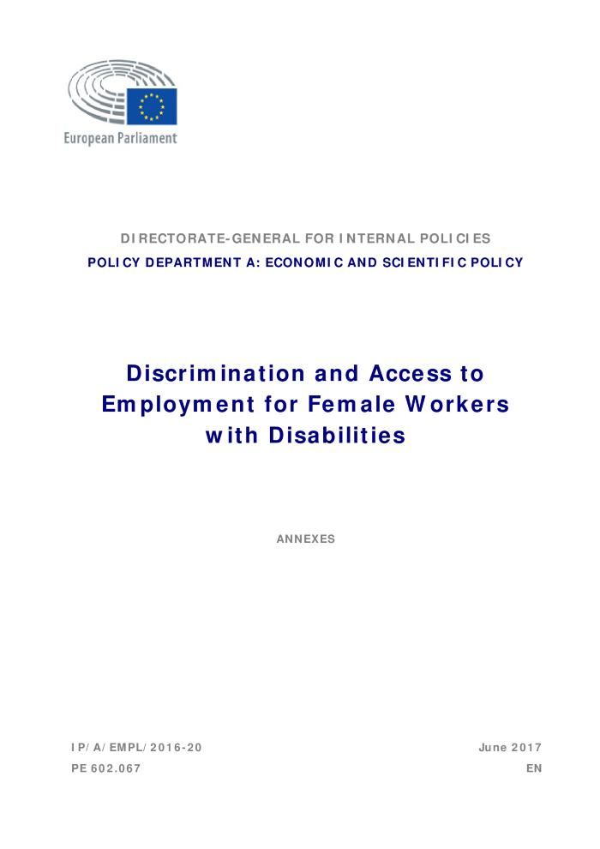
Discrimination and access to employment for female workers with disabilities : annexes (c:amaz:13837)

Slide 52
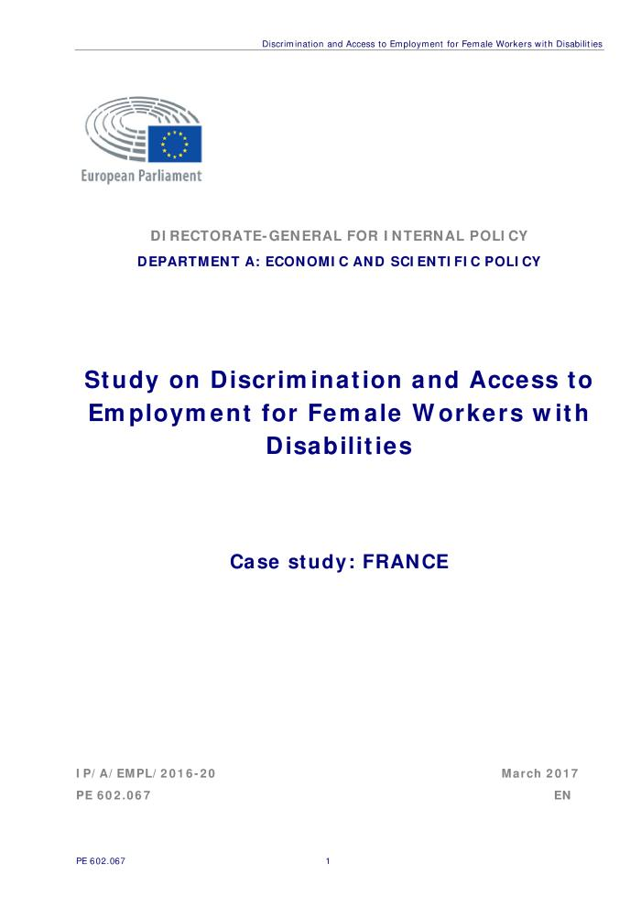
Discrimination and access to employment for female workers with disabilities : case study : France (c:amaz:13836)

Slide 53

Discrimination and access to employment for female workers with disabilities : case study : Denmark (c:amaz:13835)

Slide 54

Discrimination and access to employment for female workers with disabilities : case study : Germany (c:amaz:13833)

Slide 55

Discrimination and access to employment for female workers with disabilities : case study : United Kingdom (c:amaz:13832)

Slide 56
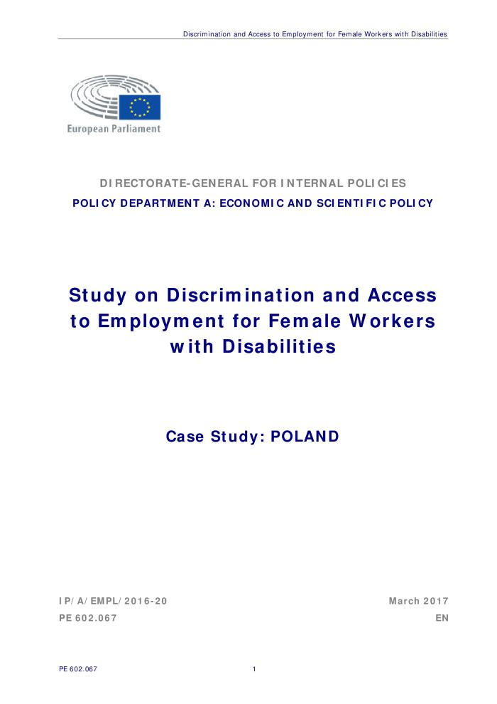
Discrimination and access to employment for female workers with disabilities : case study : Poland (c:amaz:13830)

Slide 57
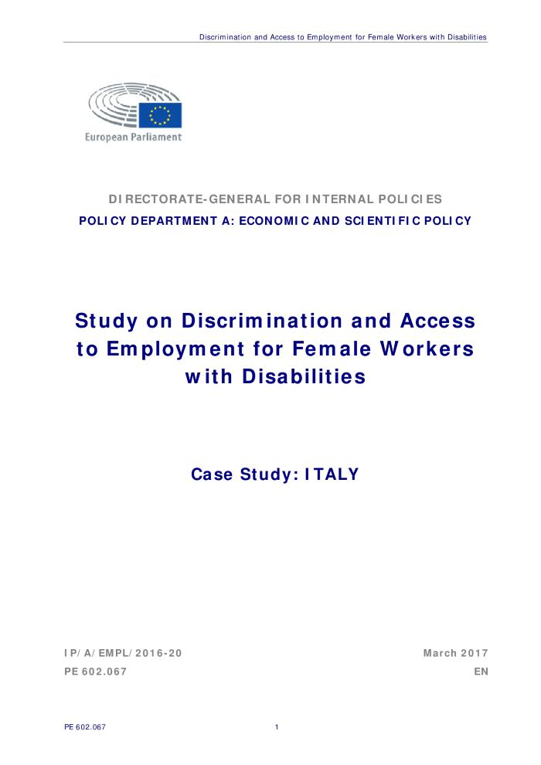
Discrimination and access to employment for female workers with disabilities : case study : Italy (c:amaz:13829)

Slide 58
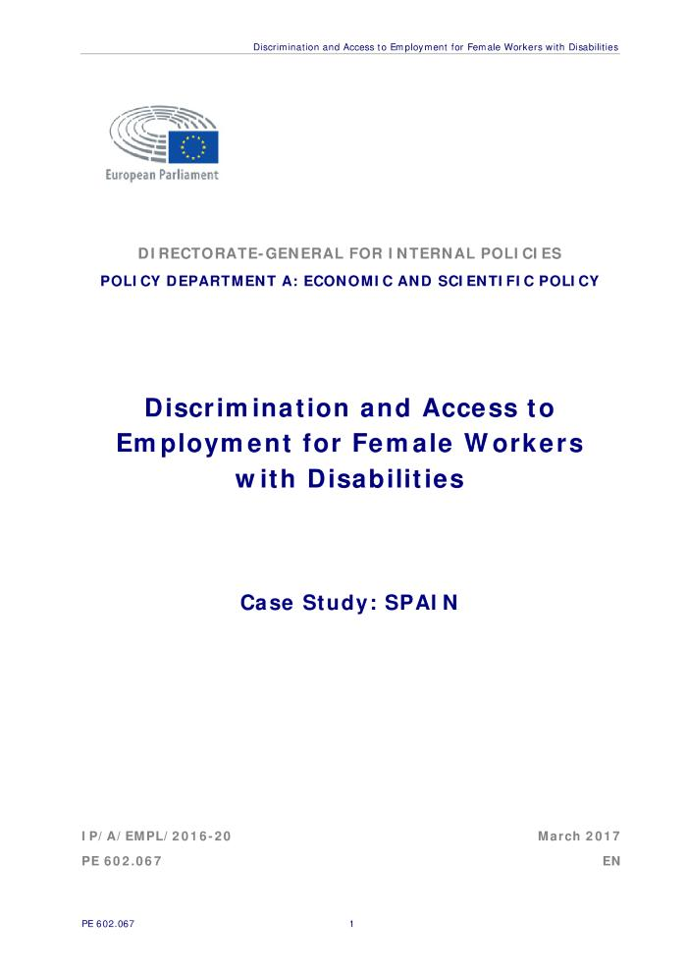
Discrimination and access to employment for female workers with disabilities : case study : Spain (c:amaz:13827)

Slide 59

Women in the boardroom : A global perspective (c:amaz:13822)

Slide 60
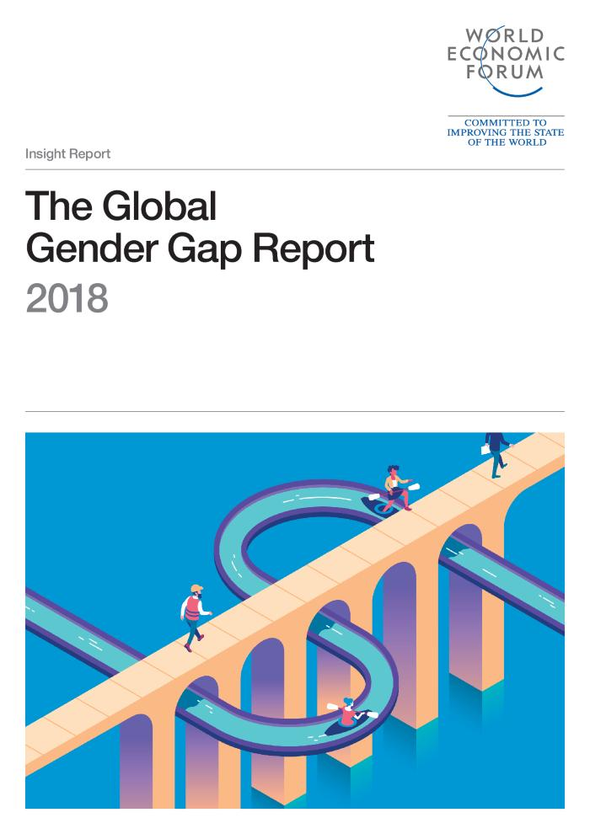
The Global Gender Gap : report 2018 (c:amaz:13805)

Slide 61

Miriam : empowerment des femmes monoparentales au CPAS : Rapport final décembre 2017 (c:amaz:13796)

Slide 62
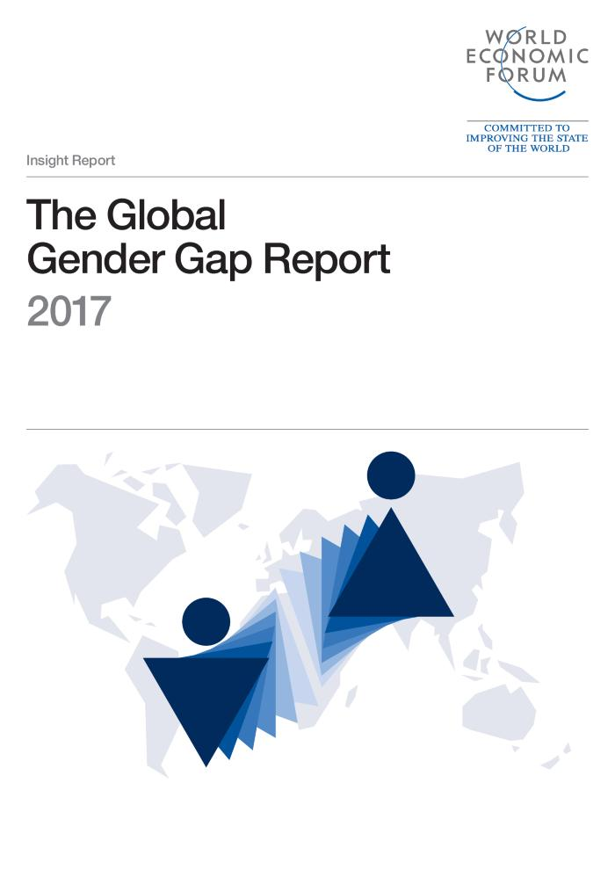
The Global Gender Gap : report 2017 (c:amaz:13765)

Slide 63

Terminology and indicators for data collection : Rape, femicide and intimate partner violence [Report] (c:amaz:13685)
The scope of the report is on reported violence obtained through administrative data sources, as they are the most relevant for assessing institutions response to violence against women. The report focuses on improving administrative data collection on the three most serious forms of violence against women: rape, femicide and intimate partner violence. The main sectors considered are police and justice, as they hold the highest potential to improve the availability and comparability of data on these forms of violence among Member States. [Source: website EIGE]

Slide 64
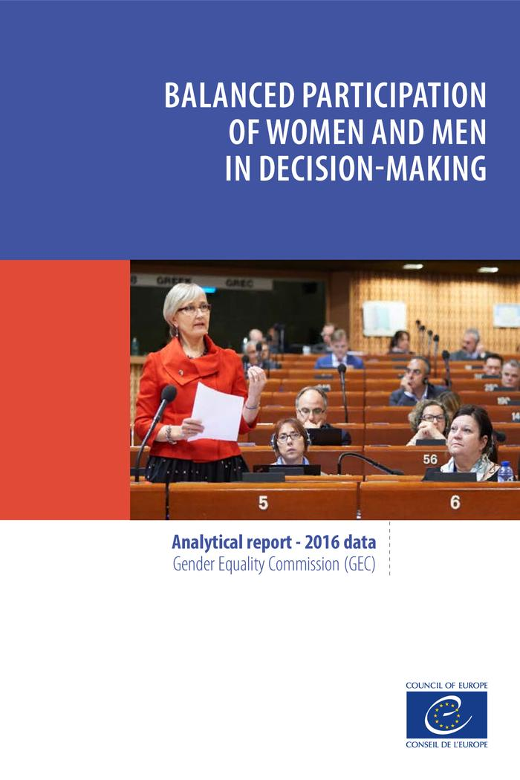
(c:amaz:13637)

Slide 65
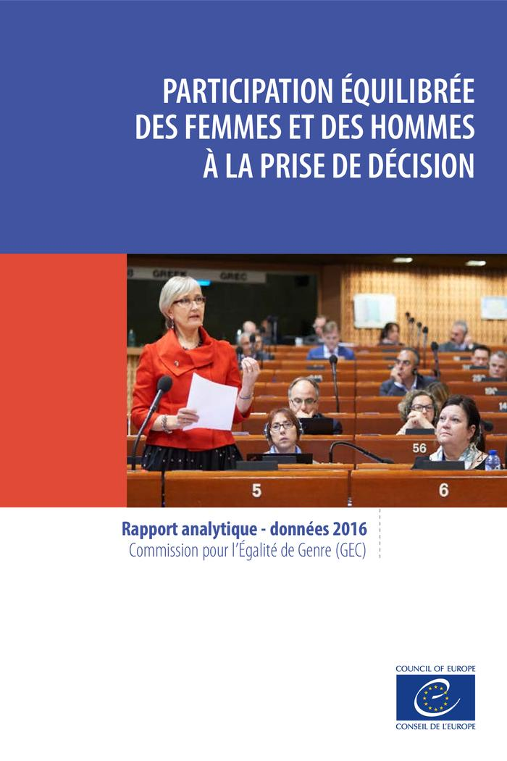
(c:amaz:13636)

Slide 66

Miriam: empowerment van alleenstaande moeders in het OCMW: eindrapport december 2017 (c:amaz:13341)

Slide 67
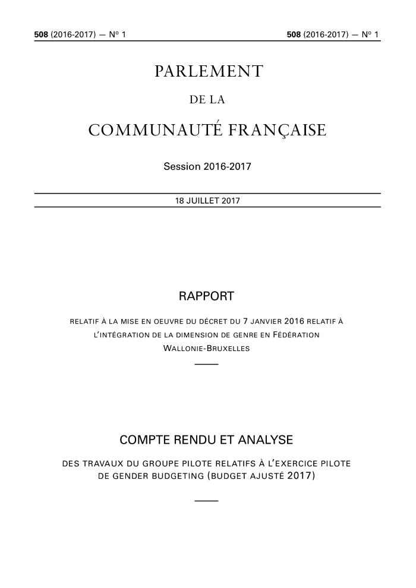
Rapport relatif à la mise en oeuvre du décret du 7 janvier 2016 relatif à l'intégration de la dimension de genre en Fédération Wallonie-Bruxelles [Compte rendu et analyse des travaux du groupe pilote relatifs à l'exercice pilote de gender budgeting (budget ajusté 2017)] (c:amaz:13259)

Slide 68
Gender equality index 2017 [infographics]: gender equality at a snail's pace (c:amaz:13174)
The Gender Equality Index is a composite indicator that measures the complex concept of gender equality and, based on the EU policy framework, assists in monitoring progress of gender equality across the EU over time.

Slide 69
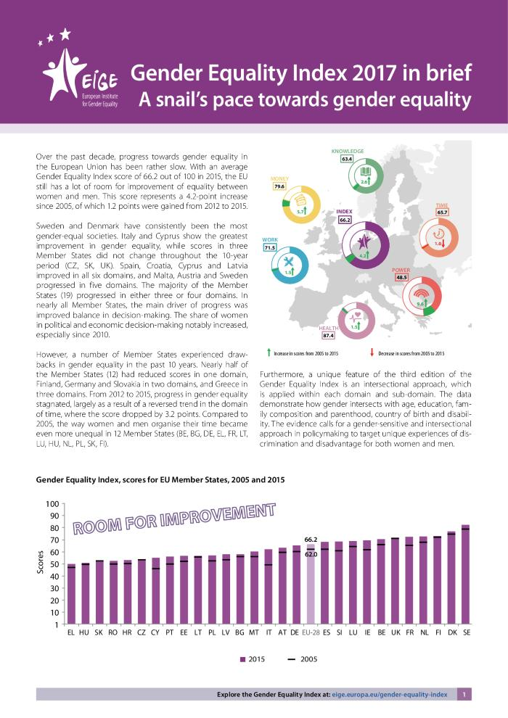
Gender equality index 2017 in brief: a snail's pace towards gender equality (c:amaz:13170)
Gender equality is a fundamental value of the European Union and is essential for its development, growth and cohesion. As such, measuring progress in gender equality is an integral part of effective policymaking. Since its launch in 2013, the Gender Equality Index of the European Institute for Gender Equality (EIGE) has been recognised for its notable contribution to policy debates and increased awareness about gender equality at the EU and national levels. The Gender Equality Index is a composite indicator that measures the complex concept of gender equality. It is a comprehensive measure for assessing the state of art and monitoring progress in gender equality across the EU over time. The Index relies on a conceptual framework that embraces different theoretical approaches to gender equality and integrates key gender equality issues within the EU policy framework (EIGE, 2013). It offers an easy-to-interpret measure for gender equality, indicating how far (or close) the EU and its Member States are from achieving gender equality. To this end, it measures gender gaps and takes into account the context and different levels of achievement of Member States.

Slide 70

Gender equality index 2017 : measuring gender equality in the European Union 2005 - 2015 : main findings (c:amaz:13169)
Gender equality is a fundamental value of the European Union and is essential for its development, growth and cohesion. As such, measuring progress in gender equality is an integral part of effective policymaking. Since its launch in 2013, the Gender Equality Index of the European Institute for Gender Equality (EIGE) has been recognised for its notable contribution to policy debates and increased awareness about gender equality at the EU and national levels. The Gender Equality Index is a composite indicator that measures the complex concept of gender equality. It is a comprehensive measure for assessing the state of art and monitoring progress in gender equality across the EU over time. The Index relies on a conceptual framework that embraces different theoretical approaches to gender equality and integrates key gender equality issues within the EU policy framework (EIGE, 2013). It offers an easy-to-interpret measure for gender equality, indicating how far (or close) the EU and its Member States are from achieving gender equality. To this end, it measures gender gaps and takes into account the context and different levels of achievement of Member States. Since the Index considers gaps that are to the detriment of either women or men as being equally problematic, a high overall score reflects both small (or absent) gender gaps and a good situation for all (e.g. good quality of work of both women and men). Finally, it suggests the different outcomes of EU and national policies for women and men and supports the development and implementation of evidence-based policymaking in the area of gender equality.

Slide 71

Gender equality index 2017 : measuring gender equality in the European Union 2005 - 2015 : report (c:amaz:13168)
This report documents the third edition of the Gender Equality Index of the European Institute for Gender Equality (EIGE). Since its launch in 2013, the Gender Equality Index has been recognised for its notable contribution to policy debates and increased awareness about gender equality at the EU and national levels. The Index is a comprehensive measure for assessing the state of the art and monitoring progress in gender equality across the EU over time. The third edition provides scores for 2005, 2010, 2012 and 2015. It relies on a conceptual framework that embraces different theoretical approaches to gender equality and integrates key gender equality issues within the EU policy framework. The Index measures gender gaps and takes into account the context and different levels of achievement of Member States within a range of relevant policy areas: work, money, knowledge, time, power and health. Additionally, it gives insights into violence against women and intersecting inequalities. It shows the different outcomes of EU and national policies for women and men and supports the development and implementation of evidence-based policymaking in the area of gender equality.

Slide 72
The pursuit of gender equality: an uphill battle (c:amaz:13164)
Gender inequalities persist in all areas of social and economic life and across countries. Young women in OECD countries generally obtain more years of schooling than young men, but women are less likely than men to engage in paid work. Gaps widen with age, as motherhood typically has marked negative effects on gender pay gaps and career advancement. Women are also less likely to be entrepreneurs, and are underrepresented in private and public leadership positions. The 2013 and 2015 OECD Gender Recommendations provide guidance on how to advance gender equality in education, employment, entrepreneurship and public life; this book discusses recent developments in these areas in one overview chapter and 24 short chapters which each include key findings and policy recommendations. Topics include violence against women, gender budgeting, the unequal sharing of unpaid work, labour market outcomes and migration. The book presents a range of indicators illustrating gender gaps. It also discusses recent policy initiatives, such as pay transparency measures to reduce gender wage gaps and policy reform aimed at fathers taking parental leave. Overall, progress has been slow and there is a strong need for further policy action to close gender gaps in education, employment, entrepreneurship and public life.

Slide 73
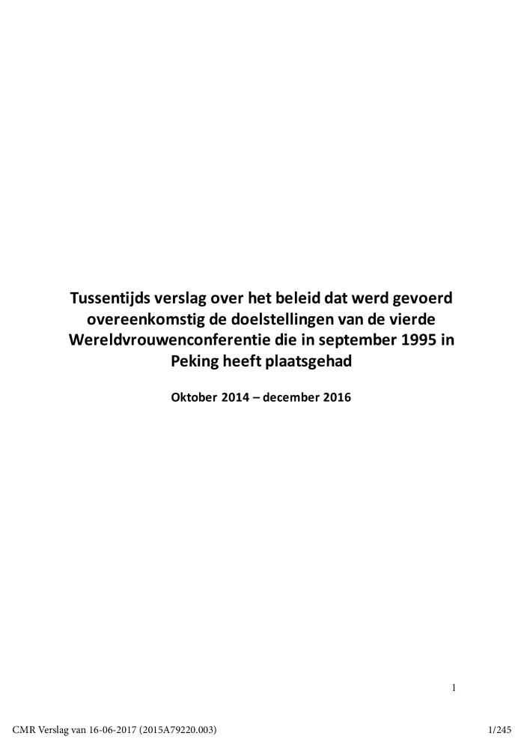
Tussentijds verslag over het beleid dat werd gevoerd overeenkomstig de doelstellingen van de vierde Wereldvrouwenconferentie die in september 1995 in Peking heeft plaatsgehad, oktober 2014 - december 2016 (c:amaz:13045)

Slide 74

Report on equality between women and men 2015 (c:amaz:7961)

Slide 75

Mapping of NGOs working for women's rights in selected EU member states (c:amaz:7952)

Slide 76
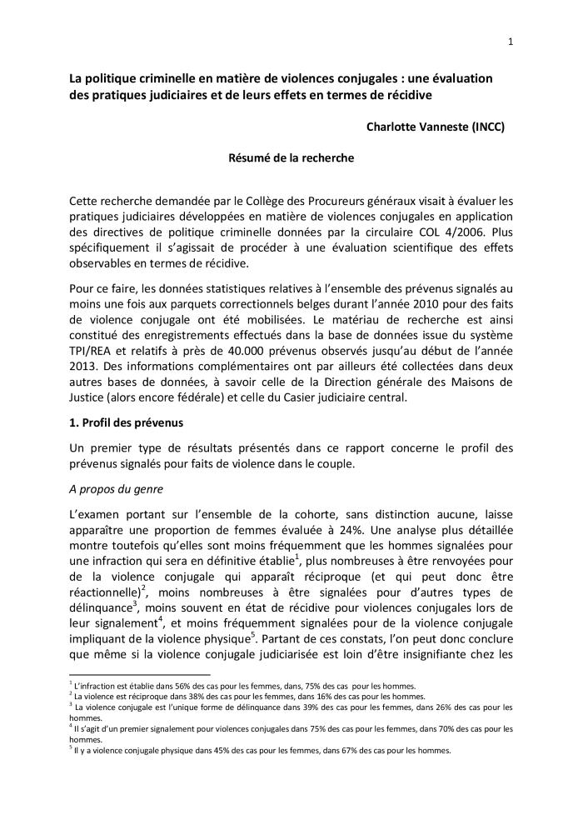
La politique criminelle en matière de violences conjugales : une évaluation des pratiques judiciaires et de leurs effets en termes de récidive (résumé) (c:amaz:13990)

Slide 77

La politique criminelle en matière de violences conjugales : une évaluation des pratiques judiciaires et de leurs effets en termes de récidive (Rapport finale) (c:amaz:13989)

Slide 78
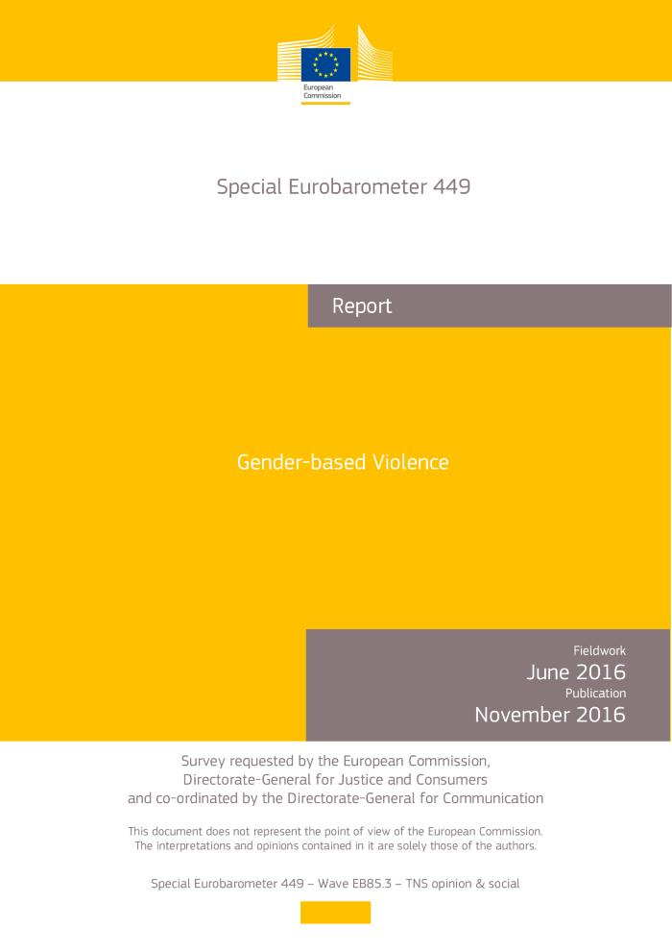
Special Eurobarometer 449 : gender-based violence (Report) (c:amaz:13923)

Slide 79

Le coût économique des discriminations (c:amaz:13886)

Slide 80

Emploi et questions sociales dans le monde : tendances pour 2016 : résumé et évolution de l'emploi et des questions sociales dans le monde (c:amaz:13879)

Slide 81

Les femmes au travail : tendances 2016 (c:amaz:13874)

Slide 82

Women, business and the law 2016 : getting to equal (c:amaz:13849)

Slide 83

Rapport : L'emploi des femmes en situation de handicap (c:amaz:13806)

Slide 84

Miriam : empowerment de femmes en situation de monoparentalité au CPAS : Rapport final décembre 2016 (c:amaz:13795)

Slide 85
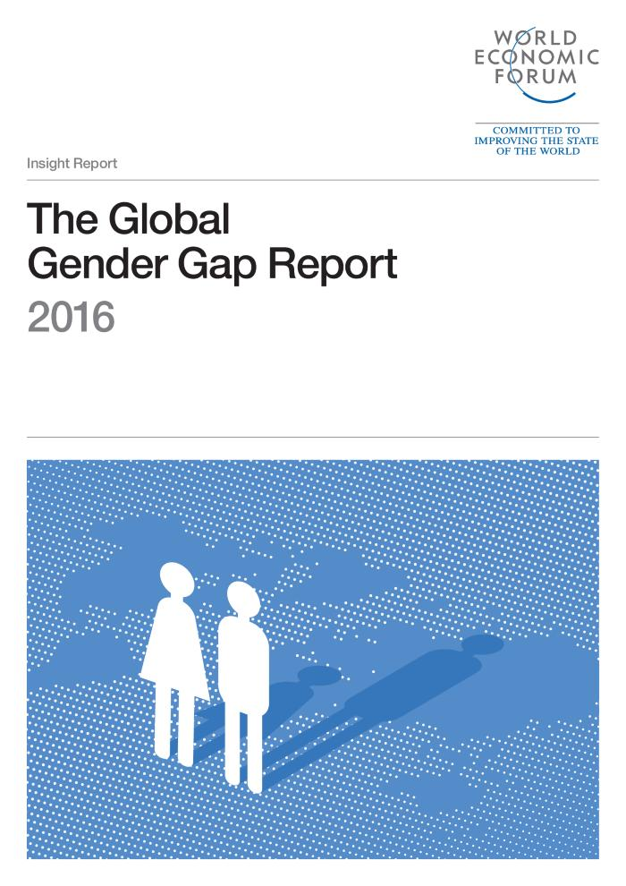
The Global Gender Gap : report 2016 (c:amaz:13762)

Slide 86

Derrière l'écran : où sont les femmes ? Les femmes dans l'industrie cinématographique en Fédération Wallonie-Bruxelles (c:amaz:13562)

Slide 87

Miriam: empowerment van alleenstaande moeders in het OCMW: eindrapport december 2016 (c:amaz:13348)

Slide 88

Anders gaan werken: vrouwen met een migratieachtergrond op de Vlaamse arbeidsmarkt (c:amaz:13254)
Een actieonderzoek naar de arbeidsmarktsituatie van migrantenvrouwen in Vlaanderen, vertrekkend van de vrouwen zelf.

Slide 89

Vrouwen, bestaansonzekerheid en armoede in het Brussels Gewest : Brussels armoederapport 2014 : samenvatting (c:amaz:12610)

Slide 90

Etude du parcours du stagiaire après sa formation (c:amaz:7933)

Slide 91

Le rapport thématique : femmes, précarités et pauvreté en Région bruxelloise : parcours de vie, parcours d'aide (c:amaz:7892)

Slide 92

Het thematische rapport : vrouwen, bestaansonzekerheid en armoede in het Brussels Gewest (c:amaz:7891)

Slide 93
De Vlaamse overheid kleurt regenboog : onderzoek naar de situatie van holebi's en transgenders op de werkvloer van de Vlaamse Overheid : rapport 2014 (c:amaz:7818)

Slide 94

The 4th review of the implementation of the Beijing Platform for Action in the EU Member States : Beijing +20 : report (c:amaz:7786)

Slide 95

Report on equality between women and men 2014 (c:amaz:7776)

Slide 96
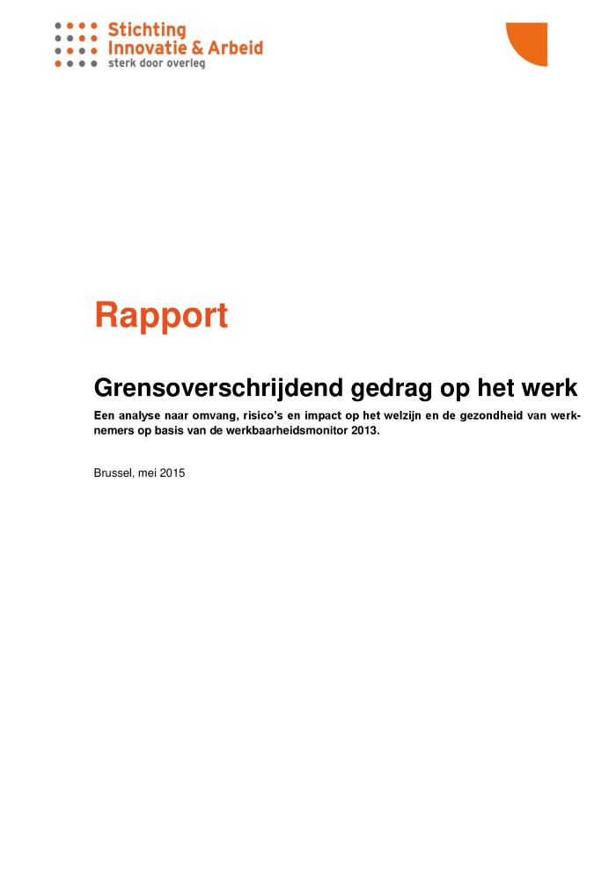
Grensoverschrijdend gedrag op het werk : een analyse naar omvang, risicos en impact op het welzijn en de gezondheid van werknemers op basis van de werkbaarheidsmonitor 2013 : rapport (c:amaz:14250)
In dit rapport kijken we hoeveel werknemers het slachtoffer werden van grensoverschrijdend gedrag op het werk en willen we weten welke de risicogroepen zijn voor de blootstelling aan grensoverschrijdend gedrag. We onderzoeken ook welke rol de arbeidscontext speelt en welke invloed de confrontatie met grensoverschrijdend gedrag heeft op de gezondheid en het welzijn van de werknemer.

Slide 97
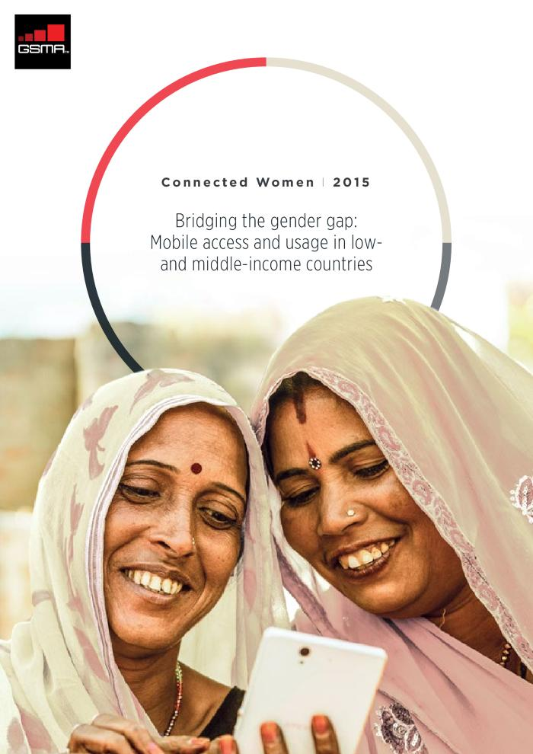
Bridging the gender gap: mobile access and usage in low and middle-income countries (c:amaz:13982)

Slide 98
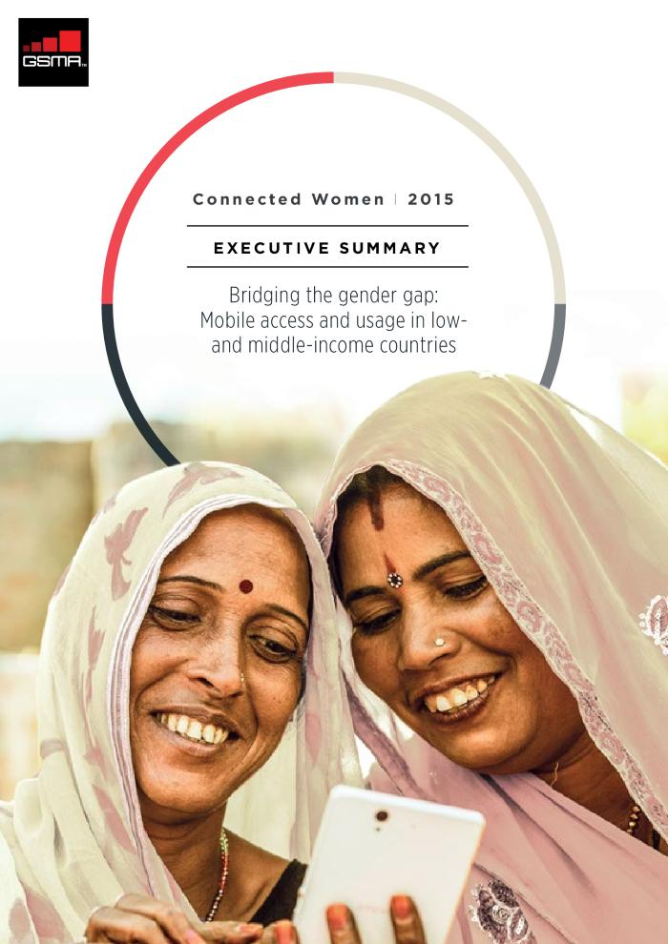
Bridging the gender gap: mobile access and usage in low and middle-income countries (executive summary) (c:amaz:13981)

Slide 99
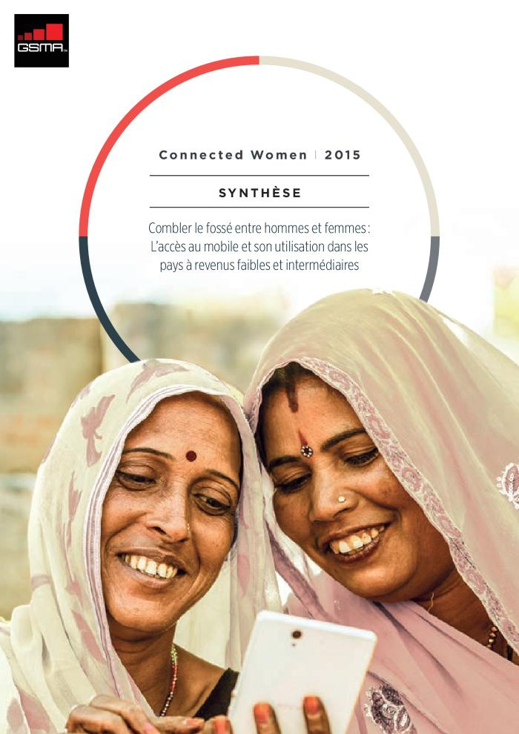
Combler le fossé entre hommes et femmes : l'accès au mobile et son utilisation dans les pays à revenus faibles et intermédiaires (synthèse) (c:amaz:13980)

Slide 100

Diversity matters (c:amaz:13957)

Slide 101

Impact des violences sexuelles de l'enfance à l'âge adulte (Rapport) (c:amaz:13928)

Slide 102

Les femmes, l'entreprise et le droit : combler l'écart - améliorer les lois protégeant les femmes contre la violence. (c:amaz:13848)

Slide 103
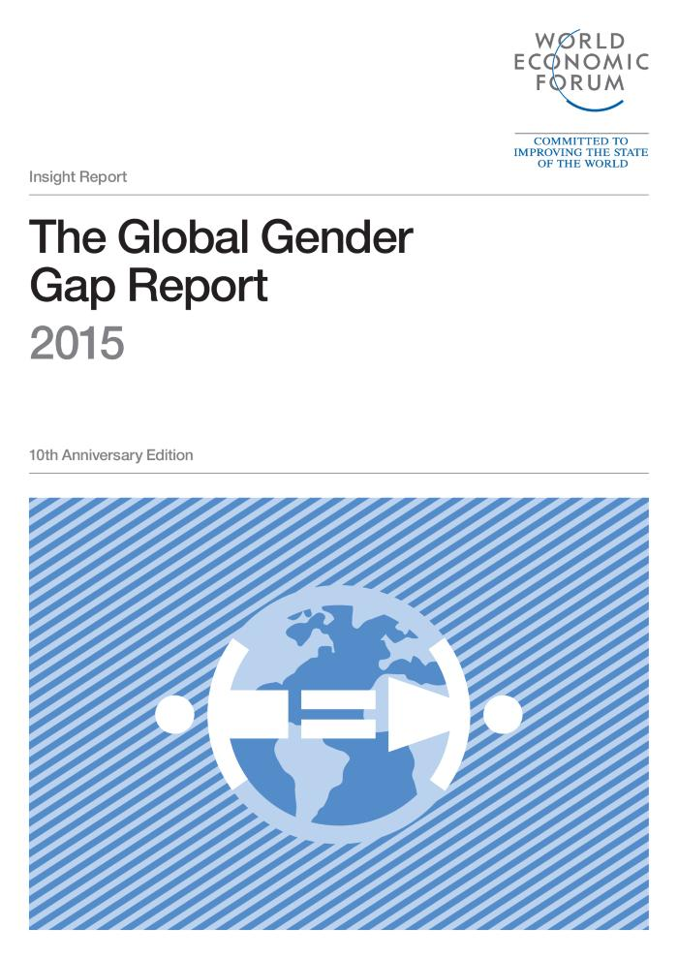
The Global Gender Gap : report 2015 (c:amaz:13764)

Slide 104
Étude sur la violence intrafamiliale et la violence conjugale basée sur l'enquête de santé 2013 (c:amaz:13614)

Slide 105

Miriam: een betere begeleiding van alleenstaande moeders met een leefloon (c:amaz:13379)

Slide 106
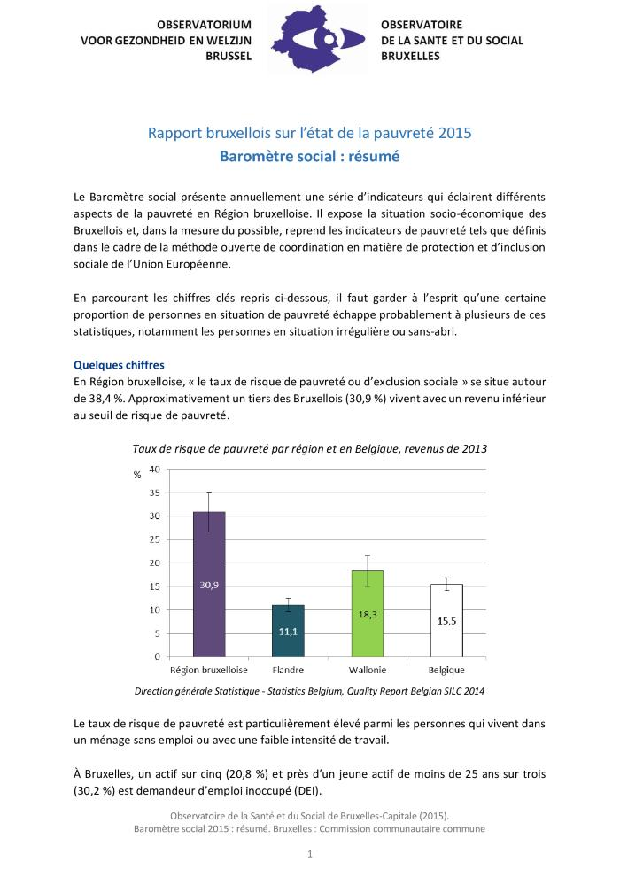
Baromètre social 2015. Résumé (c:amaz:13003)

Slide 107

Baromètre social 2015 (c:amaz:12999)

Slide 108

Secteur action sociale : actualité et perspectives (c:amaz:12956)

Slide 109

Secteur HORECA : actualité et perspectives (c:amaz:12946)

Slide 110
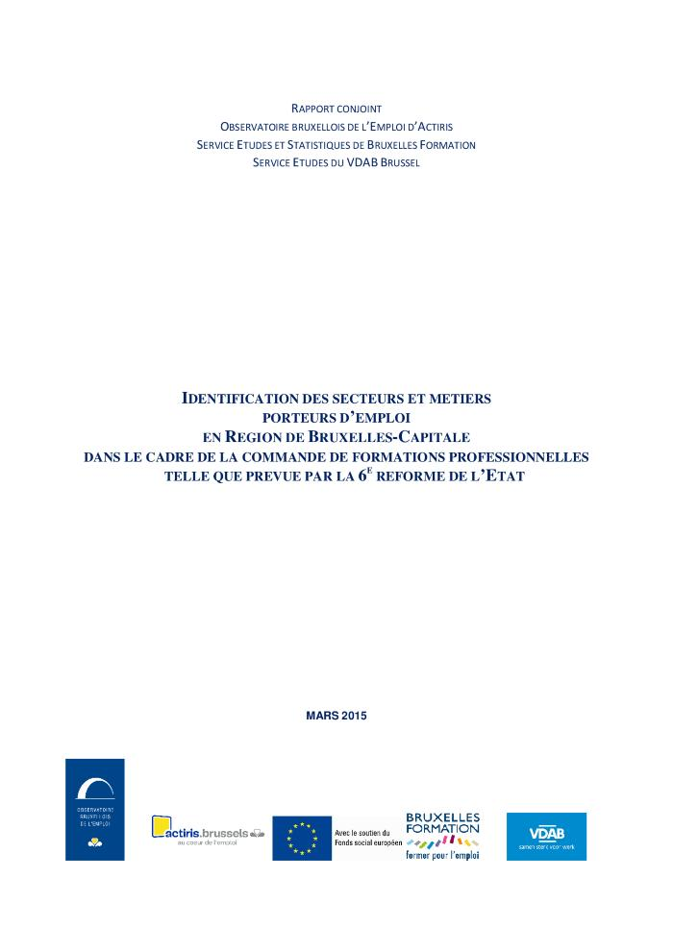
Identification des secteurs et métiers porteurs d'emploi en Région de Bruxelles-Capitale dans le cadre de la commande de formations professionnelles telle que prévue par la 6e réforme de l'Etat : rapport conjoint (c:amaz:12882)

Slide 111

Quatrième rapport d'évaluation du programme de dépistage organisé du cancer du sein en Région de Bruxelles-Capitale (2009-2013) (c:amaz:12806)

Slide 112

4e rapport général sur les activités du GRETA couvrant la période du 1er août 2013 au 30 septembre 2014 (c:amaz:12644)

Slide 113

4th general report on GRETA's activities : covering period from 1 august 2013 to 30 september 2014 (c:amaz:12643)

Slide 114

Femmes, précarités et pauvreté en Région bruxelloise : rapport bruxellois sur l'état de la pauvreté 2014 : note de synthèse (c:amaz:12609)

Slide 115

Gekruiste blikken : Brussels armoederapport 2014 (c:amaz:12608)

Slide 116

Regards croisés : rapport bruxellois sur l'état de la pauvreté 2014. (c:amaz:12607)

Slide 117

Vrouwen, bestaansonzekerheid en armoede in het Brussels Gewest : Brussels armoederapport 2014 (c:amaz:12603)

Slide 118

Femmes, précarités et pauvreté en Région bruxelloise : rapport bruxellois sur l'état de la pauvreté 2014 (c:amaz:12601)

Slide 119

Etude du parcours du stagiaire après sa formation (c:amaz:7932)

Slide 120

Violence against women human rights defenders in Mesoamaroca 2014 - 2014 : report (c:amaz:7890)

Slide 121

Quels nouveaux enjeux pour le féminisme européen? (c:amaz:7853)

Slide 122
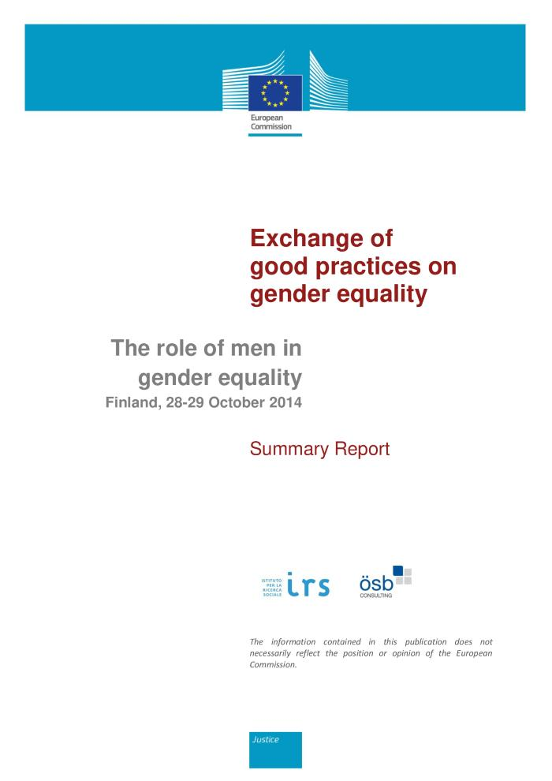
Exchange of good practices on gender equality : the role of men in gender equality Finland, 28-29 october 2014 : summary report (c:amaz:7830)

Slide 123

Evaluation of the Strategy for equality between women and men 2010-2015 as a contribution to achieve the goals of the Beijing Platform for Action (c:amaz:7773)

Slide 124

Evaluatie van de COL 10/2005 inzake de seksuele agressieset : eindrapport (c:amaz:7769)

Slide 125
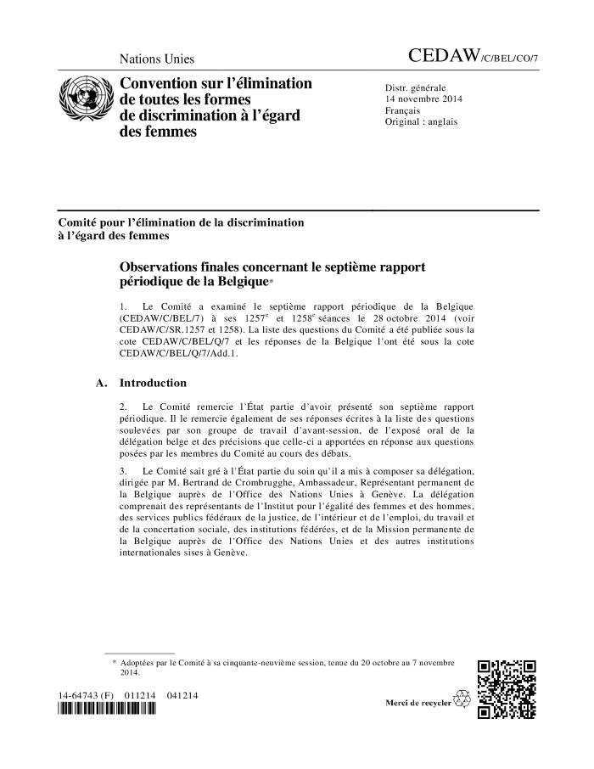
Observations finales concernant le septième rapport périodique de la Belgique (CEDAW/C/BEL/CO/7) (c:amaz:7740)

Slide 126

Positive action measures : the experience of equality bodies : an Equinet report (c:amaz:7655)

Slide 127
Review of the implementation of the Beijing Platform for Action in the EU Member States : gender equality and economic independence : part-time work and self-employment : report (c:amaz:7641)

Slide 128

Administrative data sources on gender-based violence against women in the EU : current status and potential for the collection of comparable data : report (c:amaz:7640)

Slide 129
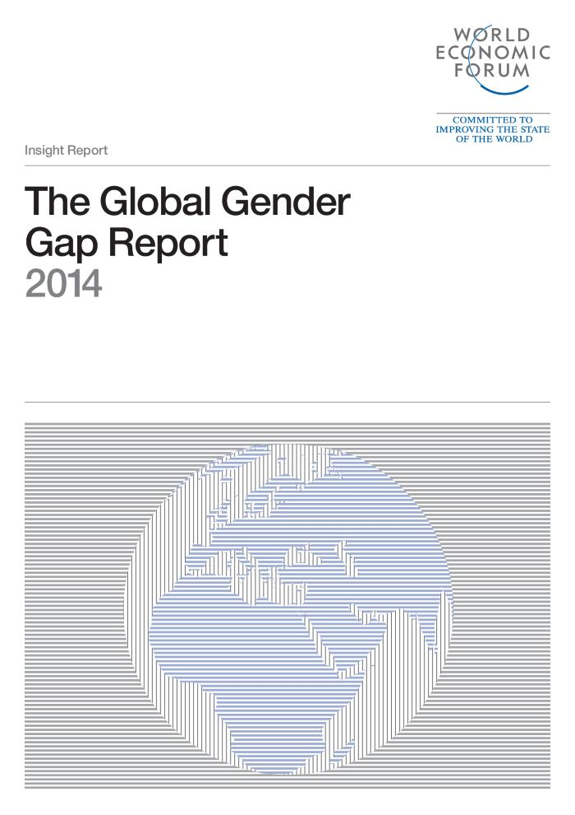
The Global Gender Gap : report 2014 (c:amaz:13761)

Slide 130

Rapport sur l'état de l'égalité de genre (c:amaz:13705)

Slide 131

Tool: alleenstaande moeders, gender en armoede (c:amaz:13381)

Slide 132

Données périnatales en Région bruxelloise : années 2008-2012 (c:amaz:12892)

Slide 133

Réforme de l'Etat : transfert de compétences en matière d'Emploi et de Formation professionnelle : rapport du Groupe d'experts (Région de Bruxelles-Capitale, 23 juin 2014) (c:amaz:12870)

Slide 134

Baromètre social : rapport bruxellois sur l'état de la pauvreté 2014 (c:amaz:12856)

Slide 135

Inventaire des mesures d'aide à l'emploi portées par le New Deal bruxellois (c:amaz:12846)

Slide 136

L'entrepreneuriat féminin en Région de Bruxelles-Capitale (c:amaz:12771)

Slide 137
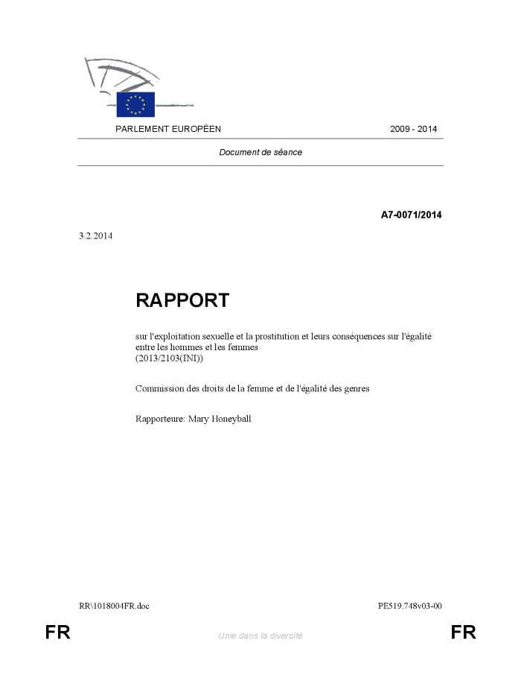
Rapport sur l'exploitation sexuelle et la prostitution et leurs conséquences sur l'égalité entre les hommes et les femmes : document de séance (c:amaz:12724)

Slide 138
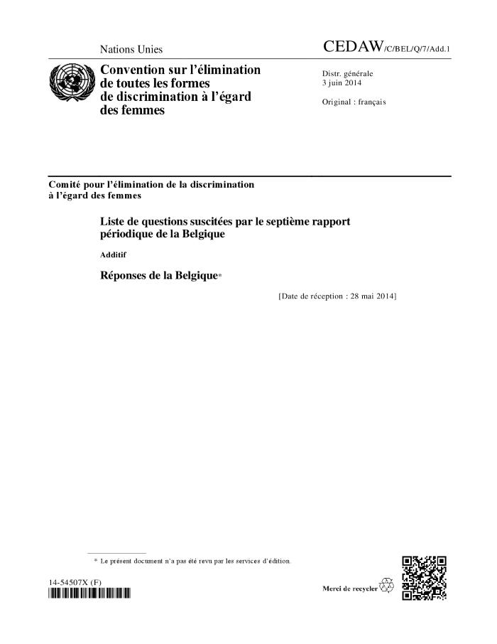
Liste de questions suscitées par le septième rapport périodique de la Belgique : Additif : Réponses de la Belgique* (CEDAW/C/BEL/Q/7/Add.1) (c:amaz:12634)

Slide 139
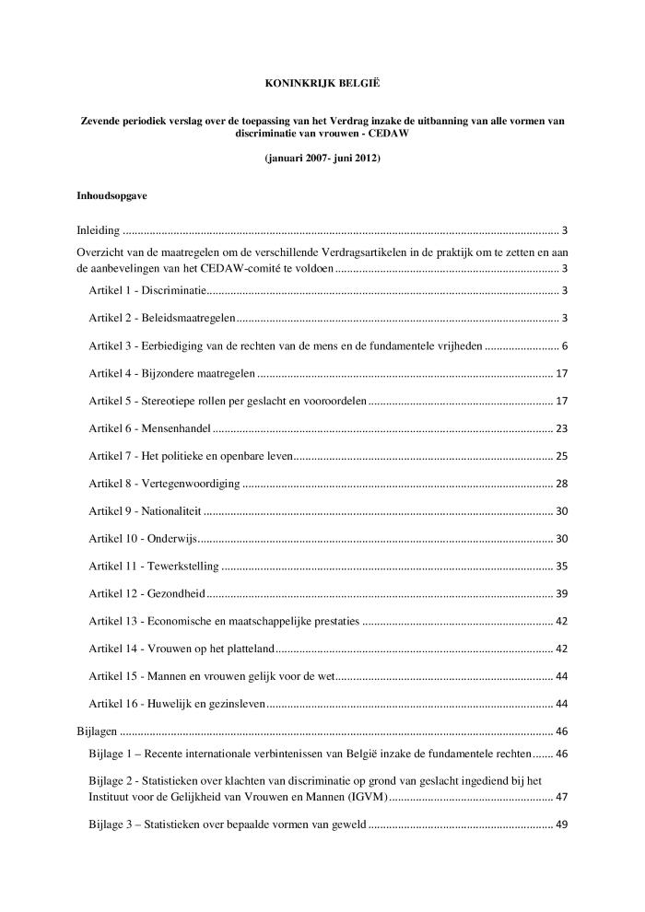
Koninkrijk België. Zevende periodiek verslag over de toepassing van het Verdrag inzake de uitbanning van alle vormen van discriminatie van vrouwen - CEDAW, (januari 2007 - juni 2012) (c:amaz:12621)

Slide 140
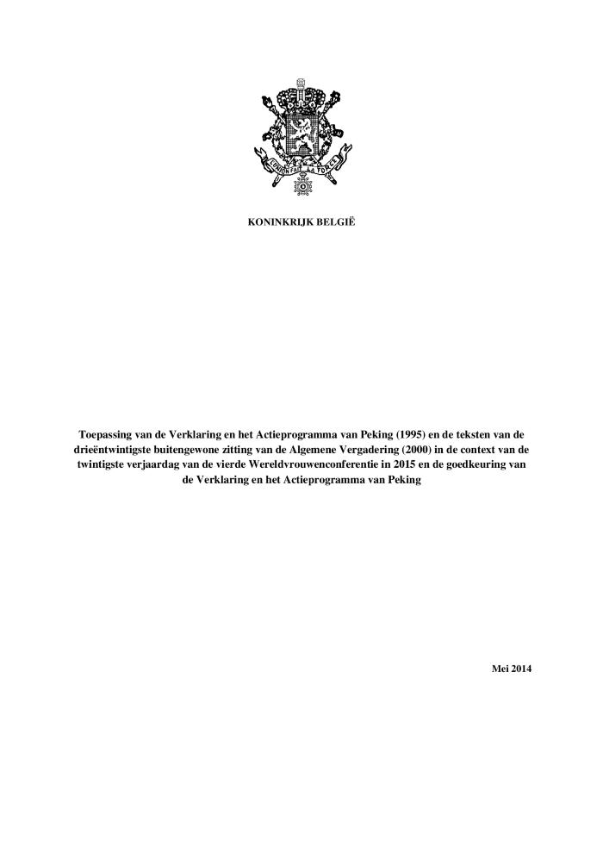
Toepassing van de Verklaring en het Actieprogramma van Peking (1995) en de teksten van de drieëntwintigste buitengewone zitting van de Algemene Vergadering (2000) in de context van de twintigste verjaardag van de vierde Wereldvrouwenconferenie in 2015 en de goedkeuring van de Verklaring en het Actieprogramma van Peking (c:amaz:12556)

Slide 141
Indice d'égalité de genre : marche à suivre : rapport sur la discussion en ligne (c:amaz:12548)

Slide 142

Indice d'égalité de genre, un nouveau moteur du changement social? : rapport sur la discussion en ligne (c:amaz:12546)

Slide 143

Les hommes et l'égalité des sexes : rapport sur la discussion on ligne (c:amaz:12542)

Slide 144

Mutilations génitales féminines : rapport sur la discussion en ligne (c:amaz:12540)

Slide 145

Capacité institutionnelle et méthodes efficaces de promotion de l'égalité entre les femmes et les hommes : rapport sur la discussion en ligne (c:amaz:12538)

Slide 146

Les avantages de l'égalité entre les hommes et les femmes : rapport de discussion en ligne (c:amaz:12536)

Slide 147
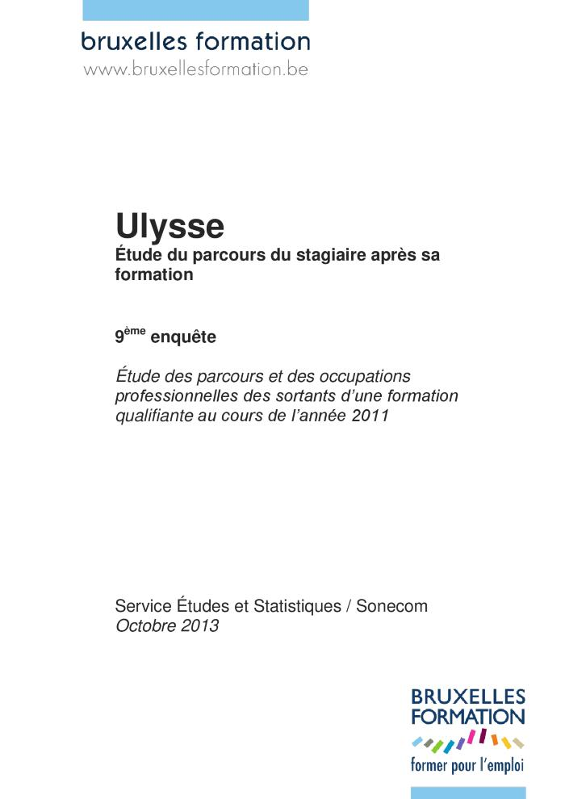
Etude du parcours du stagiaire après sa formation (c:amaz:7931)

Slide 148
Accès au logement, capabilités et empowerment pour les femmes victimes de violence conjugale : la démarche de l'équipe 'Pré-post-hébergement' du CVFE (c:amaz:7265)

Slide 149

Understanding men's violence against women : findings from the images survey in Brazil,Chile and Mexico (c:amaz:13903)

Slide 150
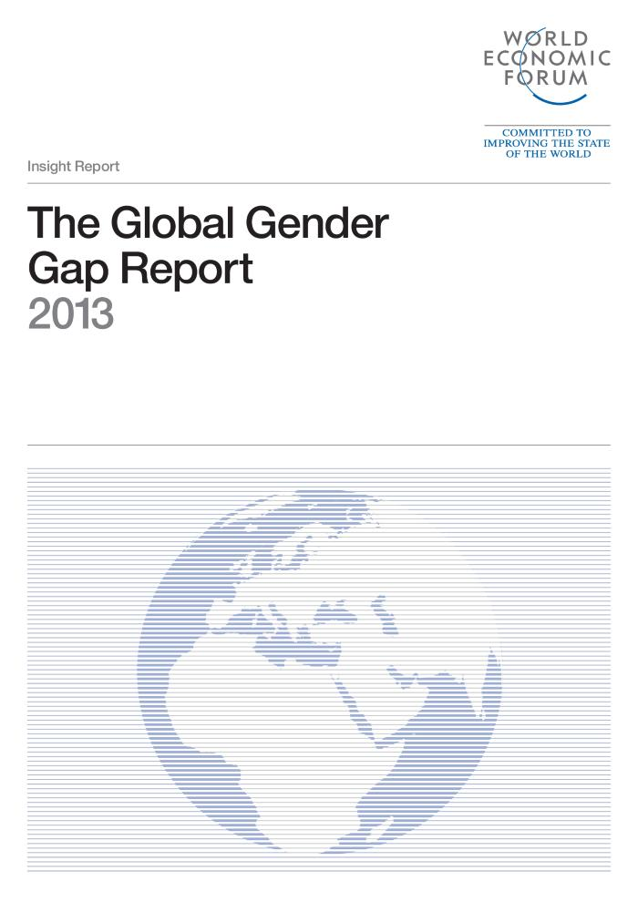
The Global Gender Gap : report 2013 (c:amaz:13763)

Slide 151
Rapport Pékin janvier-décembre 2012. Partie 1 : les initiatives prises par le Gouvernement de la Région de Bruxelles-Capitale pour promouvoir l'égalité entre les femmes et les hommes présentées par domaine prioritaire de Pékin (c:amaz:13419)

Slide 152
Pekingrapport januari-december 2012. Deel 1: verslag van de initiatieven van de Brusselse Hoofdstedelijke Regering ter bevordering van de gelijkheid tussen vrouwen en mannen, voorgesteld per prioritair domein van Peking : januari - december 2011 (c:amaz:13418)

Slide 153

Inventaire des mesures d'aide à l'emploi en 2012 : document réalisé dans le cadre du suivi du programme national de réforme 2012 (PNR) (c:amaz:12848)

Slide 154

Eenoudergezinnen in Brussel: status quaestionis in perspectief (c:amaz:12739)

Slide 155

Monoparentalités à Bruxelles: état des lieux et perspectives (c:amaz:12738)

Slide 156
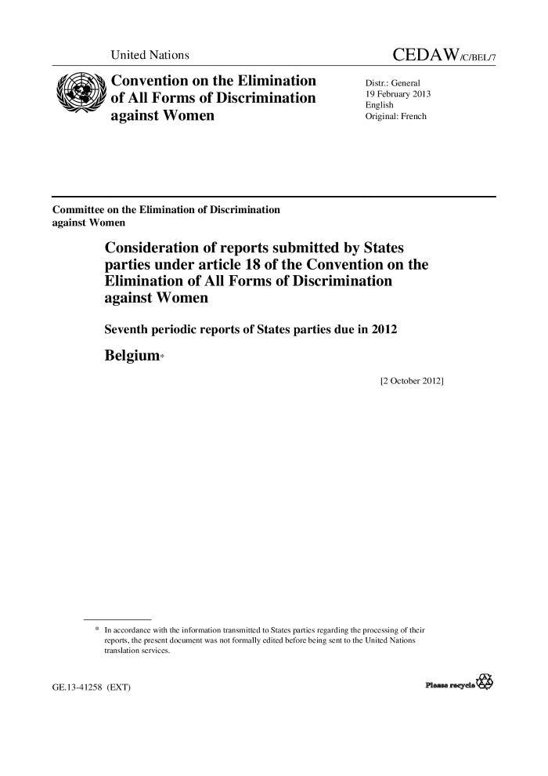
Consideration of reports submitted by States Parties under article 18 of the Convention on the Elimination of All Forms of Discrimination against Women : seventh periodic reports of States Parties due in 2012 : Belgium (CEDAW/C/BEL/7) (c:amaz:12557)

Slide 157

Female genital mutilations : online discussion report (c:amaz:12539)

Slide 158

Etude du parcours du stagiaire après sa formation (c:amaz:7929)

Slide 159

Espace public, genre et sentiment d'insecurité : développer des pistes pour les politiques bruxelloises d'urbanisme : rapport final 30-10-2012 (c:amaz:7476)

Slide 160
Neue Wege - Gleiche Chancen : Gleichstellung von Frauen und Männern im Lebensverlauf : erster Gleichstellungsbericht (c:amaz:7269)

Slide 161
Employment and Social Developments in Europe 2011 (c:amaz:7046)

Slide 162
Review of the implementation in the EU of area K on the Beijing Platform for Action : women and the environment : gender equality and climate change : report (c:amaz:6810)

Slide 163

Review of the implementation of the Beijing Platform for Action in the area F : women and the economy. Reconciliation of work and family life as a condition of equal participation in the labour market : report (c:amaz:6809)

Slide 164
Gender inequality in the European Union : flash eurobarometer 341 (c:amaz:6685)

Slide 165

Positive action measures to ensure full equality in practice between men and women, including on company boards (c:amaz:13901)

Slide 166

The Global Gender Gap : report 2012 (c:amaz:13760)

Slide 167

Inventaire des mesures d'aide à l'emploi en Région de Bruxelles-Capitale en 2011 : document réalisé dans le cadre du suivi du programme national de réforme 2011 (PNR) (c:amaz:12832)

Slide 168
La situation des femmes étrangères ou d'origine étrangère sur le marché de l'emploi en Région Bruxelloise: approche par la territorialité (c:amaz:12734)

Slide 169

Inégalités hommes-femmes : il est temps d'agir (c:amaz:12729)

Slide 170

Closing the gender gap : act now (c:amaz:12728)

Slide 171

Nota balans « Gelijke kansen » 6/12/11 - 6/12/12 (c:amaz:12304)

Slide 172

Note bilan « Egalité des chances » 6/12/11 - 6/12/12 (c:amaz:12303)

Slide 173
Plan d'action pour des parlements sensibles au genre (c:amaz:12296)

Slide 174
Plan de acciòn para los parlamentos sensibles al género (c:amaz:12295)

Slide 175
Plan of action for gender-sensitive parliaments (c:amaz:12294)

Slide 176
Rapport parlementaire mondial : l'évolution de la représentation parlementaire (c:amaz:12289)

Slide 177
Global parliamentary report : the changing nature of parliamentary representation (c:amaz:12288)

Slide 178

Etude du parcours du stagiaire après sa formation (c:amaz:7926)

Slide 179

Evaluation de la Commission femmes et développement (c:amaz:7798)

Slide 180
Egalité filles/garçons, femmes/hommes dans le système éducatif (c:amaz:6851)

Slide 181
Jämi : a Swedish Commission for Gender Mainstreaming : 1/11 report (c:amaz:6799)

Slide 182
EU donors under women's watch : WIDE checks up on gender equality and women's rights in the aid effectiveness agenda on the road to Busan 2011 (c:amaz:6568)

Slide 183

The Global Gender Gap : report 2011 (c:amaz:13757)

Slide 184
Parlements sensibles au genre : étude mondial des bonnes pratiques (c:amaz:12292)

Slide 185
Gender-sensitive parliaments : a global review of good practice (c:amaz:12290)

Slide 186
Améliorer les outils pour l'inclusion sociale et la non-discrimination des Roms dans l'UE : rapport (c:amaz:12283)

Slide 187

Genderanalyse van de gegevens over beroepsziekten in België : verslag 122 (c:amaz:12273)

Slide 188

Rapport d'activités du Conseil de l'Égalité des Chances entre Hommes et Femmes: 2006 - 2010 (c:amaz:12269)

Slide 189

Resultaten van het Belgisch voorzitterschap van de Europese Unie inzake gelijkheid van vrouwen en mannen : Brussel, 1 juli 2010 - 31 december 2010 (c:amaz:12264)
De Europese Unie streeft al meer dan 50 jaar de gelijke behandeling van vrouwen en mannen na. Tijdens het voorzitterschap van de Raad van de Europese Unie, heeft België bijzonder veel aandacht geschonken aan de gelijkheid tussen vrouwen en mannen. Volgende thema's komen in deze publicatie aan bod: (1) Een sterkere genderdimensie in werkgelegenheid en de loonkloof tussen vrouwen en mannen wegwerken. Het Belgische voorzitterschap is het eerste dat de EU2020-Strategie voor groei en werkgelegenheid in werking heeft gesteld. In het kader van de goedkeuring van de richtlijnen voor werkgelegenheid, heeft het Belgische voorzitterschap toegezien op een versterking van de gendergelijkheid. Een van de voornaamste prioriteiten is de werkgelegenheidsgraad van vrouwen optrekken, de gelijke verloning vormt eveneens een belangrijke Europese doelstelling. (2) De strijd tegen geweld tegen vrouwen. Geweld tegen vrouwen vormt een van de grootste obstakels in het realiseren van gelijkheid tussen vrouwen en mannen en betekent een grove schending van de rechten en de fundamentele vrijheden. Daarom heeft het Belgische voorzitterschap de Europese Commissie gesteund in de uitwerking van een efficiënt beleid ter preventie en bestrijding van geweld tegen vrouwen. (3) Een nieuwe Europese strategie voor de gelijkheid tussen vrouwen en mannen. De Europese Commissie heeft in september 2010 haar nieuwe strategie voor de gelijkheid van vrouwen en mannen (2011-2015) voorgesteld. Deze strategie bestaat uit vijf grote thema's: gelijke economische onafhankelijkheid, gelijke beloning voor gelijk of gelijkwaardig werk, gelijkheid in besluitvorming, waardigheid, integriteit en bestrijding van gendergerelateerd geweld en gendergelijkheid buiten de Europese Unie.

Slide 190

Résultats de la présidence belge de l'Union européenne en matière d'égalité entre les femmes et les hommes : Bruxelles, 1er juillet 2010 - 31 décembre 2010 (c:amaz:12263)

Slide 191

Results of the Belgian presidency of the European Union as regards equality between women and men : Brussels, 1 July 2010 - 31 December 2010 (c:amaz:12262)

Slide 192

Rapport Pékin : rapport sur les initiatives prises par le gouvernement de la Région de Bruxelles-Capital pour promouvoir l'égalité entre les femmes et les hommes : janvier - décembre 2011. Annexes (c:amaz:7841)

Slide 193
Protecting women against violence : analytical study of the results of the third round of monitoring the implementation of Recommandation Rec (2002)5 on the protection of women against violence in the Council of Europe member states (c:amaz:7112)

Slide 194
Présentation de la situation des femmes sur le marché de l'emploi en Région de Bruxelles-Capitale : rapport (c:amaz:6940)

Slide 195
Débat relatif aux problématiques de la formation et de l'emploi des femmes bruxelloises (c:amaz:6939)

Slide 196

Débat relatif à la note d'orientation du Gouvernement en matière d'égalité des chances entre hommes et femmes (c:amaz:6937)

Slide 197

Integrated client services for victims of violence against women : the results of a pilot programme (c:amaz:6696)

Slide 198
Gender mainstreaming active inclusion policies : final synthesis report (c:amaz:6399)

Slide 199
Taking women's rights seriously : shadow report by Dutch NGOs; an examination of the Fourth Report by the Government of the Netherlands on implementation of the Un Convention on the Elimination of all Forms of Discrimination against Women (Cedaw) 2000-2004 (c:amaz:6355)

Slide 200
Vrouwenrechten in Nederland, anno 2010 : de conclusies van het VN-Comite (c:amaz:6218)

Slide 201
7e Conférence du Conseil de l'Europe des ministres responsables de l'égalité entre les femmes et les hommes : rapport présenté par la délégation nationale de Belgique (c:amaz:6179)

Slide 202
Activities related to the strategic objectives in the Beijing and Vienna Platforms for Action and the 'Beijing + 5' and 'Beijing + 10' measures and initiatives (c:amaz:6177)

Slide 203
Employment in Europe 2010 (c:amaz:6141)

Slide 204

Gender en leermogelijkheden in het werk op basis van de data van de werk-baarheidsmonitor 2007 : technische nota (c:amaz:14316)
Uit de resultaten van de werkbaarheidsenquête van 2007 blijkt dat (verhoudingsgewijs) meer vrouwen dan mannen een job hebben die onvoldoende leermogelijkheden biedt. Ook in 2004 was dat het geval. Voor twee aspecten, met name de formele opleidingskansen en de intrin-sieke jobgebonden leerkansen, kijken we hoe het verschil zich (al dan niet) manifesteert in grotere en kleinere bedrijven, in verschillende leeftijdsgroepen, beroepsgroepen en bij voltij-ders en deeltijders. Voor deze vergelijking beperken we ons tot de recentste gegevens van 2007. Verder kijken we welke risicos in de arbeidssituatie de verschillen kunnen duiden. Het is niet onze bedoeling de hele problematiek in deze nota uit te klaren. Wij willen met deze nota enkel illustratief materiaal uit de werkbaarheidsmonitor ter beschikking stellen aan de geïnteresseerde lezer.

Slide 205

The Global Gender Gap : report 2010 (c:amaz:13758)

Slide 206

Aperçu des besoins relatifs aux métiers scientifiques et technologiques (c:amaz:12944)

Slide 207

Aperçu des besoins relatifs aux métiers scientifiques et technologiques (c:amaz:12942)

Slide 208

Les emplois verts : analyse exploratoire (c:amaz:12940)

Slide 209

Pekingrapport : verslag van de initiatieven van de Brusselse Hoofdstedelijke Regering ter bevordering van de gelijkheid tussen vrouwen en mannen : januari - december 2011 (c:amaz:12745)

Slide 210
Rapport Pékin : rapport sur les initiatives prises par le gouvernement de la Région de Bruxelles-Capital pour promouvoir l'égalité entre les femmes et les hommes : janvier - décembre 2011 (c:amaz:12744)

Slide 211

L'emploi des femmes bruxelloises : aperçu des inégalités de genre (c:amaz:12435)

Slide 212
Improving the tools for the sociale inclusion and non-discrimination of Roma in the EU : report (c:amaz:12282)

Slide 213

Activiteitenverslag van de Raad van de Gelijke Kansen voor Mannen en Vrouwen: 2006 - 2010 (c:amaz:12270)

Slide 214
Traite des femmes et des filles : rapport du Secrétaire général (A/65/209) (c:amaz:12137)

Slide 215
Trafficking in women and girls : report of the Secretary-General (A/65/209) (c:amaz:12136)

Slide 216

Pekingrapport : verslag van de initiatieven van de Brusselse Hoofdstedelijke Regering ter bevordering van de gelijkheid tussen vrouwen en mannen : september 2009 - december 2010 (c:amaz:12033)

Slide 217
Rapport Pékin : rapport sur les initiatives prises par le gouvernement de la Région de Bruxelles-Capital pour promouvoir l'égalité entre les femmes et les hommes : septembre 2009 - décembre 2010 (c:amaz:12032)

Slide 218
Brussels armoederapport 2010 (c:amaz:11840)

Slide 219
Rapport bruxellois sur l'état de la pauvreté 2010 (c:amaz:11839)

Slide 220

Smaller urban communities in Civitas for environmentally sustainable solutions : final reporting on the implementation of the gender action plan (c:amaz:7925)

Slide 221

Good practices in legislation on 'harmful practices' against women : report of the Expert group meeting (c:amaz:6834)

Slide 222
Baromètre social : rapport bruxellois sur l'état de la pauvreté 2009 (c:amaz:6403)

Slide 223
Break gender stereotypes, give talent a chance : review of the national situation for the purpose of the workshop in Belgium (c:amaz:6187)

Slide 224
Gender equality, economic growth and employment (c:amaz:6178)

Slide 225

Beijing +15 : the platform for action and the European Union (c:amaz:6176)

Slide 226
Monitoring progress towards gender equality in the sixth framework programme : synthesis report (c:amaz:6171)

Slide 227

Different systems, similar outcomes ? Tracking attrition in reported rape cases across Europe : final research report (c:amaz:13841)

Slide 228

The Global Gender Gap : report 2009 (c:amaz:13759)

Slide 229
Gecombineerde vijfde en zesde periodieke verslag van België ingediend bij het Committee on the Elimination of Discrimination against Women (CEDAW) : verslag namens het Adviescomité voor Gelijke Kansen voor Vrouwen en Mannen uitgebracht door de dames de Bethune en Zrihen (c:amaz:12626)

Slide 230

Situation des familles monoparentales face à l'emploi et au chômage en Région de Bruxelles-Capitale (c:amaz:12439)

Slide 231
Rapport d'activité 2007-2008 / L'action de l'Union européen contre la discrimination (c:amaz:12281)

Slide 232
Activity report 2007-2008 / EU action against discrimination (c:amaz:12280)

Slide 233

Intensification de l'action menée pour éliminer toutes les formes de violence à l'égard des femmes : rapport du Secrétaire général (A/64/151) (c:amaz:12111)

Slide 234
Intensification of efforts to eliminate all forms of violence against women : report of the Secretary-General (A/64/151) (c:amaz:12110)

Slide 235

Note d'orientation en matière d'égalité entre les hommes et les femmes 2009-2014 (c:amaz:11950)

Slide 236
L'égalité des sexes dans la région euro-méditerranéenne : du plan d'action à l'action ? : rapport parallèle sur la mise en oeuvre du plan d'action d'Istanbul (c:amaz:11687)
This report examines the implementation of the Istambul Plan of Action, identifies the main challenges to its implementation, and makes recommendations as to how it can advance gender equality and women's rights in the Euro-Mediterranean region. It also analyses developments with respect to gender equality and women's rights from 2006 to 2008 in the following key areas : commitment to international conventions, especially CEDAW ; discrimination in national laws and legislation ; public participation of women in civil and political life ; violence against women, including migrant women.

Slide 237
Gender equality in the Euro-mediterranean region : from plan of action to action ? : shadow report on the implementation of the Istambul plan of action (c:amaz:11686)
This report examines the implementation of the Istambul Plan of Action, identifies the main challenges to its implementation, and makes recommendations as to how it can advance gender equality and women's rights in the Euro-Mediterranean region. It also analyses developments with respect to gender equality and women's rights from 2006 to 2008 in the following key areas : commitment to international conventions, especially CEDAW ; discrimination in national laws and legislation ; public participation of women in civil and political life ; violence against women, including migrant women.

Slide 238
Que faire pour mettre fin à la pratique des mutilations génitales féminines (MGF) ? (c:amaz:11683)

Slide 239
How to put an end to the practice of female genital mutilation (FGM) ? (c:amaz:11682)

Slide 240

Gendering human rights violations : the case of interpersonal violence : coordination action on human rights violations (CAHRV): final report 2004-2007 (c:amaz:6591)

Slide 241
Casa nova : het nieuwe huishouden : verslag over het onderzoeksproject in het kader van M/V United (c:amaz:6302)

Slide 242

The Global Gender Gap : report 2008 (c:amaz:13756)

Slide 243

Élimination du viol et des autres formes de violence sexuelle dans toutes leurs manifestations, notamment dans les conflits et les situations apparentées : rapport du Secrétaire général (A/63/216) (c:amaz:12173)

Slide 244

Eliminating rape and other forms of sexual violence in all their manifestations, including in conflict and related situations : report of the Secretary-General (A/63/216) (c:amaz:12172)

Slide 245
Traite des femmes et des filles : rapport du Secrétaire général (A/63/215) (c:amaz:12139)

Slide 246

Trafficking in women and girls : report of the Secretary-General (A/63/215) (c:amaz:12138)

Slide 247

Intensification de l'action menée pour éliminer toutes les formes de violence à l'égard des femmes : rapport du Secrétaire général (A/63/214) (c:amaz:12105)

Slide 248

Intensification of efforts to eliminate all forms of violence against women : report of the Secretary-General (A/63/214) (c:amaz:12104)

Slide 249
Sixth report by the Federal Republic of Germany on the United Nations Convention to Eliminate all Forms of Discrimination Against Women (CEDAW) (c:amaz:6328)

Slide 250
Consideration of reports submitted by states parties under article 18 of the Convention on the Elimination of All Forms of Discrimination against Women : combined fifth and sixth periodic reports of states parties : Belgium (c:amaz:6285)

Slide 251
Women in science and technology : why and how must they be supported ? (c:amaz:6251)

Slide 252
EU bilateral and regional free trade agreements : bringing women to the centre of the debate (c:amaz:6242)

Slide 253
Parental leave in European companies : establishment survey on working time 2004-2005 (c:amaz:6172)

Slide 254
Protéger les femmes contre la violence : étude analytique de la mise en oeuvre effective de la recommandation Rec (2002)5 sur la protection des femmes contre la violence dans les Etats Membres du Conseil de l'Europe (c:amaz:6079)

Slide 255
Employment in Europe 2007 (c:amaz:6061)

Slide 256
Rapport d'information n° 375 : rapport d'activité fait pour l'année 2006-2007 au nom de la délégation aux droits des femmes et à l'égalité des chances entre les hommes et les femmes et compte rendu des travaux de cette délégation sur le thème 'Femmes et hommes dans les médias', déposé en application de l'article 6 septies de l'ordonnance n°58-1100 du 17 novembre 1958 relative au fonctionnement des assemblées parlementaires (c:amaz:6033)

Slide 257

The Global Gender Gap : report 2007 (c:amaz:13754)

Slide 258

Migrations et vieillissements : synthèse (c:amaz:12443)

Slide 259

Reality check : when women's NGOs map policies and legislation on violence against women in Europe (2007) (c:amaz:11971)

Slide 260
Pekingrapport : verslag over de initiatieven genomen in 2007 om de gelijkheid tussen mannen en vrouwen te bevorderen (c:amaz:11949)

Slide 261
Sensibilisatieprogramma inzake discriminatie en de wetgeving in de strijd tegen discriminatie : syntheserapport (c:amaz:11552)

Slide 262
Programme de sensibilisation à la discrimination et aux législations de lutte contre les discriminations : rapport de synthèse (c:amaz:11551)

Slide 263

Toekomst na Peking +10 : actiepistes en uitdadingen voor verdere uitwerking van de doelstellingen van het Actieplatform van Peking in België (c:amaz:11514)
In de nasleep van de 49e sessie van de Commissie voor de Status van de Vrouw van de Verenigde Naties (Peking +10), die plaatsvond te New York van 28 februari tot 11 maart 2005, heeft het Instituut zich ertoe verbonden om de concrete inwerkingtreding van de doelstellingen van het Actieplatform van Peking in België te ondersteunen door de organisatie van acht thematafels. Deze publicatie is opgebouwd rond twee delen: het eerste, met een informatief karakter, biedt een globaal overzicht van het Pekingproces en omschrijft in grote lijnen de inspanningen die werden geleverd voor de toepassing van het Actieplatform van Peking in België. Het tweede en belangrijkste deel stelt op synthetische manier de inhoud van de verschillende thematafels en twee conferenties voor. Daarbij wordt vooral de nadruk gelegd op de 'actiepistes' en de 'te overwinnen uitdagingen' die naar voor zijn gekomen in de discussies. Meer bepaald omvatten de verschillende delen die zijn gewijd aan elk van de tien themas een herinnering aan het verband met het Actieplatform van Peking, een korte stand van zaken van de aangesneden problematiek en de geïdentificeerde actiepistes en te overwinnen uitdagingen.

Slide 264

Rebondir sur Pékin +10 : pistes d'action et défis à relever pour approfondir la mise en oeuvre des objectifs de la Plate-forme d'Action de Pékin en Belgique (c:amaz:11513)

Slide 265

De loonkloof tussen vrouwen en mannen in België : rapport 2007 (c:amaz:11484)
Sociale ongelijkheden bestrijden vereist dat ze gemeten en verklaard worden. De Regering heeft aan het Instituut en de Federale Overheidsdienst Werkgelegenheid gevraagd om een eerste verslag over de loonkloof op te stellen om zo te beschikken over precieze en globale referentiegegevens per sector. Op basis van dit rapport kunnen loonverschillen tussen vrouwen en mannen objectief benaderd worden. De parameters die de kloof vergroten of verkleinen worden geïdentificeerd en er wordt een onderscheid gemaakt tussen wat als geslachtsdiscriminatie kan worden beschouwd en wat veeleer aan de werking van de arbeidsmarkt te wijten is. De oorzaken van de loonkloof zijn legio: van stereotiepe studiekeuzes, tot hindernissen bij het ontwikkelen van een loopbaan, maar ook een onevenwichtige taakverdeling die een goede combinatie privéleven/beroepsleven belemmert. Resultaat: een gemiddeld verschil van 15% tussen het loon van vrouwen en het loon van mannen.

Slide 266

L'écart salarial entre les femmes et les hommes en Belgique : rapport 2007 (c:amaz:11483)

Slide 267

Recherche - action concernant la mise en place et le suivi de marches exploratoires : rapport final 2006 (c:amaz:7516)

Slide 268
Verslag aan het Vlaams Parlement 2004-2005 : Over de toepassing van het decreet van 13 mei 1997 houdende de opvolging van de resoluties van de Wereldvrouwenconferentie die van 4 tot 14 september 1995 in Peking heeft plaatsgehad (c:amaz:6580)

Slide 269
Employment in Europe 2009 (c:amaz:6384)

Slide 270
Employment in Europe 2008 (c:amaz:6140)

Slide 271
Employment in Europe 2006 (c:amaz:6139)

Slide 272
Delivering as one : report of the Secretary-General's High-Level panel (c:amaz:5868)
See the press releases on the and on the .

Slide 273
The story behind the numbers : women and employement in Central and Eastern Europe and the Western Commonwealth of Independant States (c:amaz:5860)

Slide 274
Kindermishandeling in Vlaanderen : cliëntenregistratie bij de vertrouwenscentra kindermishandeling : rapport 2004 (c:amaz:5763)
Deze 14de jaarrapport van Kind & Gezin verzamelt alle situaties van kindermishandeling waarmee de vertrouwenscentra kindermishandeling geconfronteerd werden in het kalenderjaar 2004. : 1. De melding / 2. De gevolggeving / 3. Diagnosestelling

Slide 275

The Global Gender Gap : report 2006 (c:amaz:13755)

Slide 276
Verslagen van de Regering van het Brussels Hoofdstedelijk Gewest over het beleid gevoerd in 2006 overeenkomstig de doelstellingen van de vierde wereldvrouwenconferentie die in september 1995 in Peking heeft plaats gehad (c:amaz:11732)

Slide 277
Rapports du Gouvernement de la Région de Bruxelles-Capitale sur la Politique menée en 2006 conformément aux objectifs de la quatrième conférence mondiale sur les femmes tenue à Peking en septembre 1995 (c:amaz:11731)

Slide 278

Activiteitenverslag van de Raad van de Gelijke Kansen voor Mannen en Vrouwen: januari 2002 - december 2005 (c:amaz:11434)

Slide 279

Evaluatie van het lokale gelijkekansenbeleid van de Federale Regering van België (c:amaz:11259)

Slide 280
Evaluation de la politique locale d'égalité des chances du pouvoir fédéral en Belgique (c:amaz:11258)

Slide 281
Parité dans l'éducation : acquis et perspectives : le rapport 'GAP', première partie (c:amaz:11245)

Slide 282

De Russische Federatie : geen uitweg - huiselijk geweld tegen vrouwen (c:amaz:6693)

Slide 283

Verslag over de opgedane ervaringen Daphne 1997 - 2003 : Europa tegen geweld jegens vrouwen (c:amaz:6593)

Slide 284
Equal opportunities for women and men [cd-rom] : monitoring law and practice in new member states and accession countries of the European Union : overview (c:amaz:6038)

Slide 285
Equal opportunities for women and men : Monitoring law and practice in new member states and accession countries of the European Union : overview (c:amaz:6037)

Slide 286
Beijing +10 : country report of Hungary (1999-2004) (c:amaz:6002)

Slide 287
UN Millenium Project 2005. (c:amaz:5886)
This report recommends the way forward. It outlines a way to attain this bold ambition. It describes how to achieve the Millennium Development Goals.

Slide 288
Rapport du Gouvernement de la Communauté française au Parlement de la Communauté française sur l'évaluation de la politique gouvernementale d'égalité entre les femmes et les hommes dans le cadre du suivi des résolutions de Pékin : septembre 2003 - septembre 2005 (c:amaz:5742)

Slide 289
Périnatalité et parentalité (c:amaz:5726)

Slide 290
Modelling, benchmarking, networking : a comprehensive report of the five thematic sub-networks [cd-rom] (c:amaz:5640)
This Cd-rom presents the final results of the two-year co-operation (2003-2005) among the seventeen W.IN.NET project partners, who participated in the 'Networking Component': the core project activity devoted to discussing, exchanging and integrating good practices, methods and tools focused on modelling, benchmarking and improving the quality of services provided by Women's Resource Centres. To tackle these issues, five themetic Sub-Networks (SN) were set up, with each partner participating in at least two of them: SN1: Women's Resource Centres: Quality Indicators and Modelling - SN2: Women Entrepreneurs - SN3: Territorial System on Gender Equality and Local Development - SN4: Women Facing Difficulties and Social Exclusion - SN5: Women and New Technologies

Slide 291
Improving women's lives : World Bank actions since Beijing (c:amaz:5616)

Slide 292
Promouvoir la logique paritaire : deuxième rapport du Comité de pilotage pour l'égal accès des femmes et des hommes aux emplois supérieurs des fonctions publiques (c:amaz:5562)
'Dans son deuxième rapport, le Comité de pilotage pour l'égal accès des femmes et des hommes aux emplois supérieurs des fonctions publiques, créé en 2000, fait le constat de la très lente progression des femmes dans la haute fonction publique. L'analyse des causes des discriminations dont les femmes font l'objet est approfondie par plusieurs études menées sur les voies d'accès aux emplois supérieurs. Pour produire l'égalité effective, il se prononce en faveur d'une application de la « logique paritaire », stratégie des « actions positives ». Le Comité se place ainsi délibérément dans une démarche volontariste. La trop lente évolution de la place des femmes dans les responsabilités professionnelles, la précarité des situations et leur réversibilité toujours possible le confortent dans l'idée qu'attendre, compter sur les lents effets démographiques, se contenter des lois et décrets existants ne suffisent pas pour promouvoir une égalité effective. C'est pourquoi il considère qu'une certaine forme de contrainte est nécessaire. À partir du constat de la situation des femmes, mesurée par les tableaux de bord statistiques qu'il a mis au point, des objectifs concrets, c'est- à-dire chiffrés, doivent être définis, suivis et évalués au moins annuellement, car seul le chiffre fait preuve.Le Comité prône donc une culture du résultat et avance seize propositions. Nommé pour cinq ans, il a pour tâche de suivre la mise en oeuvre de ses recommandations, d'évaluer les effets des mesures prises et d'exercer, plus généralement, une fonction d'alerte.' La documentation française, , [En ligne]. http://www.ladocumentationfrancaise.fr/catalogue/9782110054272/index.shtml (Page consultée le 16 mars 2006)

Slide 293
Vouloir l'égalité : troisième rapport du Comité de pilotage pour l'égal accès des femmes et des hommes aux emplois supérieurs des fonctions publiques (c:amaz:5560)
'Pour la première fois, la place des femmes dans les emplois supérieurs de toutes les fonctions publiques est mesurée, dans un cadre harmonisé et cohérent. Il apparaît qu'elle est très faible dans tous les secteurs. Dans ceux pour lesquels on dispose de statistiques sur plusieurs années, on constate que l'évolution est très lente, discontinue, et parfois même défavorable. En outre, la proportion des femmes dans les emplois supérieurs est partout inférieure à celle des viviers, déjà inégalitaires. En moyenne, la part dans les nominations en 2003 est même moindre que la part dans les emplois supérieurs. Cela traduit l'absence d'effort volontariste et régulier pour corriger les déséquilibres existants. La mise en place des outils du constat n'a d'intérêt que s'ils sont un instrument d'évaluation des politiques publiques, pas seulement un moyen de pure connaissance sans incidence sur les mesures à prendre. Une volonté politique forte et permanente est nécessaire, aux niveaux central et déconcentré, pour que soit mise en ouvre une ' logique paritaire '. Les membres du Comité présentent ici quinze propositions. Les annexes comprennent notamment la loi de mai 2001 relative à l'égalité professionnelle entre les femmes et les hommes (dite loi Génisson), des statistiques relatives à la place des femmes dans les fonctions publiques et dans le champ politique, l'enquête qualitative sur la dénomination des femmes occupant des emplois supérieurs dans les fonctions publiques.' (quatrième de couverture)

Slide 294
Emancipatiebeleid en gender mainstreaming bij het Ministerie van Defensie : voorlopig beeld (c:amaz:5551)

Slide 295
Emancipatiebeleid en gender mainstreaming bij het Ministerie van Economische Zaken : voorlopig beeld (c:amaz:5550)

Slide 296
Emancipatiebeleid en gender mainstreaming bij het Ministerie van Buitenlandse Zaken : voorlopig beeld (c:amaz:5549)

Slide 297
Dat moet echt beter. Emancipatiebeleid en gender mainstreaming bij de Rijksoverheid in 2005: voorlopig beeld (c:amaz:5500)

Slide 298
Rapport d'activité 2004 / Ministère de l'égalité des chances : Grand-Duché de Luxembourg (c:amaz:5444)

Slide 299
Achievements, gaps and challenges in linking the implementation of the Beijing Platform for Action and the Millennium Declaration and Millennium Development Goals : report of the Expert Group Meeting Baku, Azerbaijan, 7-10 February 2005 (EGM/BPFA-MD-MDG/2005/REPORT) (c:amaz:5402)

Slide 300
The role of the national mechanisms in promoting gender equality and the empowerment of women : report of the expert group meeting Rome, Italy, 29 November - 2 December 2004 (EGM/National Machinery/2004/REPORT) (c:amaz:5401)

Slide 301
De 49ste Zitting van de CSW [congresmap] (c:amaz:14774)

Slide 302
Gender achievements and prospects in education : the GAP report, part one (c:amaz:11244)

Slide 303
L'intégration d'une perspective de genre dans le processus budgétaire (c:amaz:11165)

Slide 304
Gender budgeting (c:amaz:11164)

Slide 305
Mise en oeuvre et suivi de la Recommandation Rec (2002)5 sur la protection des femmes contre la violence (c:amaz:11161)

Slide 306
Implementation of and follow-up to Recommendation Rec(2002)5 on the protection of women against violence (c:amaz:11160)

Slide 307
Les femmes en Région de Bruxelles-Capitale : rapport réalisé par Amazone, à la demande de la Secrétaire d'Etat à l'Egalité des Chances de la Région de Bruxelles-Capitale (c:amaz:11142)

Slide 308
Beijing +10 : progress made within the European Union : report (c:amaz:11006)

Slide 309
Nationaal actieplan tegen geweld op vrouwen : werknota : staat van de uitvoering van het Actieplan geweld tegen vrouwen : periode van 11 mei 2001 tot december 2003 (c:amaz:6956)

Slide 310
UNAIDS 2004 report on the global AIDS epidemic : 4th global report (c:amaz:5889)
UNAIDS Global Report 2004. UNAIDS' flagship report provides an overview of global epidemic trends, as well as the latest global, regional and country epidemiological data.

Slide 311
Widening women's work and communication technology : synthesis report of the European project 2002-2004 (c:amaz:5755)
'This is the synthesis report of the IST project Widening Women's Work in Information and Communication Technology (WWW-ICT), carried out under the 5th framework programme of RTD of the European Union, in 2002-2004. Research teams in seven countries (Austria, Belgium, France, Italy, Ireland, Portugal and United Kingdom) have carried out biographical interviews and case studies on women in ICT professions: organisers of ICT training programmes, career advisers, human resource managers, recruiters, social partners, women's assocations, policy makers in the area of equal opportunities in education and the labour market.' (p. 3)

Slide 312
Les violences conjugales : rôle du médecin généraliste : résumé (c:amaz:5712)

Slide 313
Stimuleren van ondernemerschap bij vrouwen : BEST-verslag nr. 2, 2004 (c:amaz:5684)

Slide 314
Lobby Européen des Femmes : assemblée générale 2004, Bruxelles 17-18 octobre 2004. Documents de travail (c:amaz:5593)

Slide 315
Beleving van de gelijke kansen in de levensloop : een kwalitatieve analyse (c:amaz:5461)

Slide 316
Coordination pour l'égalité des chances commune au Ministère de la Communauté française et aux organismes d'intérêt public de la Communauté française : plan de promotion de l'égalité des chances, annexes, 2004 (c:amaz:5451)

Slide 317
Coordination pour l'égalité des chances commune au Ministère de la Communauté française et aux organismes d'intérêt public de la Communauté française : plan de promotion de l'égalité des chances, février 2004 (c:amaz:5450)

Slide 318
EQUAL (c:amaz:5426)

Slide 319
10 jaar Commissie Gelijke Behandeling (c:amaz:5294)

Slide 320
Verslag aan het Vlaams Parlement 2002-2003 over de toepassing van het decreet van 13 mei 1997 houdende de opvolging van de resoluties van de Wereldvrouwenconferentie die van 4 tot 14 september 1995 in Peking heeft plaatsgehad (c:amaz:5218)

Slide 321
Vers la Haute Autorité de lutte contre les discriminations et pour l'égalité : rapport au Premier ministre (c:amaz:5214)

Slide 322
Nordic-Baltic campaign against trafficking in women : final report 2002 (c:amaz:5072)

Slide 323
Traite des femmes et des filles : rapport du Secrétaire général (A/59/185) (c:amaz:12141)

Slide 324
Trafficking in women and girls : report of the Secretary-General (A/59/185) (c:amaz:12140)

Slide 325

Violences à l'égard des femmes : rapport du Secrétaire général (A/59/281) (c:amaz:12123)

Slide 326

Violence against women : report of the Secretary-General (A/59/281) (c:amaz:12122)

Slide 327
L'approche intégrée de l'égalité entre les femmes et les hommes : cadre conceptuel, méthodologie et présentation des 'bonnes pratiques' (c:amaz:11558)

Slide 328
Gender mainstreaming : conceptual framework, methodology and presentation of good practices : final report of activities of the Group of Specialists on Mainstreaming (EG-S-MS) (c:amaz:11557)

Slide 329
La promotion de l'approche intégrée de l'égalité entre les sexes à l'école (c:amaz:11159)

Slide 330
Promoting gender mainstreaming in schools (c:amaz:11158)

Slide 331
Activités principales de la Commission pendant la 5ème législature / Parlement. Européen. Commission des Droits de la Femmes et de l'Egalité des Chances (c:amaz:11124)

Slide 332
Main activities in the 5th legislative period (1999-2004) / European Parliament. Committtee on Women's Rights and Gender Equality (c:amaz:11123)

Slide 333
Etude sur le bilan de fonctionnement effectif des mécanismes nationaux pour l'égalité entre les femmes et les hommes dans les Etats Membres du Conseil de l'Europe (c:amaz:11019)

Slide 334
Stocktaking study of the effective functioning of national mechanisms for gender equality in Council of Europe Member States (c:amaz:11018)

Slide 335
Activités du Conseil de l'Europe depuis 1995 en matière d'égalité entre les femmes et les hommes relatives aux objectifs stratégiques des programmes d'action de Beijing et de Vienne et aux mesures et initiatives de Beijing +5 (c:amaz:11011)

Slide 336
Council of Europe activities since 1995 in the field of equality between women and men related to the strategic objectives in the Beijing and Vienna Platforms for Action and the 'Beijing +5' measures and initiatives (c:amaz:11010)

Slide 337
Mesurer les progrès dans la lutte contre la violence envers les femmes : focus sur les Etats membres : Irlande (c:amaz:10829)

Slide 338
Monitoring progress in combating violence against women in the EU : spotlight on Member States : Ireland (c:amaz:10828)

Slide 339
Maatschappelijke gelijkheid als basiswaarde van de democratie : Actualisering van het combinatiemodel inzake tijds- en inkomensverdeling van mannen en vrouwen, als basis voor een geïntegreerd beleid : Onderzoeksproject Maatschappelijke Gelijkheid : Rapport tweede fase (c:amaz:6897)

Slide 340

The impact of guns on women's lives : report (c:amaz:6695)

Slide 341
Ronde tafel : allochtone vrouwenopvang, Brussel - Amazone 24 april 2003 : verslagboek (c:amaz:6013)

Slide 342
Equality, diversity and enlargement (c:amaz:5557)

Slide 343
Priorités, missions, activités et perspectives de travail (2003) / Direction de l'Egalité des Chances du Ministère de la Communauté Française (c:amaz:5252)

Slide 344
Women's studies and gender research in Finland : evaluation report (c:amaz:5019)

Slide 345
Gender and education for all : the leap to equality : EFA global monitoring report 2003/4 (c:amaz:4872)

Slide 346

Pratiques traditionnelles ou coutumières affectant la santé des femmes et des fillettes : rapport du Secrétaire général (A/58/169) (c:amaz:12163)

Slide 347
Traditional or customary practices affecting the health of women and girls : report of the Secretary-General (A/58/169) (c:amaz:12162)

Slide 348
L'action du Conseil de l'Europe en matière d'égalité entre les femmes et les hommes : rapport annuel pour 2002 (c:amaz:10602)

Slide 349
Council of Europe action in the field of equality between women and men : annual report for 2002 (c:amaz:10601)

Slide 350
Les femmes dans la recherche industrielle : réveillons l'industrie européenne! (c:amaz:10464)

Slide 351
Women in industrial research : a wake up call for European industry (c:amaz:10463)

Slide 352
L'heure de l'égalité au travail : rapport global en vertu du suivi de la déclaration de l'OIT relative aux principes et droits fondamentaux au travail (c:amaz:10414)

Slide 353
Time for equality at work : global report under the follow-up to the ILO declaration on fundamental principles and rights at work (c:amaz:10413)

Slide 354

Integration of the human rights of women and the gender perspective : violence against women : report of the Special Rapporteur on violence against women, its causes and consequences, Ms. Radhika Coomaraswamy, submitted in accordance with Commission on Human Rights resolution 2001/49 : Cultural practices in the family that are violent towards women (c:amaz:6838)

Slide 355
Organismes spécialisés dans la promotion de l'égalité et/ou la lutte contre la discrimination : document de synthèse (c:amaz:5762)
'L'objectif de la présente étude est d'impulser le travail des instances qui, dans les Etats membres, sont chargées de la consitution de ces organismes. Le rapport consiste à analyser le travail des organismes existants qui oeuvrent pour la promotion de l'égalité et la lutte contre la discrimination.' (p. 3) :1. Structures, mandat et ressources / 2. Rôle à l'égard des victimes directes de dsicrimination / 3. Rôle et fonctionnement dans le processus politique / 4. Diffusion de l'information, recherche et sensibilisation / Annexe

Slide 356
Etude qualitative sur l'intégration de la dimension de genre dans les politiques de l'emploi : étude auprès des reponsables publics des politiques de l'emploi et des parteniares sociaux, dans les 15 Etats-Membres de l'Union Européenne : rapport final (c:amaz:5719)

Slide 357
Verslag aan het Vlaams Parlement 2001-2002 over de toepassing van het decreet van 13 mei 1997 houdende de opvolging van de resoluties van de Wereldvrouwenconferentie die van 4 tot 14 september 1995 in Peking heeft plaatsgehad (c:amaz:5217)

Slide 358
Report on sexual and reproductive health and rights (c:amaz:5016)

Slide 359
Belgian overview on violence and health : data and projects : an intermediate report (c:amaz:4850)

Slide 360
Un barême pour les pensions alimentaires? (c:amaz:4684)

Slide 361
Monitoring the EU accession process : equal opportunities for women and men (c:amaz:4668)

Slide 362
Monitoring the EU accession process : equal opportunities for women and men : overview (c:amaz:4667)

Slide 363
ILO gender audit 2001-02 : final report (c:amaz:4517)

Slide 364
L'image des femmes dans la publicité : rapport à la secrétaire d'état aux droits des femmes et à la formation professionnelle (c:amaz:4488)

Slide 365
La santé en matière de procréation et les droits de la femme au Maroc : rapport de voyage d'étude du Groupe parlementaire belge sur la population et le développement (25-31 mai 2002) (c:amaz:4459)

Slide 366

10-jarig bestaan van het Kinderdagverblijf van de BGDA vzw : opzet en perspectieven (c:amaz:12843)

Slide 367

Les 10 ans de la Maison d'Enfants de l'Orbem asbl : enjeux et perspectives (c:amaz:12842)

Slide 368
Mesures à prendre en vue d'éliminer les crimes d'honneur commis contre les femmes : rapport du Secrétaire général (A/57/169) (c:amaz:12153)

Slide 369
Working towards the elimination of crimes against women committed in the name of honour : report of the Secretary-General (A/57/169) (c:amaz:12152)

Slide 370
Traite des femmes et des filles : rapport du Secrétaire général (A/57/170) (c:amaz:12143)

Slide 371
Trafficking in women and girls : report of the Secretary-General (A/57/170) (c:amaz:12142)

Slide 372

Élimination de toutes les formes de violence contre les femmes, y compris les crimes tels que définis dans le document final adopté par l'Assemblée générale à sa vingt-troisième session extraordinaire, intitulée « Les femmes en l'an 2000 : égalité entre les sexes, développement et paix pour le XXIe siècle » : rapport du Secrétaire général (A/57/171) (c:amaz:12121)

Slide 373
Elimination of all forms of violence against women, including crimes identified in the outcome document of the twenty-third special session of the General Assembly entitled 'Women 2000: gender equality, development and peace for the twenty-first century' : report of the Secretary-General (A/57/171) (c:amaz:12120)

Slide 374
Rapport à l'attention du Parlement : 1 janvier 2000 - 31 décembre 2001 / Commission Nationale d'Evaluation de la loi du 3 avril 1990 relative à l'interruption de grossesse (loi du 13 août 1990) (c:amaz:10676)

Slide 375
Vingt-cinq années d'action du Conseil de l'Europe dans le domaine de l'égalité entre les femmes et les hommes (c:amaz:10604)

Slide 376
Twenty-five years of Council of Europe action in the field of equality between women and men (c:amaz:10603)

Slide 377
Groupe de spécialistes sur l'impact de l'utilisation des nouvelles technologies de l'information sur la traite des êtres humains aux fins d'exploitations sexuelles : rapport final (c:amaz:10592)

Slide 378
Group of specialists on the impact of the use of new information technologies on trafficking in human beings for the purpose of sexual exploitation : final report (c:amaz:10591)

Slide 379
La situation des femmes palestiniennes et l'aide à leur apporter : rapport au secrétaire général (c:amaz:10354)

Slide 380
Situation of and assistance to Palestinian women : report of the secretary-general (c:amaz:10353)

Slide 381
Verslag van het Vrouwenparlement : 8 maart 2002 (c:amaz:10269)

Slide 382
Actes du Parlement des Femmes : 8 mars 2002 (c:amaz:10268)

Slide 383
L'action du Conseil de l'Europe en matière d'égalité entre les femmes et les hommes : rapport annuel pour 2001 (c:amaz:10190)

Slide 384
Council of Europe action in the field of equality between women and men : annual report for 2001 (c:amaz:10189)

Slide 385
Belgisch rapport over de kwaliteit van de arbeid (c:amaz:10127)

Slide 386
Rapport sur la qualité de l'emploi en Belgique (c:amaz:10126)

Slide 387
Gender in research : gender impact assessment of the specific programmes of the Fifth Framework Programme : quality of life and management of living resources : executive summary and recommendations (c:amaz:7076)

Slide 388
Gender in research : gender impact assessment of the specific programmes of the Fifth Framework Programme : improving human research potential and the socio-economic knowledge base : final report (c:amaz:7069)

Slide 389
Gender in research : gender impact assessment of the specific programmes of the Fifth Framework Programme : confirming the international role of community research : executive summary (c:amaz:7068)

Slide 390
Gender in research : gender impact assessment of the specific programmes of the Fifth Framework Programme : environment and sustainable development sub-programme : final report (c:amaz:7067)

Slide 391
Gender in research : gender impact assessment of the specific programmes of the Fifth Framework Programme : energy sub-programma : final report (c:amaz:7066)

Slide 392
Gender in research : gender impact assessment of the specific programmes of the Fifth Framework Programme : quality of life and management of living resources : final report (c:amaz:7065)

Slide 393
Gender in research : gender impact assessment of the FP5 specific programmes : improving human research potential and the socio-economic knowledge base : executive summary (c:amaz:7030)

Slide 394
Verslag aan het Vlaams Parlement 2000-2001 over de toepassing van het decreet van 13 mei 1997 houdende de opvolging van de resoluties van de Wereldvrouwenconferentie die van 4 tot 14 september 1995 in Peking heeft plaatsgehad (c:amaz:5192)

Slide 395
Verslag aan het Vlaams Parlement 1999-2000 over de toepassing van het decreet van 13 mei 1997 houdende de opvolging van de resoluties van de Wereldvrouwenconferentie die van 4 tot 14 september 1995 in Peking heeft plaatsgehad (c:amaz:5191)

Slide 396
Trafficking in women and prostitution in the Baltic states : social and legal aspects (c:amaz:4972)

Slide 397
Engendering development through gender equality in rights, resources, and voice : summary (c:amaz:4695)

Slide 398
Engendering development through gender equality in rights, resources, and voice (c:amaz:4693)

Slide 399
EU-enlargement: empowerment or marginalisation? : problems and opportunities for central and east european women in the economy : a report on WIDE's consultation (c:amaz:4669)

Slide 400
From Beijing to Beijing+5 : review and appraisal of the implementation of the Beijing platform for action : report of the secretary-general (c:amaz:4585)

Slide 401
Gender in research : gender impact assessment of the specific programmes of the Fifth Framework Programme : an overview (c:amaz:4523)

Slide 402
Les femmes victimes de violences conjugales, le rôle des professionnels de santé : rapport au ministre délégué à la Santé (c:amaz:4436)

Slide 403
Activiteitenverslag van de Directie van de gelijke kansen voor Mannen en Vrouwen : juli 1999 - juni 2001 (c:amaz:4390)

Slide 404
Systèmes de recrutement et d'égalité des chances (c:amaz:4384)

Slide 405
International trade and gender inequality : a gender analysis of the trade agreements between the European Union and Latin America, Mexico and Mercosur (c:amaz:4361)

Slide 406
Commission on the Status of Women : report on the forty-fifth session (6-16 March and 9-11 May 2001) (c:amaz:4345)

Slide 407
Women and science: making change happen : proceedings of the conference (3 to 4 April 2000 ; Brussels) (c:amaz:4300)

Slide 408
Vers la parité en politique : rapport au Premier ministre (c:amaz:3811)

Slide 409
Equal opportunities for women and men in the European Union: annual report 2000 / European Commission. Directorate-General Employement & Social Affairs (c:amaz:13181)

Slide 410
Towards a Community strategy on gender equality (2001-2005) (c:amaz:13180)

Slide 411

Pratiques traditionnelles ou coutumières affectant la santé des femmes et des filles : rapport du Secrétaire général (A/56/316) (c:amaz:12165)

Slide 412

Traditional or customary practices affecting the health of women and girls : report of the Secretary-General (A/56/316) (c:amaz:12164)

Slide 413
Atelier sur l'approche intégrée de l'égalité entre les femmes et les hommes : rapport de l'atelier (c:amaz:10456)

Slide 414
Workshop on gender mainstreaming : report of the workshop (c:amaz:10455)

Slide 415
Systèmes de recrutement et d'égalité des chances : édition abrégée (c:amaz:10123)

Slide 416
Recrutement and equal opportunities system : abridged edition (c:amaz:10122)

Slide 417
Council of Europe action in the field of equality between women and men : annual report for 2000 (c:amaz:10082)

Slide 418
Naar een communautaire strategie inzake de gelijkheid van vrouwen en mannen (2001-2005) (c:amaz:10079)

Slide 419
Vers une stratégie communautaire en matière d'égalité entre les femmes et les hommes (2001-2005) (c:amaz:10078)

Slide 420
Gelijke kansen voor vrouwen en mannen in de Europese Unie : jaarverslag 2000 / Europese Commissie. Directoraat-Generaal Werkgelegenheid en Sociale Zaken (c:amaz:10077)

Slide 421
L'égalité des chances entre les femmes et les hommes dans l'Union Européenne : rapport annuel 2000 / Commission européenne. Direction générale de l'Emploi et des Affaires Sociales (c:amaz:10076)

Slide 422
MISSOC - La protection sociale dans les états membres de l'Union Européenne : situation au 1er janvier 1999 et évolution (c:amaz:9839)

Slide 423
MISSOC - Social protection in the Member States of the European Union : situation on 1 January 1999 and evolution (c:amaz:9838)

Slide 424
Richtsnoeren voor het werkgelegenheidesbeleid van de lidstaten voor 2000 & Aanbeveling van de Raad inzake de uitvoering van het werkgelegenheidsbeleid van de lidstaten (c:amaz:9823)

Slide 425
Lignes directrices pour les politiques de l'emploi des Etats membres en 2000 & Recommandation du Conseil concernant la mise en oeuvre des politiques de l'emploi des Etats membres (c:amaz:9822)

Slide 426
Rapport des dispositions juridiques des états membres pour combattre la discrimination (c:amaz:9750)

Slide 427
Report on member states' legal provisions to combat discrimination (c:amaz:9749)

Slide 428
HERA2 : final report : child care training in the United Kingdom (c:amaz:6994)

Slide 429
Advancing gender equality : World Bank action since Beijing (c:amaz:5615)

Slide 430
MISSOC - Social protection in the EU Member States and the European economic area : situation on 1 January 2000 (c:amaz:5032)

Slide 431
We need the best! : why and with what success do firms promote equality of opportunity? : final report on the project Evaluation Total E-Quality - development of a cost-benefit analysis (c:amaz:4786)

Slide 432
MEQ III final report (1999-2000 contract period) : final report 2000 managing e-quality phase III : the walk through implementation (c:amaz:4785)

Slide 433
Agreed conclusions on the critical areas of concern of the Beijing platform for action 1996-1999 (c:amaz:4584)

Slide 434
Atelier de réflexion et d'auto-évaluation avec les partenaires d'Afrique et du Proche Orient (c:amaz:4529)

Slide 435
Commission on the Status of Women : report on the forty-fourth session (28 February - 2 March 2000) (c:amaz:4344)

Slide 436
Evaluation des politiques, des actions et des recherches menées depuis 1985 en matière d'égalité des chances entre hommes et femmes : rapport final (c:amaz:4290)

Slide 437
Guía para el profesorado : aplicación de la coeducación en centros educativos (c:amaz:4224)

Slide 438
Oorzaken van vrouwelijke ondervertegenwoordiging in de sociale overlegstructuren (c:amaz:4216)

Slide 439
An 2000 : quel bilan pour les femmes? (c:amaz:4198)

Slide 440
Vooronderzoek : gelijke-kansenbeleid en universiteit : naar een mainstreaming-benadering : gelijke kansen bij aanstelling, benoeming en bevordering van het zelfstandig academisch personeel aan de KU Leuven (c:amaz:4189)

Slide 441
Trafficking in women (c:amaz:4181)

Slide 442
Implementation of the Convention on the Elimination of all forms of Discrimination Against Women (CEDAW) : Norway's fifth periodic report (1994-97) (c:amaz:4176)

Slide 443
Verslag aan het Vlaams Parlement : evaluatieverslag over de toepassing van het decreet van 15 juli 1997 houdende invoering van een meer evenwichtige vertegenwoordiging van mannen en vrouwen in adviesorganen (c:amaz:4162)

Slide 444
The structure of social disparities in education : gender and wealth (c:amaz:4160)

Slide 445
Consumption expenditure and female poverty : a review of the evidence (c:amaz:4159)

Slide 446
Effects of child care prices on women's labor force participation in Russia (c:amaz:4158)

Slide 447
Conférence de Pékin, cinq ans après : la mise en oeuvre par la France des recommandations de la 4e conférence mondiale sur les femmes (c:amaz:4151)

Slide 448
De lokale emancipatie effecten rapportage als instrument voor het mainstreamen van het emancipatiebeleid bij de stad Kortrijk (c:amaz:4035)

Slide 449
Traite des femmes et des petites filles : rapport du Secrétaire général (A/55/322) (c:amaz:12145)

Slide 450
Trafficking in women and girls : report of the Secretary-General (A/55/322) (c:amaz:12144)

Slide 451
Jeunes entrepreneurs, femmes entrepreneurs, entrepreneurs issus de minorités ethniques et co-entrepreneurs dans l'Union Européenne et en Europe centrale et de l'Est : résumé du rapport (c:amaz:11212)

Slide 452
Young entrepreneurs, women entrepreneurs, ethnic minority entrepreneurs and co-entrepreneurs in the European Union and Central and Eastern Europe : summary report (c:amaz:11211)

Slide 453
Evaluatie van het beleid, acties en onderzoek dat sinds 1985 gevoerd werd op het vlak van gelijke kansen tussen mannen en vrouwen : synthese van het eindrapport (c:amaz:10069)

Slide 454
Evaluation des politiques, des actions et des recherches menées depuis 1985 en matière de d'égalité des chances entre hommes et femmes : synthèse du rapport final (c:amaz:10068)

Slide 455
L'approche intégrée de l'égalité entre les femmes et les hommes : pratique et perspectives (c:amaz:9983)

Slide 456
Rol van vrouwen in de economie en het maatschappelijk leven, en met name hun deelname aan het arbeidsproces : informatief rapport van de Afdeling 'Externe Betrekkingen' (c:amaz:9424)

Slide 457
Rôle des femmes dans la vie économique et sociale et notamment leur intégration dans le marché du travail : rapport d'information de la Section 'Relations Extérieures' (c:amaz:9423)

Slide 458
Role of women in economic and social life and, in particular, their integration into the labour market : information report of the 'Section for External Relations' (c:amaz:9422)

Slide 459
Activiteitenverslag van de Dienst Gelijke Kansen voor Mannen en Vrouwen : januari 1998 - juni 1999 (c:amaz:9398)

Slide 460
Rapport d'activités du Service de l'Egalité des Chances entre Femmes et Hommes : janvier 1998 - juin 1999 (c:amaz:9397)

Slide 461
Werkgelegenheid in Europa 1999 : banen in Europa : vertrouwen te midden van onzekerheid (c:amaz:9252)

Slide 462
L'emploi en Europe 1999 : l'emploi en Europe : confiance teintée d'incertitude (c:amaz:9250)

Slide 463
Employment in Europe 1999 : jobs in Europe : confidence amidst uncertainty (c:amaz:9248)

Slide 464
Conciliation de la vie professionnelle et familiale et qualité des services de soins : rapport sur les recherches existant dans l'Union européenne (c:amaz:9232)

Slide 465
Reconciliation of work and family life for men and women and the quality of care services : report on existing research in the European Union (c:amaz:9231)

Slide 466
Ken- en stuurgetallen : instrument voor een evenredige vertegenwoordiging van mannen en vrouwen in de federale ministeries : syntheserapport (c:amaz:8970)

Slide 467
Indicateurs et objectifs chiffrés : instrument pour une représentation proportionnelle des hommes et des femmes dans les ministères fédéraux : rapport de synthèse (c:amaz:8969)

Slide 468
Ken- en stuurgetallen : instrument voor een evenredige vertegenwoordiging van mannen en vrouwen in de federale ministeries : eindrapport (c:amaz:8966)

Slide 469
Indicateurs et objectifs chiffrés : instrument pour une représentation proportionnelle des hommes et des femmes dans les ministères fédéraux : rapport (c:amaz:8965)

Slide 470
Image de la femme dans les médias : rapport sur les recherches existant dans l'Union Européenne (c:amaz:8842)

Slide 471
Images of women in the media : report on existing research in the European Union (c:amaz:8841)

Slide 472
Travaux de la Commission des Droits de la Femme 1994-1999 (c:amaz:7982)

Slide 473
The work of the Committee on Women's Rights 1994-1999 (c:amaz:7981)

Slide 474
HERA2 : women's progression through training to employment ; childcare workers in Suffolk (c:amaz:6993)

Slide 475
Verslag aan het Vlaams Parlement september 1999 over de toepassing van het decreet van 13 mei 1997 houdende de opvolging van de resoluties van de Wereldvrouwenconferentie die van 4 tot 14 september 1995 in Peking heeft plaatsgehad (c:amaz:5193)

Slide 476
Intégrer l'égalité des chances entre les femmes et les hommes dans l'ensemble des politiques et actions communautaires : rapport concernant l'avancement du suivi de la Communication COM (96) 67 final - février 1996 : évaluation établie par la Commission européenne (c:amaz:4866)

Slide 477
Mainstreaming de género : marco conceptual, metodología y presentación de 'buenas prácticas' : informe final de las actividades del Grupo de especialistas en mainstreaming (c:amaz:4804)

Slide 478
Bringing the Beijing platform for action to the grass roots : promoting NGO-government collaboration in the implementation of the Jakarta declaration for the advancement of women in Asia and the Pacific and the global platform for action (c:amaz:4582)

Slide 479
Politique d'égalité entre hommes et femmes : compte rendu et perspectives (c:amaz:4435)

Slide 480
Perspectives de la programmation fédérale dans le cadre de la révision du FSE : rapport de l'atelier parcipitatif (14/01/99) (c:amaz:4434)

Slide 481
Tussentijds verslag van de Commissie aan het Europees Parlement, de Raad, het Economisch en Sociaal Comité en het Comité van de Regio's over de tenuitvoerlegging van het communautaire actieprogramma op middellange termijn inzake gelijke kansen voor mannen en vrouwen (1996-2000) (c:amaz:4165)

Slide 482
Does gender inequality reduce growth and development ? : evidence from cross-country regressions (c:amaz:4157)

Slide 483
Protecting women and promoting equality in the labor market : theory and evidence (c:amaz:4155)

Slide 484
Violence against girls and women : a public health priority (c:amaz:4150)

Slide 485
Réponse au questionnnaire sur la mise en oeuvre de la recommandation du Conseil de l'Union Européenne du 2 décembre 1996 : Belgique [12 juin 1999] (c:amaz:3910)

Slide 486
Kansarmoedecijfers volgens het decreet op het Sociaal Impulsfonds : geactualiseerde cijfers 1998 (c:amaz:3904)

Slide 487
Le temps partiel en France (c:amaz:3901)

Slide 488
Women and health : mainstreaming the gender perspective into the health sector : report of the expert group meeting (28 September - 2 October 1998 ; Tunis) (c:amaz:3843)

Slide 489
Employment in Europe 1998 (c:amaz:3783)

Slide 490
L'Europe en chiffres (c:amaz:3762)

Slide 491
Projet de protocole facultatif révisé présenté par la Présidente sur la base des consultations officieuses tenues sur le texte composite figurant à l'annexe I du rapport de la Commission de la condition de la femme sur sa quarante-deuxième session (E/1998/27) (c:amaz:3761)

Slide 492
Report of the Committee on the Elimination of Discrimination against Women : twentieth session (19 January-5 February 1999), twenty-first session (7-25 June 1999) (c:amaz:3759)

Slide 493
Commission on the Status of Women : report on the forty-third session (1-12 March and 1 April 1999) (c:amaz:3756)

Slide 494
Precarious employment and health-related outcomes in the European Union (c:amaz:3749)

Slide 495
Programme d'action communautaire à moyen terme pour l'égalité des chances entre les femmes et les hommes (1996-2000) : résultats et enseignements obtenus par les projets : rapport sur les deux premières années (c:amaz:3640)

Slide 496
Verslag over de bescherming van het gezin en het kind (c:amaz:352)

Slide 497
Nederlandse NGO-rapportage Beijing +5 (c:amaz:10502)

Slide 498
The Beijing +5 NGO-report of the Netherlands (c:amaz:10501)

Slide 499
Tussentijds verslag van de Commissie aan het Europees Parlement, de Raad, het Economisch en Sociaal Comité en het Comité van de Regio's over de tenuitvoerlegging van het Communautaire Actieprogramma op Middellange Termijn inzake Gelijke Kansen voor Mannen en Vrouwen (1996-2000) (c:amaz:8751)

Slide 500
Rapport intermédiaire de la Commission au Parlement Européen, au Conseil, au Comité Economique et Social et au Comité des Régions sur la mise en oeuvre du Programme d'Action Communautaire à Moyen Terme pour l'Egalité des Chances entre les Femmes et les Hommes (1996-2000) (c:amaz:8750)

Slide 501
Voortgangsrapport van de Commissie inzake de follow-up van de mededeling 'integratie van de gelijke kansen voor vrouwen en mannen in alle communautaire beleidsvormen en acties' (c:amaz:8577)

Slide 502
Rapport d'avancement de la Commission sur le suivi apporté à la communication : 'Intégrer l'égalité des chances entre les femmes et les hommes dans l'ensemble des politiques et actions communautaires' (c:amaz:8576)

Slide 503
Progress report from the Commission on the follow-up of the communication : 'incorporating equal opportunities for women and men into all Community policies and activities' (c:amaz:8575)

Slide 504
Verslag van de Dienst Gelijke Kansen voor Mannen en Vrouwen 1993-1997 (c:amaz:8532)

Slide 505
Rapport du Service de l'Egalité des Chances entre Femmes et Hommes 1993-1997 (c:amaz:8531)

Slide 506
Actes du séminaire femmes en milieu rural : nouvelles activités, nouvelles qualifications 1995 - 1997 et 1998 - 2000 : bilan et perspectives (c:amaz:7074)

Slide 507
The future of work in Europe : gendered patterns of time distribution (c:amaz:6543)

Slide 508
Consideration of reports submitted by states parties under article 18 of the Convention on the Elimination of All Forms of Discrimination against Women : third and fourth periodic reports of states parties : Belgium (c:amaz:6284)

Slide 509
Gender mainstreaming : conceptual framework, methodology and presentation of good practices : final report of activities of the Group of Specialists on Mainstreaming (EG-S-MS) (c:amaz:6045)

Slide 510
Verslag aan het Vlaams Parlement (september 1998) over de toepassing van het decreet van 13 mei 1997 houdende de opvolging van de resoluties van de Wereldvrouwenconferentie die van 4 tot 14 september 1995 in Peking heeft plaatsgehad (c:amaz:5190)

Slide 511
Women, ageing and health : achieving health across the life span (c:amaz:4188)

Slide 512
De 'Fertility and family survey' in de landen van de Europese gemeenschap : het rapport over België (c:amaz:4089)

Slide 513
Egaux en droits : les homosexuel/les dans le dialogue civil et social (c:amaz:3911)

Slide 514
Kansarmoede-atlas van gezinnen met jonge kinderen 1997 (c:amaz:3766)

Slide 515
National machineries for gender equality : Expert Group meeting Santiago, Chile [31 August - 4 September 1998]: report (c:amaz:3654)

Slide 516
Commission on the Status of Women : report on the forty-second session (2-13 March 1998) (c:amaz:3652)

Slide 517
Transnational Thematic Seminar on Equal Opportunities in Vocational Training : 16-17 January 1998 Tampere, Finland (c:amaz:3311)

Slide 518
Proposal for legal measures which facilitate conciliation of working and family life : report prepared by a group of experts (c:amaz:3303)

Slide 519
Voortgangsrapport 1997 & positieve-actieplan 1998 (c:amaz:3256)

Slide 520
Voortgangsrapport 1997 & positieve-actieplan 1998 : Vlaamse openbare instellingen (c:amaz:3255)

Slide 521
Rapport d'activités du Service de l'Egalité des Chances entre Femmes et Hommes : 1993-1997 (c:amaz:14137)

Slide 522

Analyse descriptive de l'offre satisfaite : étude de concordance des profils présentés et engagés (c:amaz:12938)

Slide 523
Pratiques traditionnelles ou coutumières affectant la santé des femmes et des fillettes : rapport du Secrétaire général (c:amaz:12167)

Slide 524

Traditional or customary practices affecting the health of women : report of the Secretary-General (A/53/354) (c:amaz:12166)

Slide 525
L'approche intégrée de l'égalité entre les femmes et les hommes : cadre conceptuel, méthodologie et présentation des 'bonnes pratiques' : rapport final d'activités du Groupe de Spécialistes pour une Approche Intégrée de l'Egalitée (c:amaz:11122)

Slide 526
Gender mainstreaming : conceptual framework, methodology and presentation of good practices : final report of activities of the Group of Specialists on Mainstreaming (EG-S-MS) (c:amaz:11121)

Slide 527
IIIème et IVème rapports relatifs à l'application de la Convention sur l'élimination de toutes les formes de discrimination à l'égard des femmes : convention de New-York 1989-1997 (c:amaz:9198)

Slide 528
Verslag over het Jaarverslag van de Commissie : Gelijke kansen voor vrouwen en mannen in de Europese Unie-1996 (COM(96)0650-C4-0084/97) (c:amaz:8606)

Slide 529
Rapport sur le Rapport Annuel de la Commission : 'L'Égalité des chances pour les femmes et les hommes dans l'Union Européenne-1996' (COM(96)0650 - C4-0084/97) (c:amaz:8605)

Slide 530
Vierde rapport over de staat van de armoede in het Brussels Hoofdstedelijk Gewest : jaar 1997 (c:amaz:8469)

Slide 531
Quatrième rapport sur l'état de la pauvreté dans la Région de Bruxelles-Capitale 1997 : projet de rapport final (c:amaz:8468)

Slide 532
Verslag over de noodzaak van een campagne in de gehele Europese Unie ter bestrijding van geweld tegen vrouwen (c:amaz:8463)

Slide 533
Rapport sur la nécessité d'une campagne européenne de tolérance zéro à l'égard de la violence contre les femmes (c:amaz:8462)

Slide 534
Report on the need to establish a European Union wide campaign for zero tolerance of violence against women (c:amaz:8461)

Slide 535
Verslag over discriminatie van vrouwen in de reclame (c:amaz:8457)

Slide 536
Rapport sur la discrimination de la femme dans la publicité (c:amaz:8456)

Slide 537
Report on discrimination against women in advertising (c:amaz:8455)

Slide 538
Verslag over de mededeling van de Commissie 'Integratie van de gelijke kansen voor vrouwen en mannen un alle communautaire beleidsvormen en acties' (COM(96)0067 - C4-0148/96) (A4-0251/97) (c:amaz:8454)

Slide 539
Rapport sur la communication de la Commission intitulée 'Intégrer l'égalité des chances entre les femmes et les hommes dans l'ensemble des politiques et actions communautaires' - 'mainstreaming' (COM(96)0067 - C4-0148/96) (A4-0251/97) (c:amaz:8453)

Slide 540
Report on the Communication from the Commission - incorporating equal opportunities for women and men into all Community policies and activities - 'mainstreaming' (COM(96)0067 - C4-0148/96) (A4-0251/97) (c:amaz:8452)

Slide 541
Rapport aan de Regering van de Minister belast met het beleid van gelijke-kansen voor mannen en vrouwen in uitvoering van het Koninklijk Besluit van 27 februari 1990 houdende maatregelen tot bevordering van gelijke kansen voor mannen en vrouwen in overheidsdiensten (c:amaz:8424)

Slide 542
Rapport au Gouvernement de la Ministre chargée de la politique d'égalité des chances entre hommes et femmes en exécution de l'arrêté royal du 27 février 1990 portant des mesures en vue de la promotion de l'égalité des chances entre les hommes et les femmes dans les services publics (c:amaz:8423)

Slide 543
Verslag Eerste Conferentie van de parlementaire Commissies bevoegd voor gelijke kansen van vrouwen en mannen in de Lid-Staten van de Europese Unie en in het Europees Parlement (CCEC) over : 'Het recht op gelijkheid van vrouwen en mannen in de Europese Verdragen' (c:amaz:8413)

Slide 544
Rapport : première Conférence des Commissions parlementaires chargées de la politique de l'égalité des chances des femmes et des hommes dans les Etats membres de l'Union Européenne (CCEC) : 'Le droit à l'égalité des femmes et des hommes dans les Traités européens' (c:amaz:8412)

Slide 545
Wereldbevolkingsrapport 1997 : het recht om te kiezen : reproductieve rechten en reproductieve gezondheid (c:amaz:8397)

Slide 546
The state of world population 1997 : the right to choose : reproductive rights and reproductive health (c:amaz:8396)

Slide 547
Résolution sur le Rapport Annuel de la Commission: L'égalité des chances pour les femmes et les hommes dans l'Union Européenne-1996 (COM(96)0650 - C4-0084/97) (c:amaz:8095)

Slide 548
Employment in Europe 1997 (c:amaz:7077)

Slide 549
Rapport du Comité pour l'élimination de la discrimination à l'égard des femmes (seizième et dix-septième sessions) : Assemblée Générale : documents officiels - cinquante-deuxième session : supplément n° 38 (A/52/38/Rev.1) (c:amaz:7057)

Slide 550
A methodology for mainstreaming : detailed and extensive draft for the Final report of activities of the Group of Specialists on Mainstreaming of the Council of Europe (c:amaz:6900)

Slide 551
Commission on the Status of Women : report on the forty-first session (10-12 March 1997) (c:amaz:4343)

Slide 552
'Women in business' : NOW project : eindverslag werkjaar 1996-1997 (c:amaz:4085)

Slide 553
Improving the access of women to formal credit and financial institutions : windows of opportunity. Volume II (c:amaz:4047)

Slide 554
Loi visant à combattre la violence au sein du couple : dossier (c:amaz:4018)

Slide 555
L'emploi en Europe 1997 (c:amaz:3486)

Slide 556
Rapport intermédiaire JUMP Wallonie : les facteurs ayant des effets positifs ou négatifs sur la mise à l'emploi et en formation des femmes peu scolarisées : compte-rendu des entretiens des femmes, des employeurs, des formatrices et des instances sociales et intermédiaires (c:amaz:3211)

Slide 557
Tussentijds rapport JUMP Vlaanderen : een kwalitatief onderzoek naar belemme(ne)rende en bevorderende factoren voor de participatie van laaggeschoolde, langdurig werkloze vrouwen aan opleidingsinitiatieven en aan de arbeidsmarkt (c:amaz:3210)

Slide 558
Het Emancipatie-Effecten Rapport : een instrument voor een gelijkekansenbeleid (c:amaz:3111)

Slide 559
Verslag aan het Vlaams Parlement (december 1997) over de toepassing van het decreet van 13 mei 1997 houdende de opvolging van de resoluties van de Wereldvrouwenconferentie die van 4 tot 14 september 1995 in Peking heeft plaatsgehad (c:amaz:3091)

Slide 560
Rijkdom door verscheidenheid : twee jaar gelijkekansenbeleid in Vlaanderen (c:amaz:3049)

Slide 561
De arbeidsmarktpositie van laaggeschoolde meisjes en vrouwen in Vlaanderen (c:amaz:2973)

Slide 562

Verslag aan het Parlement van de Minister belast met het Beleid van Gelijke Kansen voor Mannen en Vrouwen naar aanleiding van de indiening van de wet strekkende tot controle op de toepassing van de resoluties van de Wereldvrouwenconferentie die van 4 tot 14 september 1995 in Peking heeft plaatsgehad (december 1997) (c:amaz:10924)

Slide 563
Rapport au Parlement de la Ministre chargée de la Politique de l'Egalité des Chances entre Hommes et Femmes suite à l'introduction de la loi visant au contrôle de l'application des résolutions de la Conférence Mondiale sur les Femmes réunie à Pékin du 4 au 14 septembre 1995 (décembre 1997) (c:amaz:10923)

Slide 564
Intégration de l'égalité des femmes et des hommes dans les activités courantes de l'administration locale : document cadre, rapport de synthèse (c:amaz:10005)

Slide 565
Mainstreaming gender equality in local government : a framework, synthesis report (c:amaz:10004)

Slide 566
Gelijke kansenplan bij het Ministerie van Ambtenarenzaken : analytisch rapport (c:amaz:8918)

Slide 567
Plan d'égalité des chances au Ministère de la Fonction Publique : rapport analytique (c:amaz:8917)

Slide 568
Portrait de femmes d'Europe centrale et orientale (c:amaz:8367)

Slide 569
Central and Eastern European Women : a portrait (c:amaz:8366)

Slide 570
Mensenrechten=vrouwenrechten ? : verslag van de openbare hoorzitting gehouden door de Commissie Rechten van de Vrouw op 26-27 juni 1995 (c:amaz:8343)

Slide 571
Droits de l'homme=droits de la femme? : compte-rendu de l'audition publique organisée par la Commission des Droits de la Femme (26-27 juin 1995) (c:amaz:8342)

Slide 572
Human rights=women rights ? : summary of the public hearing organized by the Committee on Women's Rights (26-27 June 1995) (c:amaz:8341)

Slide 573
Commission on the Status of Women : report on the fortieth session (11-22 March 1996) (c:amaz:4342)

Slide 574
Coordination 'violences physiques et sexuelles à l'égard des femmes' : rapport d'activités-année 1995 (c:amaz:4311)

Slide 575
Rapport annuel -exercice 1995- de la Coordination provinciale pour la promotion de l'égalité des chances entre hommes et femmes dans les services publics : application de l'AR du 27/02/1990 (c:amaz:4310)

Slide 576
World-wide policing : a woman's affair ! (c:amaz:4178)

Slide 577
Evaluation of the Danish leave schemes : summary of a report (c:amaz:4061)

Slide 578
Reproductive rights and reproductive health : a concise report (c:amaz:3461)

Slide 579
Shattered lives : sexual violence during the Rwandan genocide and its aftermath (c:amaz:3281)

Slide 580
Mannen en de zorg voor [jonge] kinderen (c:amaz:3272)

Slide 581
Convention sur l'élimination de toutes les formes de discrimination à l'égard des femmes : réponses de la Belgique aux questions écrites du comité relatives au deuxième rapport (c:amaz:3112)

Slide 582
Expert Group Meeting on Violence against Women Migrant Workers (27-31 May 1996 ; Manila-Philippines) : report (c:amaz:2785)

Slide 583
Plan of action against traffic in women and forced prostitution (c:amaz:2562)

Slide 584
Vrouwen in Vlaanderen (c:amaz:2369)

Slide 585
Algemeen voortgangsrapport inzake emancipatie : editie 1995 : een evaluatie van de situatie van de vrouwelijke ambtenaren van het ministerie van de Vlaamse Gemeenschap en de instellingen van openbaar nut die afhangen van de Vlaamse Regering (c:amaz:2351)

Slide 586
Act on equality between women and men (c:amaz:2328)

Slide 587
Rapport au Parlement de la Ministre chargée de la Politique de l'Egalité des Chances entre Hommes et Femmes suite à l'introduction de la loi visant au contrôle de l'application des résolutions de la Conférence Mondiale sur les Femmes réunie à Pékin du 4 au 14 septembre 1995 (décembre 1996) (c:amaz:14104)

Slide 588
Verslag aan het Parlement van de Minister belast met het Beleid van Gelijke Kansen voor Mannen en Vrouwen naar aanleiding van de indiening van de wet strekkende tot controle op de toepassing van de resoluties van de Wereldvrouwenconferentie die van 4 tot 14 september 1995 in Peking heeft plaatsgehad (december 1996) (c:amaz:14103)

Slide 589
La santé des femmes et les droits de l'individu : la promotion et la protection de la santé des femmes par le droit international relatif aux droits de l'homme (c:amaz:9950)

Slide 590
Commission de la Condition de la Femme : rapport sur la trente-neuvième session (15 mars-7 avril 1995) (c:amaz:9923)

Slide 591
Commission on the Status of Women : report on the thirty-ninth session (15 March-7 April 1995) (c:amaz:9922)

Slide 592
Peking '95 : een stap vooruit ? : voorbereidend verslag van de Vierde Wereldconferentie voor de Vrouw, 4/15 september 1995 (c:amaz:8244)
Informatiemap i.v.m. de Belgische voorbereidingen voor de Vierde Wereldvrouwenconferentie. Deze map bevat twee uitgaven van het Ministerie van Tewerkstelling en Arbeid en Gelijke-Kansenbeleid nl. de brochure 'IVde Wereldconferentie van de Verenigde Naties over de Vrouw : actie voor gelijkheid, ontwikkeling en vrede' en het 'Belgisch Verslag'.

Slide 593
Pékin '95 : un pas en avant ? : rapport préparatoire de la IVème Conférence mondiale de la Femme (4-15 septembre 1995) (c:amaz:8243)
Informatiemap i.v.m. de Belgische voorbereidingen voor de Vierde Wereldvrouwenconferentie. Deze map bevat twee uitgaven van het Ministerie van Tewerkstelling en Arbeid en Gelijke-Kansenbeleid nl. de brochure 'IVde Wereldconferentie van de Verenigde Naties over de Vrouw : actie voor gelijkheid, ontwikkeling en vrede' en het 'Belgisch Verslag'.

Slide 594
Project 'Diversificatie van de studiekeuze van meisjes in het technisch en beroepssecundair onderwijs' : rapport over het schooljaar 1994-1995 (c:amaz:6529)

Slide 595
Initiative communautaire NOW 1992-1994 : rapport d'évaluation (c:amaz:5020)

Slide 596
Mission relative à l'application de l'arrêté royal du 18 septembre 1992 visant la protection des travailleurs contre le harcèlement sexuel sur les lieux de travail : rapport d'activités de la ligne SOS Harcèlement sexuel (c:amaz:4309)

Slide 597
Dynamique des inégalités : dynamique des inégalités et fragilités sociales à la lumière du rapport entre emploi, famille et sécurité d'existence (c:amaz:4307)

Slide 598
Raadgevend studieproject 'vrouwenstudies' : eindrapport (c:amaz:4306)

Slide 599
Women in European policing : what's it all about? (c:amaz:4177)

Slide 600
Beleidsnota '96 (c:amaz:4059)

Slide 601
Improving the access of women to formal credit and financial institutions : windows of opportunity (c:amaz:4046)

Slide 602
Rapport de la Commission 'Violences à l'encontre des femmes' : contribution au document 'Les femmes en France : 1985-1995' (c:amaz:4020)

Slide 603
Mission d'étude-conseil visant l'ancrage de la politique communale d'égalité des chances entre hommes et femmes : rapport final (c:amaz:3582)

Slide 604
Population consensus at Cairo, Mexico city and Bucharest : an analytical comparison (c:amaz:3462)

Slide 605
Women in Austria 1985-1995 (c:amaz:2602)

Slide 606
Les femmes européennes en partenariat - en route pour le 21e siècle : Quatrième Conférence Mondiale de l'ONU sur les Femmes, Pékin 1995, Forum '95 des ONG, Huairou, Chine : rapport sur les activités du Lobby Européen des Femmes en Chine (c:amaz:2422)
Weergave van de activiteiten van de Europese Vrouwenlobby ter voorbereiding van en tijdens de Vierde Wereldvrouwenconferentie en het NGO-Forum.

Slide 607
Shared power responsibility : national report by the Government of Sweden for the Fourth World Conference on Women in Beijing 1995 (c:amaz:2364)

Slide 608
Rapport national du Grand-Duché de Luxembourg : Quatrième Conférence Mondiale sur les Femmes Pekin, 1995 (c:amaz:2325)

Slide 609
Algemeen voortgangsrapport inzake emancipatie : editie 1994 : een evaluatie van de situatie van de vrouwelijke ambtenaren van het Ministerie van de Vlaamse Gemeenschap en de instellingen van openbaar nut die afhangen van de Vlaamse Regering (c:amaz:1681)
Dit rapport bevat het werkingsverslag van de Dienst Emancipatiezaken van de Vlaamse Gemeenschap voor 1994/95 en is het vierde Algemeen Voortgangsrapport in drie jaar werking. Het rapport is opgesplitst in twee delen. In een eerste deel wordt het positieve-actierapport van de Vlaamse administratie beschreven. Dit jaar heeft men bijzonder veel aandacht besteed aan de positie van de vrouwen in het Departement Leefmilieu en Infrastructuur, waarvan men in dit eerste deel een weerslag terugvindt. Het tweede deel bevat een samenvatting van de positieve-actierapporten van de Vlaamse Openbare Instellingen.

Slide 610

Evolution de l'emploi en Région de Bruxelles-Capitale depuis 1980 (c:amaz:12876)

Slide 611
Stratégies d'intervention en faveur des petites entreprises et des femmes immigrées ou appartenant à des minorités ethniques (c:amaz:9977)

Slide 612
Small business intervention strategies and ethnic minority migrant women (c:amaz:9976)

Slide 613
Women's health and human rights : the promotion and protection of women's health through international human rights law (c:amaz:9949)

Slide 614
Report of the Government of the Federal Republic of Germany for the 4th World Conference on Women 1995 (c:amaz:8302)

Slide 615
Bericht der Regierung der Bundesrepublik Deutschland für die 4. Weltfrauenkonferenz 1995 (c:amaz:8301)

Slide 616
Reports of the Working Groups formed by the German National Preparatory Committee for the 4th World Conference on Women 1995 (c:amaz:8300)

Slide 617
Berichte der 12 Arbeitsgruppen des deutschen Nationalen Vorbereitungskomitees für die 4. Weltfrauenkonferenz 1995 (c:amaz:8299)

Slide 618
Van Nairobi 1985 tot Peking 1995 : rapport over de situatie van vrouwen in België (c:amaz:8210)
Deze publicatie is de verdere uitwerking van het 'Belgisch Verslag' door het Nationale Coördinatiecomité dat werd uitgebracht ter voorbereiding van de Vierde Wereldconferentie over de vrouw, die in 1995 in Peking doorgaat. De indeling van het 'Belgisch Verslag' werd behouden, maar hier en daar werd cijfer- en datamateriaal toegevoegd. Zoals het nationale rapport zal ook deze publicatie de elementen aanreiken voor een evaluatie van de situatie van de vrouw in België sinds de vorige UNO-Wereldconferentie over de vrouw in Naïrobi 1985.

Slide 619
De Nairobi 1985 à Pékin 1995 : rapport sur la situation des femmes en Belgique (c:amaz:8209)
Deze publicatie is de verdere uitwerking van het 'Belgisch Verslag' door het Nationale Coördinatiecomité dat werd uitgebracht ter voorbereiding van de Vierde Wereldconferentie over de vrouw, die in 1995 in Peking doorgaat. De indeling van het 'Belgisch Verslag' werd behouden, maar hier en daar werd cijfer- en datamateriaal toegevoegd. Zoals het nationale rapport zal ook deze publicatie de elementen aanreiken voor een evaluatie van de situatie van de vrouw in België sinds de vorige UNO-Wereldconferentie over de vrouw in Naïrobi 1985.

Slide 620
Vierde wereldconferentie over vrouwen : actie voor gelijkheid, ontwikkeling en vrede, Peking 1995 : Belgisch verslag (c:amaz:8190)
Dit verslag werd door het Belgisch coördinatiecomité opgesteld ter voorbereiding van de Vierde Wereldvrouwenconferentie die in 1995 in Peking wordt gehouden. Het coördinatiecomité werd opgericht op initiatief van de federale ministers van Gelijke Kansen en Buitenlandse Zaken en zowel de in België bevoegde instanties op federaal niveau en de instellingen op het niveau van de gewesten en de gemeenschappen als representatieve NGO's waren hierbij betrokken. De bedoeling van dit nationale Belgisch verslag is de lezer een nauwkeurig beeld te geven van de algemene situatie in België inzake de bevordering van de vrouw en de gelijke kansen voor mannen en vrouwen en opties en strategieën uit te dokteren om de situatie van de vrouw in de toekomst te verbeteren. De ongelijke verdeling van de macht en van de beslissingsbevoegdheid op alle niveaus wordt geschetst. Men geeft een overzicht van de nationale mechanismen die belast zijn met de bevordering van de vrouw en van de in België gerealiseerde juridische garanties voor gelijke rechten. Het armoedeprobleem wordt besproken vanuit het standpunt van de vrouw. De toegang tot het onderwijs, de gezondheidszorg en de arbeidsmarkt, en de maatregelen genomen omtrent het geweld tegenover vrouwen worden doorgelicht. Verder wordt de aanwezigheid van vrouwen in het leger besproken en de aandacht die vrouwen krijgen in de Belgische ontwikkelingshulp.

Slide 621
Quatrième conférence mondiale sur les femmes : lutte pour l'égalité, le développement et la paix, Pékin, 1995 : rapport de la Belgique (c:amaz:8189)
Dit verslag werd door het Belgisch coördinatiecomité opgesteld ter voorbereiding van de Vierde Wereldvrouwenconferentie die in 1995 in Peking wordt gehouden. Het coördinatiecomité werd opgericht op initiatief van de federale ministers van Gelijke Kansen en Buitenlandse Zaken en zowel de in België bevoegde instanties op federaal niveau en de instellingen op het niveau van de gewesten en de gemeenschappen als representatieve NGO's waren hierbij betrokken. De bedoeling van dit nationale Belgisch verslag is de lezer een nauwkeurig beeld te geven van de algemene situatie in België inzake de bevordering van de vrouw en de gelijke kansen voor mannen en vrouwen en opties en strategieën uit te dokteren om de situatie van de vrouw in de toekomst te verbeteren. De ongelijke verdeling van de macht en van de beslissingsbevoegdheid op alle niveaus wordt geschetst. Men geeft een overzicht van de nationale mechanismen die belast zijn met de bevordering van de vrouw en van de in België gerealiseerde juridische garanties voor gelijke rechten. Het armoedeprobleem wordt besproken vanuit het standpunt van de vrouw. De toegang tot het onderwijs, de gezondheidszorg en de arbeidsmarkt, en de maatregelen genomen omtrent het geweld tegenover vrouwen worden doorgelicht. Verder wordt de aanwezigheid van vrouwen in het leger besproken en de aandacht die vrouwen krijgen in de Belgische ontwikkelingshulp.

Slide 622
Fourth world conference on women : action for equality, development and peace, Peking 1995 Belgian report (c:amaz:8188)
Dit verslag werd door het Belgisch coördinatiecomité opgesteld ter voorbereiding van de Vierde Wereldvrouwenconferentie die in 1995 in Peking wordt gehouden. Het coördinatiecomité werd opgericht op initiatief van de federale ministers van Gelijke Kansen en Buitenlandse Zaken en zowel de in België bevoegde instanties op federaal niveau en de instellingen op het niveau van de gewesten en de gemeenschappen als representatieve NGO's waren hierbij betrokken. De bedoeling van dit nationale Belgisch verslag is de lezer een nauwkeurig beeld te geven van de algemene situatie in België inzake de bevordering van de vrouw en de gelijke kansen voor mannen en vrouwen en opties en strategieën uit te dokteren om de situatie van de vrouw in de toekomst te verbeteren. De ongelijke verdeling van de macht en van de beslissingsbevoegdheid op alle niveaus wordt geschetst. Men geeft een overzicht van de nationale mechanismen die belast zijn met de bevordering van de vrouw en van de in België gerealiseerde juridische garanties voor gelijke rechten. Het armoedeprobleem wordt besproken vanuit het standpunt van de vrouw. De toegang tot het onderwijs, de gezondheidszorg en de arbeidsmarkt, en de maatregelen genomen omtrent het geweld tegenover vrouwen worden doorgelicht. Verder wordt de aanwezigheid van vrouwen in het leger besproken en de aandacht die vrouwen krijgen in de Belgische ontwikkelingshulp.

Slide 623
Positieve-actieplan 1993 - 1994 : Departement LIN (c:amaz:7053)

Slide 624
Gender equality in Norway : the national report to the Fourth UN Conference on Women on Beijing 1995 (c:amaz:3613)

Slide 625
L'accueil des enfants de moins de trois ans (c:amaz:3445)

Slide 626
4th World Conference on Women United Nations (Beijing, 4 - 15th September 1995) : national report Portugal (c:amaz:2373)

Slide 627
Spanish women on the threshold of the 21st century : report submitted by Spain to the Fourth World Conference on Women Beijing, 1995 (c:amaz:2362)

Slide 628
United Nations Fourth World Conference on Women - Beijing 1995 : report of the United Kingdom of Great Britain and Northern Ireland (c:amaz:2326)

Slide 629
United Nations Fourth World Conference on Women : national report of Ireland (c:amaz:2323)

Slide 630
Equality in Denmark : the Danish national report to the Fourth World Conference on Women 1995 (c:amaz:2322)

Slide 631
De knelpunten voorbij : NGO beïnvloeding nationale regeringsrapportage 22 april 1994, ter voorbereiding op de VN-Wereldvrouwenconferentie en het NGO-Forum 1995 : verslag (c:amaz:1416)
Dit verslag bevat de uiteenzetting tegenover ambtenaren van de Nederlandse overheid van maar liefst 74 niet-gouvernementele vrouwenorganisaties en organisaties voor ontwikkelingssamenwerking en mondiale vorming, over hoe het emancipatiebeleid tot aan het jaar 2000 er volgens hen uit zou moeten zien. 'De Knelpunten Voorbij' is een eerste samenhangende inventarisatie van standpunten over het Nederlandse emancipatiebeleid, die bijeengebracht zijn in het kader van de voorbereidingen van de VN-Wereldconferentie en het NGO-Forum van 1995 in Peking. Dit verslag had de bedoeling invloed uit te oefenen op de 'nationale regeringsrapportage' die op dat moment nog in voorbereiding was voor de regionale voorbereidingsconferentie, die van 17 tot 21 oktober 1994 in Wenen werd gehouden. 'De knelpunten voorbij' informeert tevens over de wisselwerking tussen NGO's en overheden, en over de samenwerkingsverbanden van niet-gouvernementele organisaties voor ontwikkelingssamenwerking en mondiale vorming.

Slide 632
Fixation des salaires et ségrégation sexuelle dans l'emploi en Belgique : rapport final (c:amaz:8538)

Slide 633
Wage determination and sex segregation in employment in Belgium : final report (c:amaz:8537)

Slide 634
Pilootproject : 'Diversificatie van de studiekeuze van meisjes in het technisch en beroepssecundair onderwijs' : rapport over het schooljaar 1992-1993 (c:amaz:723)
Deze publicatie is een rapport over de werking van het pilootproject. Het project is in drie te onderscheiden thema's opgesteld nl. roldoorbrekende studie- en beroepskeuzeoriëntatie, begeleiding van meisjes in de nijverheidsrichtingen en doorstroming van meisjes uit nijverheidstechnische richtingen naar vervolgonderwijs en naar werk. De bedoeling van dit rapport is meerzijdig. Enerzijds is het een stand van zaken voor de Vlaamse Gemeenschap en de Europese Commissie en anderzijds is het bedoeld opdat de medewerkers een evaluatie kunnen vormen over het project zelf.

Slide 635
Modelproject : diversificatie van de studiekeuze van meisjes in het technisch en beroepssecundair onderwijs : rapport over het werkjaar 1992-1993 (c:amaz:6908)

Slide 636
Summary record of the public hearing on the rape of women in former Yugoslavia (18 February 1993 ; Brussels) (c:amaz:675)
Dit document geeft een samenvatting weer van de openbare hoorzitting over de systematische verkrachting van vrouwen in het voormalige Joegoslavië. Verschillende leden van de Warburton delegatie brengen verslag uit over hun bevindingen.

Slide 637
Convention sur l'élimination de toutes les formes de discrimination à l'égard des femmes : analyse de l'article 16 et autres articles de la Convention se rapportant à la famille (c:amaz:6541)

Slide 638
Informele economie in het dagelijks leven van vrouwen : eindrapport (c:amaz:636)
Vrouwen zitten voor wat tewerkstelling betreft voor een groot gedeelte in het informele economie, d.w.z. in de zwarte sector (betaald) en in de huishoudelijke-communale sector. In dit eindrapport worden de belangrijkste bevindingen uiteengezet omtrent deze informele arbeid.

Slide 639
Wage determination and sex segregation in employment : national reports : summary (c:amaz:5134)

Slide 640
MISSOC - Social protection in the Member States of the European Union : situation on 1 July 1993 and evolution (c:amaz:3857)

Slide 641
Netwerk van gemeenten en OCMW's voor een gelijke kansenbeleid : tussentijds verslag van 15 september 1992 tot 15 september 1993 (c:amaz:3581)

Slide 642
Mission d'étude-conseil visant l'ancrage de la politique communale d'égalité de chances entre hommes et femmes: rapport final (c:amaz:3578)

Slide 643
Activiteitenrapport 1991-1992 (c:amaz:10085)

Slide 644
Rapport d'activités 1991-1992 (c:amaz:10084)

Slide 645
Verslag van de Commissie over de tenuitvoerlegging van richtlijn 92/85/EEG van de Raad van 19 oktober 1992 inzake de tenuitvoerlegging van maatregelen ter bevordering van de verbetering van de veiligheid en de gezondheid op het werk van werkneemsters tijdens de zwangerschap, na de bevalling en tijdens de lactatie (c:amaz:9236)

Slide 646
Verslag over de problematiek van de integratie in het beroepsleven en de arbeid van de migrantenvrouwen (c:amaz:8138)
In dit verslag worden drie vaststellingen gemaakt : ten eerste is het aantal vrouwen in de werkloosheidsstatistieken gering ondanks het feit dat vele migrantenvrouwen werkzoekende zijn ; ten tweede werkt de grote meerderheid van de migrantenvrouwen inn lage-loonsectoren ; ten derde is het onderwijs weinig toegankelijk voor deze vrouwen en zijnde door migrantenvrouwen gevolgde opleidingen meestal gericht op sectoren met weinig toekomstmogelijkheden. Men formuleert een aantal voorstellen.

Slide 647
Rapport sur la problématique relative à l'insertion professionnelle et au travail des femmes issues de l'immigration (c:amaz:8137)
In dit verslag worden drie vaststellingen gemaakt : ten eerste is het aantal vrouwen in de werkloosheidsstatistieken gering ondanks het feit dat vele migrantenvrouwen werkzoekende zijn ; ten tweede werkt de grote meerderheid van de migrantenvrouwen inn lage-loonsectoren ; ten derde is het onderwijs weinig toegankelijk voor deze vrouwen en zijnde door migrantenvrouwen gevolgde opleidingen meestal gericht op sectoren met weinig toekomstmogelijkheden. Men formuleert een aantal voorstellen.

Slide 648
Convention sur l'élimination de toutes les formes de discrimination à l'égard des femmes : examen des rapports presentes par les états parties conformemant à l'article 18 de la convention troisièmes rapports périodiques des états partis : Canada (c:amaz:6733)

Slide 649
Modelproject : diversificatie van de studiekeuze van meisjes in de opleidingen van het technisch en beroeps secundair onderwijs (c:amaz:6527)

Slide 650
Premier rapport aux gouvernement, communautés, régions, comité commun à l'ensemble des services publics concernant l'exécution de l'A.R. du 27/02/1990 portant des mesures en vue de la promotion de l'égalité des chances entre les hommes et les femmes dans les services publics en vertu du chapitre II, art. 7 (c:amaz:4368)

Slide 651
La loi sur les agressions sexuelles au Canada : une évaluation : étude de la jurisprudence en matière d'agression sexuelle de 1985 à 1988 (c:amaz:4024)

Slide 652

L'égalité des chances : deuxième programme d'actions positives de la Commission en faveur de son personnel féminin (1992-1996) (c:amaz:3617)

Slide 653
Lone parent families in the European Community : the 1992 report to the European Commission (c:amaz:3423)

Slide 654
Rapport final du projet de coordination 'Violence physique et sexuelle à l'égard des femmes' : Province de Hainaut 1991-1992 (c:amaz:3178)

Slide 655
Conduire le changement structurel : le rôle des femmes : rapport d'un groupe d'experts de haut niveau au Secrétaire général (c:amaz:97)
In deze publicatie onderzoekt een groep van experten de relatie tussen structurele maatregelen en de integratie van de vrouw in de economie met het oog op een verbetering van 1) de situatie van de vrouw, 2) het functioneren van het socio-economisch systeem in zijn geheel voor de jaren '90.

Slide 656
Gelijke behandeling van politievrouwen in de Europese Gemeenschap (c:amaz:9454)

Slide 657
Equal treatment of policewomen in the European Community (c:amaz:9453)

Slide 658
Rapport du Séminaire tripartite sous-régional sur la promotion de l'égalité de chances et de traitement dans l'emploi pour les pays de l'Europe centrale et orientale : Prague, 14-18 octobre 1991 : programme de l'égalité des droits (c:amaz:7006)

Slide 659
Gemeentelijk emancipatiebeleid : eindverslag van 6 december 1990 tot 7 december 1991 (c:amaz:5219)

Slide 660
Vrouwen aan universiteiten : verklaring van de achterstelling van het vrouwelijk personeel aan de Vlaamse universiteiten (c:amaz:4369)

Slide 661
Egalité des chances et formation professionnelle : un bilan après treize ans : le programme 'femmes' du CEDEFOP 1977-1990 (c:amaz:4319)

Slide 662
La position des femmes sur le marché du travail belge : évolution entre 1983 et 1990 (c:amaz:4305)

Slide 663
De positieve actieplannen ten behoeve van vrouwen en het sociaal overleg : verslag van de denkdag van 5 maart 1991 (c:amaz:4210)

Slide 664
Gemeentelijk emancipatiebeleid : eindverslag van 16 november 1990 tot 15 november 1991 (c:amaz:3580)

Slide 665
Positieve acties in de overheidsdiensten : analytisch rapport voor de stad Kortrijk (c:amaz:3477)

Slide 666
Study on the relationship between female activity and fertility. Volume 2 : National reports (c:amaz:3451)

Slide 667
Study on the relationship between female activity and fertility. Volume 1 : Synthesis report : issues and policy in the relationship between female activity and fertility (c:amaz:3450)

Slide 668
Report of the Committee on the Elimination of Discrimination against Women : eight session, supplement n° 38 (A/44/38) (c:amaz:7140)

Slide 669
Rapport du Comité pour l'Elémination de la Discrimination à l'Egard des Femmes : neuvième session : Assemblée Générale documents officiels : quarante-cinquième session : supplément n° 38 (A/45/38) (c:amaz:7019)

Slide 670
Mädchen und Jungen in der Sekundarbildung und im Hochschulwesen : Analyse der Statistischen Daten (c:amaz:6998)

Slide 671
Inventarisatie van lopend en recent afgerond vrouwenstudies / emancipatie-onderzoek : advies (c:amaz:6964)

Slide 672
Les femmes dans la haute fonction publique : développement de carrière : une stratégie pour l'optimisation des ressources humaines (c:amaz:4322)

Slide 673
12 programmes européens pour l'égalité professionnelle (c:amaz:4321)

Slide 674
Rapport d'évaluation portant sur la mise en oeuvre du deuxième programme communautaire (1986-1990) sur l'égalité des chances entre les hommes et les femmes (c:amaz:4318)

Slide 675
Actions positives : modèle de rapport analytique pour le secteur privé (c:amaz:4208)

Slide 676
Vrouwen en emancipatie in de Vlaamse Gemeenschap : een stand van zaken, 1985-1990 (c:amaz:3596)

Slide 677
Gemeentelijk emancipatiebeleid : tussentijds verslag van 16 december 1989 tot 15 november 1990 (c:amaz:3579)

Slide 678
L'accueil, par la police, des femmes maltraitées (c:amaz:3176)

Slide 679
Symposium interparlementaire sur la participation des femmes au processus de prise de décision dans la vie politique et parlementaire : rapports et conclusions (c:amaz:8844)

Slide 680
Inter-parliamentary symposium on the participation of women in the political and parliamentary decision-making process : reports and conclusions (c:amaz:8843)

Slide 681
Les femmes dans la haute fonction publique : structures et lignes de conduite : document de travail (c:amaz:7020)

Slide 682
Analyse de la situation de cadres de direction feminins dans les secteurs des nouvelles technologies (c:amaz:7004)

Slide 683
Garde des enfants et égalité des chances : rapport consolidé à l'intention de la Commission des Communautés européennes (c:amaz:6863)

Slide 684
Rapport du Comité pour l'élimination de la discrimination à l'égard des femmes : Sixième session : Assemblée Générale documents officiels : quarante-deuxième session : supplément n° 38 (A/42/38) (c:amaz:7012)

Slide 685
Setting the agenda : report of the consulations on the national agenda for women 1986 (c:amaz:6870)

Slide 686
Convention sur l'élimination de toutes les formes de discrimination à l'égard des femmes : examen des rapports présentés par les états parties en vertu de l'article 18 de la convention : rapports initiaux des Etats parties : Belgique [CEDAW/C/5/Add.53] (c:amaz:6404)

Slide 687
Rapport du Comité pour l'élimination de la discrimination à l'égard des femmes : Cinquième session : Assemblée Générale documents officiels : quarante et unième session : supplément n° 45 (A/41/45) (c:amaz:7013)

Slide 688
Europe sociale : nouvelles technologies et changement social - dix ans de politique communautaire en faveur de l'égalité entre les hommes et les femmes : supplément 2/86 (c:amaz:6997)

Slide 689
Rapport du Comité pour l'élimination de la discrimination à l'égard des femmes : quatrième session: Assemblée Générale documents officiels : quarantième session : supplèment n° 45 (A/40/45) (c:amaz:7011)

Slide 690
National report of Hellas (Greece) : World conference to review and appraise the achievements of the United Nations decade for women equality, development and peace : Nairobi, Kenya, July 15-26 1985 : summarised version (c:amaz:6826)

Slide 691
Belgische deelneming aan de wereldconferentie belast met onderzoek en evaluatie van de resultaten van het VN-decennium voor de vrouw : gelijkheid, ontwikkeling en vrede (Nairobi, Kenia, 15-26 juli 1985) (c:amaz:10099)

Slide 692
Participation belge à la Conférence mondiale chargée d'examiner et d'évaluer les résultats de la Décennie des Nations Unies pour la femme : égalité, développement et paix (Nairobi, Kenya, 15-26 juillet 1985) (c:amaz:10098)

Slide 693
Cinquième et sixième rapports périodiques de la Belgique présentés au Comité pour l'élimination de la discrimination à l'égard des femmes (Comité CEDAW) : rapport fait au nom du Comité d'Avis pour l'Egalité des Chances entre les Femmes et les Hommes par Mmes de Bethune et Zrihen (c:amaz:12627)

Slide 694

Examen des rapports soumis par les États parties en application de l'article 18 de la Convention : septièmes rapports périodiques des États parties devant être soumis en 2012 : Belgique (CEDAW/C/BEL/7) (c:amaz:12558)

Slide 695
Ontwerp van wet tot opheffing van de laatste drie leden van artikel 383 van het Strafwetboek. Voorstel van wet tot opheffing van het 8e, 9e en 10e lid van artikel 383 van het Strafwetboek handelend over de middelen om zwangerschap te voorkomen (c:amaz:9855)

Slide 696
Projet de loi abrogeant les trois derniers alinéas de l'article 383 du Code pénal. Proposition de loi portant supression des alinéas 8, 9 et 10 de l'article 383 du Code pénal relatif aux moyens destinés à empêcher la conception (c:amaz:9854)

Slide 697
Verslag over de mededeling van de Commissie aan de lidstaten tot vaststelling van de richtsnoeren voor Programma's in het kader van de Communautaire Initiatieven (PCI's) waarvoor de lidstaten voorstellen voor steunverlening uit hoofde van het EQUAL-initiatief kunnen indienen (COM(1999)476 - C5-0260/1999 - 1999/2186(COS)) (c:amaz:9797)

Slide 698
Rapport sur le projet de communication de la Commission aux Etats membres établissant les lignes directrices des programmes d'initiative communautaire (PIC) pour lesquels les Etats membres sont invités à soumettre des propositions de demande d'aide dans le cadre de l'initiative EQUAL (COM(1999)476- C5-0260/1999 - 1999/2186(COS)) (c:amaz:9796)

Slide 699
Verslag over de follow-up van het Actieplatform van Beijing (2000/2020(INI)) (c:amaz:9795)

Slide 700
Rapport sur le suivi du Programme d'action de Pékin (2000/2020(INI)) (c:amaz:9794)

Slide 701
Verslag over de mededeling van de Commissie aan de Raad en het Europees Parlement 'Over nieuwe maatregelen ter bestrijding van de vrouwenhandel' (COM(1998)726 - C5-0123/1999 - 1999/2125(COS)) (c:amaz:9793)

Slide 702
Rapport sur la communication de la Commission au Conseil et au Parlement Européen 'Pour de nouvelles actions dans le domaine de la lutte contre la traite des femmes' (COM(1998)726 - C5-0123/1999 - 1999/2125(COS)) (c:amaz:9792)

Slide 703
Verslag over het voorstel voor een verordening van de Raad betreffende de bevoegdheid en de erkenning en tenuitvoerlegging van beslissingen in huwelijkszaken en inzake de ouderlijke verantwoordelijkheid voor gemeenschappelijke kinderen (COM(1999)220 - C5-0045/1999 - 1999/0110(CNS)) (c:amaz:9791)

Slide 704
Rapport sur la proposition de règlement du Conseil relatif à la compétence, la reconnaissance et l'exécution des décisions en matière matrimoniale et de responsabilité parentale des enfants communs (COM(1999)220 - C5-0045/1999 - 1999/0110(CNS)) (c:amaz:9790)

Slide 705
Verslag van de Commissie aan de Raad, het Europees Parlement en het Economisch en Sociaal Comité over de tenuitvoerlegging van aanbeveling 96/694 van de Raad van 2 december 1996 betreffende de evenwichtige deelneming van vrouwen en mannen aan het besluitvormingsproces (c:amaz:9789)

Slide 706

Rapport de la Commission au Conseil, au Parlement Européen et au Comité Economique et Social sur la mise en oeuvre de la Recommandation 96/694 du Conseil du 2 décembre 1996 concernant la participation équilibrée des femmes et des hommes aux processus de décision (c:amaz:9788)

Slide 707

Verslag van de Regering over het beleid gevoerd overeenkomstig de doelstellingen van de Vierde Wereldvrouwenconferentie die in september 1995 te Peking heeft plaatsgehad (jaar 1999) (c:amaz:9783)

Slide 708

Rapport du Gouvernement sur la politique menée conformément aux objectifs de la Quatrième Conférence Mondiale sur les Femmes tenue à Pékin en septembre 1995 (année 1999) (c:amaz:9782)

Slide 709
Verslag over de mededeling van de Commissie - Een gemeenschappelijke strategie voor de modernisering van de sociale bescherming (COM(1999)347 - C5-0253/1999 - 1999/2182(COS)) (c:amaz:9495)

Slide 710
Rapport sur la communication de la Commission relative à une stratégie concertée pour moderniser la protection sociale (COM(1999)347) - C5-0253/1999 - 1999/2182(COS)) (c:amaz:9494)

Slide 711
Report on the communication from the Commission on a concerted strategy for modernising social protection ((COM(1999)347 - C5-0253/1999 - 1999/2182(COS)) (c:amaz:9493)

Slide 712
Verslag over de opstelling van een handvest van de grondrechten van de Europese Unie (C5-0058/1999 - 1999/2064(COS)) (c:amaz:9490)

Slide 713
Rapport sur l'élaboration d'une Charte des droits fondamentaux de l'Union européenne (C5-0058/1999 - 1999/2064(COS)) (c:amaz:9489)

Slide 714
Aanbeveling voor de tweede lezing betreffende het gemeenschappelijk standpunt, door de Raad vastgesteld met het oog op de aanneming van het belsuit van het Europees Parlement en de Raad tot vaststelling van een communautair actieprogramma (het programma DAPHNE) (2000-2003) betreffende preventieve maatregelen ter bestrijding van geweld tegen kinderen, jongeren en vrouwen (9150/1/1999 - C5-0181/1999 - 1998/0192(COD)) (c:amaz:9483)

Slide 715
Recommandation pour la deuxième lecture concernant la position commune arrêtée par le Conseil en vue de l'adoption d'une décision du Parlement Européen et du Conseil relative à un programme d'action communautaire (Programme Daphne) (2000-2003) relatif à des mesures préventives pour lutter contre la violence envers les enfants, les adolescents et les femmes (9150/1999 - C5-0181/1999 - 1998/0192(COD)) (c:amaz:9482)

Slide 716
Recommendation for second reading on the common position established by the Council with a view to the adoption of a European Parliament and Council decision adopting a programme of Community action (the DAPHNE Programme) (2000-2003) on preventive measures to fight violence against children, young persons and women (9150/1999 - C5-0181/1999 - 1998/0192(COD)) (c:amaz:9481)

Slide 717
Verslag over de mededeling van de Commissie 'Vrouwen en wetenschap' : vrouwen mobiliseren om het wetenschappelijk onderzoek in Europa te verrijken (COM (1999)76 - C5-103/1999 - (1999)2106(COS)) (c:amaz:9436)

Slide 718
Rapport sur la communication de la Commission 'Femmes et sciences' : mobiliser les femmes pour enricher la recherche européenne (COM(1999)76 - C5-0103/1999 - 1999/2106(COS)) (c:amaz:9435)

Slide 719
Report on the communication from the Commission entitled : 'Women end science' : mobilising women to enrich European research (COM(1999)76 - C5-0103/1999 - 1999/2106(COS)) (c:amaz:9434)

Slide 720
Verslag mededeling van de Commissie aan het europees Parlement en de Raad - gevolgen van de inwerkingtreding van het Verdrag van Amsterdam voor de op 1 mei 1999 lopende wetgevingsprocedures op het gebied van de rechten van de vrouw en gelijke kansen (SEC(1999)0581 - C4-0219/1999) (c:amaz:9433)

Slide 721
Rapport communication de la Commission au Parlement Européen et au Conseil - conséquences de l'entrée en vigueur du Traité d'Amsterdam sur les procédures législatives en cours au 1er mai 1999 dans le domaine des droits de la femme et de l'égalité des chances (SEC(1999)581 - C4-0219/1999) (c:amaz:9432)

Slide 722
Report on the Commission communication to the European Parliament and the Council on the effects of the entry into force of the Amsterdam Treaty on legislative procedures in progress as at 1 May 1999 in the sphere of women's rights and equal opportunities (SEC(99)0581 - C4-0219/99) (c:amaz:9431)

Slide 723
Gelijkwaardigheid : balans 1993-1999 en perspectieven van het integratiebeleid en van de racismebestrijding (c:amaz:9318)

Slide 724
Egaux & reconnus : bilan 1993-1999 et perspectives de la politique des immigrés et de la lutte contre le racisme (c:amaz:9317)

Slide 725
Verslag van de regering inzake de bestrijding van de mensenhandel en de toepassing van de wetten van 13 april 1995 (jaar 1998) (c:amaz:9282)

Slide 726
Rapport du gouvernement sur la lutte contre la traite des êtres huamins et l'application des lois du 13 avril 1995 (année 1998) (c:amaz:9281)

Slide 727
Bespreking van het verslag van de regering inzake de bestrijding van de mensenhandel en de toepassing van de wetten van 15 april 1995 (jaar 1998) : verslag namens de commissie voor de justitie (c:amaz:9280)

Slide 728
Examen du rapport du gouvernement sur la lutte contre la traite des êtres huamins et l'application des lois du 13 avril 1995 (année 1998) : rapport fait au nom de la commission de la justice (c:amaz:9279)

Slide 729
Bespreking van de verslagen over de mensenhandel : verslag namens de bijzondere commissie (c:amaz:9278)

Slide 730
Examen des rapports sur la traite des êtres humains : rapport fait au nom de la commission spéciale (c:amaz:9277)

Slide 731
Rapport de la Commission sur la transposition de la directive 92/85/CEE du conseil du 19 octobre 1992 concernant la mise en oeuvre de mesures visant à promouvoir l'amélioration de la sécurité et de la santé des travailleuses enceintes, accouchées ou allaitantes au travail (c:amaz:9235)

Slide 732
III° en IV° Verslag betreffende de toepassing van het Verdrag inzake de uitbanning van alle vormen van discriminatie ten aanzien van vrouwen : verdrag van New-York 1989-1997 (c:amaz:9199)

Slide 733
Verslag van de Regering inzake de bestrijding van de mensenhandel en de toepassing van de wetten van 13 april 1995 (c:amaz:8872)

Slide 734
Rapport du gouvernement sur la lutte contre la traite des êtres humains et l'application des lois du 13 avril 1995 (c:amaz:8871)

Slide 735
Het netwerk kinderopvang van de EC 1986-1996 : het resultaat van tien jaar werk (c:amaz:8655)

Slide 736
Le réseau de la CE des modes de garde d'enfants 1986-1996 : une décennie de réalisations (c:amaz:8654)

Slide 737
Les conditions de travail des femmes dans différents secteurs de l'économie européenne : étude des informations collectées : rapport final (c:amaz:8610)

Slide 738
Women's working conditions in different sectors of the European economy : an information collection study : final report (c:amaz:8609)

Slide 739
Verslag aan het Parlement van de Staatssecretaris belast met de Ontwikkelingssamenwerking ter uitvoering van de wet van 6 maart 1996 strekkende tot controle op de toepassing van de resoluties van de Wereldvrouwenconferentie die van 4 tot 14 september 1995 in Peking heeft plaatsgehad - december 1996 (c:amaz:8602)

Slide 740
Rapport au Parlement du sécretaire d'Etat chargé de la Coopération au Développement en exécution de la loi du 6 mars 1996 visant au contrôle de l'application des résolutions de la Conférence mondiale sur les femmes réunie à Pékin du 4 au 14 septembre 1995 (c:amaz:8601)

Slide 741
Wetsontwerp strekkende om het geweld tussen partners tegen te gaan (c:amaz:8590)

Slide 742
Projet de loi visant à combattre la violence au sein du couple (c:amaz:8589)

Slide 743
Nationale Commissie voor de evaluatie van de wet van 3 april 1990 betreffende de zwangerschapsafbreking (wet van 13 augustus 1990) : verslag ten behoeve van het Parlement (1 januari 1996-31 december 1997) (c:amaz:8585)

Slide 744
Commission nationale d'évaluation de la loi du 3 avril 1990 relative à l'interruption de grossesse (loi du 13 août 1990) : rapport à l'attention du Parlement (1er janvier 1996-31 décembre 1997) (c:amaz:8584)

Slide 745
Jaarlijks gelijke kansen rapport : leidraad voor het opstellen van het jaarlijks rapport over gelijke kansen voor mannen en vrouwen binnen de onderneming (c:amaz:8548)

Slide 746
Rapport annuel égalité des chances : lignes de conduite pour la réalisation du rapport annuel sur l'égalité des chances entre hommes et femmes dans les entreprises privées (c:amaz:8547)

Slide 747
Optima : comparatief rapport (c:amaz:8530)

Slide 748
Optima : rapport comparatif (c:amaz:8529)

Slide 749
L'égalité des chances et la négociation collective dans l'Union Européenne : une étude de cas dans le secteur de l'industrie alimentaire en Belgique : phase III (c:amaz:8509)

Slide 750
Equal opportunities and collective bargaining in the European Union : a case study on the Belgian food industry from Belgium : phase III (c:amaz:8507)

Slide 751
Verslag over gelijke kansen voor vrouwen en mannen in overheidsdienst (c:amaz:8460)

Slide 752
Rapport sur la mise en oeuvre du principe de l'égalité de traitement entre hommes et femmes dans la fonction publique (c:amaz:8459)

Slide 753
Report on implementation of equal opportunities for men and women in the civil service (c:amaz:8458)

Slide 754
Verslag over de mededeling van de Commissie 'Een gedragscode voor de toepassing van gelijke beloning voor arbeid van gelijke waarde voor mannen en vrouwen op het werk' (COM(96)0336-C4-0460/96) (c:amaz:8409)

Slide 755
Rapport sur la communication de la Commission - Code de conduite concernant l'application de l'égalité de rémunération entre les femmes et les hommes pour un travail de valeur égale (COM(96)0336 - C4-0460/96) (c:amaz:8408)

Slide 756
Verslag over het voorstel van de Commissie voor een richtlijn van de Raad betreffende de door UNICE, CEEP en EVV gesloten kaderovereenkomst over ouderschapsverlof (COM(96)0026 - C4-0138/96) (c:amaz:8348)

Slide 757
Rapport sur la proposition de la Commission concernant une directive du Conseil relative à l'accord-cadre de l'UNICE, du CEEP et de la CES sur le congé parental (COM(96)0026-C4-0138/96) (c:amaz:8347)

Slide 758
Report on the Commission proposal for a Council directive on the framework agreement concluded by UNICE, CEEP and ETUC on parental leave (COM(96)0026 - C4-0138/96) (c:amaz:8346)

Slide 759
Dis papa, comment as-tu appris à t'occuper de moi? : le rôle des services d'accueil des jeunes enfants dans le soutien à une répartition plus égale des responsabilités familiales entre les pères et les mères (c:amaz:8334)

Slide 760
Fathers, nurseries and childcare : the role of services for young children in supporting more equal sharing of family responsabilities between fathers and mothers (c:amaz:8333)

Slide 761
Rapport sur le Mémorandum sur l'égalité des rémunérations pour un travail de valeur égale (COM(94)0006-C4-0084/94) (c:amaz:8328)

Slide 762
Report on the Memorandum on equal pay for work of equal value (COM(94)0006 - C4-0084/94) (c:amaz:8327)

Slide 763
Verslag over de mensenhandel (c:amaz:8307)

Slide 764
Report on trafficking in human beings (c:amaz:8306)

Slide 765
Verslag over het voorstel voor een aanbeveling van de Raad betreffende de evenwichtige deelneming van vrouwen en mannen aan de besluitvorming (COM(95)0593 - C4-0081/96 - 95/0308(CNS)) (c:amaz:8129)

Slide 766
Rapport sur la proposition de recommandation du Conseil concernant la participation équilibrée des femmes et des hommes dans la prise de décision (COM(95)0593 - C4-0081/96 - 95/0308(CNS)) (c:amaz:8128)

Slide 767
Verslag over het voortgangsrapport van de Commissie inzake de follow-up van de mededeling 'Integratie van de gelijke kansen voor vrouwen en mannen in alle communautaire beleidsvormen en acties' (COM(98)0122 - C4-0234/98) (c:amaz:8120)

Slide 768
Rapport sur le rapport d'avancement de la Commission sur le suivi apporté à la communication: 'Intégrer l'égalité des chances entre les femmes et les hommes dans l'ensemble des politiques et actions communautaires' (COM(98)0122 - C4-0234/98) (c:amaz:8119)

Slide 769
Tweede verslag over het verslag van de Commissie aan de Raad, het Europees Parlement, het Economisch en Sociaal Comité en het Comité van de Regio's over de gezondheidstoestand van vrouwen in de Europese Gemeenschap (COM(97)0224 - C4-0333/97) (c:amaz:8116)

Slide 770
Deuxième rapport sur le rapport de la Commission au Conseil, au Parlement Européen, au Comité Economique et Soial et au Comité des Régions sur l'état de la santé des femmes dans la Communauté Européenne (COM(97)0224 - C4-0333/97) (c:amaz:8115)

Slide 771
Resolutie over het Jaarverslag van de Commissie : Gelijke kansen voor vrouwen en mannen in de Europese Unie (COM(96)0650-C4-0084/97) (c:amaz:8096)

Slide 772
Verslag over de situatie van alleenstaande moeders en eenoudergezinnen (c:amaz:8083)

Slide 773
Rapport sur la situation des mères célibataires et des familles monoparentales (c:amaz:8082)

Slide 774
Verslag over het verslag van de Commissie aan de Raad, het Europees Parlement, het Economisch en Sociaal Comité en het Comité van de Regio's over de gezondheidstoestand van vrouwen in de Europese Gemeenschap (COM(97)0224-C4-0333/97) (c:amaz:8081)

Slide 775
Rapport sur le rapport de la Commission au Conseil, au Parlement Européen, au Comité Economique et Social et au Comité des Régions sur l'état de la santé des femmes dans la Communauté Européenne (COM(97)0224-C4-0333/97) (c:amaz:8080)

Slide 776
Verslag van de Commissie energie, onderzoek en technologie over de ethische aspecten van nieuwe biomedische technologieën en met name prenatale diagnostiek (PND) (c:amaz:7996)
Deze publicatie bevat de tekst van en de toelichting bij de 'Ontwerp-resolutie over de ethische aspecten van nieuwe biomedische technologieën en met name prenatale diagnostiek (PND)'. Ook het advies van de Commissie Rechten van de Vrouw is opgenomen.

Slide 777
Rapport de la Commission de l'Energie, de la Recherche et de la Technologie sur les aspects éthiques des nouvelles technologies biomédicales et notamment le diagnostic prénatal (DPN) (c:amaz:7994)
Deze publicatie bevat de tekst van en de toelichting bij de 'Ontwerp-resolutie over de ethische aspecten van nieuwe biomedische technologieën en met name prenatale diagnostiek (PND)'. Ook het advies van de Commissie Rechten van de Vrouw is opgenomen.

Slide 778

Examen des rapports soumis par les États parties en application de l'article 18 de la Convention : septièmes rapports périodiques des États parties devant être soumis en 2012 : Belgique. Annexes (c:amaz:7739)

Slide 779

Intervention d'ouverture du Président de la délégation belge à l'occasion de la présentation par la Belgique de son 7ième rapport sur la Convention sur l'Élimination de toutes les Formes de Discrimination à l'Égard des Femmes (c:amaz:7738)

Slide 780
Verslag van de Commissie Rechten van de Vrouw over het IRIS-netwerk en beroepsonderwijs voor vrouwen (B3-1908/91) (c:amaz:76)
Dit verslag bevestigt de ontwerp-resolutie over het IRIS-netwerk en beroepsonderwijs voor vrouwen. Het bevat 1) de tekst van de ontwerp-resolutie, 2) een toelichting waarbij de plaats van de opleidingen in het Verdrag van Maastricht wordt bekeken.

Slide 781
De glazen plafond index : een instrument ter ondersteuning van doorstroom van vrouwen naar hoge posities : verslag van de ontwikkeling van de eerste versie (c:amaz:7063)

Slide 782
Europese werkgelegenheidsstrategie : Nationaal actieplan voor de werkgelegenheid 2004 : België (c:amaz:7044)

Slide 783
Reseau sur 'les femmes dans les initiatives locales d'emploi' Belgique - Luxembourg : rapport intermédiaire (c:amaz:7003)

Slide 784

Présentation de la politique du Gouvernement en matiére d'égalité des chances entre hommes et femmes : rapport (c:amaz:6941)

Slide 785
The Integration of Women's Rights from the Middle East and North Africa into the Euro-Mediterranean Partnership : Women's Rights in Algeria, Egypt, Israel, Jordan, Lebanon, Morocco, Palestine, Syria and Tunisia (c:amaz:6896)

Slide 786
Affirmative action for women : a progress report on the pilot program (c:amaz:6889)

Slide 787
Women and migration : in a European perspective (c:amaz:6868)

Slide 788
National agenda for women : implementation report (c:amaz:6867)

Slide 789
Evaluation thématique de l'intégration des femmes dans neuf projets de développement rural exécutés par la Commission en Amérique latine, en Asie et dans le Bassin méditerranéen : Rapport de synthèse (Phase III) (c:amaz:6866)

Slide 790
Thematic evaluation on the integration of women in rural development : evalution of nine projects financed by the European Development Fund in Botswana, Burkina Faso, Cameroon, Kenya, Niger, Swaziland, Togo and Zambia : synthesis report (c:amaz:6865)

Slide 791

Further promotion and encouragement of human rights and fundamental freedoms, including the question of the programme and methods of work of the Commission : alternative approaches and ways and means within the United Nations System for improving the effective enjoyment of human rights and fundamental freedoms : report of the Special Rapporteur on violence against women, its causes and consequences, Ms. Radhika Coomaraswamy, submitted in accordance with Commission on Human Rights resolution 1995/85 : a framework for model legislation on domestic violence (c:amaz:6841)

Slide 792

Global report on trafficking in persons (c:amaz:6832)

Slide 793
Women and development : policy and implementation in Netherlands development cooperation 1985-1996 : evaluation report 1998 (c:amaz:6827)

Slide 794

Advocating for the rights of the domestic abuse victims : end of term report for 2011 : January to December 2011 (c:amaz:6701)

Slide 795

Advocating for the rights of the domestic abuse victims : final report, 2009 tot 2010 (c:amaz:6699)

Slide 796

Rapport de mission au Burundi du 4 au 10 juillet 2011 (c:amaz:6623)

Slide 797
Vrouwenrechten zijn mensenrechten (c:amaz:6496)

Slide 798
Verslag van de Commissie Rechten van de Vrouw over nieuwe arbeidsplaatsen voor vrouwen (B3-965/91) (c:amaz:61)

Slide 799
The fourth and fifth reports of Hungary to the UN Committee for the elimination of all forms of discrimination against woman (c:amaz:6003)

Slide 800
Rapport sur la politique wallonne en matière d'égalité des chances entre les hommes et les femmes : politique menée en 2004 par le Gouvernement wallon conformément à la quatrième Conférence mondiale del'ONU sur les femmes (c:amaz:5741)

Slide 801
Women's resource centres and new technologies : final report, sub-network n°5 (c:amaz:5645)

Slide 802
Women facing difficulties and social exclusion : final report, sub-network n°4 (c:amaz:5644)

Slide 803
Good practice guide to gender equality and local development : sub-network n°3 (c:amaz:5643)

Slide 804
Women entrepreneurs : final report, sub-network n°2 (c:amaz:5642)

Slide 805
Modelling and quality indicators for benchmarking women's resource centres services and gender mainstreaming actions : final report, sub-network n°1 (c:amaz:5641)

Slide 806
Rapport au Parlement Wallon présenté par le Ministre-Président en charge de l'égalité des chances : politique menée par le Gouvernement wallon conformément à la Quatrième Conférence Mondiale sur les Femmes, à Pékin (c:amaz:5268)

Slide 807
Rapport du Gouvernement de la Communauté Française consécutif au décret du 19 décembre 2002 portant suivi des résolutions de la Conférence des Nations Unies sur les Femmes à Pékin (de septembre 2002 à septembre 2003) (c:amaz:5255)

Slide 808
Rapport du Gouvernement de la Communauté Française consécutif au décret du 19 décembre 2002 portant suivi des résolutions de la Conférence des Nations Unies sur les Femmes à Pékin (de septembre 1999 à septembre 2002) (c:amaz:5253)

Slide 809
Priorités, missions, activités et perspectives de travail (nov.2001-déc.2002) / Direction de l'Egalité des Chances du Ministère de la Communauté Française (c:amaz:5251)

Slide 810
Rapport au Gouvernement fédéral, aux Gouvernements des communautés et des régions et au comité commun à l'ensemble des services publics sur la mise en oeuvre de l'arrêté royal du 27 février 1990 (c:amaz:4995)

Slide 811
Gelijke kansen : 10 jaar beleid in België : gelijke kansen en positieve acties in de privé-sector (c:amaz:4991)

Slide 812
The situation of girls and young women (c:amaz:4940)

Slide 813
Egalité et droits des femmes : un aperçu des années 90 : le rapport alternatif au CEDAW (c:amaz:4677)

Slide 814
Autodéfense pour femmes : inventaire et évaluation de cours d'autodéfense pour femmes offerts sur l'île de Montréal : rapport (c:amaz:4444)

Slide 815
Perinatale activiteiten in Vlaanderen 2000 (c:amaz:4381)

Slide 816
Verslag ten behoeve van het Parlement : 1 januari 1998-31 december 1999 / Nationale Commissie voor de Evaluatie van de Wet van 3 april 1990 betreffende de Zwangerschapsafbreking (Wet van 13 augustus 1990) (c:amaz:4380)

Slide 817
Verslag ten behoeve van het Parlement : 1 januari 1996-31 december 1997 / Nationale Commissie voor de Evaluatie van de Wet van 3 april 1990 betreffende de Zwangerschapsafbreking (Wet van 13 augustus 1990) (c:amaz:4379)

Slide 818
Projekt fysiek en seksueel geweld tegen vrouwen Provincie West-Vlaanderen : jaarverslag 1994 (c:amaz:4314)

Slide 819
Projet de maillage pour l'accueil de victimes d'agressions sexuelles en Belgique francophone : rapport final d'évaluation (c:amaz:4312)

Slide 820
Congrès statutaire 25 & 26 mai 2000 (c:amaz:4218)

Slide 821
Plan d'action belge 2000 établi dans le cadre des lignes directrices européennes pour l'emploi (c:amaz:4014)

Slide 822
Verslag over het verslag van de Commissie over de tenuitvoerlegging van Richtlijn 92/85/EEG van 19 oktober 1992 inzake de tenuitvoerlegging van maatregelen ter bevordering van de verbetering van de veiligheid en de gezondheid op het werk van werkneemsters tijdens de zwangerschap, na de bevalling en tijdens de lactatie (COM(1999)100 - C5-0158/1999 - 1999/2151(CNS)) (c:amaz:4006)

Slide 823
Bespreking van het Verslag aan het Vlaams Parlement over de toepassing van het decreet van 13 mei 1997 houdende de opvolging van de resoluties van de Wereldvrouwenconferentie die van 4 tot 14 september 1995 in Peking heeft plaatsgehad (c:amaz:3999)

Slide 824
Bespreking van de verslagen over de mensenhandel : motie aangenomen in plenaire vergadering (c:amaz:3795)

Slide 825
Labour situation and strategies of farm women in diversified rural areas of Europe : executive summary (c:amaz:3750)

Slide 826
Positieve akties, analytisch rapport en gelijke kansen plan (c:amaz:3598)

Slide 827
Verslag aan het Vlaams Parlement : evaluatieverslag over de toepassing van het decreet van 15 juli 1997 houdende invoering van een meer evenwichtige vertegenwoordiging van mannen en vrouwen in adviesorganen (c:amaz:3575)

Slide 828
Rapport concernant l'évaluation intermédiaire de la mise en oeuvre du troisième programme d'action communautaire (c:amaz:3567)

Slide 829
An evaluation of the Iris network : final report (c:amaz:3553)

Slide 830
Réponses au questionnaire sur la poursuite de la mise en oeuvre de la recommandation du Conseil du 13 décembre 1984 relative à la promotion des actions positives en faveur des femmes (84/635/CEE) (c:amaz:3098)

Slide 831
Fourth United Nations World Conference on Women 4-15 September 1995, Peking : report of the UK delegation (c:amaz:2327)

Slide 832
Verslag ten behoeve van het Parlement : 1 januari 1993 - 31 december 1993 / Nationale Commissie voor de Evaluatie van de Wet van 3 april 1990 bettreffende de Zwangerschapsafbreking (Wet van 13 augustus 1990) (c:amaz:2257)

Slide 833
Women and the United Nations (c:amaz:2076)
Uitgebreid hoofdstuk over vrouwen en de Verenigde Naties. Aan bod komen een aantal thema's waaronder : uiteenzetting over de Vierde Wereldvrouwenconferentie te Peking met toespraken van vooraanstaanden, vrouwendelegaties en de conferentiedeelnemers; samenvatting van het UNDP rapport; de invloed van de Rooms Katholieke kerk op de VN; de VN en de vooruitgang van vrouwen 1948-1995; bespreking van UNIFEM; bijdrage over gender, ontwikkeling en werkgelegenheid en een bespreking van het wereldbevolkingsrapport 1995.

Slide 834
Actie voor gelijkheid, ontwikkeling & vrede : dossier (c:amaz:1843)
Artikel over het Belgisch verslag voor de VN-vrouwenconferentie in Peking. Dit verslag schetst in acht hoofdstukken de situatie van de vrouw in België en het beleid inzake de bevordering van de vrouw. In een negende hoofdstuk worden opties en strategieën voor de toekomst erg beknopt weergegeven. Het verslag werd opgesteld door het Nationaal Pekingcomité met afgevaardigden van de regering en vertegenwoordigers van niet-gouvernementele organisaties.

Slide 835
Verslag van de Commissie sociale zaken, werkgelegenheid en arbeidsmilieu over het ontwerp-advies van de Commissie inzake een billijke beloning (SEC(91) 2116 def.) (c:amaz:18)
Dit verslag bevat in een punt A de tekst van de ontwerp-resolutie over het ontwerp-advies van de Commissie inzake een billijke beloning. In bijlage worden de door het Europees Parlement bij deze ontwerp-resolutie ingediende amendementen opgenomen. Punt B bevat een toelichting omtrent het principe van gelijke beloning, formuleert een nieuwe definitie en schets de situatie hieromtrent in Europa. Deze situatie wordt ook in grafieken weergegeven (tabel 4 : 'Low payment among female workers'). Het verslag bevat ook een advies van de Commissie Economische en Monetaire Zaken en Industriebeleid en van de Commissie Cultuur, Jeugd, Onderwijs en Media aan de Commissie Sociale Zaken, Werkgelegenheid en Arbeidsmilieu.

Slide 836

Convention européenne des droits de l'homme (c:amaz:13976)

Slide 837

Women active in the ICT sector (c:amaz:13151)

Slide 838

List of issues in relation to the Seventh periodic report of Belgium : Addendum : Replies of Belgium* (CEDAW/C/BEL/Q/7/Add.1) (c:amaz:12633)

Slide 839

List of issues and questions in relation to the Seventh periodic report of Belgium (CEDAW/C/BEL/Q/7) (c:amaz:12631)

Slide 840

Mise en oeuvre de la Déclaration et du Programme d'action de Beijing (1995) et des textes issus de la Ving-troisième session extraordinaire de l'Assemblée générale (2000) dans le contexte du vingtième anniversiares de la quatrième Conférence mondiale sur les Femmes et de l'Adoption de la Déclaration et du Programme d'action de Beijing en 2015 (c:amaz:12555)

Slide 841

'Beijing +10' : rapport de la 49e session de la 'Commission de la condition de la femme', New York - (28/02/05-11/03/05) : rapport de la DGD, service d'appui à la politique (c:amaz:12337)

Slide 842
Women and science: making change happen : programme (3 & 4 April 2000 ; Brussels) (c:amaz:12276)

Slide 843

Beleidskeuzenota gender 2010-2014 (c:amaz:11951)

Slide 844

Verslag van de Regering, van de Minister belast met het gelijkekansenbeleid en de Minister van Ontwikkelingssamenwerking over het beleid gevoerd overeenkomstig de doelstellingen van de Vierde Wereldvrouwenconferentie die in 1995 plaatsvond te Peking (jaren 2004-2005) (c:amaz:11801)

Slide 845

Rapports du Gouvernement, du Ministre chargé de la politique d'Egalité des chances et du Ministre à la Coopération au Développement sur la politique menée conformément aux objectifs de la Quatrième Conférence Mondiale sur les Femmes tenue à Pékin en septembre 1995 (années 2004-2005) (c:amaz:11800)

Slide 846
Strijd tegen armoede evoluties en perspectieven : een bijdrage aan politiek debat en politieke actie : steunpunt tot bestrijding van armoede, bestaansonzekerheid en sociale uitsluiting (c:amaz:11560)

Slide 847
Lutter contre la pauvreté : évolutions et perspectives : une contribution au débat et à l'action politiques, décembre 2007 (c:amaz:11559)

Slide 848
Verslag van de Commissie inzake de tenuitvoerlegging van richtlijn 96/34/EG van de Raad van 3 juni 1996 betreffende de door UNICE, het CEEP en het EVV gesloten raamovereenkomst inzake ouderschapsverlof (COM(2003)358 def.) (c:amaz:11428)

Slide 849
Rapport de la Commission sur la transposition de la directive 96/34/CE du Conseil du 3 juin 1996 concernant l'accord-cadre sur le congé parental conclu par l'UNICE, le CEEP et la CES ( COM(2003)358 final) (c:amaz:11427)

Slide 850
20 april 2006 : Ordonnantie betreffende het opstellen, door de Regering, van een jaarlijks evaluatieverslag over haar beleid inzake gelijkheid tussen mannen en vrouwen (1) (c:amaz:11331)

Slide 851
20 avril 2006 : Ordonnance relative à l'élaboration par le Gouvernement d'un rapport annuel d'évaluation de la politique gouvernementale d'égalité entre les femmes et les hommes (1) (c:amaz:11330)

Slide 852
20 juli 2006 : Ordonnantie betreffende het opstellen van het armoederapport van het Brussels Hoofdstedelijk Gewest (1) (c:amaz:11318)

Slide 853
20 juillet 2006 : Ordonnance relative à l'élaboration du rapport sur l'état de la pauvreté dans la Région de Bruxelles-Capitale (1) (c:amaz:11317)

Slide 854

Strategic enforcement : powers and competences of equality bodies (c:amaz:11219)

Slide 855
Vrouwen in het Brussels Hoofdstedelijk Gewest : rapport gerealiseerd door Amazone op vraag van de Staatssecretaris voor Gelijke Kansenbeleid van het Brussels Hoofdstedelijk Gewest (c:amaz:11143)

Slide 856

Verslagen van de Regering, van de Minister belast met het Gelijkekansenbeleid en van de Staatssecretaris voor Ontwikkelingssamenwerking [sic] over het beleid gevoerd overeenkomstig de doelstellingen van de Vierde Wereldvrouwenconferentie die in september 1995 te Beijing heeft plaatsgehad (jaar 2002-2003) (c:amaz:11131)

Slide 857

Rapports du Gouvernement, de la Ministre chargée de la Politique d'Egalité des Chances et du Ministre à la Coopération au Développement sur la politique menée conformément aux objectifs de la Quatrième Conférence Mondiale sur les Femmes tenue à Pékin en septembre 1995 (années 2002-2003) (c:amaz:11130)

Slide 858
Pékin +10 : progrès réalisés au sein de l'Union européenne : rapport (c:amaz:11007)

Slide 859
Verslag over de situatie van medewerkende echtgenoten van zelfstandige werknemers (c:amaz:10916)

Slide 860
Rapport sur la situation des conjoints aidants des travailleurs indépendants (c:amaz:10915)

Slide 861
Report on the situation of assisting spouses of the self-employed (c:amaz:10914)

Slide 862
Advies over de problematiek van de kinderopvang (c:amaz:1078)
Werkingsverslag en advies van de Werkgroep Vrouwen van de Vlaamse Raad betreffende het probleem van de kinderopvang. Er werd ondermeer aandacht besteed aan de financiële en fiscale omkadering van het statuut van de onthaalouder, de kwaliteit van de verleende opvang en de mogelijke besteding van de extra middelen voor kinderopvang die ter beschikking zullen komen.

Slide 863
Verslag ten behoeve van het Parlement : 1 januari 2000 - 31 december 2001) / Nationale Commissie voor de Evaluatie van de wet van 3 april 1990 betreffendre de zwangerschapsafbreking (wet van 13 augustus 1990) (c:amaz:10677)

Slide 864
Verslagen van de Regering, van de Minister belast met het Gelijkekansenbeleid en van de Staatssecretaris voor Ontwikkelingssamenwerking over het beleid gevoerd overeenkomstig de doelstellingen van de Vierde Wereldvrouwenconferentie die in september 1995 te Peking heeft plaatsgehad (jaar 2001) (c:amaz:10301)

Slide 865
Rapports du Gouvernement, de la Ministre chargée de la Politique d'Egalité des Chances et du Secrétaire d'Etat à la Coopération au Développement sur la politique menée conformément aux objectifs de la Quatrième Conférence Mondiale sur les Femmes tenue à Pékin en septembre 1995 (année 2001) (c:amaz:10300)

Slide 866
Gelijke kansen tussen vrouwen en mannen : een factor voor socio-economische verandering in de onderneming (c:amaz:10071)

Slide 867
L'égalité des chances entre les femmes et les hommes : un facteur de changement socio-économique pour l'entreprise (c:amaz:10070)

Slide 868
Verslagen van de Regering, van de minister belast met het Gelijke Kansenbeleid en van de staatssecretaris voor Ontwikkelingssamenwerking over het beleid gevoerd overeenkomstig de doelstellingen van de Vierde Wereldvrouwenconferentie die in september 1995 te Peking heeft plaatsgehad (jaar 2000) (c:amaz:10063)

Slide 869
Rapports du Gouvernement, de la Ministre Chargée de la Politique d'Egalité des Chances et du Secrétaire d'Etat à la Coopération au Développement sur la politique menée conformément aux objectifs de la Quatrième Conférence Mondiale sur les Femmes tenue à Pékin en septembre 1995 (année 2000) (c:amaz:10062)

Slide 870
Verslag over de mededelingen van de Commissie over het initiatief en het actieplan 2001-2004 : 'e-Learning - Het onderwijs van morgen uitdenken' (COM(2000)318 - C5-0741/2000 en COM(2001)172-C5-0151/2001-2000/2337(COS)) (c:amaz:10047)

Slide 871
Rapport sur les communications de la Commission sur l'initiative et le plan d'action 2001-2004 'e-Learning-Penser l'éducation de demain' (COM(2000)318-C5-0741/2000 et COM(2001)172-C5-0151/2001-2000/2337(COS)) (c:amaz:10046)

Slide 872
Verslag over de normalisering van huishoudelijk werk in de informele economie (2000/2021(INI)) (c:amaz:10045)

Slide 873
Rapport sur la normalisation du travail domestique dans l'économie informelle (2000/2021(INI)) (c:amaz:10044)

Slide 874
Verslag over de rol van vrouwen in de vreedzame conflictregeling (2000/2025(INI)) (c:amaz:10043)

Slide 875
Rapport sur la participation des femmes au réglement pacifique des conflits (2000/2025(INI)) (c:amaz:10042)

Slide 876
Verslag over het verslag van de Commissie over de tenuitvoerlegging van de aanbeveling van de Raad 96/94 van 2 december 1996 betreffende de evenwichtige deelneming van vrouwen en mannen aan het besluitvormingsproces (COM(2000)120-C5-0210/2000-2000/2117(COS)) (c:amaz:10041)

Slide 877
Rapport sur le rapport de la Commission concernant la mise en oeuvre de la recommandation du Conseil n° 96/94 du 2 décembre 1996 sur une participation équilibrée des femmes et des hommes aux processus de décision (COM(2000)120-C5-0210/2000-2000/2117(COS)) (c:amaz:10040)

Slide 878
Verslag over de gevolgen van de globalisering voor de vrouwelijke immigranten uit de mediterrane landen (2000/2251(INI)) (c:amaz:10039)

Slide 879
Rapport sur les conséquences de la globalisation sur les femmes émigrantes des pays méditerranéens (2000/2251(INI)) (c:amaz:10038)

