Slide 1
Een structurele aanpak van de verarming van eenoudergezinnen in België (c:amaz:12530)

Slide 2
Pour une réponse structurelle à la précarisation des familles monoparentales en Belgique (c:amaz:12529)

Slide 3
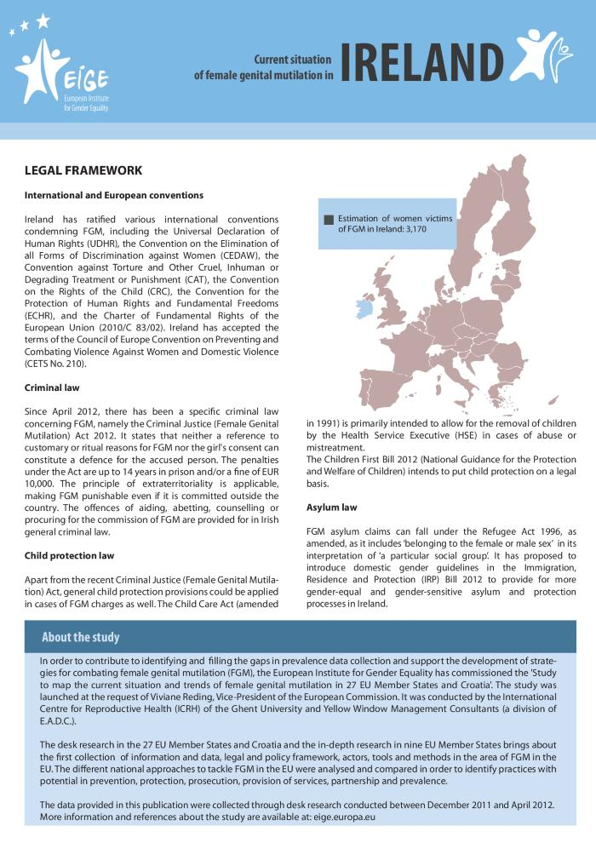
Current situation of female genital mutilation in Ireland (c:amaz:7216)

Slide 4
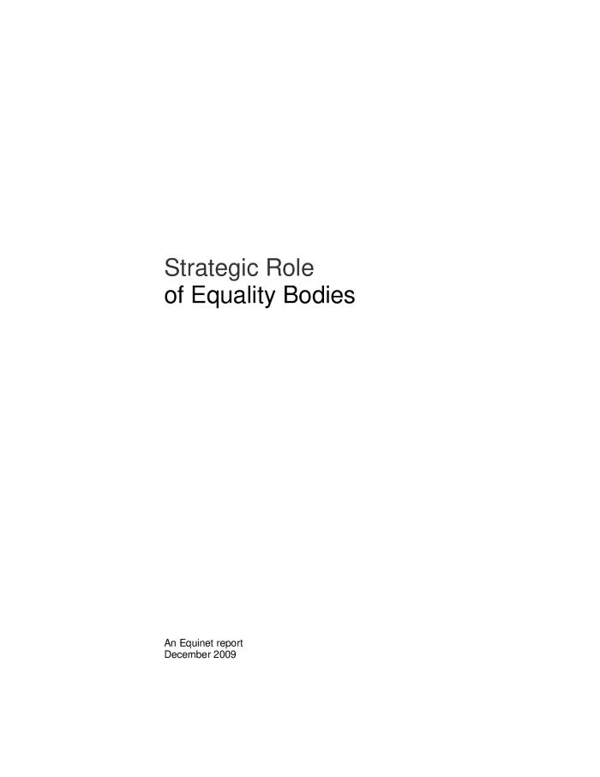
Strategic role of equality bodies (c:amaz:6563)

Slide 5
Women and men in Ireland 2005 (c:amaz:5753)

Slide 6
Deliverable 9 : final report (c:amaz:5540)

Slide 7
Deliverable 7 : report of EQUAPOL : national thematic seminars (c:amaz:5538)

Slide 8
Gender equality in training (c:amaz:4923)

Slide 9
Mesurer les progrès dans la lutte contre la violence envers les femmes : focus sur les Etats membres : Irlande (c:amaz:10829)

Slide 10
Monitoring progress in combating violence against women in the EU : spotlight on Member States : Ireland (c:amaz:10828)

Slide 11
Ireland : state of the art report (c:amaz:5533)

Slide 12
A woman's model for social welfare reform (c:amaz:5049)

Slide 13
Women & men in Ireland : facts and figures (c:amaz:4932)

Slide 14
Women and men in Ireland as entrepreneurs and as business managers (c:amaz:4931)

Slide 15
Gender equality in arts and culture (c:amaz:4929)

Slide 16
Gender equality in the peace and reconciliation programme (Peace 2) (c:amaz:4928)

Slide 17
Gender equality and work with refugees (c:amaz:4927)

Slide 18
Gender equality in youth services and facilities (c:amaz:4926)

Slide 19
Gender equality in economic and social infrastructure (c:amaz:4924)

Slide 20
Gender equality in IT, E-commerce and internet usage (c:amaz:4921)

Slide 21
Gender equality in tourism (c:amaz:4920)

Slide 22
Gender equality in environment and waste management (c:amaz:4919)

Slide 23
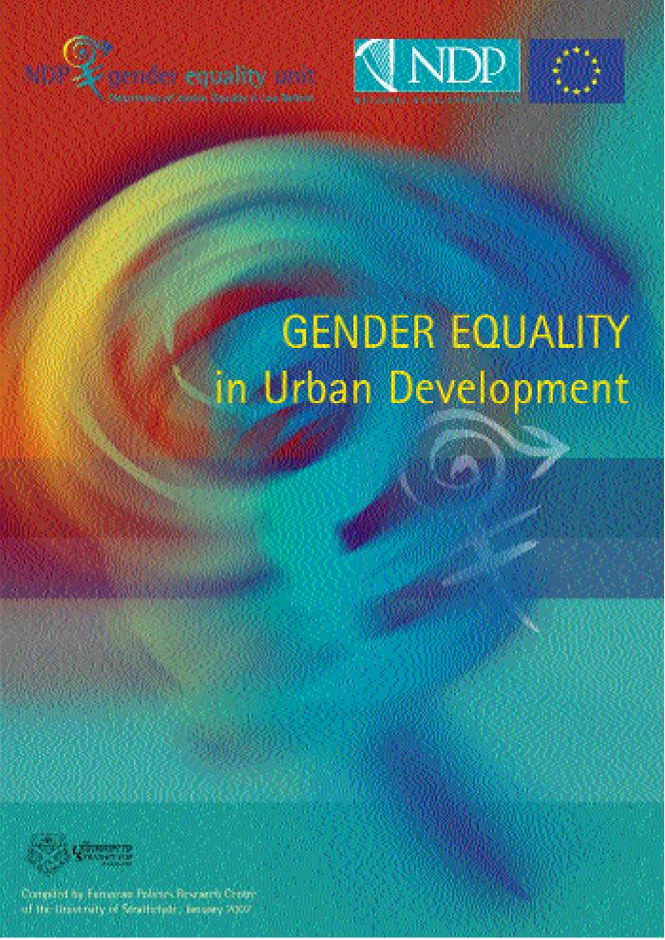
Gender equality in urban development (c:amaz:4915)

Slide 24
Gender equality in sports and leisure (c:amaz:4914)

Slide 25
Gender equality in film and media (c:amaz:4912)

Slide 26
Gender equality in research and development (c:amaz:4911)

Slide 27
Gender equality in community development (c:amaz:4778)

Slide 28
Bebes et employeurs : comment reconcilier travail et vie de famille. Volume 2 : Autriche, Irlande et Japon (c:amaz:10668)
This study considers how a wide range of policies, including tax/benefit policies, childcare policies, and employment and workplace practices, help determine parental labour market outcomes and family formation in Austria, Ireland, and Japan. These three countries have experienced changes in female aspirations and labour force behaviour, while at the same time birth rates have dropped significantly. For some (potential) parents, having children (or having as many as desired) and fulfilling labour market aspirations are mutually exclusive activities. As a result, current labour supply is less than what it could be, and human capital is underused. This result reflects an inefficient use of labour market resources, and if this situation were to be perpetuated, it would limit economic growth relative to potential. The declining number of children also has obvious implications for the shape of future societies. This volume includes some options for policy reform towards a better reconciliation of work and family commitments in Austria, Ireland and Japan.

Slide 29
Babies and bosses : reconciling work and family life. Volume 2 : Austria, Ireland and Japan (c:amaz:10667)
This study considers how a wide range of policies, including tax/benefit policies, childcare policies, and employment and workplace practices, help determine parental labour market outcomes and family formation in Austria, Ireland, and Japan. These three countries have experienced changes in female aspirations and labour force behaviour, while at the same time birth rates have dropped significantly. For some (potential) parents, having children (or having as many as desired) and fulfilling labour market aspirations are mutually exclusive activities. As a result, current labour supply is less than what it could be, and human capital is underused. This result reflects an inefficient use of labour market resources, and if this situation were to be perpetuated, it would limit economic growth relative to potential. The declining number of children also has obvious implications for the shape of future societies. This volume includes some options for policy reform towards a better reconciliation of work and family commitments in Austria, Ireland and Japan.

Slide 30
How to incorporate equal opportunities into project selection criteria (c:amaz:4937)

Slide 31
How to promote gender balance in decision-making (c:amaz:4936)

Slide 32
How to incorporate gender equality into evaluations (c:amaz:4930)

Slide 33
Make it happen : effective gender mainstreaming in Ireland and the UK : conference report of the gender mainstreaming in UK & Ireland (c:amaz:4903)

Slide 34
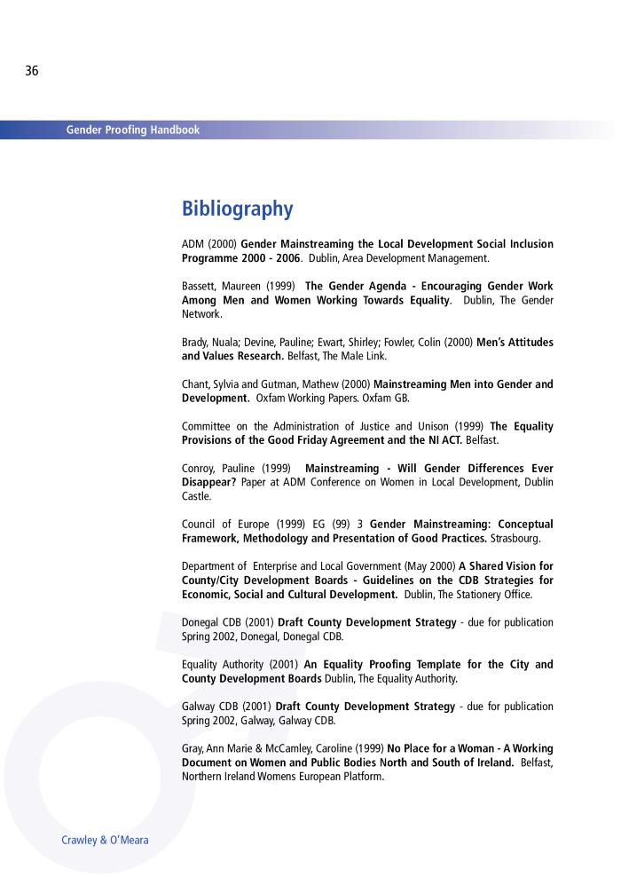
Gender proofing handbook (c:amaz:4590)

Slide 35
Gender equality in agricultural and rural development (c:amaz:4925)

Slide 36
Gender equality in enterprise development and research (c:amaz:4922)

Slide 37
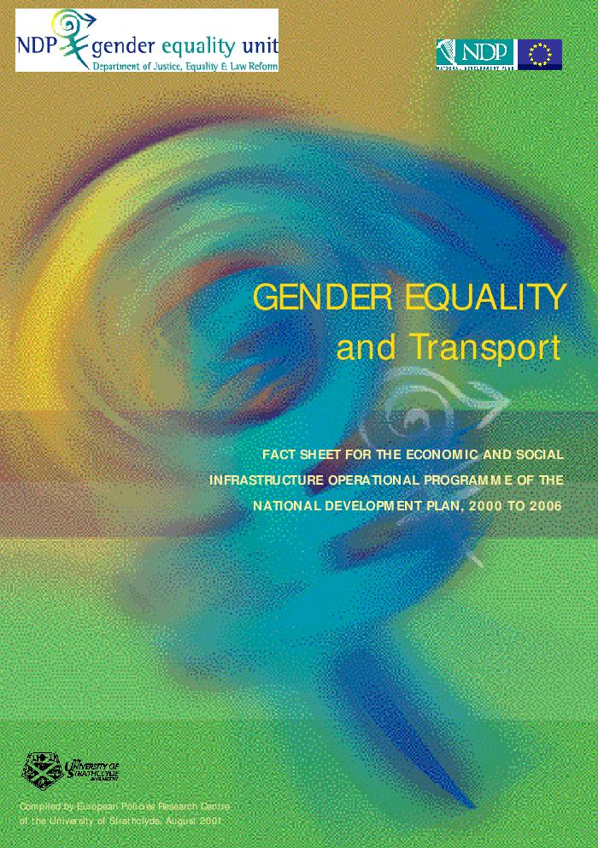
Gender equality and transport : fact sheet for the Economic and Social Infrastructure Operational Programme of the National Development Plan, 2000 to 2006 (c:amaz:4918)

Slide 38
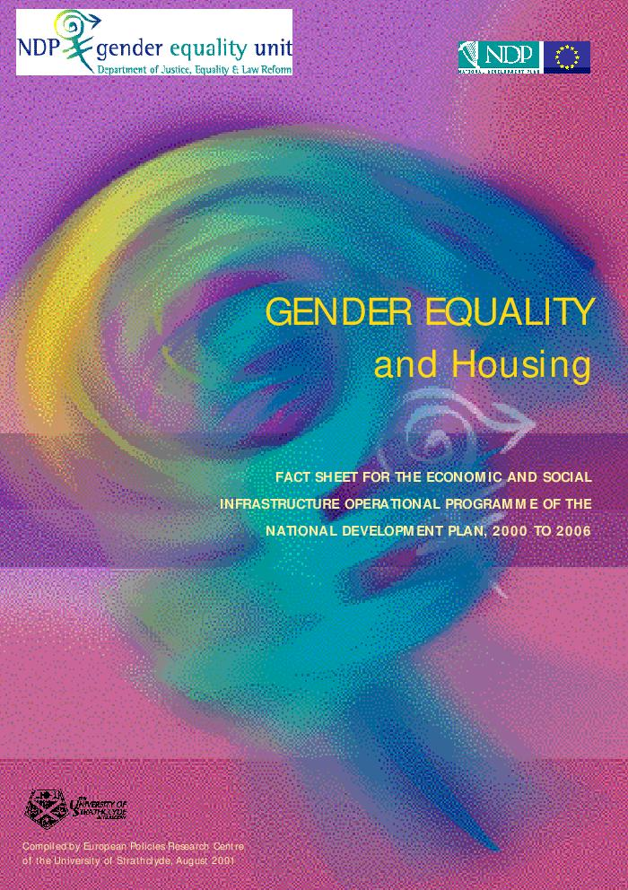
Gender equality and housing : fact sheet for the Economic and Social Infrastructure Operational Programme of the National Development Plan, 2000 to 2006 (c:amaz:4913)

Slide 39
Framing the future : an integrated strategy to support women's community and voluntary organisations (c:amaz:4908)

Slide 40
Women in sport : Task Force report (c:amaz:4226)

Slide 41
Partnership 2000 : Working Group Report on equality proofing (c:amaz:4234)

Slide 42
Gender equality in the civil service : gender imbalance in Irish civil service grades at higher executive officer level (HEO) and above (c:amaz:4511)

Slide 43
Predicting the impact of policy : gender-auditing as a means of assessing the probable impact of policy initiatives on women. Country report : Ireland (c:amaz:4243)

Slide 44
Gender proofing and the European Structural Funds : outline guidelines (c:amaz:4233)

Slide 45
Equal opportunities in the state-sponsored sector : report on a survey of equal opportunities in the state-sponsored sector (c:amaz:4227)

Slide 46
Femmes et développement rural dans l'Union Européenne (c:amaz:3410)

Slide 47
Actions innovantes menées en Europe contre le harcèlement sexuel au travail : Belgium-France-Germany-Ireland-Netherlands-Spain (c:amaz:3167)

Slide 48
Inschakeling van migrantenvrouwen in het arbeidsproces (c:amaz:8322)

Slide 49
Women in science and technology : activities in the European Union : project paper (c:amaz:4012)

Slide 50
The under representation of women in science & technology : how to improve the situation for women studying/working in S & T? : proceedings of STOA workshop (c:amaz:4011)

Slide 51
United Nations Fourth World Conference on Women - Beijing 1995 : report of the United Kingdom of Great Britain and Northern Ireland (c:amaz:2326)

Slide 52
United Nations Fourth World Conference on Women : national report of Ireland (c:amaz:2323)

Slide 53
Breaking the silence : violence in the home : the women's perspective (c:amaz:6468)

Slide 54
12 programmes européens pour l'égalité professionnelle (c:amaz:4321)

Slide 55
Where do women figure? (c:amaz:7014)

Slide 56
TUC equal value manual : using job evaluation to eliminate sex discrimination in pay (c:amaz:5138)

Slide 57
Where do women figure? (c:amaz:7015)

Slide 58
L'insertion professionnelle des femmes immigrées (c:amaz:8321)

Slide 59
New technologies and non-traditional sectors : IRIS seminar dossier (23-24 September 1991 ; Dublin) (c:amaz:5880)

Slide 60
Country report : Ireland, analysis of policy context and policies (c:amaz:5518)

Slide 61
Equality officer's procedures : the equality officer concept : Ireland (c:amaz:5137)

Slide 62
Gender equality in research and development (c:amaz:4910)

Slide 63
Integrating gender equality in the evaluation of the Irish 2000-06 National Development Plan (c:amaz:4904)

Slide 64
De genderkloof overbruggen : segregatie op de arbeidsmarkt terugdringen (c:amaz:4349)

Slide 65
Making their mark : the experiences of childcare projects within the NOW programme in Ireland (c:amaz:4325)

Slide 66
Gender impact assessement Ireland (c:amaz:4282)

Slide 67
Het recht op geluk (c:amaz:2263)

Slide 68
De geheime oversteek : het drama van de Ierse abortusreizen (c:amaz:1867)
Bijdrage over het leed van de bijna vierduizend Ierse vrouwen die jaarlijks naar Groot-Brittannië reizen voor een abortus. Meestal alleen, soms met een vriendin of vriend. Iedereen weet het. Iedereen doet het. Weinigen durven te vertellen over de eenzaamheid, de leugens en de mythen rond het grote geheim.

