Slide 1
Zeg niet te gauw 'voor deze jury is er geen vrouw' (c:amaz:3465)

Slide 2
Working conditions in the European Union : the gender perspective (c:amaz:6161)

Slide 3
Women and men in OECD countries (c:amaz:13028)

Slide 4
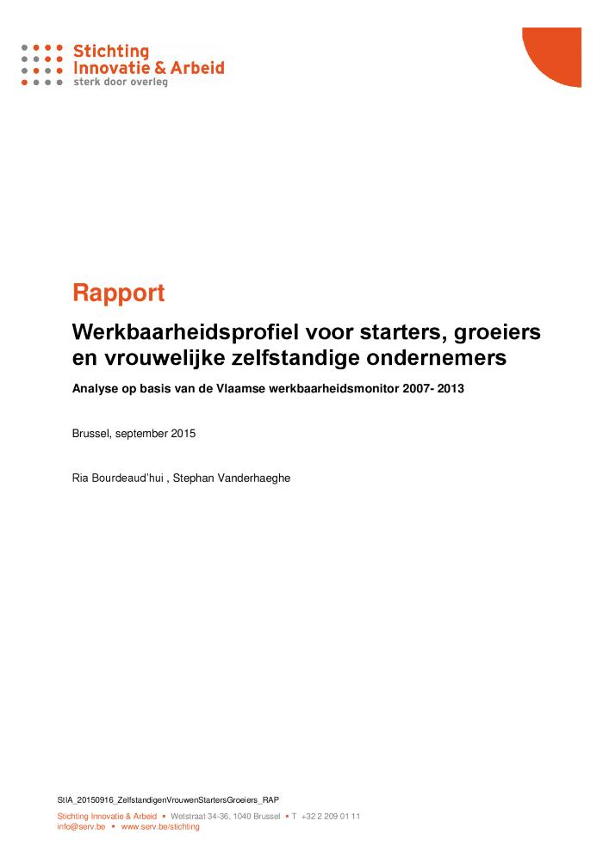
Werkbaarheidsprofiel voor starters, groeiers en vrouwelijke zelfstandige ondernemers: analyse op basis van de Vlaamse werkbaarheidsmonitor 2007-2013: rapport (c:amaz:14424)

Slide 5
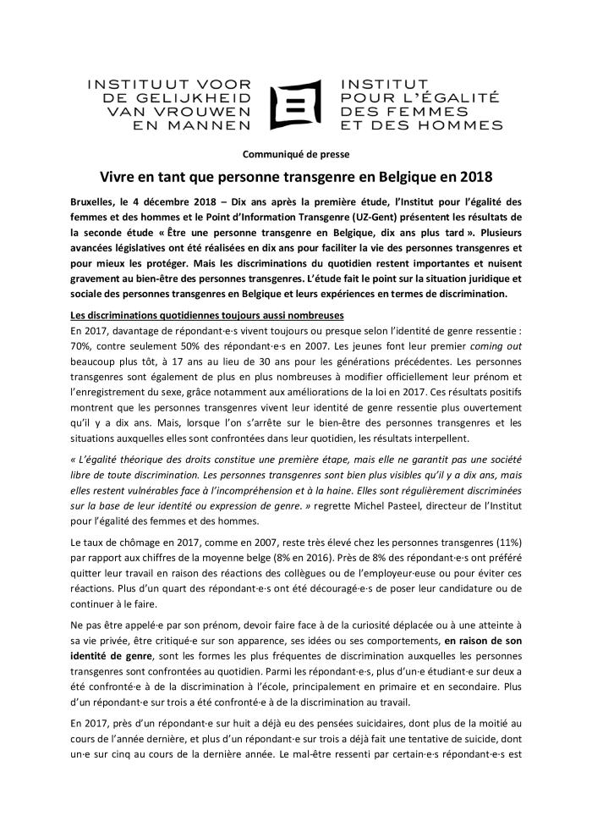
Vivre en tant que personne transgenre en Belgique en 2018 (c:amaz:13642)

Slide 6
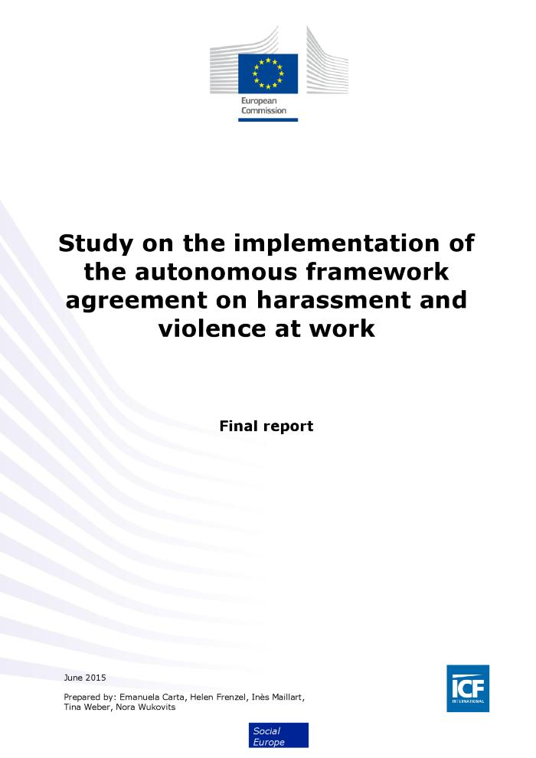
Study on the implementation of the autonomous framework agreement on harassment and violence at work: final report (c:amaz:14170)
The information presented in this report is based on a range of sources, including a review of transnational and national literature, national stakeholder consultations and a survey of enterprises and employee health and safety representatives. In total, around 155 stakeholders (mainly representatives of social partner organisations and national ministries) were consulted for this study. An online enterprise survey was commissioned for this study and yielded responses from 400 enterprises in the 8 Member States targeted by the survey (France, Hungary, Italy, Netherlands, Poland, Spain, Sweden and the UK). It aimed to gather information regarding perceptions on the significance and trends in the incidence of violence and harassment in the workplace, measures taken to address it, and awareness of the European Framework Agreement and national implementation tools. A similar survey was also disseminated to employee side health and safety representatives via ETUC, which received just under 240 responses.

Slide 7
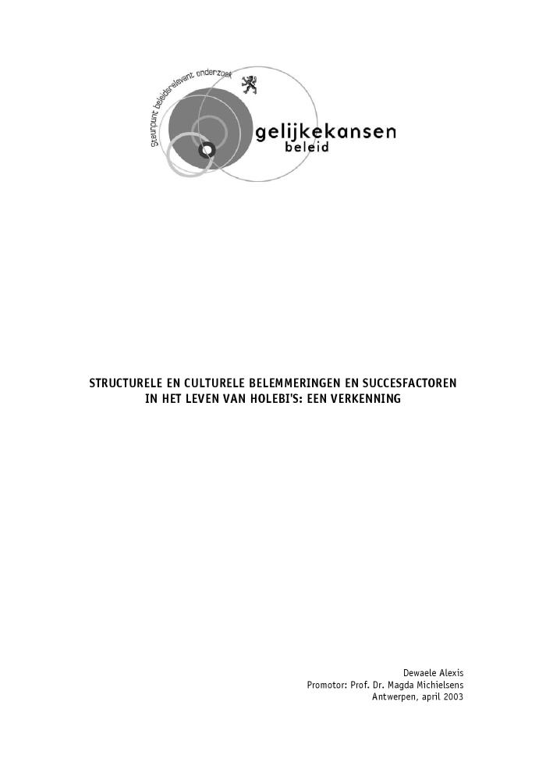
Structurele en culturele belemmeringen en succesfactoren in het leven van holebi's : een verkenning (c:amaz:4704)

Slide 8
Sexualité surexposée (c:amaz:6066)

Slide 9
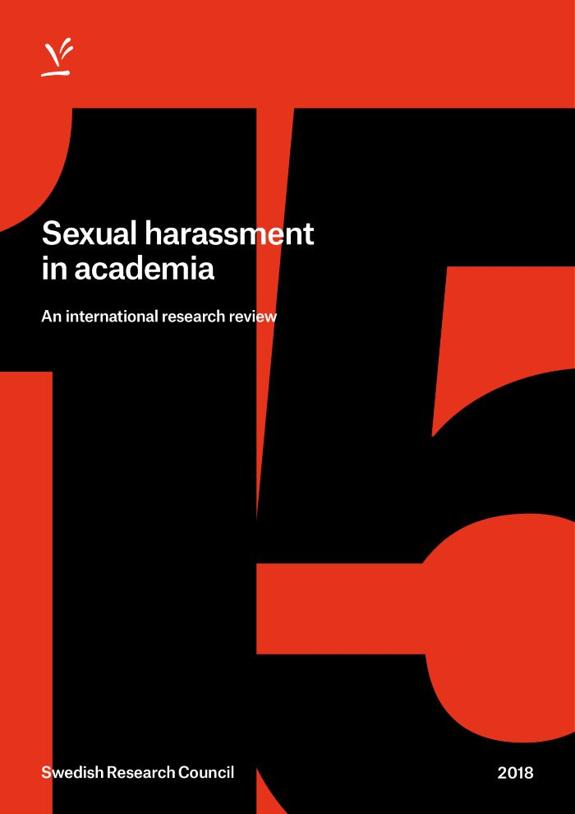
Sexual harassment in academia: an international research review (c:amaz:14169)
The Swedish Research Council has commissioned a research review on sexual harassment in academia from the Swedish Secretariat for Gender Research, University of Gothenburg. The overall request from the Swedish Research Council was for a broad, international review of research into sexual harassment in academia, but without any other specific requirements or wishes.

Slide 10
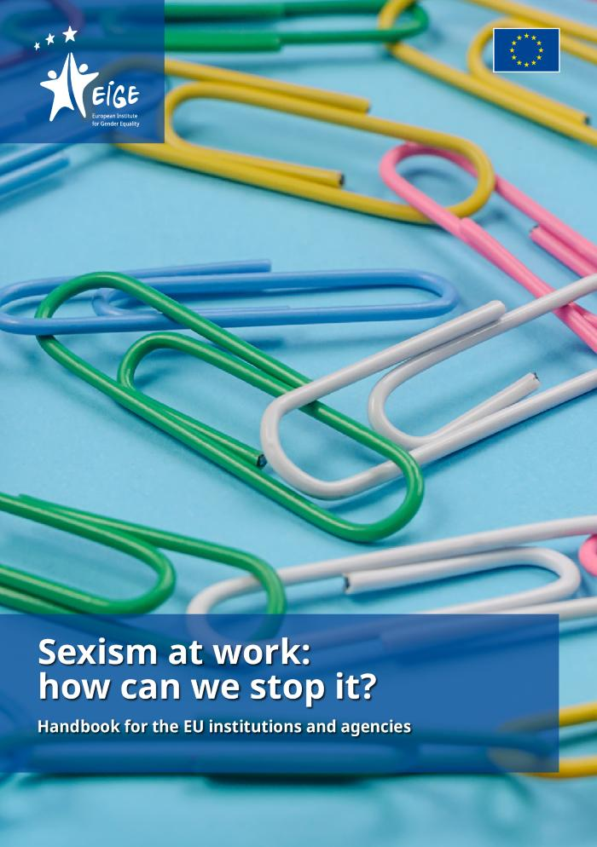
Sexism at work: how can we stop it?: handbook for the EU institutions and agencies (c:amaz:14430)

Slide 11
Quelles vieillesses pour les femmes ? (c:amaz:5464)

Slide 12
Quality of life in Europe : résumé (c:amaz:11047)

Slide 13
Quality of life in Europe (c:amaz:5342)

Slide 14
Leven als transgender persoon in België. Tien jaar later (c:amaz:13640)

Slide 15
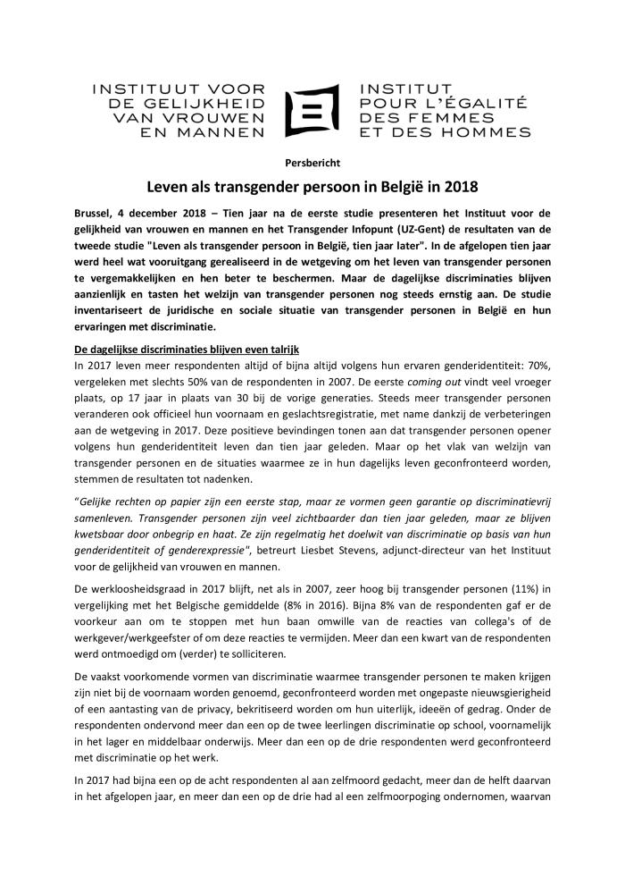
Leven als transgender persoon in België in 2018 (c:amaz:13643)

Slide 16
La qualité de vie en Europe : résumé (c:amaz:11048)

Slide 17
La loi et le code sur le bien-être au travail et extraits du réglement général pour la protection du travail (c:amaz:5687)

Slide 18
Kwaliteit van het bestaan in Europa : samenvatting (c:amaz:11049)

Slide 19
Kies voor evenwicht in uw jury (c:amaz:3774)

Slide 20
Jeunes adultes d'aujourd'hui : inquiétudes, incompréhensions et défi d'un monde qui change (c:amaz:13526)

Slide 21
Ik zie wat jij niet ziet: gender- en seksuele identiteit in het jeugdwerk: handvaten voor een LGBTQIA+ vriendelijker vrijetijdsaanbod (c:amaz:14426)

Slide 22
Het Vlaamse beleid naar etnisch-culturele minderheden : Jaarrapport 2001 (c:amaz:7029)

Slide 23
Gids ter begeleiding van transgenders op het werk (c:amaz:13055)
Deze gids is bestemd voor alle werknemers, werkgevers, vakbonden en andere partijen die betrokken zijn bij het onthaal en de begeleiding van transgender personen op het werk. Het doel van deze gids is hen te informeren en adviseren over hun rechten, plichten en verantwoordelijkheden zoals bepaald in de wet, rekening houdend met praktische en menselijke aspecten. Opgelet, vanaf 1 januari 2018 is een nieuwe wet van kracht voor de aanpassing van de geslachtsregistratie op de identiteitsdocumenten. De tips in deze brochure zullen niet veel veranderen.

Slide 24
Gender equality : striving for justice in an unequal world (c:amaz:11231)
'Based on the findings of UNRISD ongoing gender research and over 60 specially commissioned studies, the report's analysis is centred on the economic and political reforms of the 1990s. If most of these reforms did not directly address gender equality, they nevertheless received considerable scrutiny from a gender perspective. And whatever their intentions, they had significant and mixed implications for gender relations and women's well-being.As its title alludes, achieving gender equality and gender justice will be very difficult in a world that is increasingly unequal. The report presents strong arguments for why gender equality must be placed at the core of efforts to reorient the development agenda. Indeed, if some of the key contemporary challenges (economic growth and structural transformation, equality and social protection, and democratization) are to be met, this is essential.'

Slide 25
Geluk(t)?! (c:amaz:13587)
/docstore/db82e7/611.pdf

Slide 26
Frauennetze 98/99 : 5000 Adressen und Informationen aus Beruf, Weiterbildung, Politik, Kultur und Frauenbewegung [cd-rom] (c:amaz:3346)

Slide 27
Egalité des sexes : en quête de justice dans un monde d'inégalités : vue d'ensemble (c:amaz:5858)

Slide 28
Egalité des sexes : en quête de justice dans un monde d'inégalités (c:amaz:11232)
'Based on the findings of UNRISD ongoing gender research and over 60 specially commissioned studies, the report's analysis is centred on the economic and political reforms of the 1990s. If most of these reforms did not directly address gender equality, they nevertheless received considerable scrutiny from a gender perspective. And whatever their intentions, they had significant and mixed implications for gender relations and women's well-being.As its title alludes, achieving gender equality and gender justice will be very difficult in a world that is increasingly unequal. The report presents strong arguments for why gender equality must be placed at the core of efforts to reorient the development agenda. Indeed, if some of the key contemporary challenges (economic growth and structural transformation, equality and social protection, and democratization) are to be met, this is essential.'

Slide 29
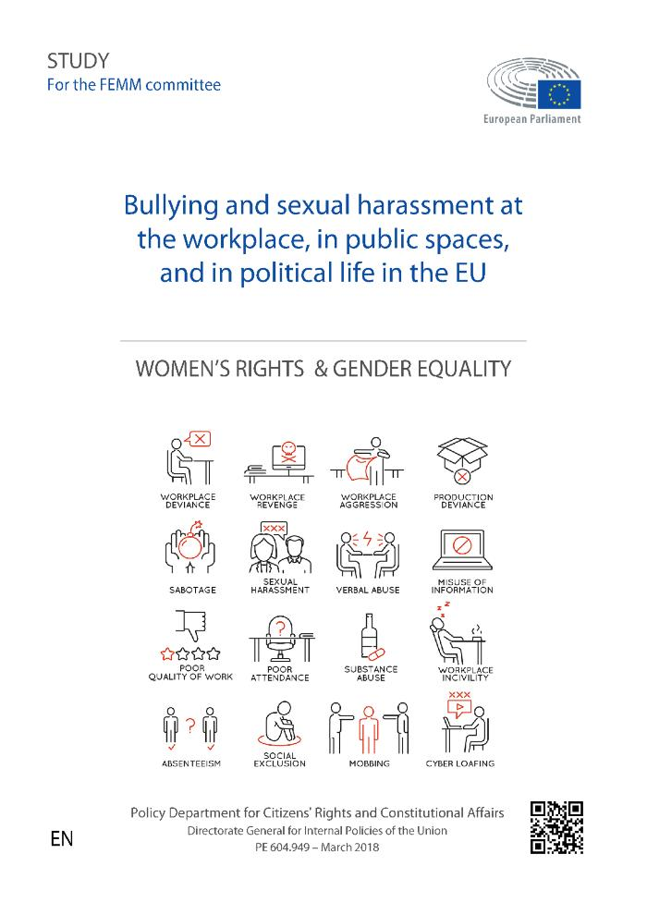
Bullying and sexual harassment at the workplace, in public spaces, and in political life in the EU (c:amaz:14083)
This study, commissioned by the European Parliaments Policy Department for Citizens Rights and Constitutional Affairs at the request of the Committee on Women's Rights and Gender Equality (FEMM),provides a broad account and an in-depth analysis of bullying and sexual harassment in the workplace, in public spaces and in political life. In this study trends in understanding of phenomena are acknowledged,status and progress in research is accounted for, key issues of controversies and debate are identified and recommendations for actions and intervention are provided.

Slide 30
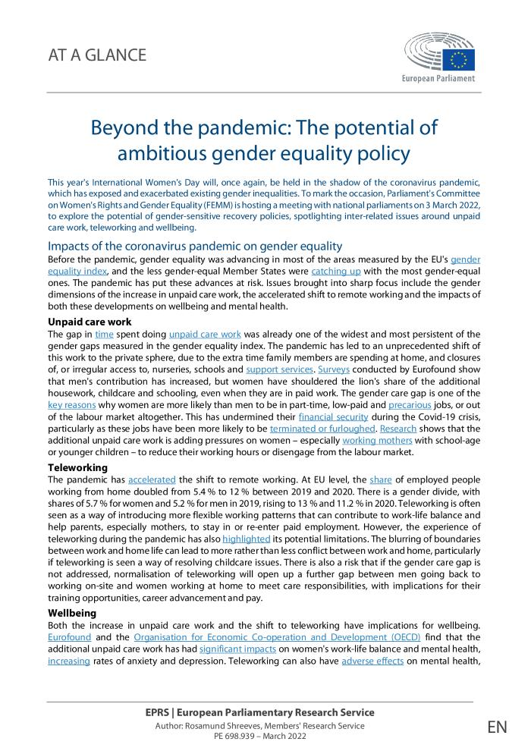
Beyond the pandemic: the potential of ambitious gender equality policy [At a glance] (c:amaz:14750)
This year's International Women's Day will, once again, be held in the shadow of the coronavirus pandemic, which has exposed and exacerbated existing gender inequalities. To mark the occasion, Parliament's Committee on Women's Rights and Gender Equality (FEMM) is hosting a meeting with national parliaments on 3 March 2022, to explore the potential of gender-sensitive recovery policies, spotlighting inter-related issues around unpaid care work, teleworking and wellbeing.

Slide 31
Being transgender in Belgium. Ten years later (c:amaz:13641)

Slide 32
Actieve vrouwen, unieke vrouwen : praktische gids voor een beter evenwicht (c:amaz:6256)

Slide 33
6 februari 2007 : Wet tot wijziging van de wet van 4 augustus 1996 betreffende het welzijn van de werknemers bij de uitvoering van hun werk wat de gerechtelijke procedures betreft (c:amaz:11761)

Slide 34
6 février 2007 : Loi modifiant la loi du 4 août 1996 relative au bien-être des travailleurs lors de l'exécution de leur travail en ce qui concerne les procédures judiciaires (c:amaz:11760)

Slide 35
10 janvier 2007 : Loi modifiant plusieurs dispositions relatives au bien-être des travailleurs lors de l'exécution de leur travail dont celles relatives à la protection contre la violence et le harcèlement moral ou sexuel au travail (c:amaz:11758)

Slide 36
10 januari 2007 : Wet tot wijziging van verschillende bepalingen betreffende het welzijn van de werknemers bij de uitvoering van hun werk waaronder deze betreffende de bescherming tegen geweld, pesterijen en ongewenst seksueel gedrag op het werk (c:amaz:11759)

Slide 37
Être une personne transgenre en Belgique. Dix ans plus tard (c:amaz:13639)

Slide 38
'Ne dites pas trop vite il n'y a pas de femmes' : une liste de 'femmes-ressources' dans les domaines politique, économique, scientifique, social et culturel 1998 (c:amaz:3254)

